Slide 1
The Data Analysis Process – high level definition
Step 1:
Frame the problem
Formulate exact questions that we are trying to answer or problems that we are trying to solve
Step 2:
Collect the raw data
Data gathering: series of data captured for a specific time period, relevant records, values etc.
Step 3:
Prepare the data for analysis
Sun
Build a DB with data arranged in tables. ‘Clean’ the data, enrich it with required additional values etc.
Step 4:
Explore the data
Tues
Review, understand the data and perform summary statistics with descriptive analysis.
Step 5:
In-depth analysis
Thurs
Usually Machine Learning, AI analysis using regression, mathematical model building -- predictive analysis.
Step 6:
Communicate results
Data visualisation, findings summary, interpretation of results , recommendations, conclusions
Frid

Slide 2
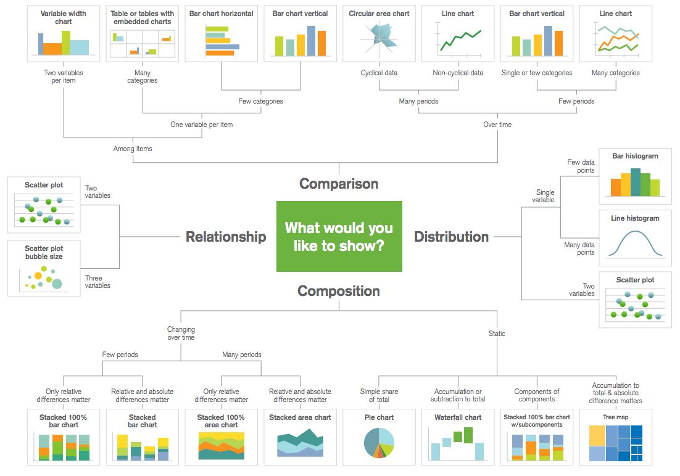

Slide 3
What is our vision?
What question are we answering?
Points to remember:
It doesn’t need to be revolutionary
We need to show that we can ask a specific question, take the right steps to answer it and then communicate it properly

Slide 4
Does working from home offer the opportunity for a more sustainable future?
We are testing this with three different hypotheses
At a local level (London) lockdown/working from home improves air quality and this is related to method of mobility chosen.
Stringency data, air quality and traffic data
Outcome = air quality (nitrogen dioxide)
Predictor = cycling and walking
At a national level how did choice of mobility change?
stringency, google
International level electricity usage was decreased during lockdown periods.
- stringency, electricity data, google mobility

Slide 5
What is the appropriate model and what variables need to be included?
It’s about cause and effect, what outcome can we predict?
Is our outcome continuous or binary?

Slide 6
Data Engineering
Data Modelling
Data Visualisation
Creative direction
1 person
2 people
1 person
1 person
Clean data
Dtypes
Missing values
Formatting
Computing new variables
Predictive model building
Interpretation of results
Building exploratory charts/graphs
Building final charts/graphs
Colour scheme
Imagery
Story building/recomendations
SUNDAY
13TH
SEPTEMBER
TUESDAY
15TH
SEPTEMBER
THURSDAY
17TH
SEPTEMBER
FRIDAY
18TH
SEPTEMBER

