Slide 1
Detecting Adverse drug reactions in text
Amanda Shan Rui Ho
EN605.646.81 Natural Language Processing
Notes:
Hi, I’m Amanda. Today, I will be presenting my project on Detecting Adverse Drug Reactions in Text as part of the JHU course, Natural Language Processing.

Slide 2
Overview
Introduction
Methodology
Evaluation Results
Future improvements
Notes:
I will be briefly introducing the background and project aim before sharing more details on the methodology implemented. I will then discuss results that were found and what some possible future improvement work can revolve around.

Slide 3
Introduction Importance of detecting drug, ADR in text
Background
Recommendations for Adverse Drug Reactions (ADRs) largely curated from independent reports or electronic health records: under-reported
Inconsistent documentation makes it difficult to tag ADRs to drugs
Inefficient and difficult to research ADRs
Project aim
Building a system using natural language techniques to automatically detect drug & associated ADRs in text
Improving crucial information extraction expedites medical intervention and treatment development
Notes:
Let me illustrate the motivations behind detecting Adverse Drug Reactions, or ADR for short, in text. The majority of recommendations made for ADRs to patients are derived from either independent reports or electronic health records submitted by clinicians or pharmaceutical companies. Due to the nature of the sources, the occurrence of ADRs are believed to be under reported. In addition, there is no single documentation structure to reporting ADRs, which makes it difficult to maintain a knowledge repository of ADRs tagged to specific drugs. As a result, the development and research of ADRs is inefficient and difficult. This is where my project comes in, where I’m interested in building a system using NLP techniques to automatically detect drug and ADR associations in text. Doing so can improve the process of information extraction, helping to expedite medical intervention and treatment of ADRs in patients.

Slide 4
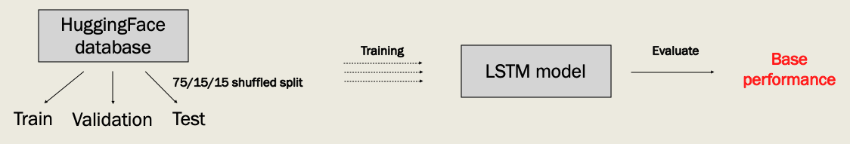
Methodology overview
Drug/ADR detection system consists of a bi-directional Long Short-Term Memory (LSTM) model to make base predictions
Natural language processing techniques such cosine similarity & dependency parsing used to improve base predictions
Notes:
The methodology behind implementing a system to detect drug and ADR pairs can be categorized into two phases. The first phase consists of implementing a bi-directional Long Short-Term Memory model, or LSTM model for short, to make base predictions. As shown on the diagram on the right, the training, validation and testing datasets were obtained from the HuggingFace database, extracted using a 75, 15, 15 shuffled split. These datasets were used to train the LSTM model to make base predictions. Then, we evaluate the predictions to obtain a base performance.

Slide 5
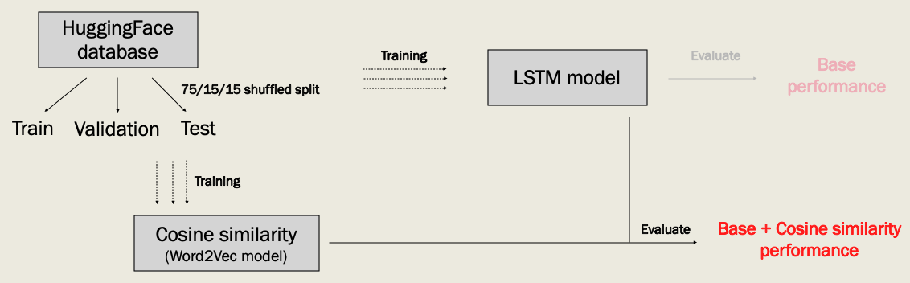
Methodology overview
Drug/ADR detection system consists of a bi-directional Long Short-Term Memory (LSTM) model to make base predictions
Natural language processing techniques such cosine similarity & dependency parsing used to improve base predictions
Notes:
The second phase consists of improvement works on the base predictions using NLP techniques. The first improvement I attempted was incorporating cosine similarity scores to decrease false positives in the LSTM predictions. To do so, I made use of the HuggingFace training data to train a word2vec model. The word2vec model is then used to generate cosine similarity scores of drug and ADR pairs predicted by the LSTM model. This first improvement was then evaluated for its performance using the HuggingFace testing dataset.

Slide 6
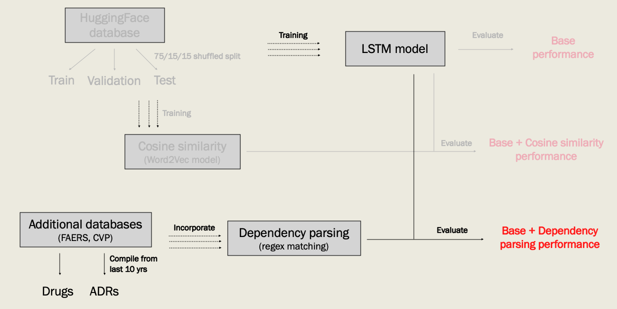
Methodology overview
Drug/ADR detection system consists of a bi-directional Long Short-Term Memory (LSTM) model to make base predictions
Natural language processing techniques such cosine similarity & dependency parsing used to improve base predictions
Notes:
The second improvement I attempted is to incorporate dependency parsing to improve the number of true drug and ADR predictions that the LSTM model might have missed. The dependency parsing makes use of specific regex patterns to identify potential drug and ADR pairs, then uses a database of drug and ADR terms extracted from additional public databases to make final drug and ADR predictions. Thie second improvement is then evaluated for its performance using the HuggingFace testing dataset.

Slide 7
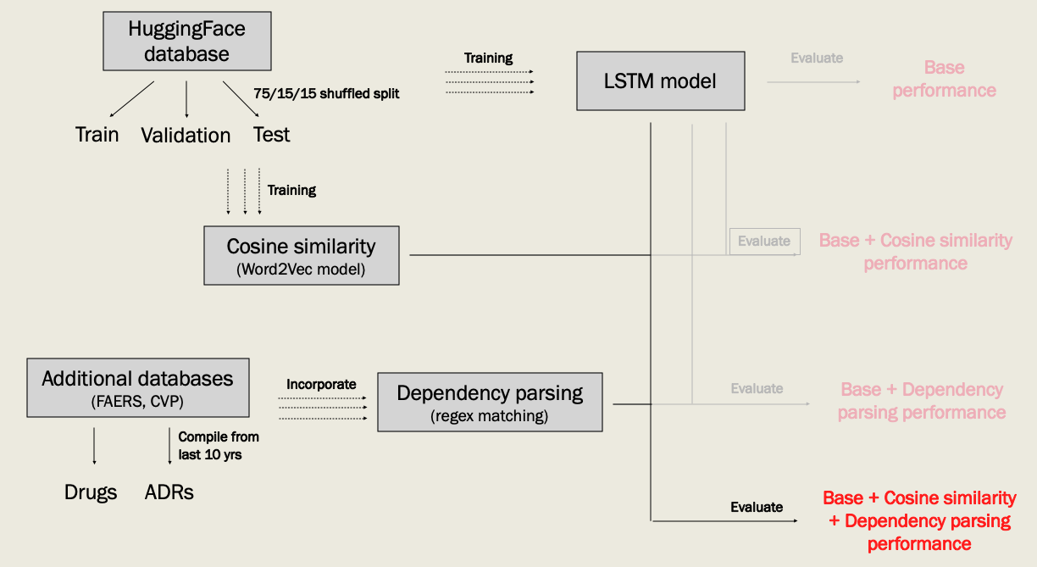
Methodology overview
Drug/ADR detection system consists of a bi-directional Long Short-Term Memory (LSTM) model to make base predictions
Natural language processing techniques such as cosine similarity & dependency parsing used to improve base predictions
Notes:
Lastly, we test out whether incorporating both cosine similarity and dependency parsing with the LSTM model to make predictions would help in performance, using the same HuggingFace testing data for evaluation.

Slide 8
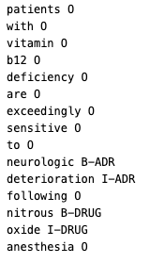
LSTM model training Making base predictions
Bi-directional LSTM model implemented using FLAIR
HuggingFace datasets (train, validation, test) sequence tagged with IOB tags
B-DRUG, I-DRUG, B-ADR, I-ADR, O
Trained with batch size of 3, 10 epochs
Beginning of ADR
Beginning of Drug
Notes:
The LSTM model was implemented using the FLAIR python module. To train, validate and test a LSTM model using FLAIR, the HuggingFace datasets had to be preprocessed to be compatible for FLAIR training. To do so, turned the information available in the HuggingFace datasets into sequence tagged data, where each sentence was tokenized then sequence tagged with IOB tags. There are 5 IOB tags in the sequence tagged datasets. B-Drug and B-ADR tags indicate words that represented the beginning of a drug or ADR entity span.

Slide 9
LSTM model training Making base predictions
Bi-directional LSTM model implemented using FLAIR
HuggingFace datasets (train, validation, test) sequence tagged with IOB tags
B-DRUG, I-DRUG, B-ADR, I-ADR, O
Trained with batch size of 3, 10 epochs
Inter-span of ADR
Inter-span of Drug
Notes:
I-DRUG and I-ADR represented the inter-span of a drug or ADR entity.

Slide 10
LSTM model training Making base predictions
Bi-directional LSTM model implemented using FLAIR
HuggingFace datasets (train, validation, test) sequence tagged with IOB tags
B-DRUG, I-DRUG, B-ADR, I-ADR, O
Trained with batch size of 3, 10 epochs
Others
Notes:
The O tag represented other words that were part of a drug or ADR entity.
The LSTM model was trained using a batch size of 3 over 10 epochs with a learning rate of 0.01. The training parameters were chosen due to hardware limitations.

Slide 11
Evaluation: LSTM predictions Baseline prediction performance
Reasonable baseline performance given training parameters
Metric | Precision | Recall | F1 Score
Drug | 0.714 | 0.864 | 0.782
ADR | 0.654 | 0.788 | 0.715
Overall | 0.691 | 0.834 | 0.756
Notes:
We use typical evaluation metrics such as precision, recall and f1 score to measure the prediction performance of the LSTM model. The table here shows the results obtained for drug predictions, ADR predictions, and overall drug/ADR predictions. With an average of 70 to 80%, the LSTM model had reasonable baseline performance given the training parameters.

Slide 12
Evaluation: LSTM predictions Baseline prediction performance
Reasonable baseline performance given training parameters
Metric | Precision | Recall | F1 Score
Drug | 0.714 | 0.864 | 0.782
ADR | 0.654 | 0.788 | 0.715
Overall | 0.691 | 0.834 | 0.756
Struggled more with ADR detection
Notes:
Across the 3 categories, the LSTM model obtained lower scores across the evaluation metrics for ADR predictions. It is evident that the LSTM model struggled more with ADR detection than drug detection in the texts.

Slide 13
Evaluation: LSTM predictions Baseline prediction performance
Reasonable baseline performance given training parameters
Metric | Precision | Recall | F1 Score
Drug | 0.714 | 0.864 | 0.782
ADR | 0.654 | 0.788 | 0.715
Overall | 0.691 | 0.834 | 0.756
Struggled more with ADR detection
Poor performance in false positives
Notes:
A lower overall precision compared to recall also suggested that the model had a poorer performance in keeping false positives low, compared to detecting true positives.

Slide 14
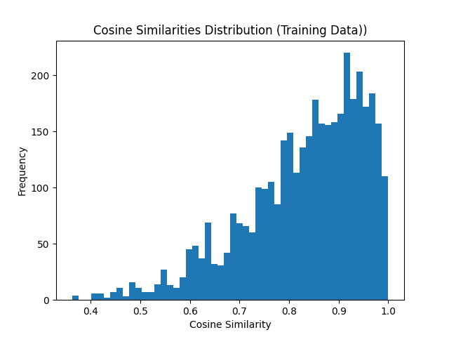
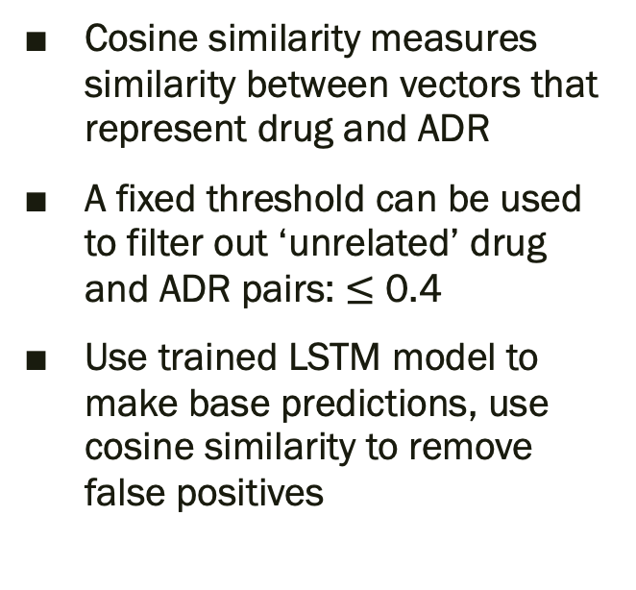

Improving false positives Incorporating cosine similarity
Cosine similarity measures similarity between vectors that represent drug and ADR
A fixed threshold can be used to filter out ‘unrelated’ drug and ADR pairs: $≤$ 0.4
Use trained LSTM model to make base predictions, use cosine similarity to remove false positives
Majority of drug, ADR pairs $≥$ 0.4
Notes:
As such, I incorporated cosine similarity scores to see if it could help with improving false positives in the LSTM predictions. Cosine similarity in this case, is a similarity measurement between drug and ADR vectors. The metric can be used to filter out false positives by implementing a fixed threshold to discard LSTM predictions. To determine the appropriate threshold to use, I generated cosine similarity scores for the drug, ADR pairs found in the HuggingFace training data, and looked at the distribution of scores obtained. As seen in this histogram, the majority of drug and ADR pairs in the training data has a cosine similarity score of at least 0.4. With this in mind, we can use the trained LSTM model to make the same drug and ADR predictions, then use a trained word2vec model to generate cosine similarity scores of the LSTM predicted pairs, and discard those below 0.4 as false positives.

Slide 15
Evaluation: LSTM + cosine similarity Improvement 1 prediction performance
Performance results
Metric | Precision | Recall | F1 Score
Drug | 0.718 | 0.581 | 0.642
ADR | 0.654 | 0.535 | 0.589
Overall | 0.688 | 0.560 | 0.617
More drugs correctly detected
Notes:
Using the same evaluation metrics to measure the performance of the LSTM and cosine similarity predictions, we compare the performance with the baseline performance. We see an improvement in precision scores for the drug category, but the same score obtained for the ADR category. This suggests that more drugs were correctly detected when incorporating cosine similarity as part of the prediction process, without compromising on ADR detection performance.

Slide 16
Evaluation: LSTM + cosine similarity Improvement 1 prediction performance
Better drug detection with cosine similarity incorporated
Metric | Precision | Recall | F1 Score
Drug | 0.718 | 0.581 | 0.642
ADR | 0.654 | 0.535 | 0.589
Overall | 0.688 | 0.560 | 0.617
Dip in recall due to discarded predictions without replacement
Notes:
However, we see a decrease in recall scores across the categories. This is expected, as cosine similarity scores were used to discard LSTM predictions as false positives, but discarded predictions were not replaced with alternative predictions.

Slide 17
Evaluation: LSTM + cosine similarity Improvement 1 discussion
Performance of cosine similarity dependent on training data used to train word2vec model
If drug & ADR pair does not appear in the training data, no cosine similarity can be calculated
Current performance is limited to HuggingFace training dataset (~4500 text)
Notes:
Overall, we see that although cosine similarity helped to improve drug detection, it was a marginal improvement. This is likely because the accuracy of cosine similarity scores is highly dependent on the training data used to train the word2vec model. A cosine similarity score can only be calculated for a drug and ADR pair that has appeared in the training data. Since the word2vec model was trained using a small dataset of about 4500 example texts, performance improvement is limited.

Slide 18
Improving true positives Incorporating dependency parsing
Drug and ADRs are associated by causal effect terms in sentences
Construct regex patterns: drug/ADRs are noun phrases linked by a causal term
Use drug and ADR databases identify related noun phrases
Dependency parsing used if LSTM model did not make a drug or ADR prediction
Causal associations:
e.g. “the fatal stroke may have resulted from arterial spasm caused by ergotamine overdosage”
Dependency parsing:
Regex pattern: * NP * causal term * NP *
Extract NPs using nltk pattern matching
Identify NPs that are drugs/ADRs using databases
Notes:
As the cosine similarity scores targeted false positives without replacing them with alternative predictions, I looked at incorporating dependency parsing as a way to generate more predictions. The idea is that drug and ADR pairs are likely to be associated by causal effect terms when appearing in texts. Take for example the sentence, “the fatal stroke may have resulted from arterial spasm caused by ergotamine overdosage”. In this sentence, the drug ergotamine, and the ADR stroke, is associated by the causal term ”resulted”. Using such causal effect terms, we can make use of a general regex pattern of two noun phrase bounded by a causal term in the middle, to detect drug and ADR pairs. Noun phrases can also be identified using specific regex patterns. Since drug and ADR pairs might not always be noun phrases, we attempt to make more accurate drug and ADR predictions by keeping only noun phrases that appear in a list of drug and ADR names that have been extracted from public databases. Since dependency parsing is used to catch predictions that the LSTM model had missed, we made use of this method to generate drug and ADR predictions only if the LSTM model did not make a prediction.

Slide 19
Evaluation: LSTM + dependency parsing Improvement 2 prediction performance
Dependency parsing improved drug and ADR pairs that the LSTM model missed
Metric | Precision | Recall | F1 Score
Drug | 0.713 | 0.868 | 0.783
ADR | 0.597 | 0.810 | 0.684
Overall | 0.664 | 0.841 | 0.742
Increase in recall indicates more true positives detected
Notes:
The LSTM and dependency parsing prediction system showed a increase in recall scores across the categories. This indicates that dependency parsing worked as intended, and helped to detect more drug and ADR pairs that the LSTM model had missed.

Slide 20
Evaluation: LSTM + dependency parsing Improvement 2 prediction performance
Dependency parsing improved drug and ADR pairs that the LSTM model missed
Metric | Precision | Recall | F1 Score
Drug | 0.713 | 0.868 | 0.783
ADR | 0.597 | 0.810 | 0.684
Overall | 0.664 | 0.841 | 0.742
Dip in precision suggests more false positives also detected, especially for ADRs
Notes:
However, the addition of dependency parsing actually lowered precision scores when we compared it with the baseline model, suggesting more false positives were detected. In particular, we see a huge drop in precision score for the ADR category, indicating more incorrect ADR predictions were made with dependency parsing.

Slide 21
Evaluation: LSTM + dependency parsing Improvement 2 discussion
Performance of drug/ADR detection using dependency parsing dependent on the list of causal terms, and drug/ADR databases used for pattern matching
Performance can be improved if:
A more exhaustive list of causal words is extracted from public databases
Additional drug/ADR names such as acronyms are extracted
Notes:
Although recall scores increased, the performance of dependency parsing is highly dependent on the list of causal terms we used to construct regex patterns, or list of drug and ADR names used to retain relevant noun phrases. My project implemented a list of over 15 causal terms such as “resulted”, including variations such as “resulting”, “results” and “result”. However, this is not a very comprehensive list of causal terms. The performance of dependency parsing might be further improved if I am able to gather a more exhaustive list of causal terms from public databases that might maintain such a list, or if we can compile a bigger list of drug and ADR names that includes their acronyms.

Slide 22
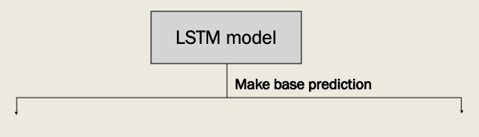
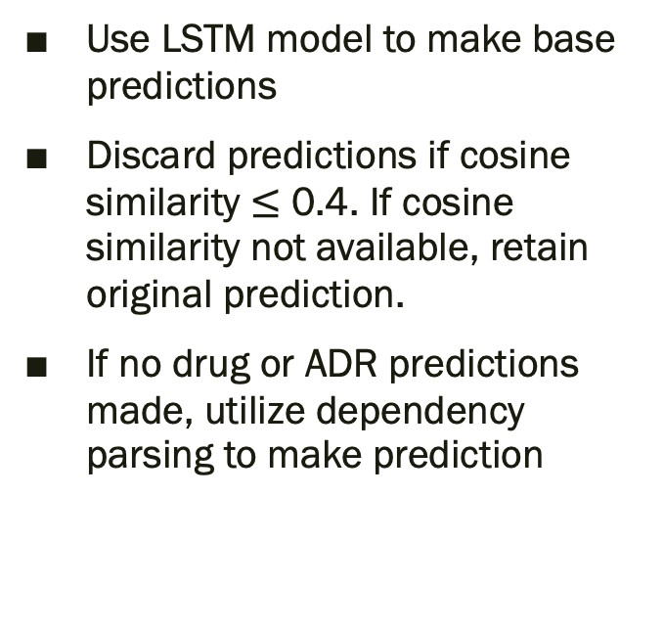
Final prediction system Incorporating improvements with base model
Use LSTM model to make base predictions
Discard predictions if cosine similarity $≤$ 0.4. If cosine similarity not available, retain original prediction.
If no drug or ADR predictions made, utilize dependency parsing to make prediction
Notes:
Finally, with the incorporation of cosine similarity and dependency parsing implemented separately, we see if incorporating both with the LSTM model can help with overall performance improvement. This is done by first using the trained LSTM model to make base predictions.

Slide 23
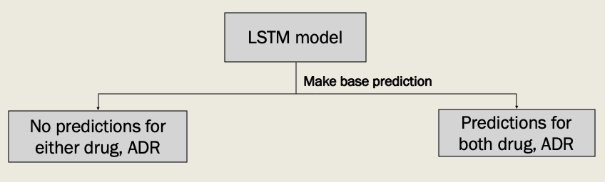
Final prediction system Incorporating improvements with base model
Use LSTM model to make base predictions
Discard predictions if cosine similarity $≤$ 0.4. If cosine similarity not available, retain original prediction.
If no drug or ADR predictions made, utilize dependency parsing to make prediction
Notes:
The LSTM model might either make predictions for both a drug and an ADR, or have no prediction for either of them.

Slide 24
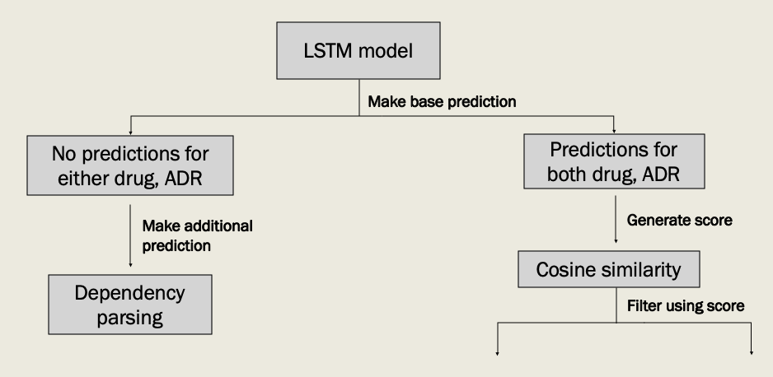
Final prediction system Incorporating improvements with base model
Use LSTM model to make base predictions
Discard predictions if cosine similarity $≤$ 0.4. If cosine similarity not available, retain original prediction.
If no drug or ADR predictions made, utilize dependency parsing to make prediction
Notes:
If there are no predictions made for either drug or ADR, we make use of dependency parsing to make additional predictions to supplement the missing LSTM prediction. However, if a LSTM prediction was made for both drug and ADR, then a cosine similarity score can be generated for each pair that was made. Based on the cosine similarity score,

Slide 25
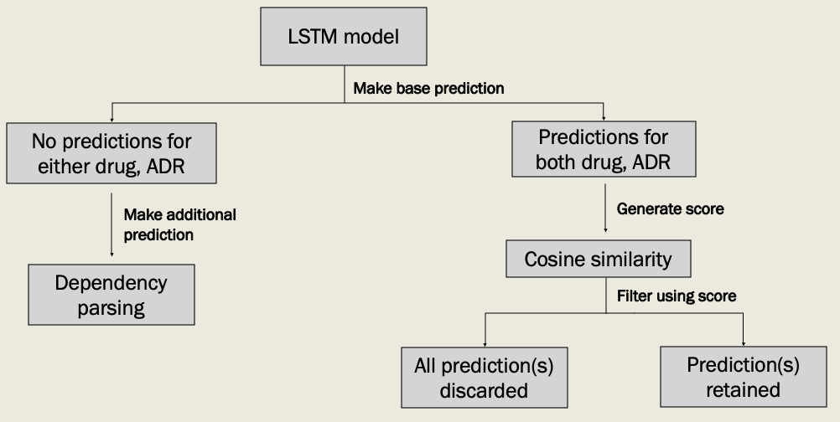
Final prediction system Incorporating improvements with base model
Use LSTM model to make base predictions
Discard predictions if cosine similarity $≤$ 0.4. If cosine similarity not available, retain original prediction.
If no drug or ADR predictions made, utilize dependency parsing to make prediction
Notes:
We can then determine if the drug and ADR pair should be discarded as false positives, or retained.

Slide 26
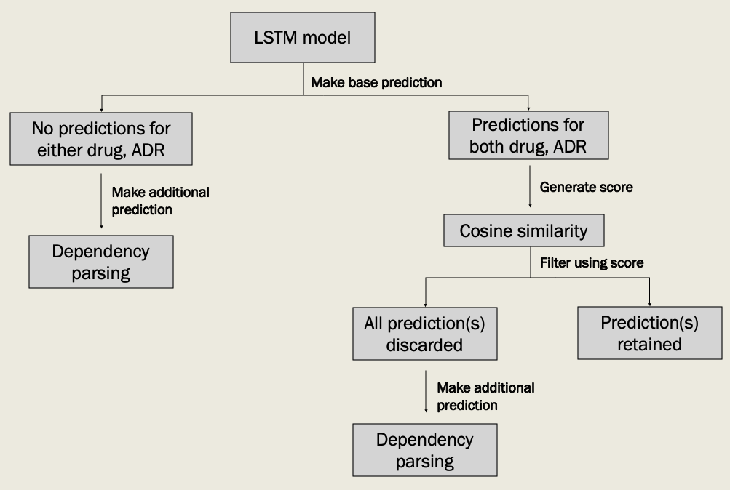
Final prediction system Incorporating improvements with base model
Use LSTM model to make base predictions
Discard predictions if cosine similarity $≤$ 0.4. If cosine similarity not available, retain original prediction.
If no drug or ADR predictions made, utilize dependency parsing to make prediction
Notes:
If all LSTM predictions were discarded as a result of poor cosine similarity scores, we again make use of dependency parsing to generate alternative predictions.

Slide 27
Evaluation: Final prediction system Final prediction performance
Final prediction system produced similar performance as the LSTM + dependency parsing system
Metric | Precision | Recall | F1 Score
Drug | 0.713 | 0.868 | 0.783
ADR | 0.597 | 0.801 | 0.684
Overall | 0.664 | 0.841 | 0.742
Only difference was a slight dip in recall
Notes:
Compared to the baseline performance, the final prediction system actually obtained the same result in majority of the precision, recall or f1 scores for the 3 categories. Unexpectedly, the only difference in performance was a slight dip in recall scores for the ADR category.

Slide 28
Evaluation: Final prediction system Final prediction discussion
Final prediction system identified drug/ADR pairs that were not labelled in the testing dataset
Additional pairs falsely become false positives
Possible that increase in dependency parsing related false positives, offset discarded cosine similarity related false positives
Text: “interferon alpha induced polymyositis and cardiomyopathy is diagnosed …”
Final system predictions
Test dataset
Drug | ADR
… | …
[‘interferon alpha’] | [‘cardiomyopathy’, ‘polymyositis’]
… | …
Drug | ADR
… | …
[‘interferon alpha’] | [‘cardiomyopathy’]
… | …
Notes:
Given the improvement in false and true positives when incorporating cosine similarity and dependency parsing separately, the results found for the final prediction system warrant a deeper investigation. It was found that the final prediction system identified many more drug and ADR pairs that were not labelled in the HuggingFace testing dataset, but were indeed true drug and ADR pairs. For instance, this was part of a sentence found in the HuggingFace testing dataset. The final prediction system correctly identified interferon alpha as the drug, and both cardiomyopathy and polymyositis as ADRs. However, the testing dataset only labelled one of the two ADRs found in the input text. There were multiple instances of incomplete labels, resulting in additional drug and ADR pairs identified by the final prediction system, to be misclassified as false positives.
In addition, incorporating cosine similarity was show to decrease false positives. It is possible that the increase in false positives generated by dependency parsing, could have offset the discarded false positives made by cosine similarity, resulting in the same prediction performance as the baseline system.

Slide 29
Future improvements Additional methods to improving performance
Utilize drug/ADR pairs from additional databases (FAERS, CVP) to extract abstracts from scientific literature
Drug, ADR, Text data can be used to supplement LSTM model training
Text data can be used to supplement word2vec model training, making it more robust in calculating cosine similarity scores
Query additional databases to expand drug and ADR names used for reference matching in dependency parsing e.g. acronyms
Increase number of training epochs for LSTM model training
Notes:
With limited time and hardware limitations, there are always additional improvements we can explore to improve the performance of the final prediction system. A possible improvement is to utilize the drug and ADR pairs extracted from additional databases to generate additional input texts as training data. This is possible scientific abstracts containing a drug and ADR pair can be extracted using the PubMED API. Additional input texts can not only be used to supplement the HuggingFace data to train the LSTM model, they can also be used to supplement the word2vec model training, making it better at generateing more accurate cosine similarity scores.
Another possible improvement is to look at additional databases to expand the list of drug and ADR names, possibly including alternative names or acronyms used. With a bigger drug and ADR list, we can identify more noun phrases that are drugs and ADRs, improving the predictions made using dependency parsing.
Lastly, one of the easiest way to improve prediction performance is to increase the number of training epochs for LSTM model training. This gives the LSTM model more data and iterations to learn patterns that can be helpful in making more accurate drug and ADR predictions.
We have come to the end of the presentation.

Slide 30
HuggingFace database
Training
LSTM model
Evaluate
Base performance
75/15/15 shuffled split
Train
Validation
Test

Slide 31
HuggingFace database
Training
LSTM model
Evaluate
Base performance
75/15/15 shuffled split
Train
Validation
Test
Training
Cosine similarity (Word2Vec model)
Evaluate
Base + Cosine similarity performance

Slide 32
HuggingFace database
Training
LSTM model
Evaluate
Base performance
75/15/15 shuffled split
Train
Validation
Test
Training
Cosine similarity (Word2Vec model)
Evaluate
Base + Cosine similarity performance
Additional databases
(FAERS, CVP)
Incorporate
Dependency parsing (regex matching)
Evaluate
Base + Dependency parsing performance
Compile from last 10 yrs
Drugs
ADRs

Slide 33
HuggingFace database
Training
LSTM model
Evaluate
Base performance
75/15/15 shuffled split
Train
Validation
Test
Training
Cosine similarity (Word2Vec model)
Evaluate
Base + Cosine similarity performance
Additional databases
(FAERS, CVP)
Incorporate
Dependency parsing (regex matching)
Evaluate
Base + Dependency parsing performance
Compile from last 10 yrs
Drugs
ADRs
Base + Cosine similarity + Dependency parsing performance
Evaluate

Slide 34
HuggingFace database
Training
LSTM model
Evaluate
Base performance
75/15/15 shuffled split
Train
Validation
Test
Training
Cosine similarity (Word2Vec model)
Evaluate
Base + Cosine similarity performance
Additional databases
(FAERS, CVP)
Incorporate
Dependency parsing (regex matching)
Evaluate
Base + Dependency parsing performance
Compile from last 10 yrs
Drugs
ADRs
Base + Cosine similarity + Dependency parsing performance
Evaluate

Slide 35
LSTM model
Make base prediction

Slide 36
LSTM model
Make base prediction
No predictions for either drug, ADR
Predictions for both drug, ADR

Slide 37
LSTM model
Make base prediction
No predictions for either drug, ADR
Predictions for both drug, ADR
Make additional prediction
Generate score
Cosine similarity
Dependency parsing
Filter using score

Slide 38
LSTM model
Make base prediction
No predictions for either drug, ADR
Predictions for both drug, ADR
Make additional prediction
Generate score
Cosine similarity
Dependency parsing
Filter using score
All prediction(s) discarded
Prediction(s) retained

Slide 39
LSTM model
Make base prediction
No predictions for either drug, ADR
Predictions for both drug, ADR
Make additional prediction
Generate score
Cosine similarity
Dependency parsing
Filter using score
All prediction(s) discarded
Prediction(s) retained
Make additional prediction
Dependency parsing

