Slide 1
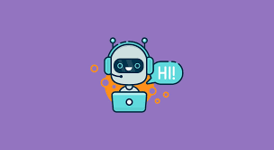
Chatbot using python

Slide 2
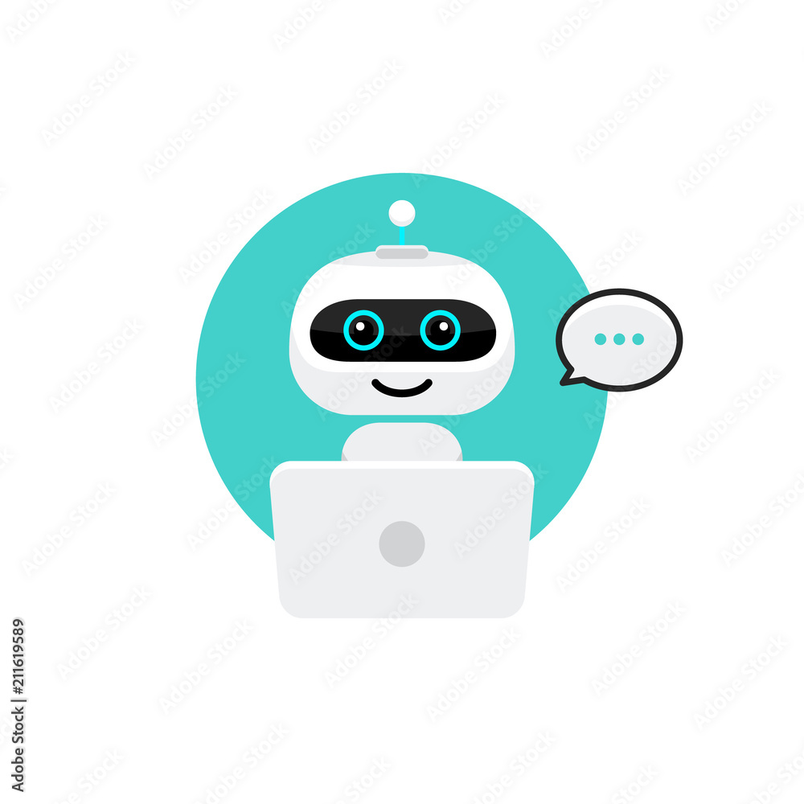
01
Introduction
02
Applications
CONTENTS
03
How do chatbots work?
04
Coding used

Slide 3
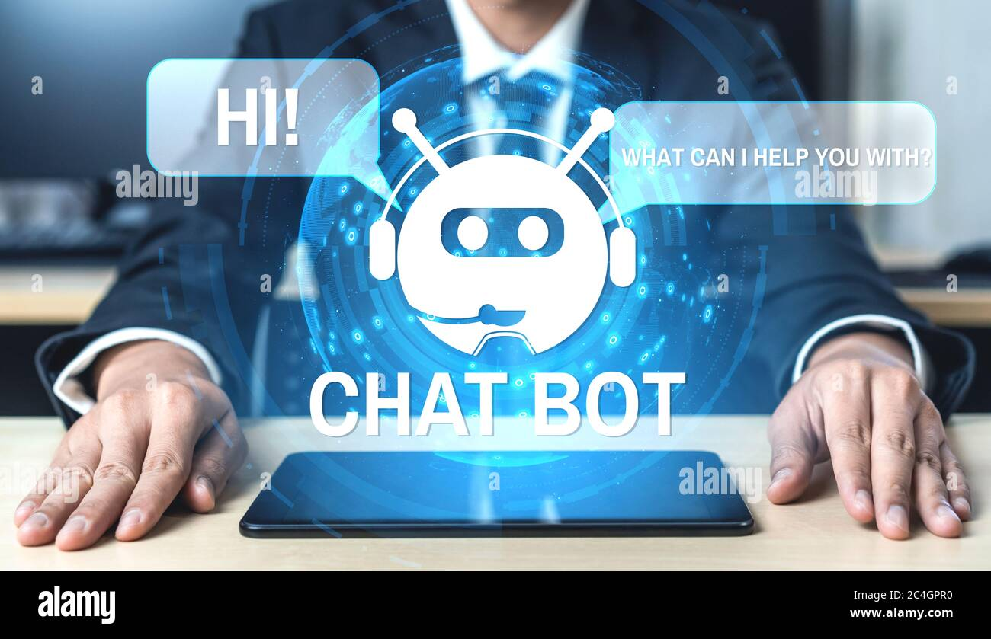
01
INTRODUCTION
CHATBOT

Slide 4
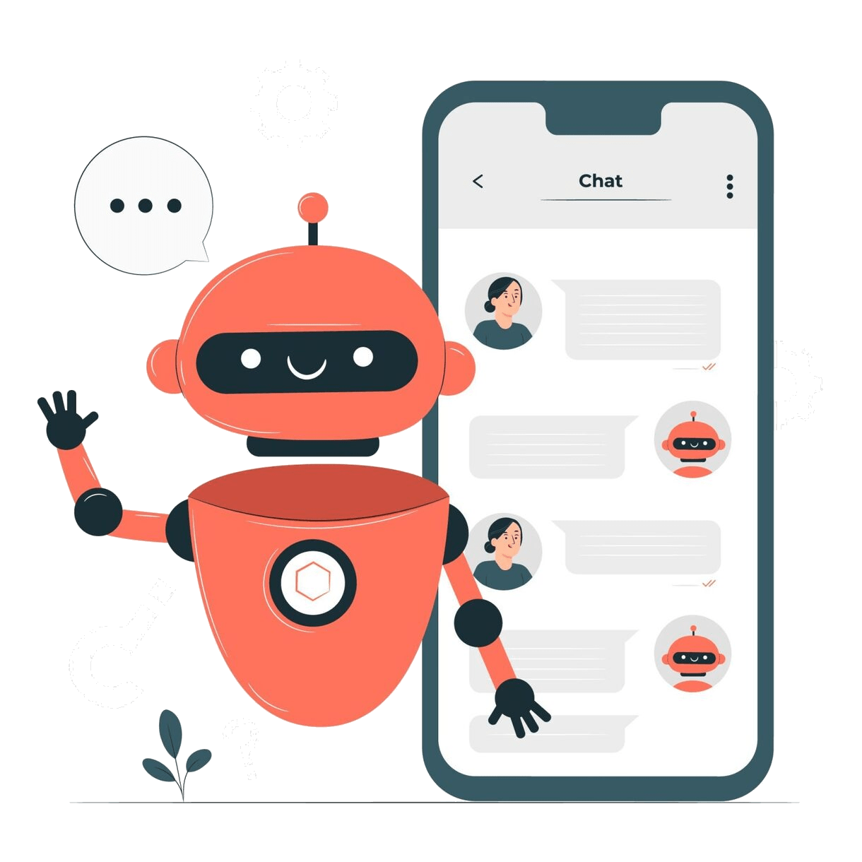
CHATBOT
What is a chatbot?
A chatbot is a software application that’s used to engage in human conversation in a natural way. Chatbots are commonly used across many different industries for many different purposes.
Chatbots can understand natural human language, simulate human conversation, and run simple, automated tasks. Chatbots are used in a variety of channels, such as messaging apps, mobile apps, websites, phone lines, and voice-enabled apps.
Chatbots can be developed to handle just a few simple commands or to
serve as complex digital assistants and interactive agents. A chatbot can be a part of a larger application or be completely stand-alone.

Slide 5
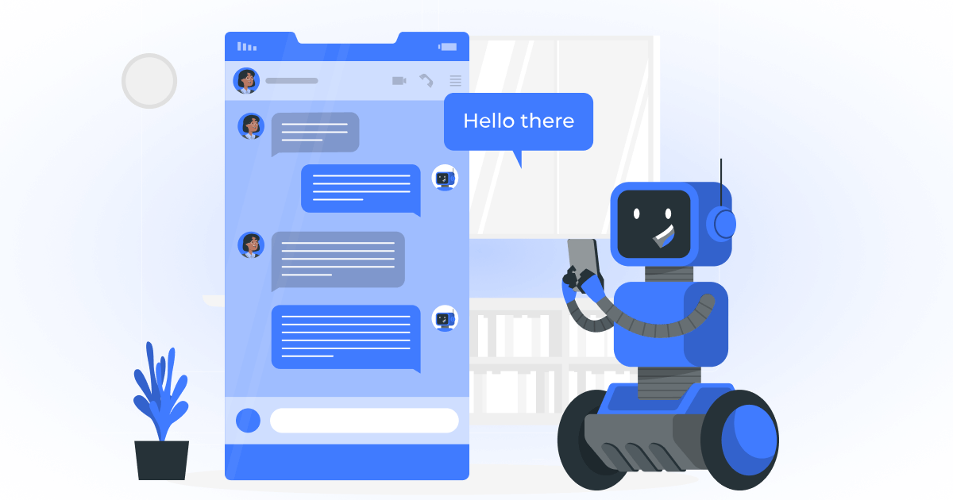
02
APPLICATIONS
CHATBOT

Slide 6
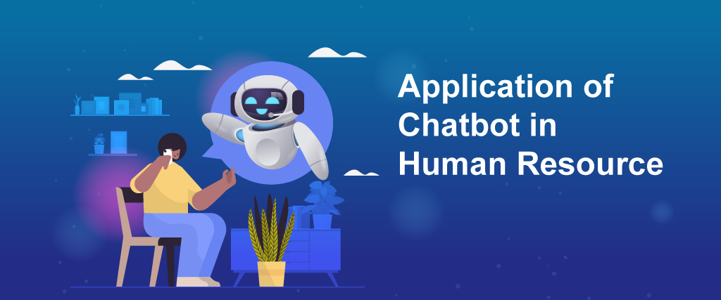
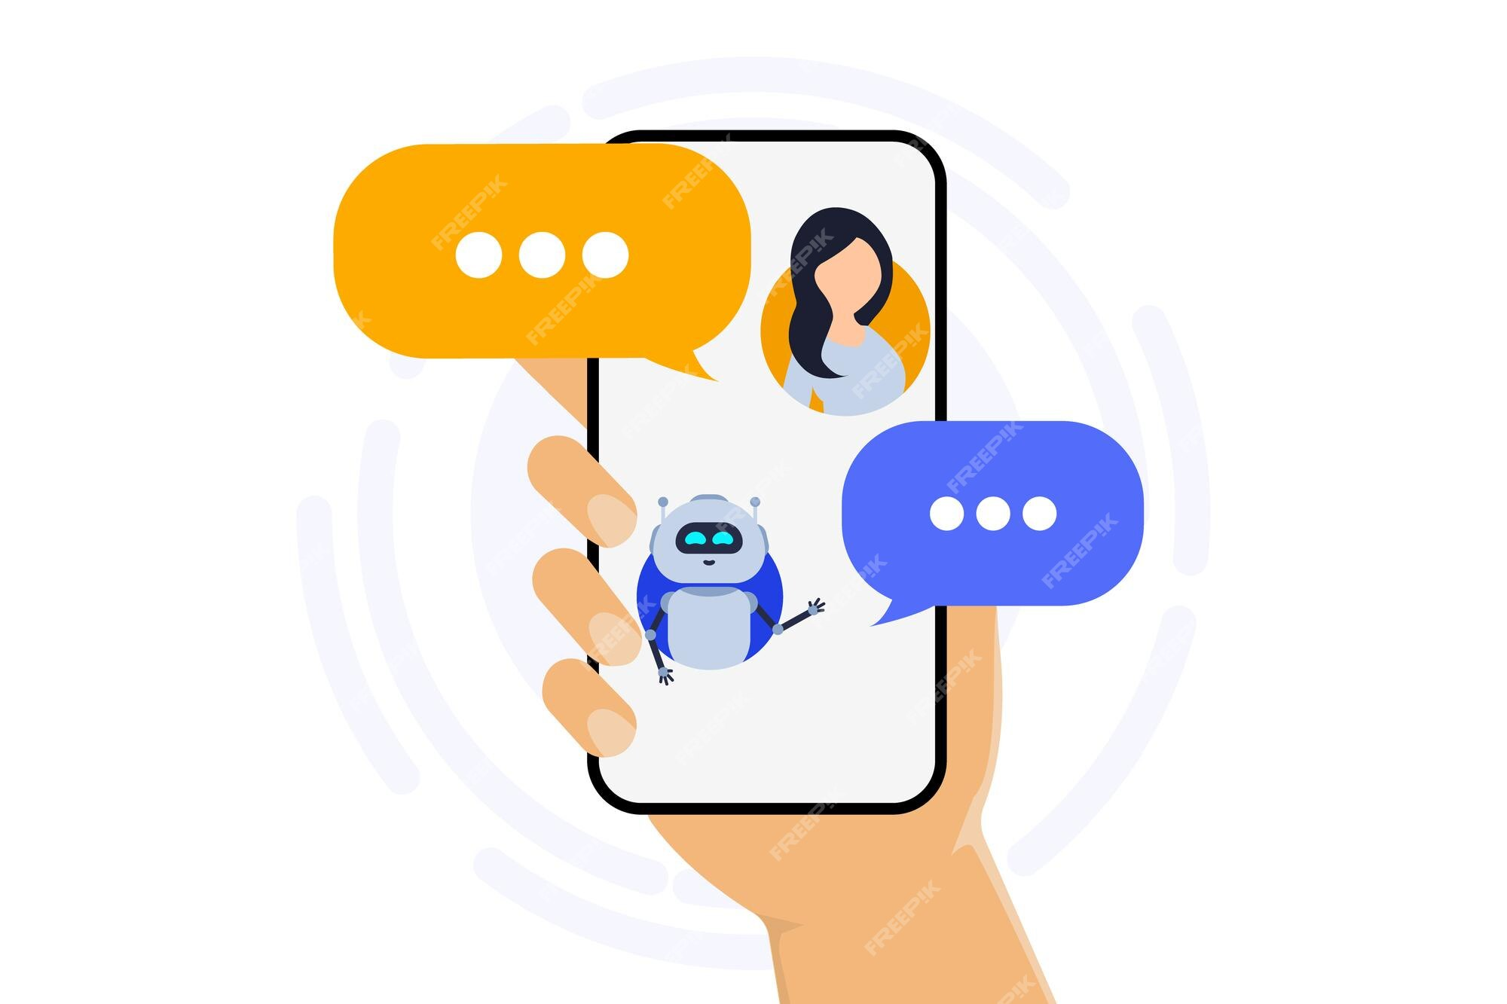
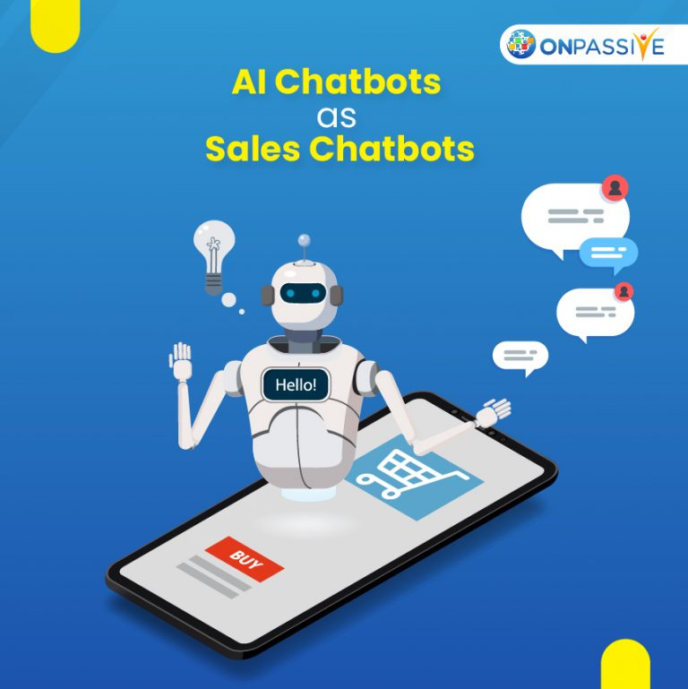
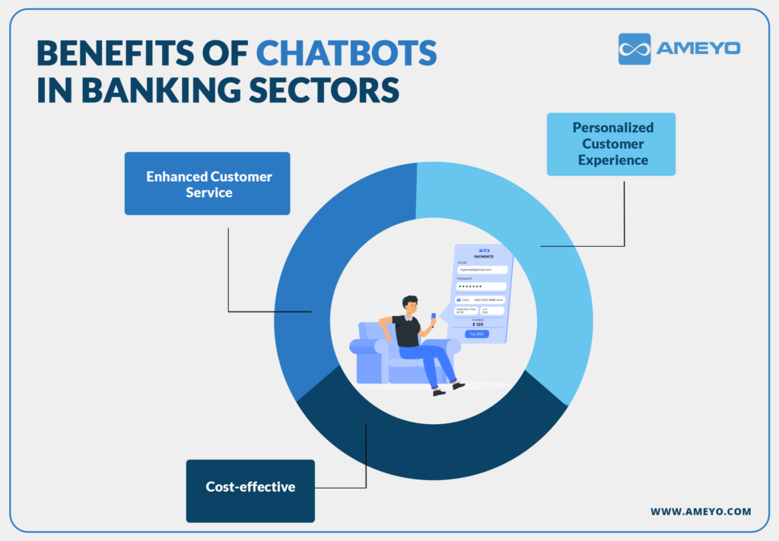
APPLICATIONS
CUSTOMER SERVICES
Human resources
Finance and accounting
Sales
Chatbots can be used to create virtual customer service agents that are always available, which leads to more satisfied customers. Chatbots can also be used to file and acknowledge help desk requests or perform routine tasks for customers.
Chatbots can assist with HR tasks like helping employees file for paid time off or sick leave, notifying employees of policy changes, and helping employees understand and manage their benefits.
Chatbots can pre-qualify leads, provide quotes to potential customers, and start a proactive conversation, which frees up time for salespeople to focus on closing sales.
Chatbot applications can assist employees with filing expense reports, opening purchase order requests, and updating and keeping track of supplier details.

Slide 7
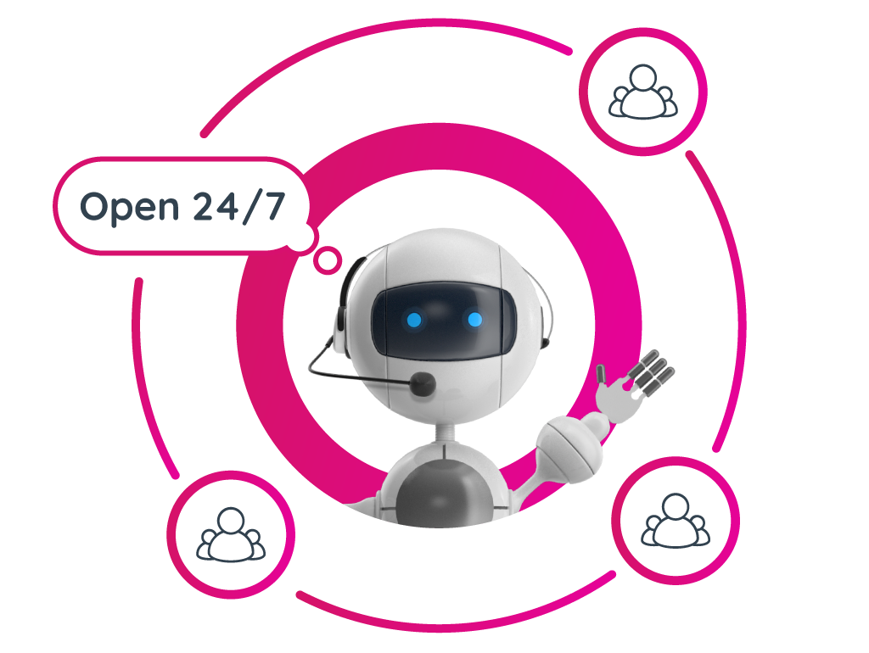
03
HOW DO CHATBOT WORKS?
CHATBOT

Slide 8
A chatbot is any app that users interact with in a conversational way, using text, graphics, or speech.
How do chatbots work?
STEP1
STEP2
STEP3
A user enters a message
intoa chatbotvia a channelsuch as an app, website,or text message
or evenby speaking ona phonecall.This message canbe a command or
a question.
The chatbot receives the content of the message and captures related info such as the channel the message came in through. The chatbot then uses NLP to determine the purpose of the message and identify relevant intents.
The chatbot determines an
appropriate response and
returns the response to the
user via the same channel. This
process continues following
steps one to three as the
conversation continues.

Slide 9
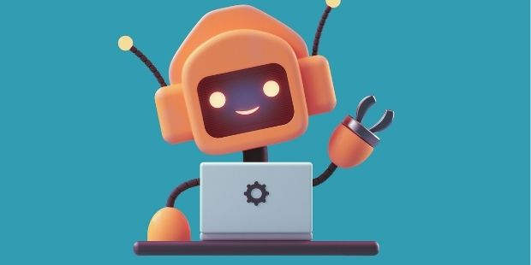
04
CHATBOT CODING
CHATBOT

Slide 10
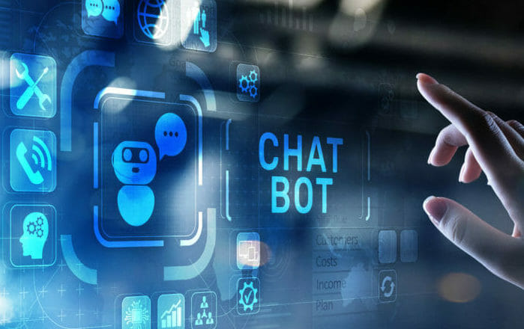
Chatbot using python
j
ChatterBot library in Python
ChatterBot is a library in python
which generates responses to
user input. It uses a number of
machine learning algorithms to
produce a variety of responses.
It becomes easier for the users to
make chatbots using the
ChatterBot library with
more accurate responses.
python in chatbot
Fundamentally, the chatbot utilizing Python is designed and programmed to take in the data we provide and then analyze it using the complex algorithms for Artificial Intelligence. It then delivers us either a written response or a verbal one.

Slide 11
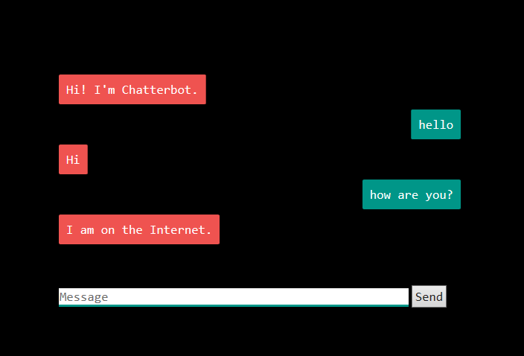
Technology stack :
1. Front-end: HTML, CSS, and JavaScript for creating a user
friendly web interface with chat functionality.
2. Chatbot Engine: Python with NLP libraries like NLTK or
spaCy for text analysis and understanding user input.
3. Assessment Module: Python-based logic for simulating
mental health assessments inspired by established scales.
4. Resource Recommendations: Algorithmic logic to
recommend mental health resources based on user responses.
5. User Data Handling: MySQL or MongoDB for simulating
data storage to track user progress while maintaining anonymity.

Slide 12
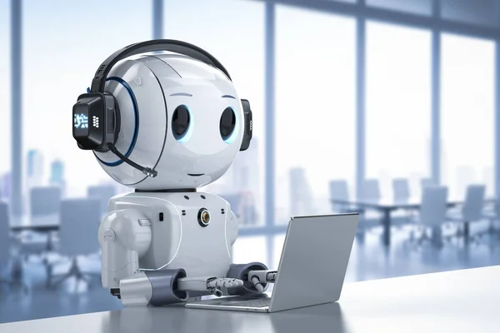
THANK YOU
------

