Slide 1


CHATBOT USING PYTHON

Slide 2
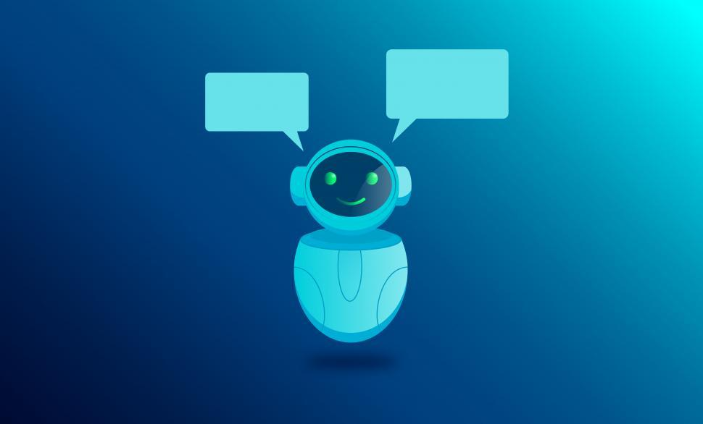
Phase 5: Project Documentation & Submission
Documentation:
• Clearly outline the problem statement, design thinking process, and the phases of development.
• Describe the libraries used and the integration of NLP techniques.
• Explain how the chatbot interacts with users and the web application.
• Document any innovative techniques or approaches used during the development.
Dataset Link: https://www.kaggle.com/datasets/grafstor/simple-dialogs-for-chatbot

Slide 3

Problem Statement
At the most basic level, a chatbot is a computer program that simulates and processes human conversation (either written or spoken), allowing humans to interact with digital devices as if they were communicating with a real person.
1
Design Thinking
Design thinking is divided into 5 stages which are: Empathize
Define
Ideate
prototype
Test.
Design thinking lets you gather creative ideas for your chatbot and test them with users. It help you address your customer's problems and avoid possible mistakes.

Slide 4
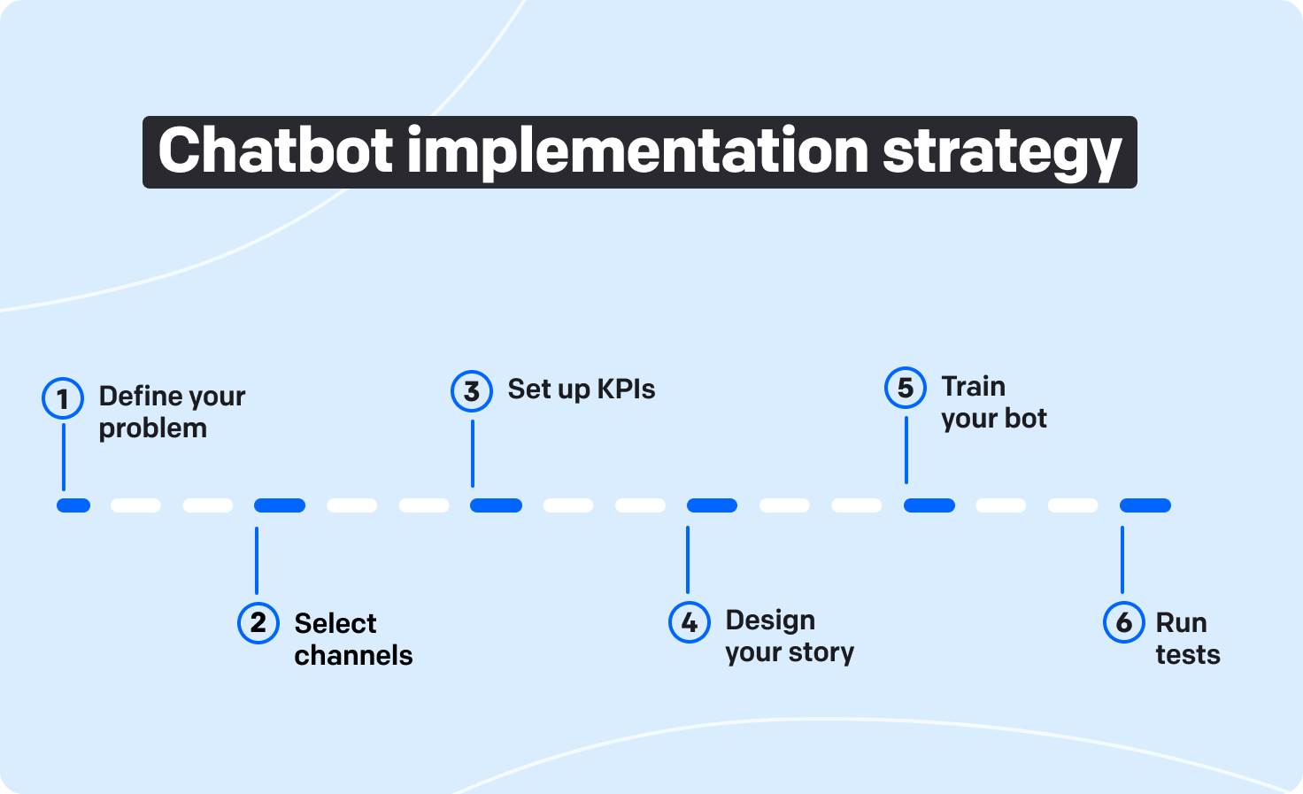
Phases Of Development
Identify the problem you want to solve Choose your channel
Define your chatbot KPIs
Design your Story
Train your chatbot
Run tests

Slide 5
Importing libraries
#model
import tensorflow as tf
from sklearn.model_selection import train_test_split
#nlp processing
import unicodedata
import re
import numpy as np
import warnings
warnings.filterwarnings('ignore')
/opt/conda/lib/python3.10/site-packages/scipy/ init .py:146:
UserWarning: A NumPy version >=1.16.5 and <1.23.0 is required for this
version of SciPy (detected version 1.23.5
warnings.warn(f"A NumPy version >={np_minversion} and
<{np_maxversion}"

Slide 6

Data Collection and Preprocessing:
Collect and prepare the data necessary for your chatbot. This includes training data, which consists of conversation examples and responses. Preprocessing is vital for cleaning and structuring the data to make it suitable for training your chatbot.
The basic text processing in NLP are:
1. Sentence Segmentation
2. Normalization
3. Tokenization
Software used:
1. Python
2. Natural Language Processing (NLP) Libraries
3. Machine Learning Libraries
4. Chatbot Frameworks
5. Web Frameworks(Optional)
6.APIs and Data Sources
7. Development Environment
8. Version Contro
9. Hosting and Deployment
10. Databases

Slide 7
Segmentation
formatting data to be in a question answer format
#reading data
data=open('/kaggle/input/simple-dialogs-for-chatbot/dialogs.txt','r').
read()
#paried list of question and corresponding answer
QA_list=[QA.split('\t') for QA in data.split('\n')]
print(QA_list[:5])
[['hi, how are you doing?', "i'm fine. how about yourself?"], ["i'm
fine. how about yourself?", "i'm pretty good. thanks for asking."],
["i'm pretty good. thanks for asking.", 'no problem. so how have you
been?'], ['no problem. so how have you been?', "i've been great. what about you?"], ["i've been great. what about you?", "i've been good.
i'm in school right now."]]questions=[row[0] for row in QA_list]
answers=[row[1] for row in QA_list]
print(questions[0:5])
print(answers[0:5])
['hi, how are you doing?', "i'm fine. how about yourself?", "i'm
pretty good. thanks for asking.", 'no problem. so how have you been?',
"i've been great. what about you?"]
["i'm fine. how about yourself?", "i'm pretty good. thanks for
asking.", 'no problem. so how have you been?', "i've been great. what
about you?", "i've been good. i'm in school right now."]

Slide 8
Normalization
To reduce its randomness, bringing it closer to a predefined “standard”
def remove_diacritic(text):
return ''.join(char for char in unicodedata.normalize('NFD',text)
if unicodedata.category(char) !='Mn')
def preprocessing(text):
#Case folding and removing extra whitespaces
text=remove_diacritic(text.lower().strip())
#Ensuring punctuation marks to be treated as tokens
text=re.sub(r"([?.!,¿])", r" \1 ", text)
#Removing redundant spaces
text= re.sub(r'[" "]+', " ", text)
#Removing non alphabetic characters
text=re.sub(r"[^a-zA-Z?.!,¿]+", " ", text)
text=text.strip()
#Indicating the start and end of each sentence
text='<start> ' + text + ' <end>'
return text
preprocessed_questions=[preprocessing(sen) for sen in questions]
preprocessed_answers=[preprocessing(sen) for sen in answers]
print(preprocessed_questions[0])
print(preprocessed_answers[0])
<start> hi , how are you doing ? <end>
<start> i m fine . how about yourself ? <end>

Slide 9
Tokenization
Creating Dataset
for training and testing the model
def tokenize(lang):
lang_tokenizer = tf.keras.preprocessing.text.Tokenizer(
filters='')
#build vocabulary on unique words
lang_tokenizer.fit_on_texts(lang)
return lang_tokenizer
def load_Dataset(data,size=None):
if(size!=None):
y,X=data[:size]
else:
y,X=data
X_tokenizer=tokenize(X)
y_tokenizer=tokenize(y)
X_tensor=vectorization(X_tokenizer,X)
y_tensor=vectorization(y_tokenizer,y)
return X_tensor,X_tokenizer, y_tensor, y_tokenizerdef load_Dataset(data,size=None):
if(size!=None):
y,X=data[:size]
else:
y,X=data
X_tokenizer=tokenize(X)
y_tokenizer=tokenize(y)
X_tensor=vectorization(X_tokenizer,X)
y_tensor=vectorization(y_tokenizer,y)
return X_tensor,X_tokenizer, y_tensor, y_tokenizer
Word Embedding
representing words in form of real-valued vetors
def vectorization(lang_tokenizer,lang):
#word embedding for training the neural network
tensor = lang_tokenizer.texts_to_sequences(lang)
tensor = tf.keras.preprocessing.sequence.pad_sequences(tensor,
padding='post')
return tensor

Slide 10
Splitting Data
Creating training and validation sets using an 80-20 split after the required preprocessing isapplied to the whole data
X_train, X_val, y_train, y_val = train_test_split(X_tensor, y_tensor,
test_size=0.2) # Show length
print(len(X_train), len(y_train), len(X_val), len(y_val))
2980 2980 745 745
Tensorflow Dataset
BUFFER_SIZE = len(X_train)
BATCH_SIZE = 64
steps_per_epoch = len(X_train)//BATCH_SIZE
embedding_dim = 256
units = 1024
vocab_inp_size = len(X_tokenizer.word_index)+1
vocab_tar_size = len(y_tokenizer.word_index)+1
dataset = tf.data.Dataset.from_tensor_slices((X_train,
y_train)).shuffle(BUFFER_SIZE)
dataset = dataset.batch(BATCH_SIZE, drop_remainder=True)
example_input_batch, example_target_batch = next(iter(dataset))
example_input_batch.shape, example_target_batch.shape
(TensorShape([64, 24]), TensorShape([64, 24]))

Slide 11
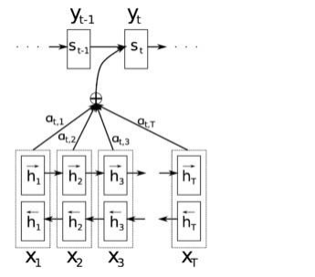
MODEL
Buliding Model Architecture
Bahdanau Attention Mechanism
Encoder
https://machinelearningmastery.com/the-bahdanau-attention-mechanism/
class Encoder(tf.keras.Model):
def init (self, vocab_size, embedding_dim, enc_units,
batch_sz):
super(Encoder, self). init ()
self.batch_sz = batch_sz
self.enc_units = enc_units
self.embedding = tf.keras.layers.Embedding(vocab_size,
embedding_dim)
self.gru = tf.keras.layers.GRU(self.enc_units,
return_sequences=True,
return_state=True,
recurrent_initializer='glorot_uniform')
def call(self, x, hidden):
x = self.embedding(x)
output, state = self.gru(x, initial_state = hidden)
return output, state
Adding attention mechanism to an Encoder-Decoder Model to make the model focus on specific
parts of input sequence by assigning weights to different parts of the input sequence

Slide 12
def initialize_hidden_state(self):
return tf.zeros((self.batch_sz, self.enc_units))
encoder = Encoder(vocab_inp_size, embedding_dim, units, BATCH_SIZE)
# sample input
sample_hidden = encoder.initialize_hidden_state()
sample_output, sample_hidden = encoder(example_input_batch,
sample_hidden)
print ('Encoder output shape: (batch size, sequence length, units)
{}'.format(sample_output.shape))
print ('Encoder Hidden state shape: (batch size, units)
{}'.format(sample_hidden.shape))
Encoder output shape: (batch size, sequence length, units) (64, 24,
1024)
Encoder Hidden state shape: (batch size, units) (64, 1024)

Slide 13
Attention Mechanism
class BahdanauAttention(tf.keras.layers.Layer):
def init (self, units):
super(BahdanauAttention, self). init ()
self.W1 = tf.keras.layers.Dense(units)
self.W2 = tf.keras.layers.Dense(units)
self.V = tf.keras.layers.Dense(1)
def call(self, query, values):
# query hidden state shape == (batch_size, hidden size)
# query_with_time_axis shape == (batch_size, 1, hidden size)
# values shape == (batch_size, max_len, hidden size)
# we are doing this to broadcast addition along the time axis
to calculate the score
query_with_time_axis = tf.expand_dims(query, 1) # score shape == (batch_size, max_length, 1)
# we get 1 at the last axis because we are applying score to
self.V
# the shape of the tensor before applying self.V is
(batch_size, max_length, units)
score = self.V(tf.nn.tanh(
self.W1(query_with_time_axis) + self.W2(values)))

Slide 14
# attention_weights shape == (batch_size, max_length, 1)
attention_weights = tf.nn.softmax(score, axis=1) # context_vector shape after sum == (batch_size, hidden_size)
context_vector = attention_weights * values
context_vector = tf.reduce_sum(context_vector, axis=1)
return context_vector, attention_weightsattention_layer = BahdanauAttention(10)
attention_result, attention_weights = attention_layer(sample_hidden,
sample_output)
print("Attention result shape: (batch size, units)
{}".format(attention_result.shape))
print("Attention weights shape: (batch_size, sequence_length, 1)
{}".format(attention_weights.shape))
Attention result shape: (batch size, units) (64, 1024)
Attention weights shape: (batch_size, sequence_length, 1) (64, 24, 1)

Slide 15
Decoder
class Decoder(tf.keras.Model):
def init (self, vocab_size, embedding_dim, dec_units,
batch_sz):
super(Decoder, self). init ()
self.batch_sz = batch_sz
self.dec_units = dec_units
self.embedding = tf.keras.layers.Embedding(vocab_size,
embedding_dim)
self.gru = tf.keras.layers.GRU(self.dec_units,
return_sequences=True,
return_state=True,
recurrent_initializer='glorot_uniform')
self.fc = tf.keras.layers.Dense(vocab_size)
# used for attention
self.attention = BahdanauAttention(self.dec_units)
def call(self, x, hidden, enc_output):
# enc_output shape == (batch_size, max_length, hidden_size)
context_vector, attention_weights = self.attention(hidden,
enc_output)

Slide 16
# x shape after passing through embedding == (batch_size, 1,
embedding_dim)
x = self.embedding(x)
# x shape after concatenation == (batch_size, 1, embedding_dim
+ hidden_size)
x = tf.concat([tf.expand_dims(context_vector, 1), x], axis=-1) # passing the concatenated vector to the GRU
output, state = self.gru(x)
# output shape == (batch_size * 1, hidden_size)
output = tf.reshape(output, (-1, output.shape[2]))
# output shape == (batch_size, vocab)
x = self.fc(output)
return x, state, attention_weights
decoder = Decoder(vocab_tar_size, embedding_dim, units, BATCH_SIZE)
sample_decoder_output, _, _ = decoder(tf.random.uniform((BATCH_SIZE,
1)),
sample_hidden, sample_output)
print ('Decoder output shape: (batch_size, vocab size)
{}'.format(sample_decoder_output.shape))
Decoder output shape: (batch_size, vocab size) (64, 2349

Slide 17

Training Model
01
Pass the input through the encoder which return encoder output and the encoder hidden
state
02
03
04
The encoder output, encoder hidden state and the decoder input (which is the start
token) is passed to the decoder.
The decoder returns the predictions and the decoder hidden state
The decoder hidden state is then passed back into the model and the predictions are
used to calculate the loss.
The final step is to calculate the gradients and apply it to the optimizer and
backpropagate.
07
Teacher forcing is the technique where the target word is passed as the next input to the
decoder.
06
05
Use teacher forcing to decide the next input to the decoder.

Slide 18
optimizer = tf.keras.optimizers.Adam()
loss_object = tf.keras.losses.SparseCategoricalCrossentropy(
from_logits=True, reduction='none')
def loss_function(real, pred):
mask = tf.math.logical_not(tf.math.equal(real, 0))
loss_ = loss_object(real, pred)
mask = tf.cast(mask, dtype=loss_.dtype)
loss_ *= mask
return tf.reduce_mean(loss_)
@tf.function
def train_step(inp, targ, enc_hidden):
loss = 0
with tf.GradientTape() as tape:
enc_output, enc_hidden = encoder(inp, enc_hidden)dec_hidden = enc_hidden
dec_input = tf.expand_dims([y_tokenizer.word_index['<start>']]
* BATCH_SIZE, 1) # Teacher forcing - feeding the target as the next input
for t in range(1, targ.shape[1]):
# passing enc_output to the decoder
predictions, dec_hidden, _ = decoder(dec_input,
dec_hidden, enc_output)
loss += loss_function(targ[:, t], predictions)

Slide 19
# using teacher forcing
dec_input = tf.expand_dims(targ[:, t], 1)
batch_loss = (loss / int(targ.shape[1]))
variables = encoder.trainable_variables +
decoder.trainable_variables
gradients = tape.gradient(loss, variables)
optimizer.apply_gradients(zip(gradients, variables))
return batch_loss
EPOCHS = 40
for epoch in range(1, EPOCHS + 1):
enc_hidden = encoder.initialize_hidden_state()
total_loss = 0
for (batch, (inp, targ)) in
enumerate(dataset.take(steps_per_epoch)):
batch_loss = train_step(inp, targ, enc_hidden)
total_loss += batch_loss
if(epoch % 4 == 0):
print('Epoch:{:3d} Loss:{:.4f}'.format(epoch,total_loss /steps_per_epoch))
Epoch: 4 Loss:1.5338
Epoch: 8 Loss:1.2803
Epoch: 12 Loss:1.0975
Epoch: 16 Loss:0.9404
Epoch: 20 Loss:0.7773
Epoch: 24 Loss:0.6040
Epoch: 28 Loss:0.4042
Epoch: 32 Loss:0.2233
Epoch: 36 Loss:0.0989
Epoch: 40 Loss:0.0470

Slide 20
Model Evaluation
def remove_tags(sentence):
return sentence.split("<start>")[-1].split("<end>")[0]
def evaluate(sentence):
sentence = preprocessing(sentence)
inputs = [X_tokenizer.word_index[i] for i in sentence.split(' ')]
inputs = tf.keras.preprocessing.sequence.pad_sequences([inputs],
maxlen=max_length_X,
padding='post')
inputs = tf.convert_to_tensor(inputs)
result = ''
hidden = [tf.zeros((1, units))]
enc_out, enc_hidden = encoder(inputs, hidden)
dec_hidden = enc_hidden
dec_input = tf.expand_dims([y_tokenizer.word_index['<start>']], 0)
for t in range(max_length_y):
predictions, dec_hidden, attention_weights =
decoder(dec_input,
dec_hidden,
enc_out)
)

Slide 21
# storing the attention weights to plot later on
attention_weights = tf.reshape(attention_weights, (-1, ))
predicted_id = tf.argmax(predictions[0]).numpy()
result += y_tokenizer.index_word[predicted_id] + ' '
if y_tokenizer.index_word[predicted_id] == '<end>':
return remove_tags(result), remove_tags(sentence# the predicted ID is fed back into the model
dec_input = tf.expand_dims([predicted_id], 0)
return remove_tags(result), remove_tags(sentence)
def ask(sentence):
result, sentence = evaluate(sentence)
print('Question: %s' % (sentence))
print('Predicted answer: {}'.format(result))
ask(questions[1])
Question: i m fine . how about yourself ?
Predicted answer: i m pretty good . thanks for asking .

Slide 22
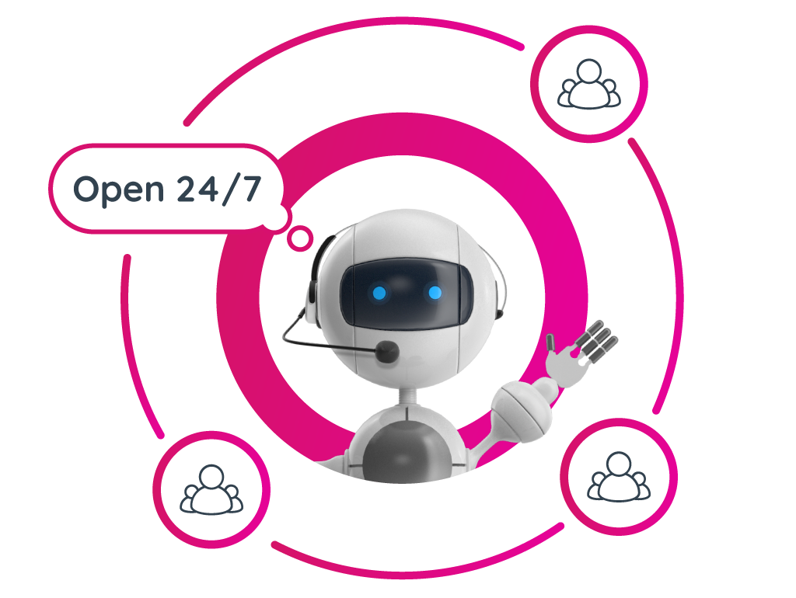
Benifits Of Chatbot
Chatbots offer several benefits across various industries and applications. Some of the key advantages of using chatbots include:
1. 24/7 Availability: Chatbots can operate around the clock, providing instant assistance to users regardless of the time of day. This helps improve customer service and support by addressing inquiries and issues at any hour.
2. Cost-Effective: Chatbots can significantly reduce operational costs by automating routine tasks and inquiries, reducing the need for human intervention in basic customer service interactions.
3. Scalability: Chatbots can handle a large volume of requests simultaneously, making them highly scalable. They can efficiently manage high-demand situations without adding additional staff.
4. Consistency: Chatbots provide a consistent level of service as they follow predefined rules and guidelines. They don't get tired, and their responses remain consistent, ensuring a uniform customer experience.
1

Slide 23

5. Speed and Efficiency: Chatbots can quickly respond to user inquiries, reducing wait times and increasing efficiency. This is especially valuable in customer support and service-oriented businesses.
6. Data Collection and Analysis: Chatbots can collect and analyze user data, providing valuable insights into user behavior and preferences. This data can be used for improving products, services, and marketing strategies.
7. Personalization: Advanced chatbots can use data to offer personalized responses and recommendations to users, enhancing the user experience and increasing engagement.
8. Multilingual Support: Chatbots can communicate in multiple languages, making them ideal for businesses with a global or diverse customer base.
9. Reduction of Human Error: Chatbots are less prone to errors in routine tasks, which can be crucial in fields like healthcare, finance, and e-commerce.
10. Automation of Repetitive Tasks: Chatbots excel at automating repetitive, rule-based tasks, such as data entry, appointment scheduling, and order tracking.
1

Slide 24
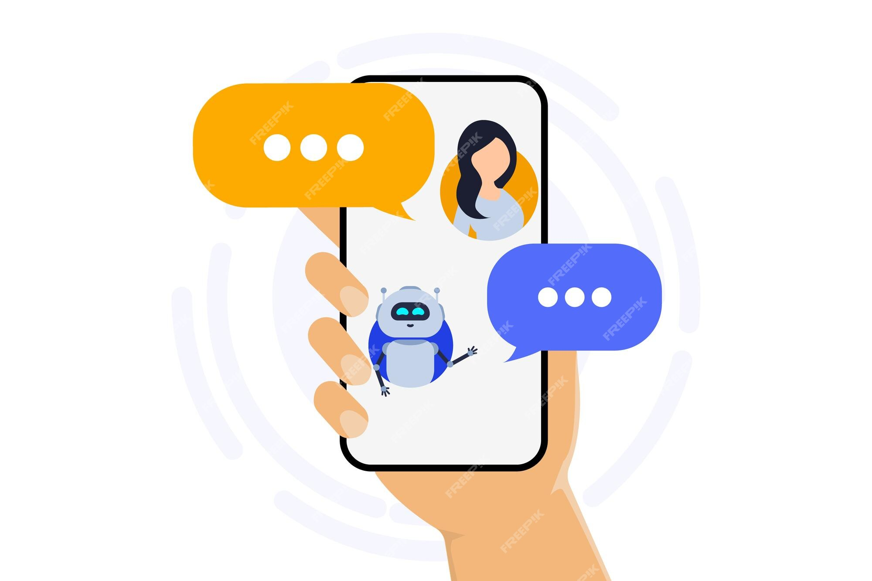
11. Improved Lead Generation and Sales: Chatbots can engage with website visitors and guide them through the sales funnel, increasing conversion rates and lead generation.
12. Enhanced Customer Engagement: Chatbots can initiate conversations with users, collect feedback, and follow up on previous interactions, helping to maintain and strengthen customer relationships.
13. Integration with Existing Systems: Chatbots can be integrated with other software and systems, such as CRM and e-commerce platforms, to streamline processes and enhance data sharing.
14. Onboarding and Training: Chatbots can be used for employee onboarding and training by providing information, answering questions, and guiding new hires through company policies and procedures.
15. Reduced Workload: Chatbots can help offload routine tasks from customer support and service teams, allowing human agents to focus on more complex and value-added activities.
16. Accessibility: Chatbots can improve accessibility for individuals with disabilities by providing text-based communication that can be easily converted into speech or braille.
While chatbots offer many benefits, it's important to strike a balance between automation and human interaction to ensure a positive customer experience. Depending on the specific use case and industry, the level of automation and human involvement may vary.
1

Slide 25
Conclusion:
Creating a chatbot in Python is an exciting and valuable endeavor. It allows you to build a versatile tool that can enhance user experiences, automate tasks, and provide support around the clock.
In conclusion, creating a chatbot in Python offers a wealth of possibilities, from enhancing customer support to automating tasks and providing valuable information. As you embark on your chatbot development journey, remember that success requires continuous learning, adaptation, and a commitment to delivering a valuable and user-friendly solution. Python's extensive libraries, community support, and flexibility make it a powerful choice for building chatbots that can serve a wide range of purposes and improve user experiences.

Slide 26

TEAM WORK BY
Begency.E
Antony packia sweety.F
Braillen Reba.B
Aarthi Nisha
Amanda Judith

