Slide 1
Data Preprocessing – Advanced Practice
Data Cleaning, Transformation & Normalization
With Exam-Level Numerical Problems & Graphs

Slide 2
Numerical Problem 1 – Missing Value
Dataset: 10, 20, ?, 40, 50
Mean = (10+20+40+50)/4 = 30
Replace missing value with 30

Slide 3
Numerical Problem 2 – Binning (Smoothing)
Data: 4, 8, 15, 21, 24, 28, 34
Bin1: 4,8,15 → Mean = 9
Bin2: 21,24,28 → Mean = 24.33
Bin3: 34

Slide 4
Numerical Problem 3 – Min-Max Normalization
Dataset: 5, 10, 15, 20, 25
Min=5, Max=25
Normalize 15: (15-5)/(25-5)=10/20=0.5

Slide 5
Numerical Problem 4 – Z-Score
Dataset Mean=100, SD=20
Value=130
Z=(130-100)/20=1.5

Slide 6
Numerical Problem 5 – Decimal Scaling
Dataset: 345, 678, 123
Max value=678
Divide by 1000
Normalized: 0.345, 0.678, 0.123

Slide 7
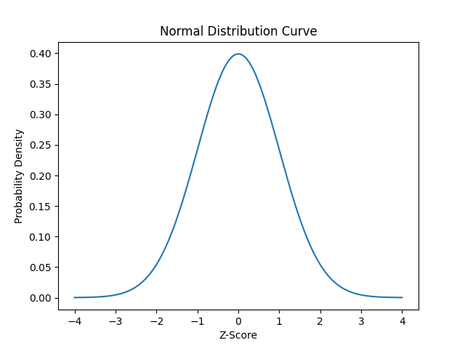
Graphical Illustration – Normal Distribution

Slide 8
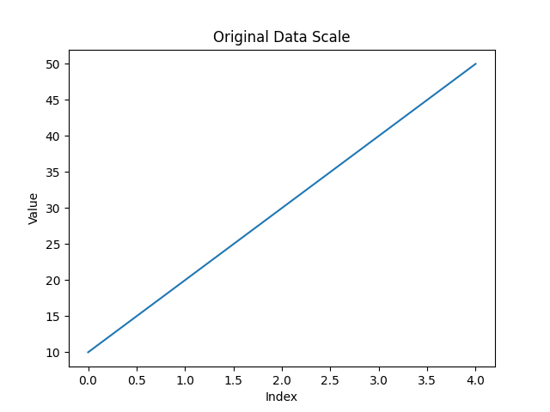
Scaling Diagram – Original Data

Slide 9
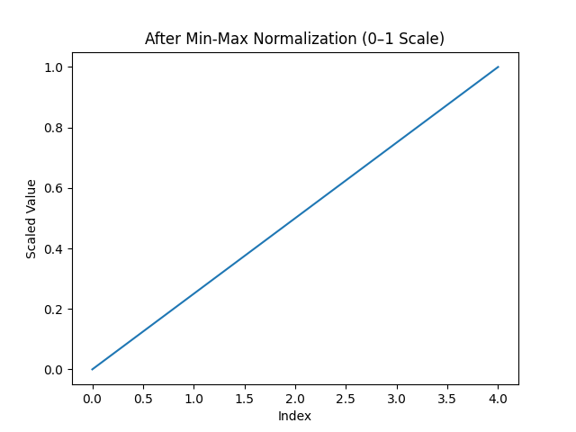
Scaling Diagram – After Min-Max Normalization

Slide 10
Exam-Oriented Practice Questions
1. Apply Min-Max on: 2,4,6,8,10
2. Compute Z-score if μ=60, σ=5, x=75
3. Identify outlier in: 12,14,13,90,15

Slide 11
Summary
Preprocessing improves accuracy
Normalization essential for ML algorithms
Practice numericals for exam preparation

