Slide 1
Reviving Loyalty
A Data-Driven Re-Engagement Plan for Wander Luxe
By Amandeep Kaur Randhawa
June 23, 2025

Slide 2


Project Overview
Addressing declining customer retention
Focused on two key segments: Timeless Trends and Heights of Style
Approach: Combine demographic and psychographic data to understand disengagement

Slide 3

Objectives
Identify why key customer groups are disengaging
Use data-backed insights to shape personalized marketing strategies
Rebuild loyalty and increase Customer Lifetime Value (CLV)

Slide 4
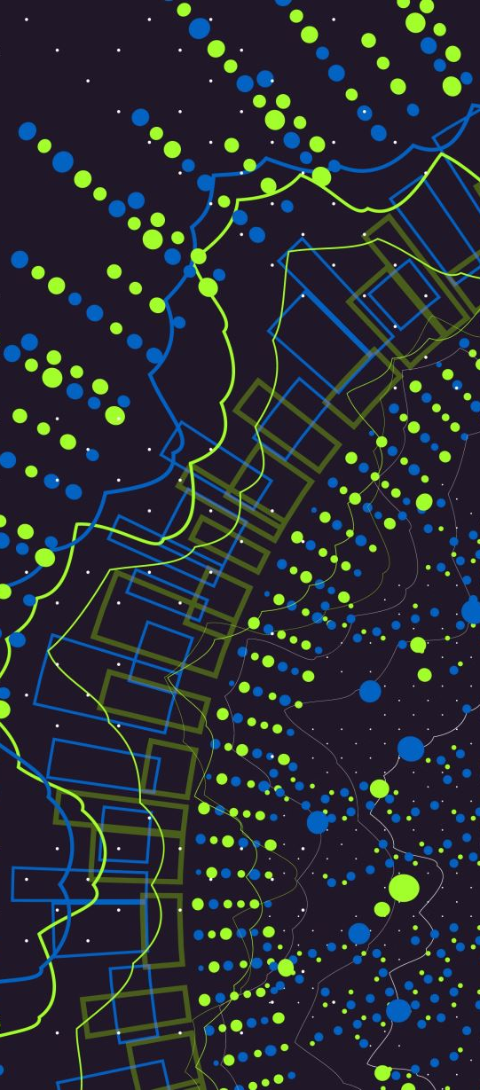
Methodology
Tools: Environics Analytics, DemoStats, SocialValues
Approach: Segmentation analysis, persona development, ELEVATE framework
Visuals: Radar charts, heatmaps, PCA, cluster and bubble plots

Slide 5

Target Segments
Timeless Trends: Older, affluent, value-driven (−$295 drop in spend)
Heights of Style: Mid-younger, trend-seeking (−$167 drop in spend)

Slide 6
Customer Personas
Helen – Age 62, loyal for 10 years, disengaged due to lack of personalization
Zayn – Age 37, trend-driven, disengaged due to uninspiring promotions

Slide 7
Demographic Insights
Timeless Trends: Aged 55–84, detached homes, high income/education
Heights of Style: Aged 25–44, diverse housing, family presence

Slide 8
Psychographic Insights
Timeless Trends: Brand integrity, social responsibility, community
Heights of Style: Novelty, cultural exploration, trend sampling

Slide 9

Behavior Trends (2023 vs 2024)
−5% purchase rate and significant spend drop for both segments
Signals urgent need for re-engagement strategies

Slide 10

The ELEVATE Framework
Engage
Engage Personas – Helen & Zayn
Learn
Learn from Data – Segment-specific targeting
Emphasize
Emphasize Brand Purpose – Local, authentic
Value
Value with Relevance – Family-centric offers
Amplify
Amplify Digital – Influencers, reels
Target
Target Precisely – Age/geolocation filters
Evaluate & Adapt
Evaluate & Adapt – KPIs, A/B testing

Slide 11
Implementation Timeline
Segment
Q1: Segment messaging & campaign design
Launch
Q2: Launch loyalty tiers, trend collections
Optimize
Q3: Optimize, scale, evaluate

Slide 12
Risk & Mitigation
Digital Fatigue – Use multi-channel campaigns
Misalignment of Values – Co-create with community
Saturation – Rotate creatives monthly

Slide 13
KPIs for Success
Increase in purchase rate
Higher average spend/year
Improved CLV and repeat purchase rate
Reduction in churn

Slide 14
Conclusion
Segment-specific re-engagement is crucial
Psychographics reveal why customers disengage
ELEVATE ensures personalization and growth

Slide 15
Thank You
Amandeep Kaur Randhawa
amandeepkrandhawa@gmail.com
Toronto, ON

