Slide 1







Dashboard Using Cognos Analytics
Amandeep Randhawa
12/8/2024

Slide 2



OUTLINE
Executive Summary
Introduction
Methodology
Results
Visualization – Charts
Dashboard
Discussion
Findings & Implications
Conclusion
Appendix

Slide 3

EXECUTIVE SUMMARY
Purpose :The report focuses on the creation and analysis of a dashboard based on two datasets. It aims to provide insights into current technology usage, future technology trends, and demographic data.
Main Findings: The dashboard reveals significant trends in technology adoption and user demographics.
Key insights include the most popular technologies, emerging trends, and user distribution across various demographics.
Methodology: Data was sourced from two comprehensive datasets. Analysis was performed using IBM Cognos Analytics, emphasizing descriptive statistics and visualizations.

Slide 4

INTRODUCTION
The report provides insights into current and future technology trends based on data collected from various respondents. The focus is on programming languages, databases, platforms, web frameworks, and demographic information. The data helps identify key areas of interest and potential growth in the technology sector.
The survey captures a snapshot of the technology landscape, highlighting preferences and usage patterns among developers and IT professionals. Understanding these trends aids in anticipating shifts in technology adoption and preparing for future challenges.

Slide 5

METHODOLOGY
The assignment aimed to create visualizations and dashboards to analyze technology usage and demographic data from a survey dataset using IBM Cognos Analytics.
Dataset: CSV files were used:m5_survey_data_demographics.csv: Contains demographic information.m5_survey_data_technologies_normalised.csv: Contains data on technology usage and future trends.
Dashboard Structure:
Current Technology Usage:- Visualizations included a bar chart for top programming languages, a column chart for databases, a word cloud for platforms, and a hierarchy bubble chart for web frameworks.
Future Technology Trend:- included a bar chart for desired programming languages next year, a column chart for desired databases, a tree map for desired platforms, and a hierarchy bubble chart for web frameworks.
Demographics:-Visualizations included a pie chart for gender distribution, a map chart for respondent count by country, a line chart for age distribution, and a stacked bar chart for education level by gender.
Visualization Features: Various chart types were used to effectively present the data, including bar charts, column charts, word clouds, hierarchy bubble charts, tree maps, pie charts, map charts, line charts, and stacked bar charts.
Key features such as value labels, contrast colors, and markers were utilized to enhance the readability and interpretability of the charts.

Slide 6
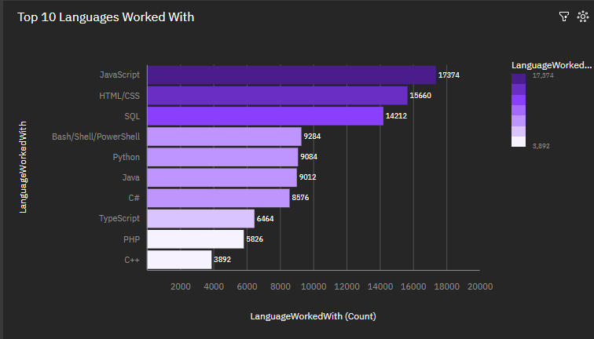
RESULTS

Slide 7
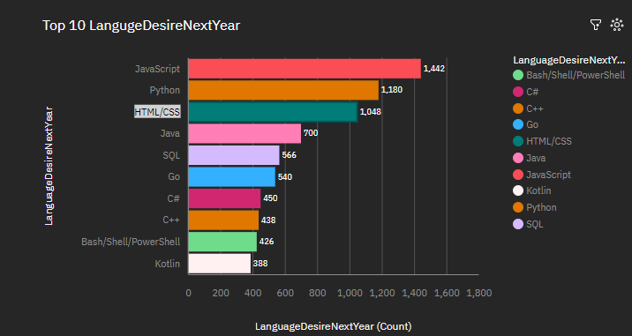
RESULTS
RESULTS

Slide 8
PROGRAMMING LANGUAGE TRENDS
Current Year
Next Year
Top 10 Languages Worked With:
The bar chart displayed the most commonly used programming languages among developers. Languages like JavaScript, Python, and Java were among the top.
Top 10 Languages Desired Next Year: The bar chart highlighted the programming languages developers were most interested in learning or using in the future, with Python and JavaScript leading the way.

Slide 9
PROGRAMMING LANGUAGE TRENDS - FINDINGS & IMPLICATIONS
Findings:- JavaScript, Python, and Java are frequently at the top of usage charts, indicating their extensive adoption for web, data science, and enterprise applications.
Popularity Factors:JavaScript's dominance is largely due to its central role in web development, supported by frameworks like React and Angular.
Python's simplicity and effectiveness in data science, machine learning, and automation have boosted its popularity.
Java remains a staple for enterprise applications, given its stability and widespread use in Android development.
Implications :-
For Developers: Staying current with top languages like Python and JavaScript is crucial.
Learning emerging languages could open up opportunities in innovative fields.
For the Industry:
Companies may shift tech stacks to incorporate more versatile and efficient languages. There is likely to be a continuous demand for skills in popular and emerging languages.

Slide 10
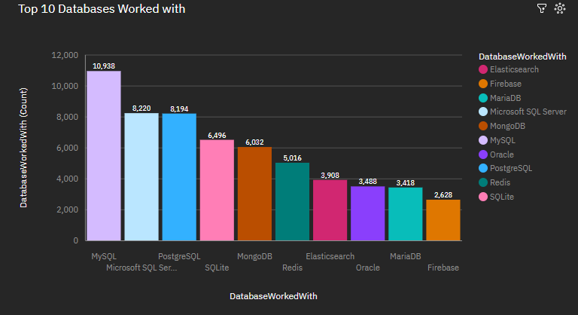
Database Trends This Year

Slide 11
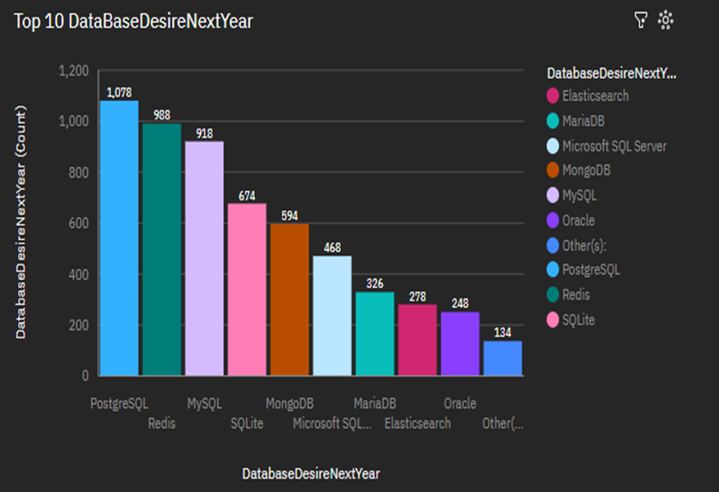
Database Trends Next Year

Slide 12
DATABASE TRENDS
Current Year
Next Year
Top 10 Databases Worked With:
The column chart showed the databases most frequently used by developers.
Popular choices included MySQL, PostgreSQL, and SQLite.
Top 10 Databases Desired Next Year:
The column chart depicted the databases developers were keen to work with next year, showing interest in PostgreSQL and MongoDB.Plat

Slide 13
DATABASE TRENDS - FINDINGS & IMPLICATIONS
Current Trends
Top Databases:
Relational: MySQL and PostgreSQL are popular for their reliability and open-source benefits.
NoSQL: MongoDB is favored for flexibility and scalability in web/mobile apps.
Usage Factors:
Performance: High performance and scalability are crucial for database selection.
Future Trends
Emerging Databases:
Cloud-Based: Amazon DynamoDB and Google Firebase are increasingly popular for easy integration.
Graph Databases: Neo4j is gaining traction for complex relational data.
Desired Features:
AI Integration: Databases with analytics and AI integration are in demand.
Implications:
For Developers:
Understanding the strengths and limitations of both SQL and NoSQL databases is crucial for designing scalable and efficient applications.
Familiarity with cloud-based and specialized databases can provide a competitive edge in the job market.
For the Industry:
A shift towards cloud-native databases is likely, driven by the need for scalability and flexibility.
The increasing focus on data security and privacy may influence database development and adoption patterns, emphasizing secure access and encryption.

Slide 14

DASHBOARD
GitHub Link of the Cognos Dashboard :-
https://github.com/AmandeepRandhawa/Dashboard/blob/main/_%20New%20dashboard.pdf.

Slide 15
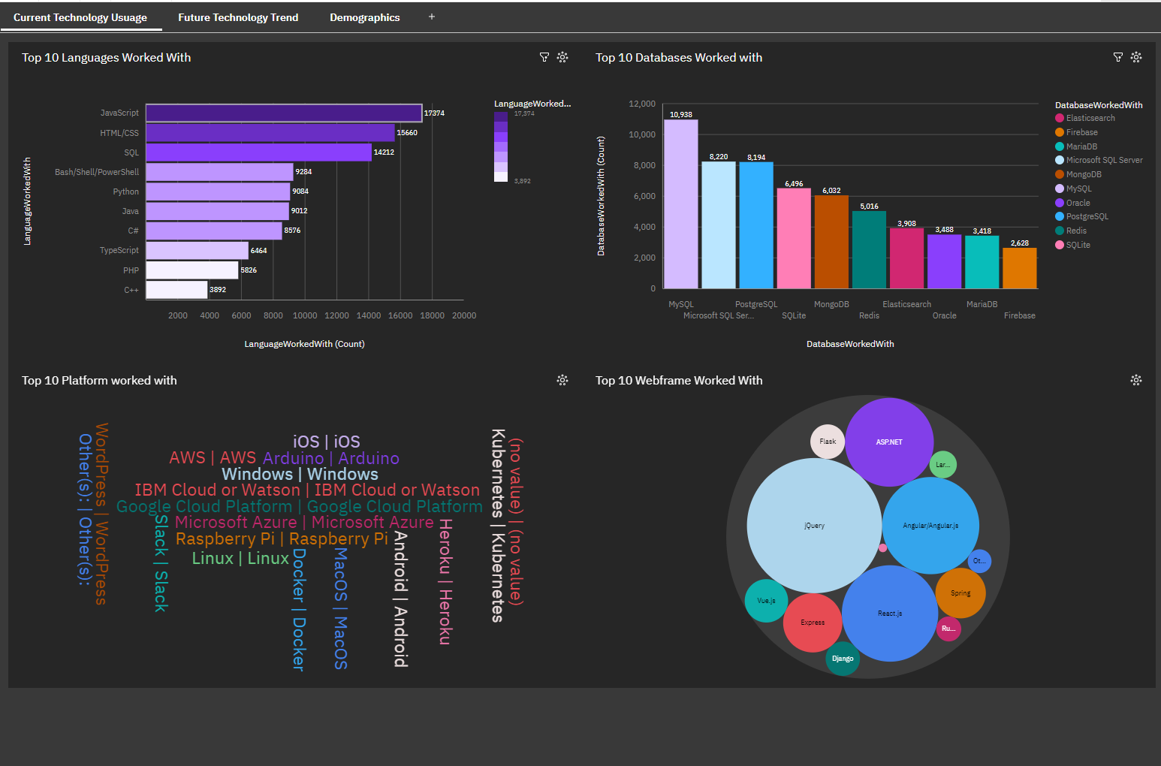
DASHBOARD TAB 1

Slide 16
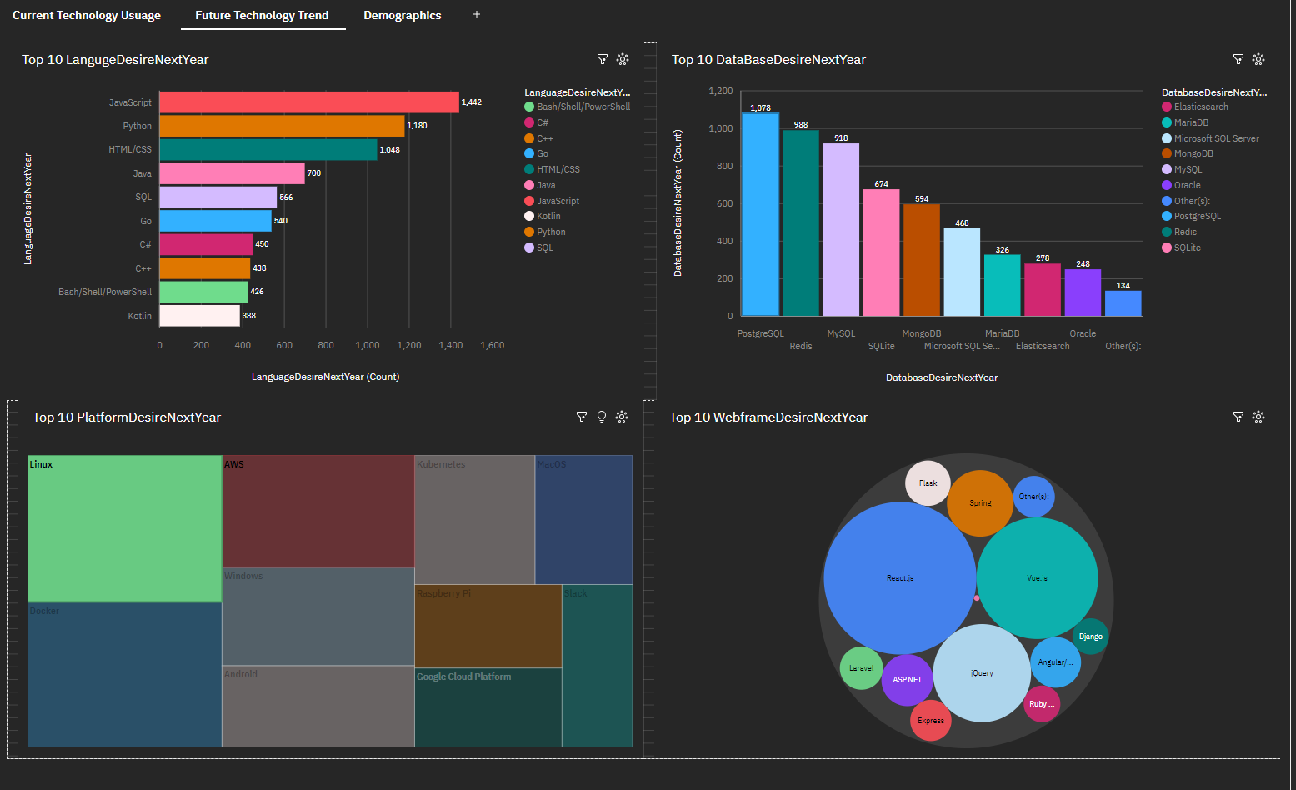
DASHBOARD TAB 2

Slide 17
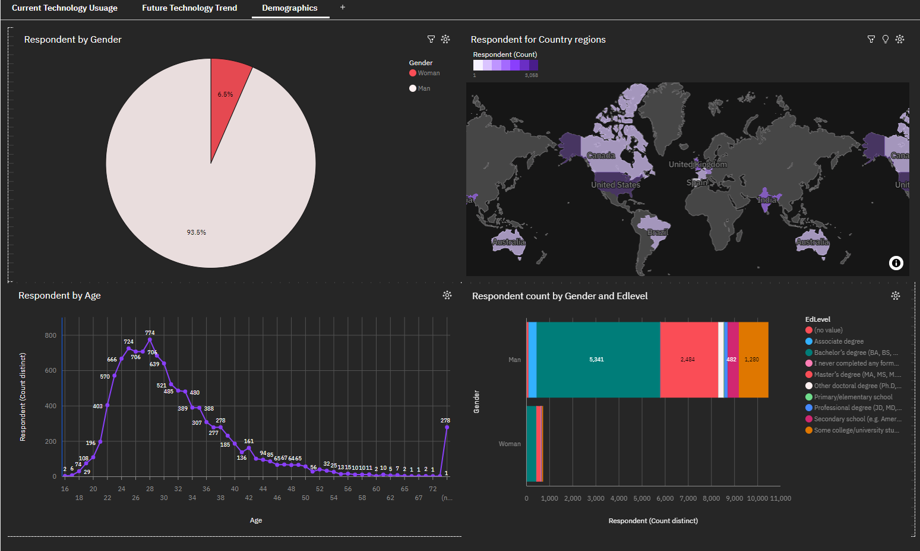
DASHBOARD TAB 3

Slide 18
DISCUSSION
Technology Trends and Preferences:
Current Usage vs. Future Trends:
Comparing the "Top 10 Languages Worked With" and "Top 10 Languages Desired Next Year" can reveal shifts in technology preferences. For instance, which languages or platforms are expected to grow in popularity, and which are declining?
Database Trends:
Similar comparisons for databases can be discussed. Why are certain databases like PostgreSQL and Redis increasingly desired compared to others?
Platform Preferences:
The trends in platform usage and future desires, such as the rise of cloud platforms (e.g., Google Cloud Platform, AWS) and Linux, can indicate where the industry might be headed.
Demographic Insights:
Gender Distribution: Discuss the implications of the gender distribution in the data. What does the high percentage of men in the dataset imply, and how does it relate to the broader tech industry?
Geographical Distribution: The dashboard includes a map showing respondents by country or region. This can lead to a discussion on global trends and regional differences in technology usage.
Education Levels:
The correlation between education levels and technology usage might be another point of interest. For example, how does the level of education correlate with the types of technologies used or desired?
Filters and Data Segmentation:
Impact of Filters: The impact of the filters applied (e.g., focusing on SQLite in databases, Linux in platforms) could be discussed to ensure the audience understands the context of the data presented.

Slide 19
OVERALL FINDINGS & IMPLICATIONS
Technology Adoption Trends:
Languages: JavaScript, Python, and HTML/CSS are leading in both current usage and future interest, indicating their continued dominance in the software development landscape.
Databases: MySQL and PostgreSQL are popular, with an increasing desire for PostgreSQL in the future, suggesting a trend towards open-source and flexible database solutions.
Platforms: Linux and Docker show strong current usage and are highly desired for future work, highlighting a shift towards containerization and open-source environments.
Demographic Insights:
Gender Disparity: The significant gender imbalance (with a high percentage of male respondents) suggests a need for more inclusive practices in the tech industry to encourage diversity.
Geographical Distribution: The wide distribution of respondents across various regions can offer insights into regional trends and potential markets for technology adoption.
Implications:
For Technology Providers:
There’s a clear demand for tools and technologies that integrate well with popular languages and platforms like JavaScript, Python, and Docker. Providers should focus on enhancing support and features for these technologies.
For Companies and Employers:
The preference for open-source technologies such as PostgreSQL and Linux indicates that companies might benefit from investing in training and infrastructure that support these technologies.
The gender disparity highlighted in the data suggests the need for initiatives aimed at fostering a more diverse workforce in technology roles.
For Educators and Trainers:
The insights into desired technologies for the next year can help in tailoring curricula to meet future industry demands, ensuring that graduates are proficient in the most sought-after skills.

Slide 20

CONCLUSION
Continued Dominance of Key Technologies: JavaScript, Python, and Docker remain essential in current and future tech landscapes, underscoring their importance in development and operations.
Emerging Preferences: A growing interest in PostgreSQL and Linux highlights a trend towards open-source and flexible solutions, which could shape future technology strategies.
Demographic Challenges: The gender disparity in tech suggests a pressing need for more diversity and inclusion initiatives within the industry.
Strategic Implications:
Focus on Innovation: Organizations should prioritize innovation in the tools and technologies that are most widely adopted and desired by professionals.
Prepare for the Future: Invest in training and infrastructure that align with emerging trends, particularly in open-source platforms and databases.
Promote Diversity: Address the gender gap through targeted recruitment, mentorship, and educational programs to build a more inclusive tech community.

Slide 21

APPENDIX
Additional Visualizations:Charts or graphs that were not included in the main presentation due to time constraints but provide further insights or support the conclusions.

Slide 22
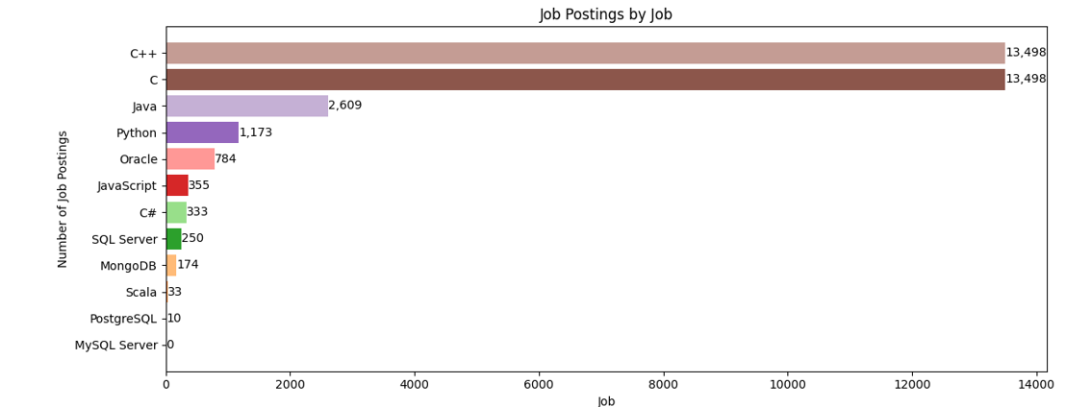
JOB POSTINGS

Slide 23
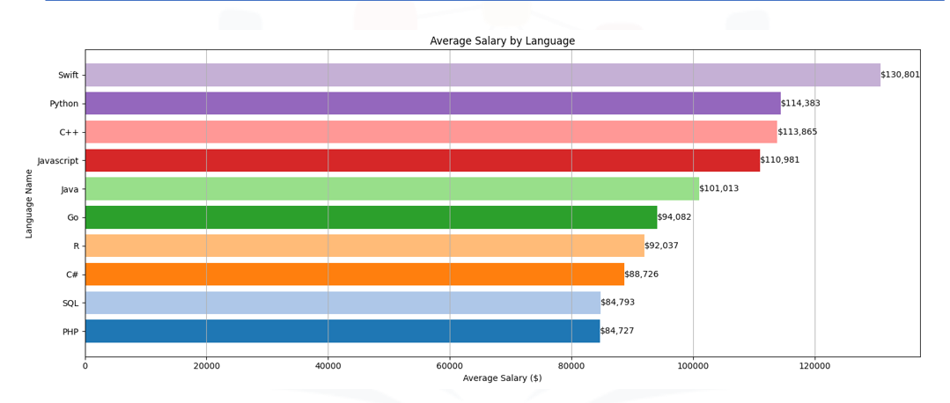
POPULAR LANGUAGES

