Slide 1

Ontario Library Financial Analysis
Revenue Efficiency Insights (2006–2010)

Slide 2

Overview
This analysis explores public library financial performance across Ontario from 2006 to 2010.
Key focus: Revenue efficiency, funding impacts, and trends across different population sizes.

Slide 3
Key Metrics & Methods
- Revenue per Cardholder calculated annually
- Population grouped into Small, Medium, Large
- Outlier filtering applied for RevPerCardholder > $2,500
- Tools used: R, dplyr, ggplot2, heatmaps

Slide 4

Insight 1: Local Grant vs. Revenue
• Weak correlation (≈ 0.012) between Local Operating Grants and Revenue per Cardholder.
• Indicates funding does not directly predict revenue efficiency.
• Bubble plots used for multi-variable visualization.

Slide 5
Insight 2: Population Group Trends
• Boxplots show yearly revenue distribution by Small, Medium, and Large groups.
• Small libraries show greater variance.
• Larger libraries tend to maintain stable RevPerCardholder over time.

Slide 6
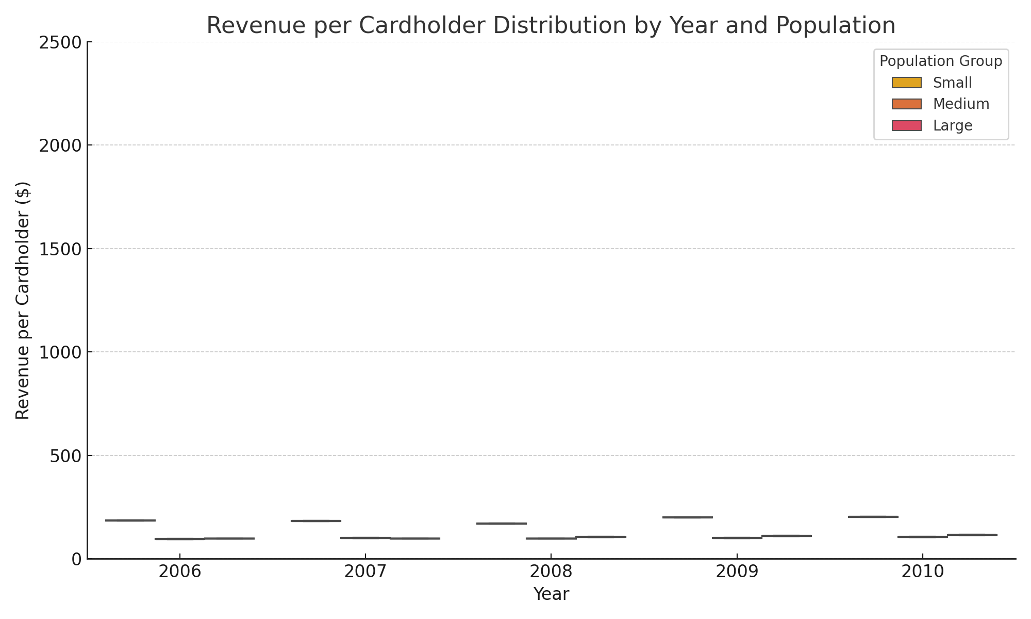
Boxplot: Revenue per Cardholder by Year & Population

Slide 7
Conclusion
Revenue efficiency (RevPerCardholder) showed minimal correlation with local funding, suggesting that funding alone doesn’t guarantee performance.
Libraries in larger population areas maintained more consistent revenue metrics, indicating scalability and stability advantages.
Smaller libraries faced greater variability, pointing to potential resource or access disparities.
These insights can inform targeted policy support, optimized funding strategies, and performance benchmarking across Ontario’s library systems.

