Slide 1



ecom
View in Power BI
Last data refresh:
5/24/2026 1:14:44 PM UTC
Downloaded at:
5/25/2026 7:12:17 PM UTC

Slide 2
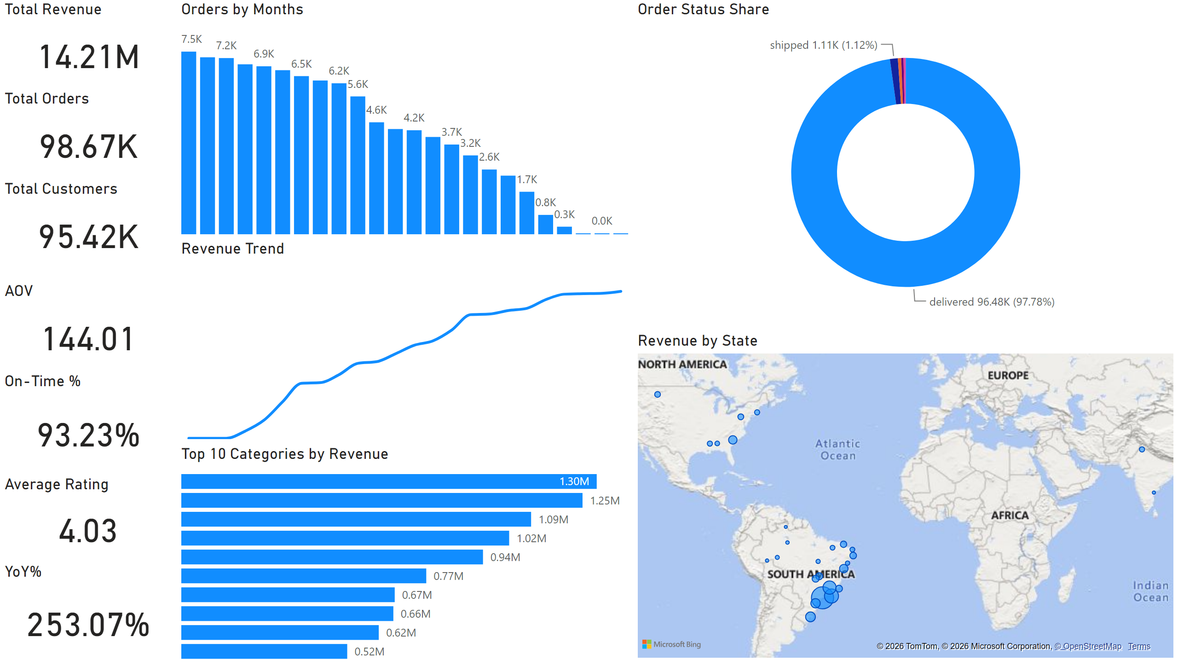
Overview (Executive Dashboard)
Notes:
Total Revenue
No alt text provided
Total Orders
No alt text provided
Total Customers
No alt text provided
AOV
No alt text provided
On-Time %
No alt text provided
Average Rating
No alt text provided
YoY%
No alt text provided
Revenue Trend
No alt text provided
Orders by Months
No alt text provided
Top 10 Categories by Revenue
No alt text provided
Revenue by State
No alt text provided
Order Status Share
No alt text provided

Slide 3
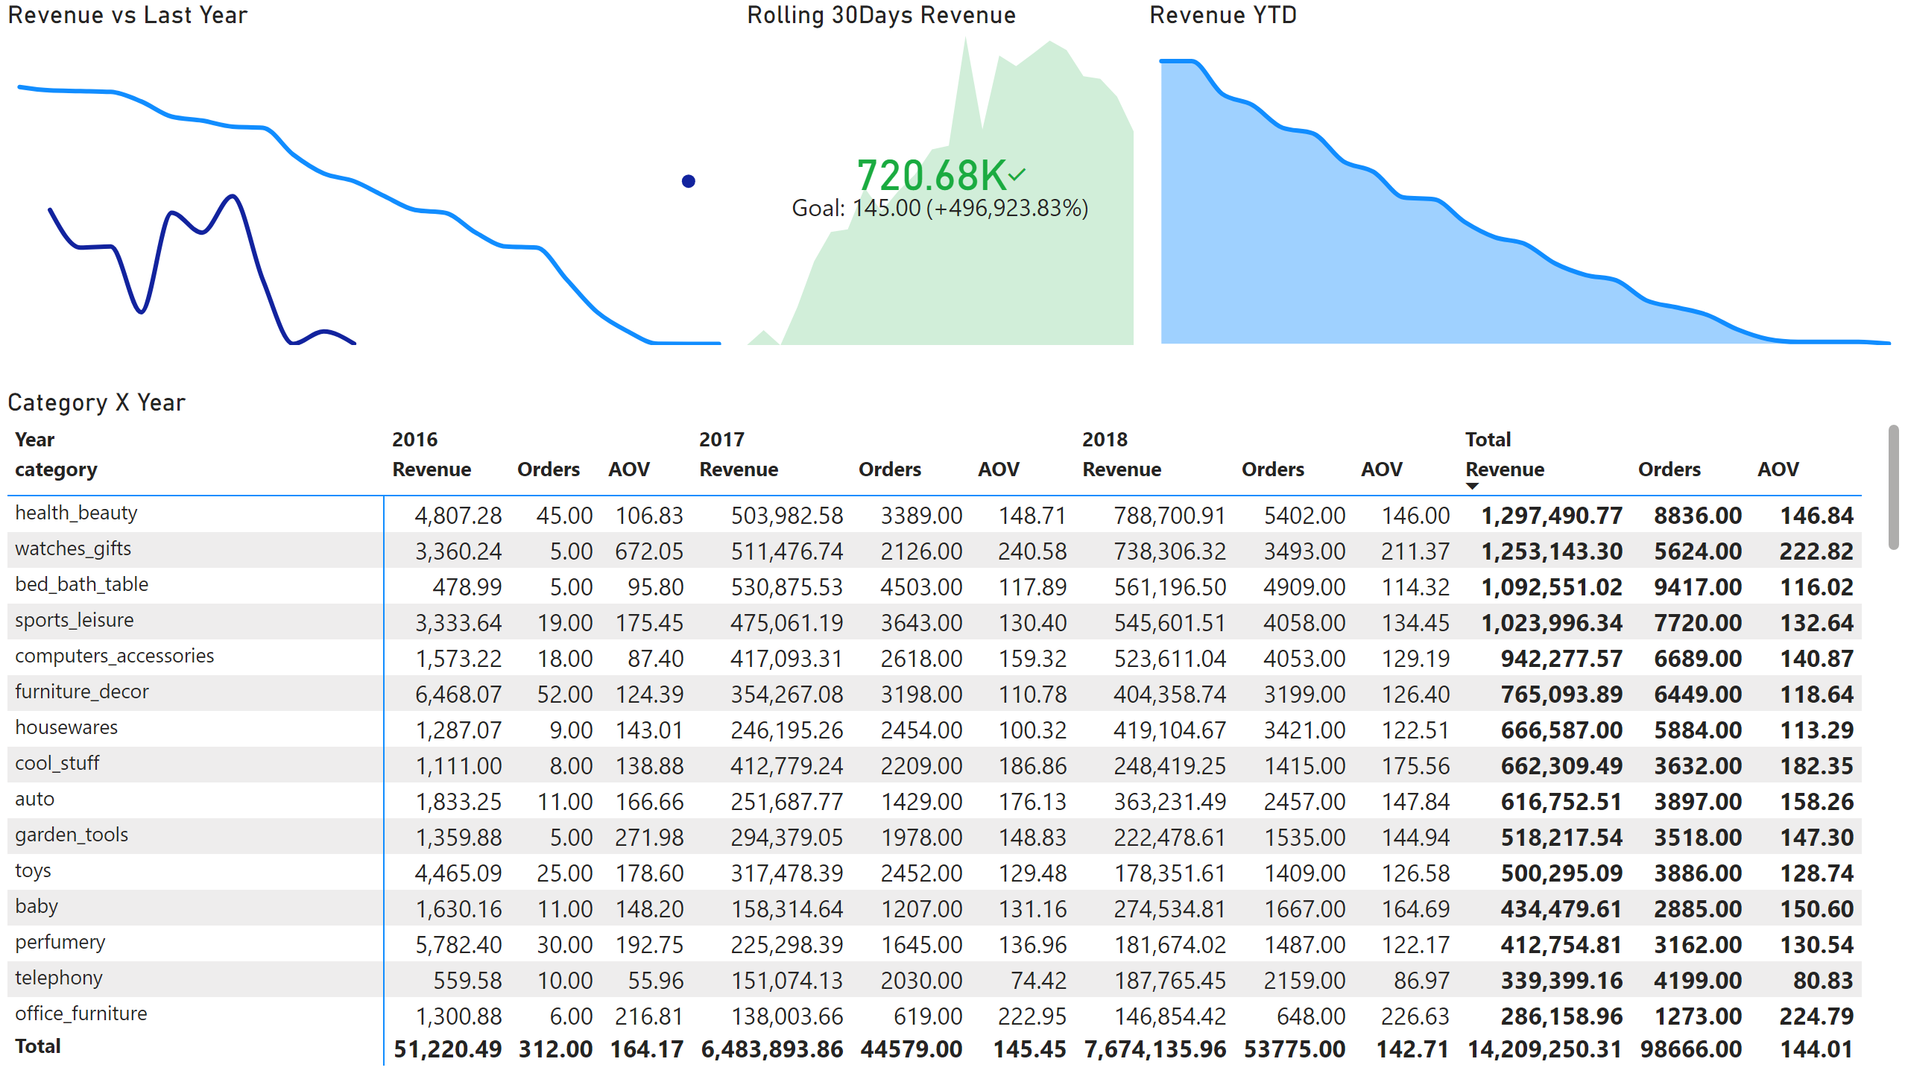
Sales Trends
Notes:
Revenue vs Last Year
No alt text provided
Rolling 30Days Revenue
No alt text provided
Revenue YTD
No alt text provided
Category X Year
No alt text provided

Slide 4
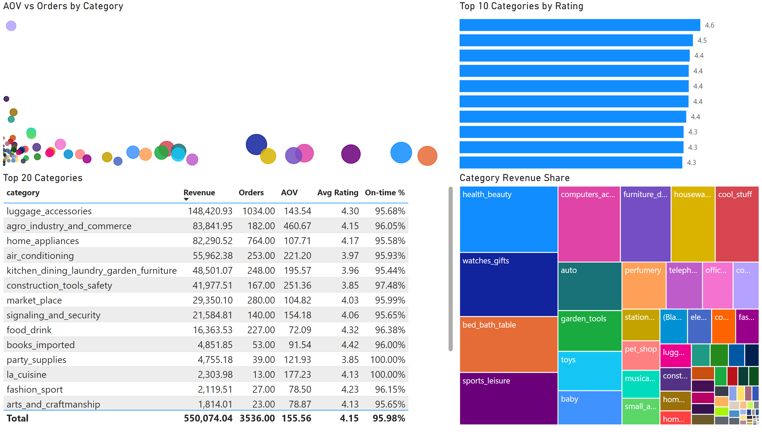
Category & Product
Notes:
Category Revenue Share
No alt text provided
AOV vs Orders by Category
No alt text provided
Top 10 Categories by Rating
No alt text provided
Top 20 Categories
No alt text provided

Slide 5
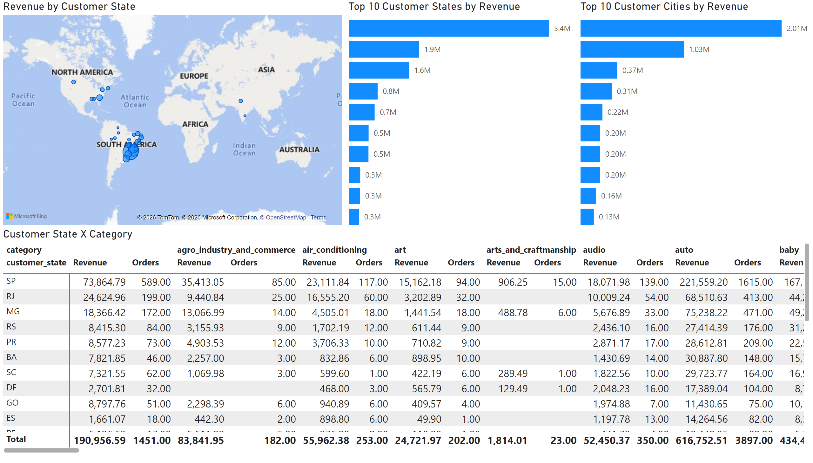
Customer Geo
Notes:
Revenue by Customer State
No alt text provided
Top 10 Customer States by Revenue
No alt text provided
Customer State X Category
No alt text provided
Top 10 Customer Cities by Revenue
No alt text provided

Slide 6
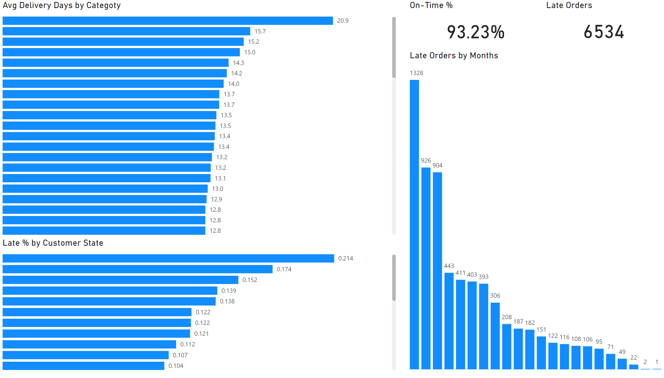
Delivery & Logistics
Notes:
Late Orders
No alt text provided
On-Time %
No alt text provided
Late Orders by Months
No alt text provided
Avg Delivery Days by Categoty
No alt text provided
Late % by Customer State
No alt text provided

Slide 7
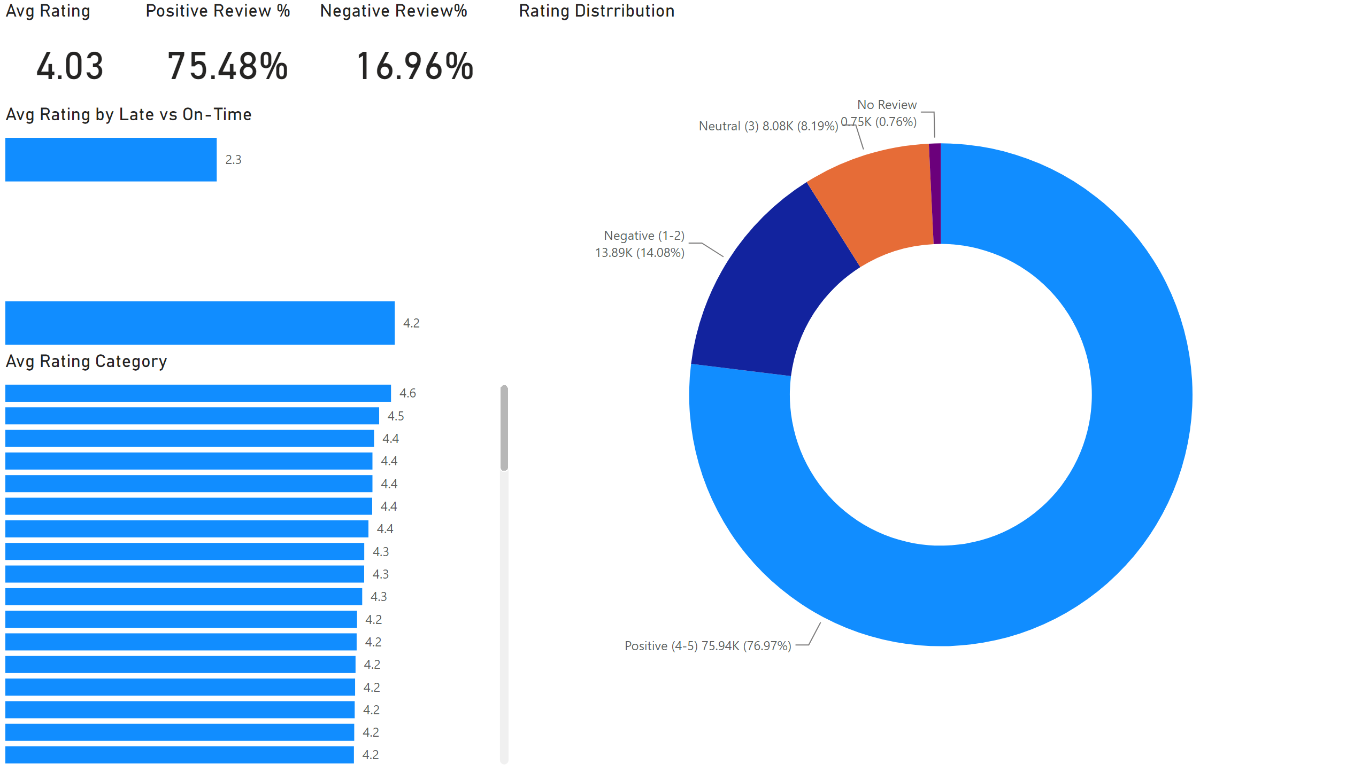
Reviews
Notes:
Avg Rating
No alt text provided
Negative Review%
No alt text provided
Positive Review %
No alt text provided
Rating Distrribution
No alt text provided
Avg Rating by Late vs On-Time
No alt text provided
Avg Rating Category
No alt text provided

Slide 8
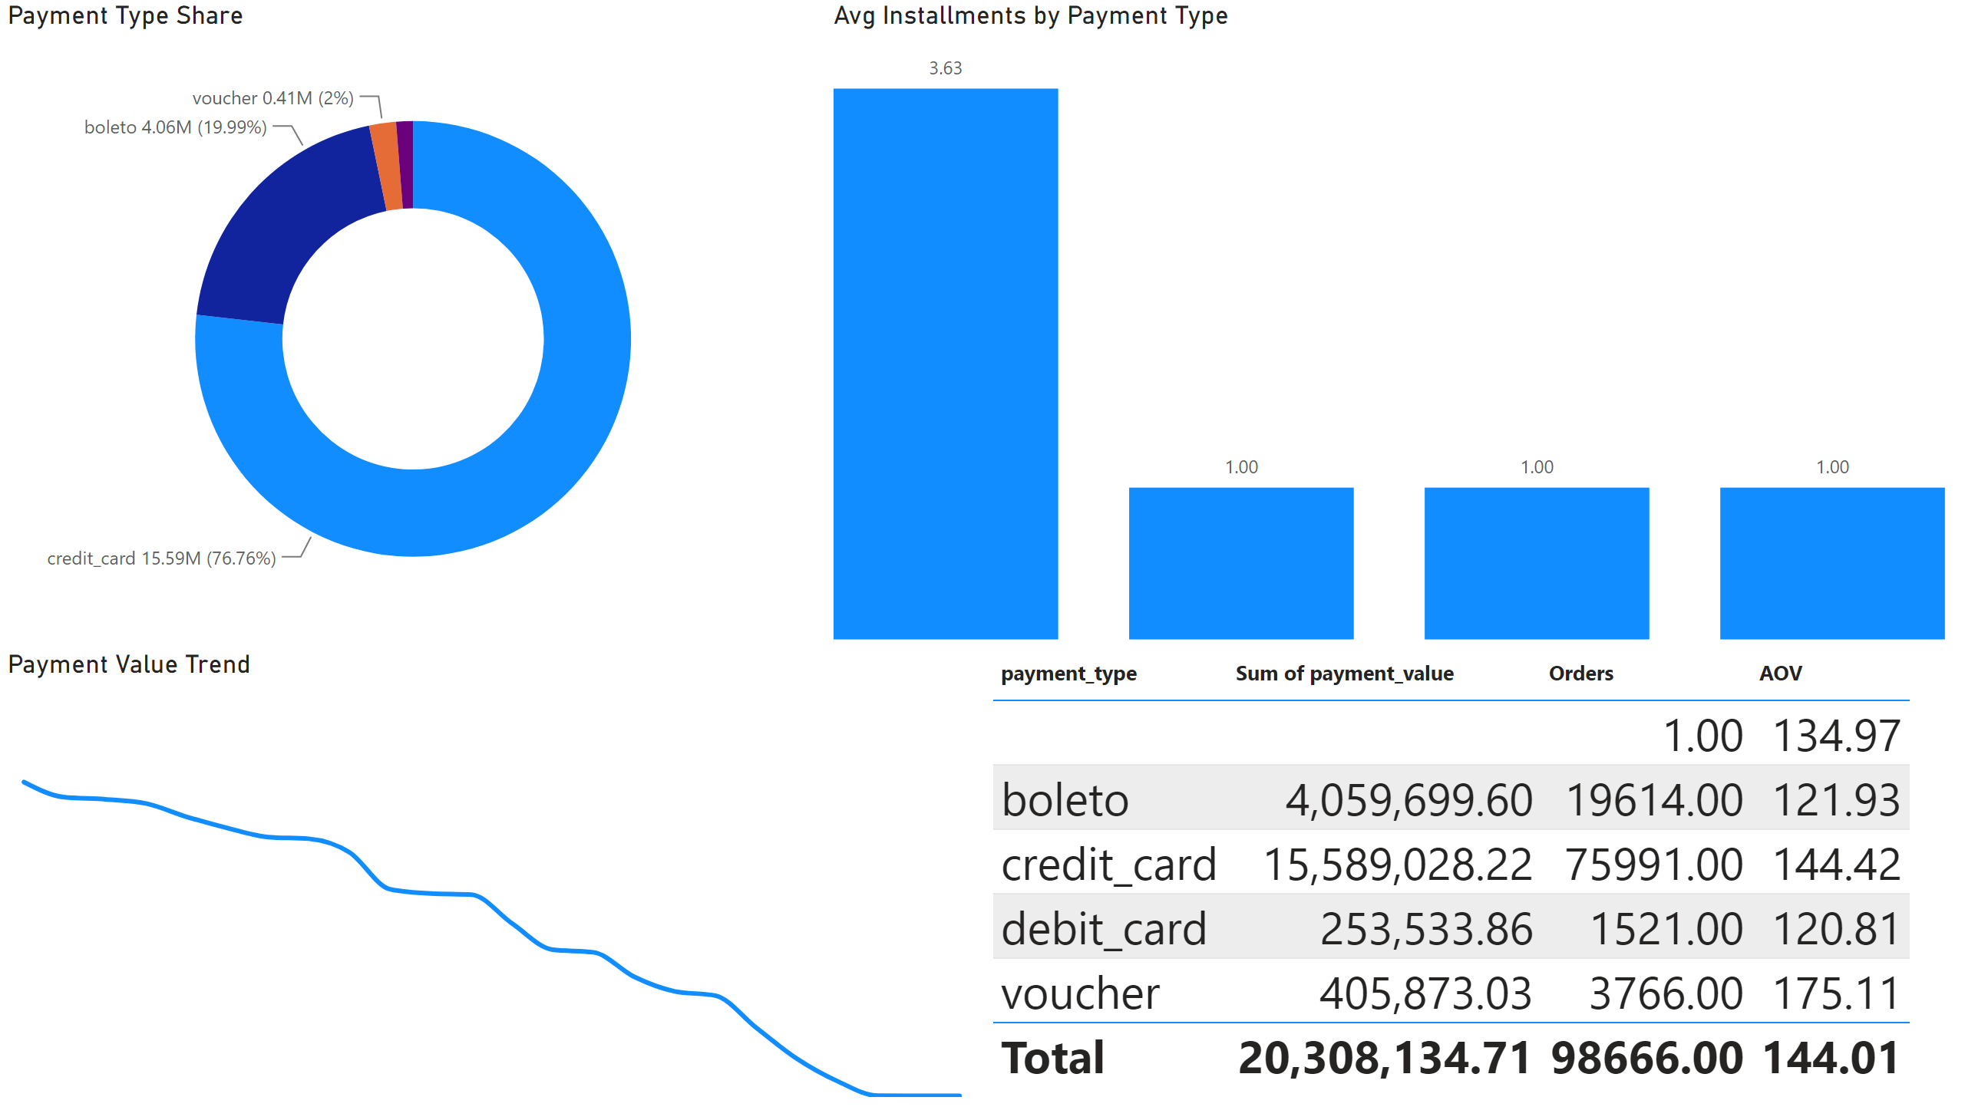
Payments
Notes:
Payment Type Share
No alt text provided
Avg Installments by Payment Type
No alt text provided
Payment Value Trend
No alt text provided
Top 20 Categories
No alt text provided

Slide 9
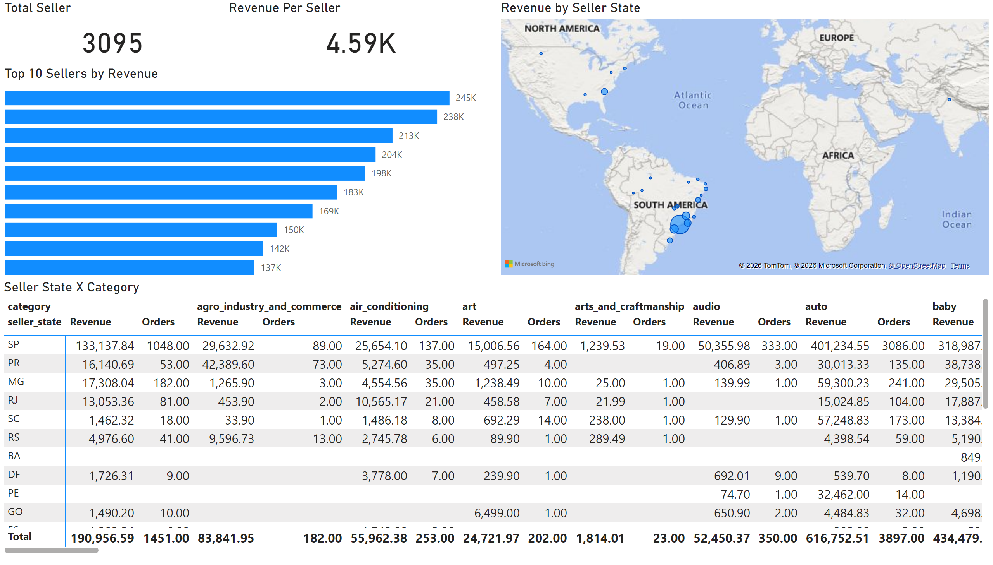
Seller
Notes:
Total Seller
No alt text provided
Revenue Per Seller
No alt text provided
Revenue by Seller State
No alt text provided
Top 10 Sellers by Revenue
No alt text provided
Seller State X Category
No alt text provided

Slide 10
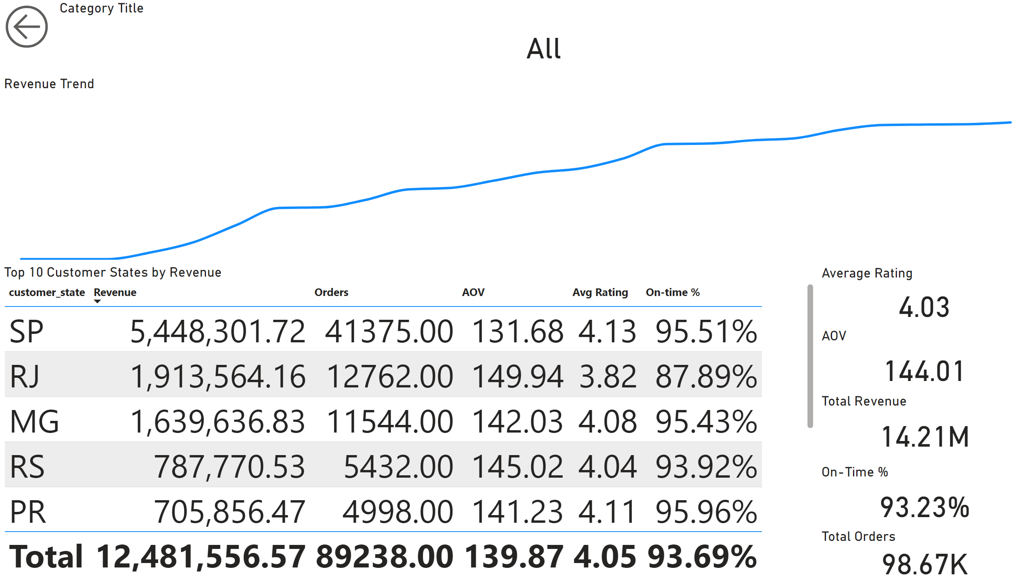
Drillthrough
Notes:
actionButton
No alt text provided
Category Title
No alt text provided
Total Revenue
No alt text provided
Total Orders
No alt text provided
AOV
No alt text provided
Average Rating
No alt text provided
On-Time %
No alt text provided
Revenue Trend
No alt text provided
Top 10 Customer States by Revenue
No alt text provided

