Slide 1



ride
View in Power BI
Last data refresh:
5/25/2026 11:34:14 AM UTC
Downloaded at:
5/25/2026 7:07:55 PM UTC

Slide 2
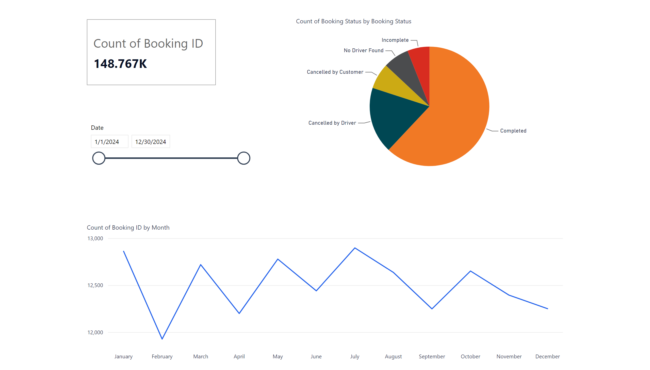
Overall
Notes:
lineChart
No alt text provided
pieChart
No alt text provided
cardVisual
No alt text provided
slicer
No alt text provided

Slide 3
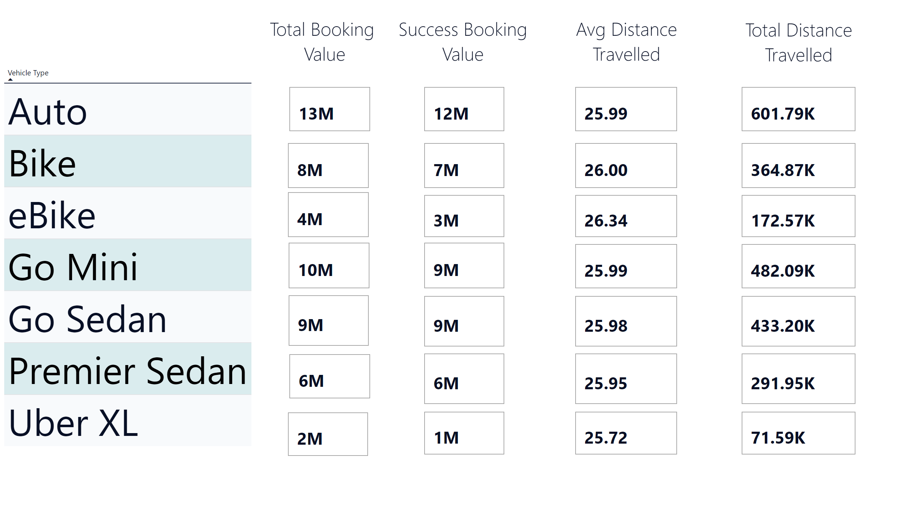
Vehicle Type
Notes:
tableEx
No alt text provided
textbox
No alt text provided
textbox
No alt text provided
textbox
No alt text provided
textbox
No alt text provided
cardVisual
No alt text provided
cardVisual
No alt text provided
cardVisual
No alt text provided
cardVisual
No alt text provided
cardVisual
No alt text provided
cardVisual
No alt text provided
cardVisual
No alt text provided
cardVisual
No alt text provided
cardVisual
No alt text provided
cardVisual
No alt text provided
cardVisual
No alt text provided
cardVisual
No alt text provided
cardVisual
No alt text provided
cardVisual
No alt text provided
cardVisual
No alt text provided
cardVisual
No alt text provided
cardVisual
No alt text provided
cardVisual
No alt text provided
cardVisual
No alt text provided
cardVisual
No alt text provided
cardVisual
No alt text provided
cardVisual
No alt text provided
cardVisual
No alt text provided
cardVisual
No alt text provided
cardVisual
No alt text provided
cardVisual
No alt text provided
cardVisual
No alt text provided
cardVisual
No alt text provided

Slide 4
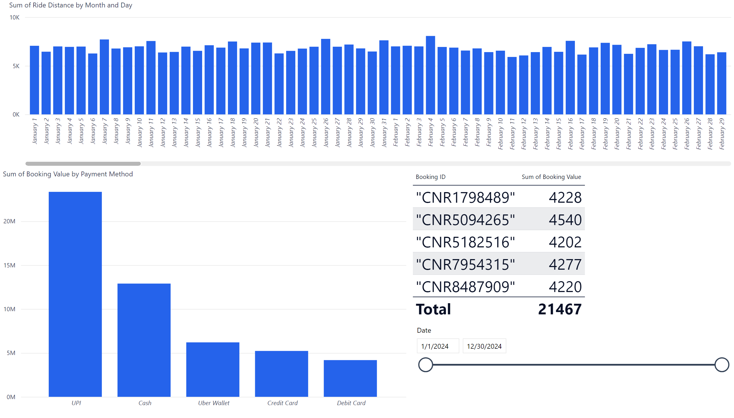
Revenue
Notes:
columnChart
No alt text provided
columnChart
No alt text provided
slicer
No alt text provided
tableEx
No alt text provided

Slide 5
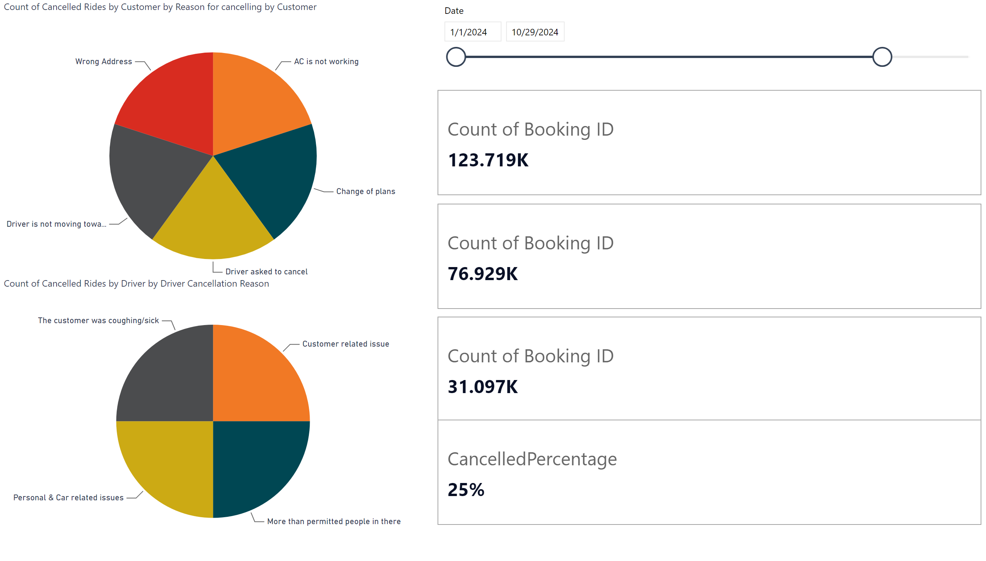
Cancellation
Notes:
pieChart
No alt text provided
pieChart
No alt text provided
slicer
No alt text provided
cardVisual
No alt text provided
cardVisual
No alt text provided
cardVisual
No alt text provided
cardVisual
No alt text provided

Slide 6
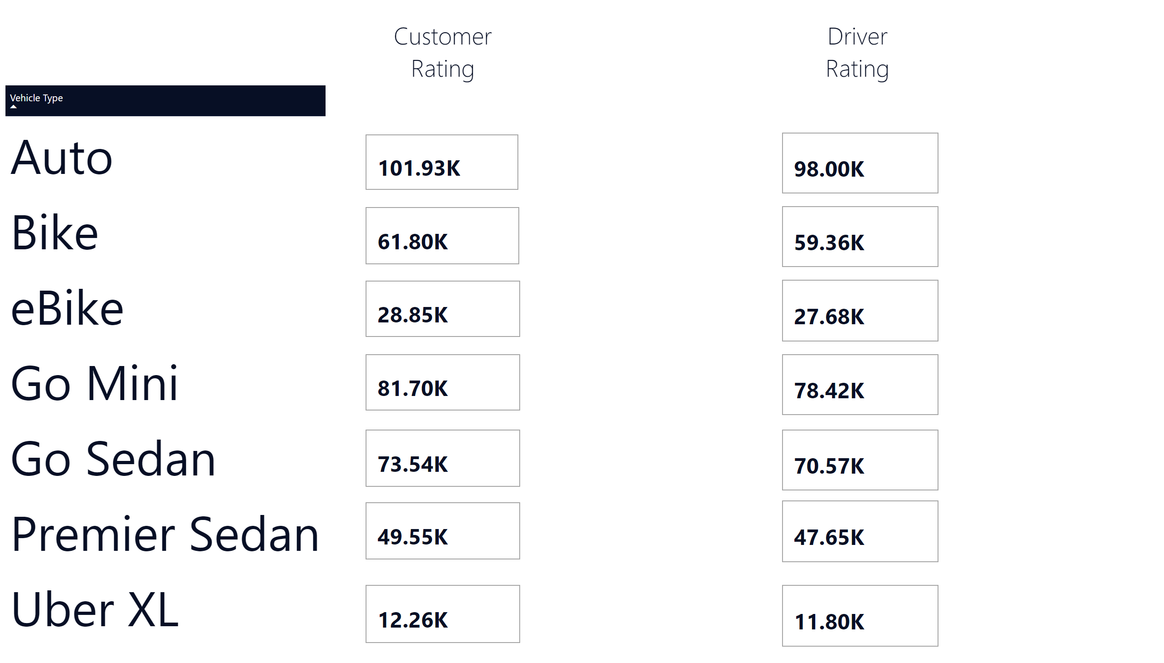
Ratings
Notes:
tableEx
No alt text provided
textbox
No alt text provided
textbox
No alt text provided
cardVisual
No alt text provided
cardVisual
No alt text provided
cardVisual
No alt text provided
cardVisual
No alt text provided
cardVisual
No alt text provided
cardVisual
No alt text provided
cardVisual
No alt text provided
cardVisual
No alt text provided
cardVisual
No alt text provided
cardVisual
No alt text provided
cardVisual
No alt text provided
cardVisual
No alt text provided
cardVisual
No alt text provided
cardVisual
No alt text provided

Slide 7
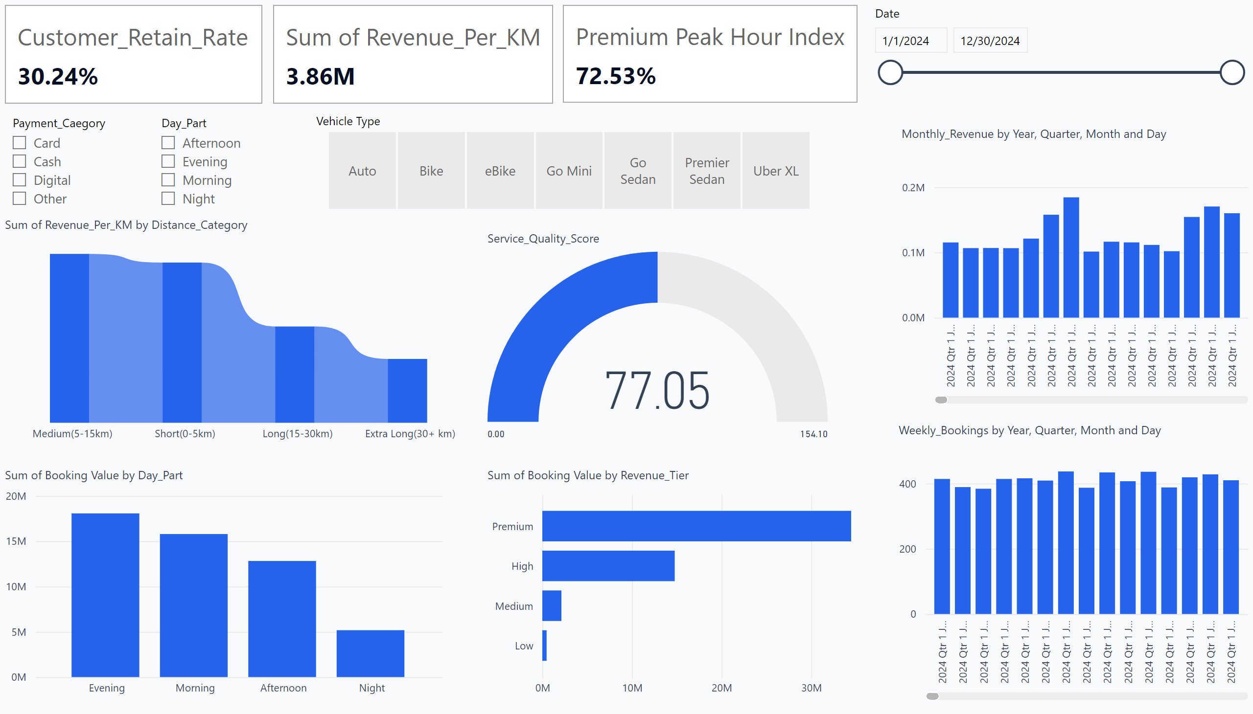
Summary
Notes:
gauge
No alt text provided
cardVisual
No alt text provided
cardVisual
No alt text provided
cardVisual
No alt text provided
clusteredColumnChart
No alt text provided
clusteredBarChart
No alt text provided
ribbonChart
No alt text provided
lineStackedColumnComboChart
No alt text provided
lineClusteredColumnComboChart
No alt text provided
slicer
No alt text provided
slicer
No alt text provided
slicer
No alt text provided
slicer
No alt text provided

