Slide 1
Saviom
Amandeep Kaur(748434)

Slide 2
Resource planning tool
Success of business is depends upon how accurately resources are used.
It has various stages like planning,scheduling and management of resources.
For example: saviom , eresources ,resource Guru etc.

Slide 3
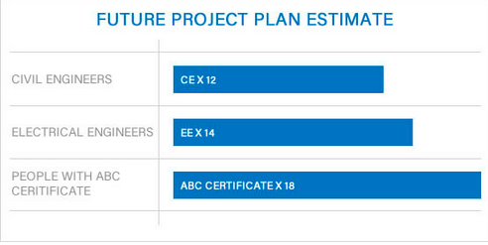
Features
Calculate shortage and needless resources in advance to insure success.

Slide 4
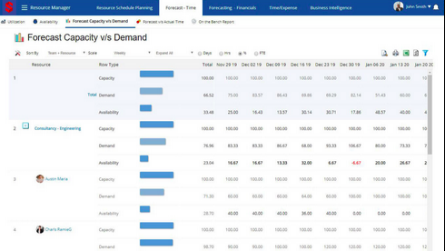
Matching resource with future demand
Establish a link between resource capacity and customer requirements.

Slide 5
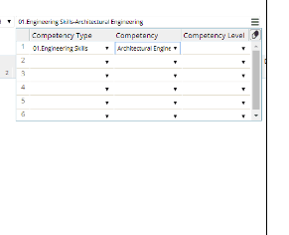
Perfect resource for task.
Employees:education,experience and skills.
Materials

Slide 6
Advantages
Cost effective.
Overall view of work type and utilization.
Reduce risk.

Slide 7
References
Saviom,Enterprise resource management, https://www.saviom.com/resource-planning-adwords.php?callFor=Tour&ActionType=AWERMRPAV&gclid=EAIaIQobChMIsMHg_9jl5wIVl-NkCh0VFghcEAAYASAAEgKoufD_BwE

