Slide 1
BlablaMove – POC
Billing Variant
Toutain Xavier – Meersman Rudy – Fornali Damien - Benza Amandine

Slide 2
1.
USE CASES

Slide 3




Use Cases
Bob, the guy who wants to move
Bob is a lambda student who needs to move from Nice to Sophia. Since Bob is a smart guy, he will use BlablaMove to do that.
Alice, the nice girl who will help Bob to move
Like Bob, Alice is a student. She goes in car to Sophia everyday and she decides to create an account on BlablaMove, to help others students to move.

Slide 4
2.
REALISATION

Slide 5





Realisation
Web Service
Roads
Billing
Users
Offers

Slide 6
3.
ARCHITECTURE OVERVIEW

Slide 7
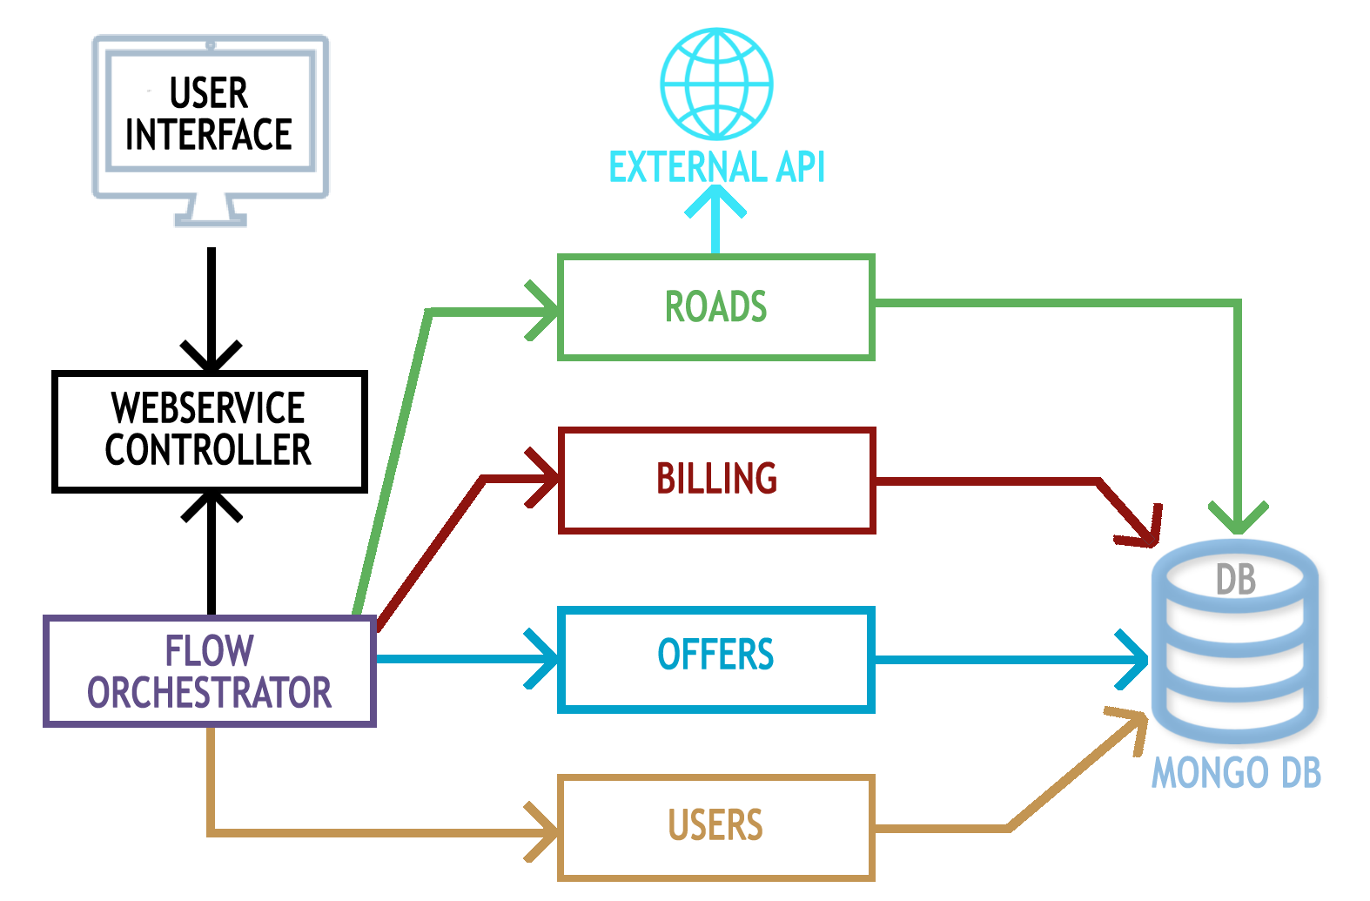
Architecture Overview

Slide 8

4.
TECHNOLOGICAL
CHOICES

Slide 9




Technological Choices
Java – SpringBoot
NoSQL – Mongo
Docker

Slide 10
5.
LIVE
DEMO

Slide 11
6.
WORK DISTRIBUTION

Slide 12
Work Distribution
Xavier
Offers
Roads
Database establishment
Rudy
Billing
Scripts
Damien
Users
Testing
Amandine
Internal Communication
Logging

Slide 13
7.
PLANNING

Slide 14
Planning
Complexify Billing business logic
User Identification
Small User Interface
Implementation of additional scenarios
Load tests

Slide 15
THANK YOU!

