Slide 1
BlablaMove – POC
Billing Variant
Toutain Xavier – Meersman Rudy – Fornali Damien - Benza Amandine

Slide 2
1.
ARCHITECTURE OVERVIEW

Slide 3
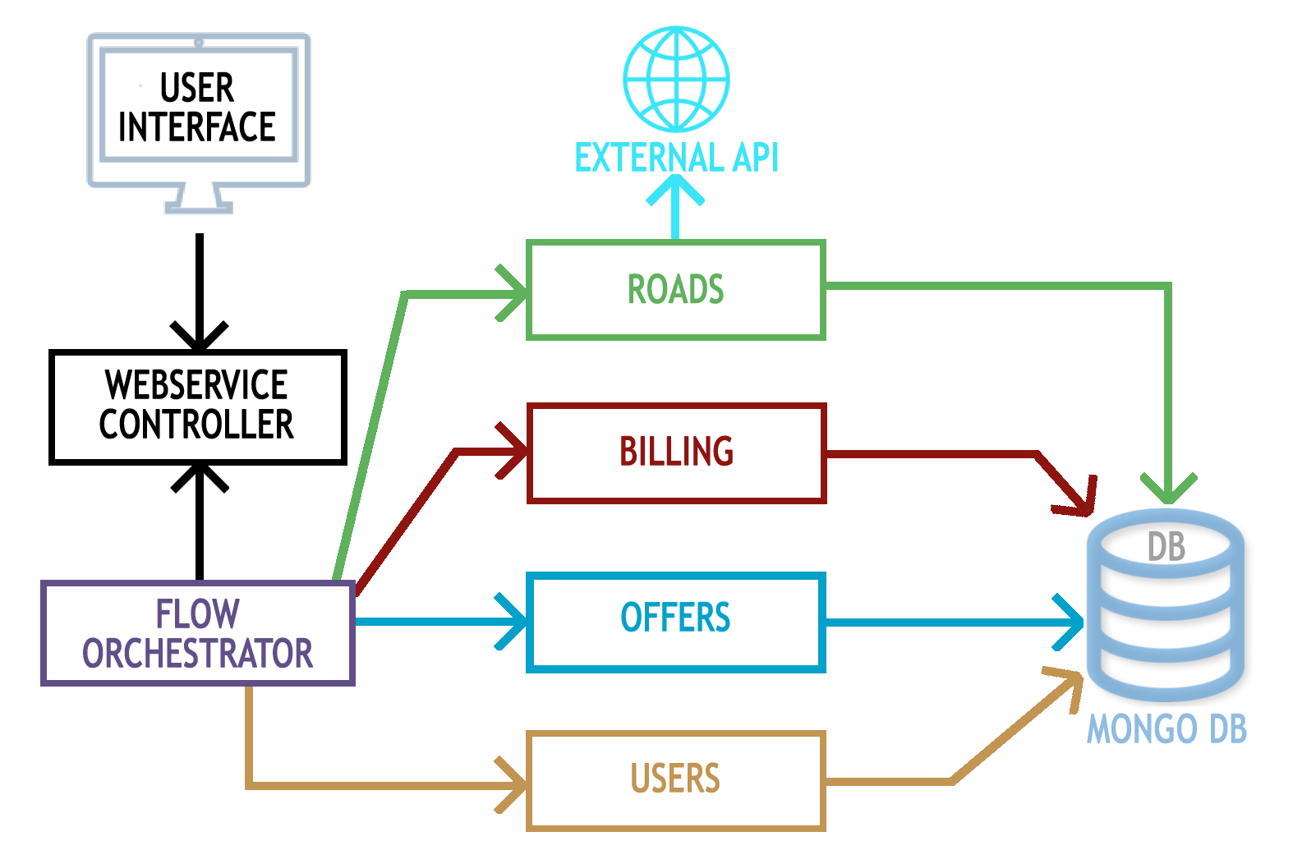
Architecture Overview

Slide 4

2.
TECHNOLOGICAL
CHOICES

Slide 5




Technological Choices
Java - Springboot
Mongo Database
Docker

Slide 6
3.
USE CASES

Slide 7




Use Cases
Bob, the guy who wants to move
Bob is a lambda student who needs to move from Nice to Sophia. Since Bob is a smart guy, he will use BlablaMove to do that.
Alice, the nice girl who will help Bob to move
Like Bob, Alice is a student. She goes in car to Sophia everyday and she decides to create an account on BlablaMove, to help others students to move.

Slide 8
4.
LIVE
DEMO

Slide 9
5.
WORK DISTRIBUTION

Slide 10
Work Distribution
Xavier
Offers
Database establishment
Rudy
Billing
Scripts
Damien
Users
Testing
Amandine
Internal Communication
Logging

Slide 11
6.
PLANNING

Slide 12
Planning

Slide 13
THANK YOU!

