Slide 1

BlablaMove - Oral defense
Billing Variant
Toutain Xavier – Meersman Rudy – Fornali Damien - Benza Amandine

Slide 2
1.
CHANGES IMPOSED BY
THE CLIENT

Slide 3

Changes imposed by the client
Hackers are trying to destroy BlablaMove's billing !
Need to secure the system
Ensure data consistency
Ensure that the transactions are successfully completed
1
2
3
4

Slide 4
2.
REALISATION

Slide 5





Realisation
01
Users
Billing
Offers
Roads
Integrity
Web Service

Slide 6
Focus on Integrity
Journaling System
DDOS Prevention
Exception System
Transactional Database
1
2
3
4

Slide 7

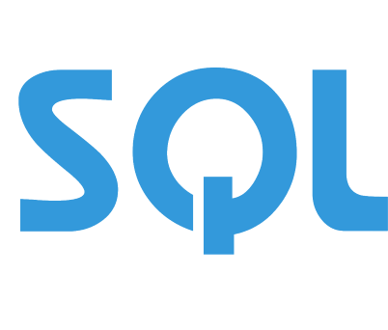
Focus on the new database
1
From NoSQL to SQL
Limited impact on the architecture
Transactional handling
Ensure data consistency
2
3
4

Slide 8
3.
ARCHITECTURE OVERVIEW

Slide 9
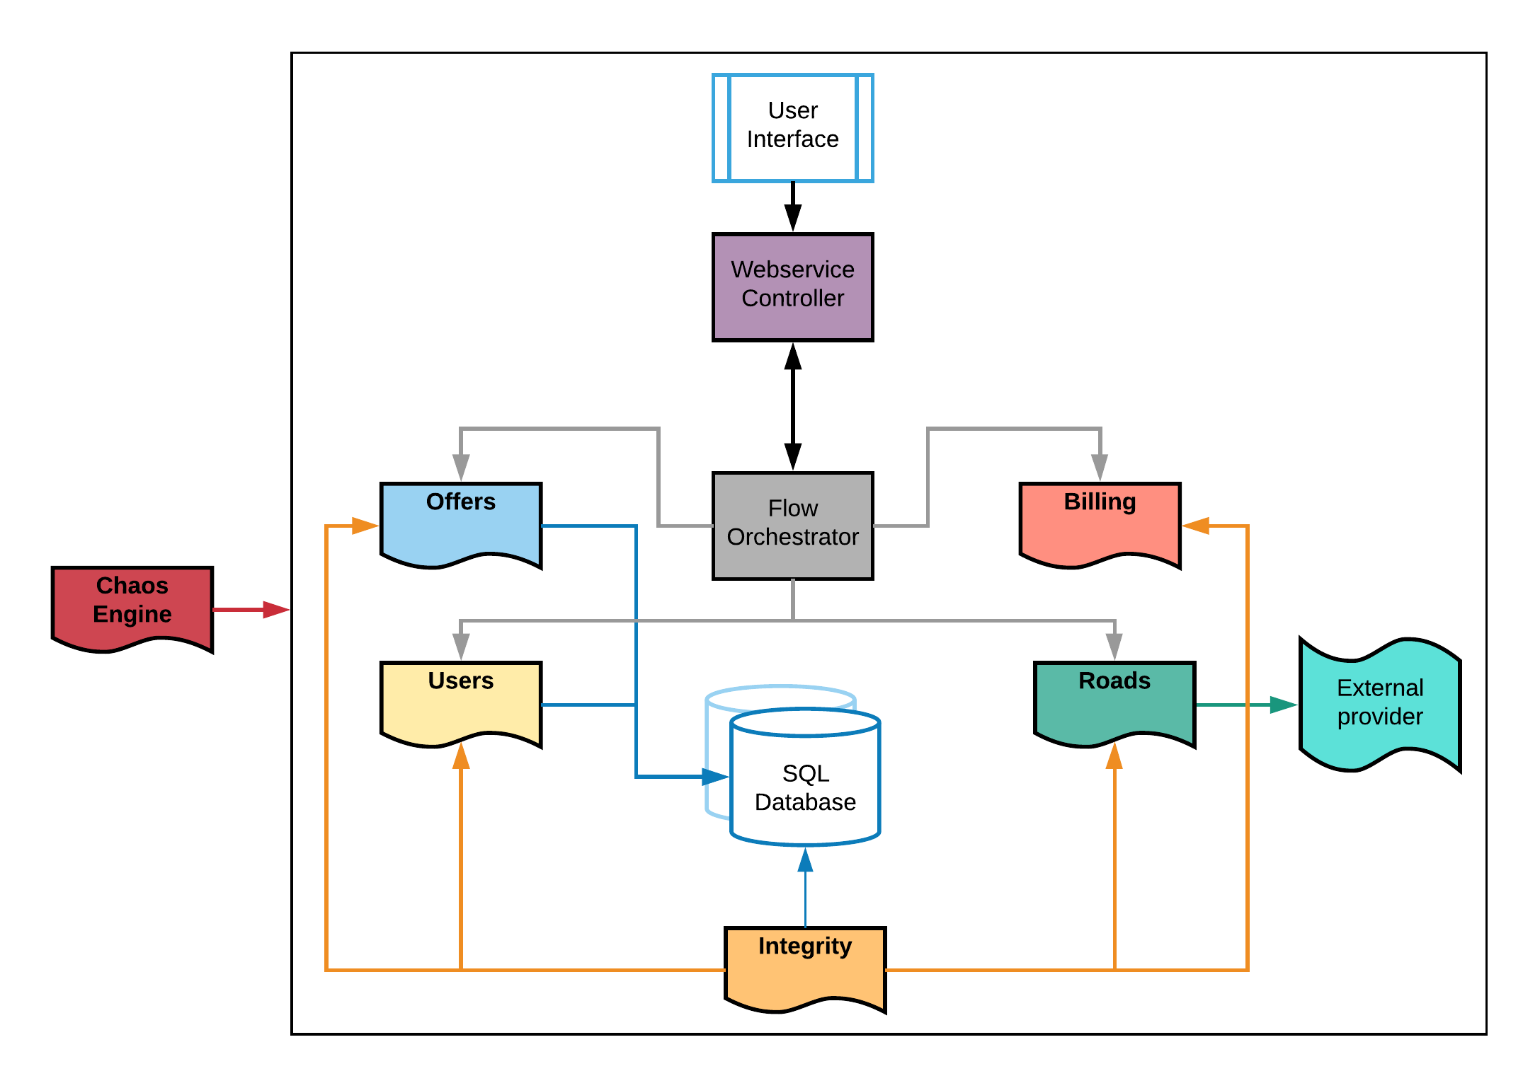
Architecture Overview
1
2
3
4

Slide 10
4.
TECHNOLOGICAL
CHOICES

Slide 11

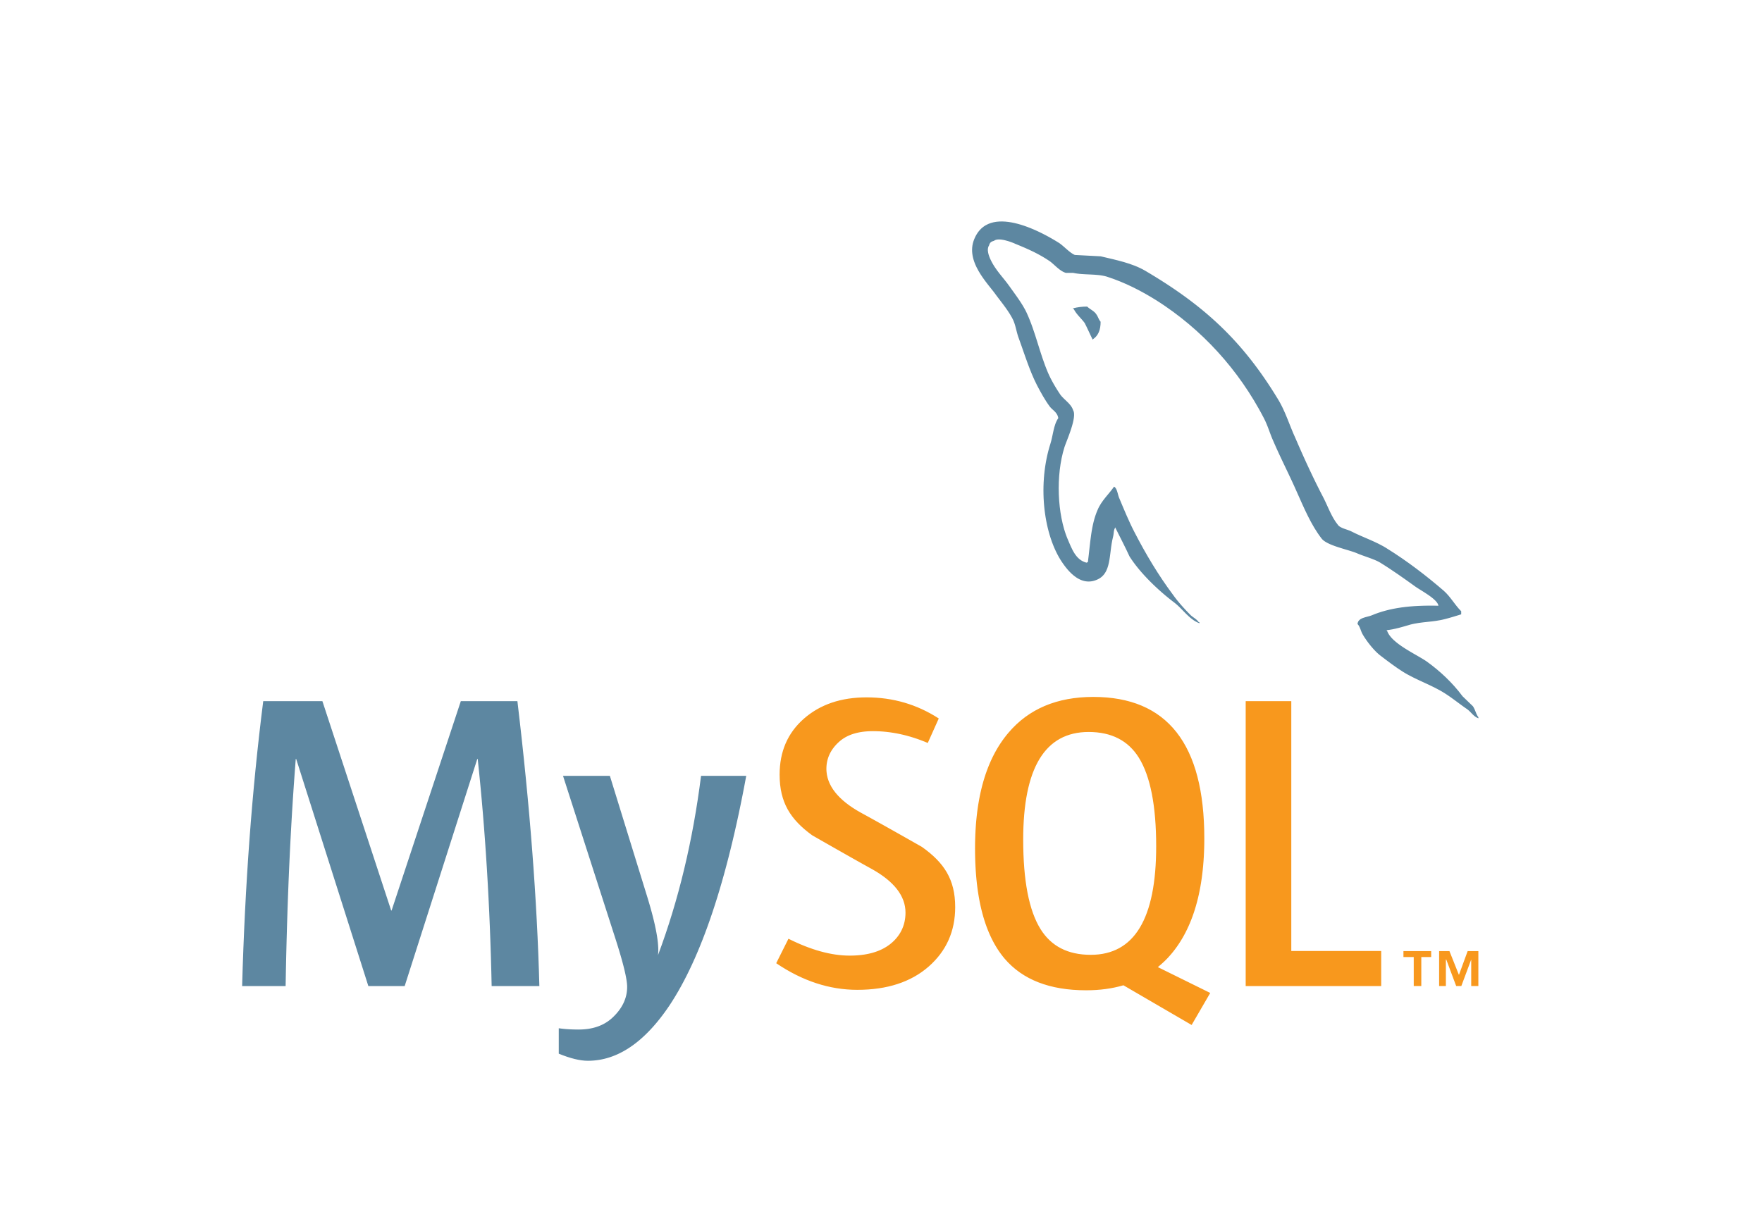





Technological Choices
Java - Springboot
MySQL Database
phpMyAdmin
NodeJS
Docker
01

Slide 12




5.
LIVE
DEMO

Slide 13
6.
PLANNING VS RESULTS

Slide 14



Planning vs Results
Initial objectives
Results
Database update
Consolidate system
Database failure use case
Billing improvement
Additional use cases focused on Billing

Slide 15
7.
WORK
DISTRIBUTION

Slide 16
Work Distribution
Rudy
Xavier
Chaos Component
Database update
NodeJS Server
Master/Slave DB
UI
Billing improvement
Chaos Component
Damien
Amandine
Journaling System
DDOS Prevention
Exception System
Identification
DDOS Prevention
Mailing

Slide 17
THANK YOU !

