Slide 1
BlablaMove - Oral defense
Billing Variant
Toutain Xavier – Meersman Rudy – Fornali Damien - Benza Amandine

Slide 2
0.
CHANGES IMPOSED BY
THE CLIENT

Slide 3

Changes imposed by the client
Hackers are trying to destroy BlablaMove's billing !
Need to secure the system
Ensure data coherence
Ensure that the transactions are successfully completed
1
2
3
4

Slide 4
0.
REALISATION

Slide 5





Realisation
01
Users
Billing
Offers
Roads
Integrity
Web Service

Slide 6
0.
ARCHITECTURE OVERVIEW

Slide 7
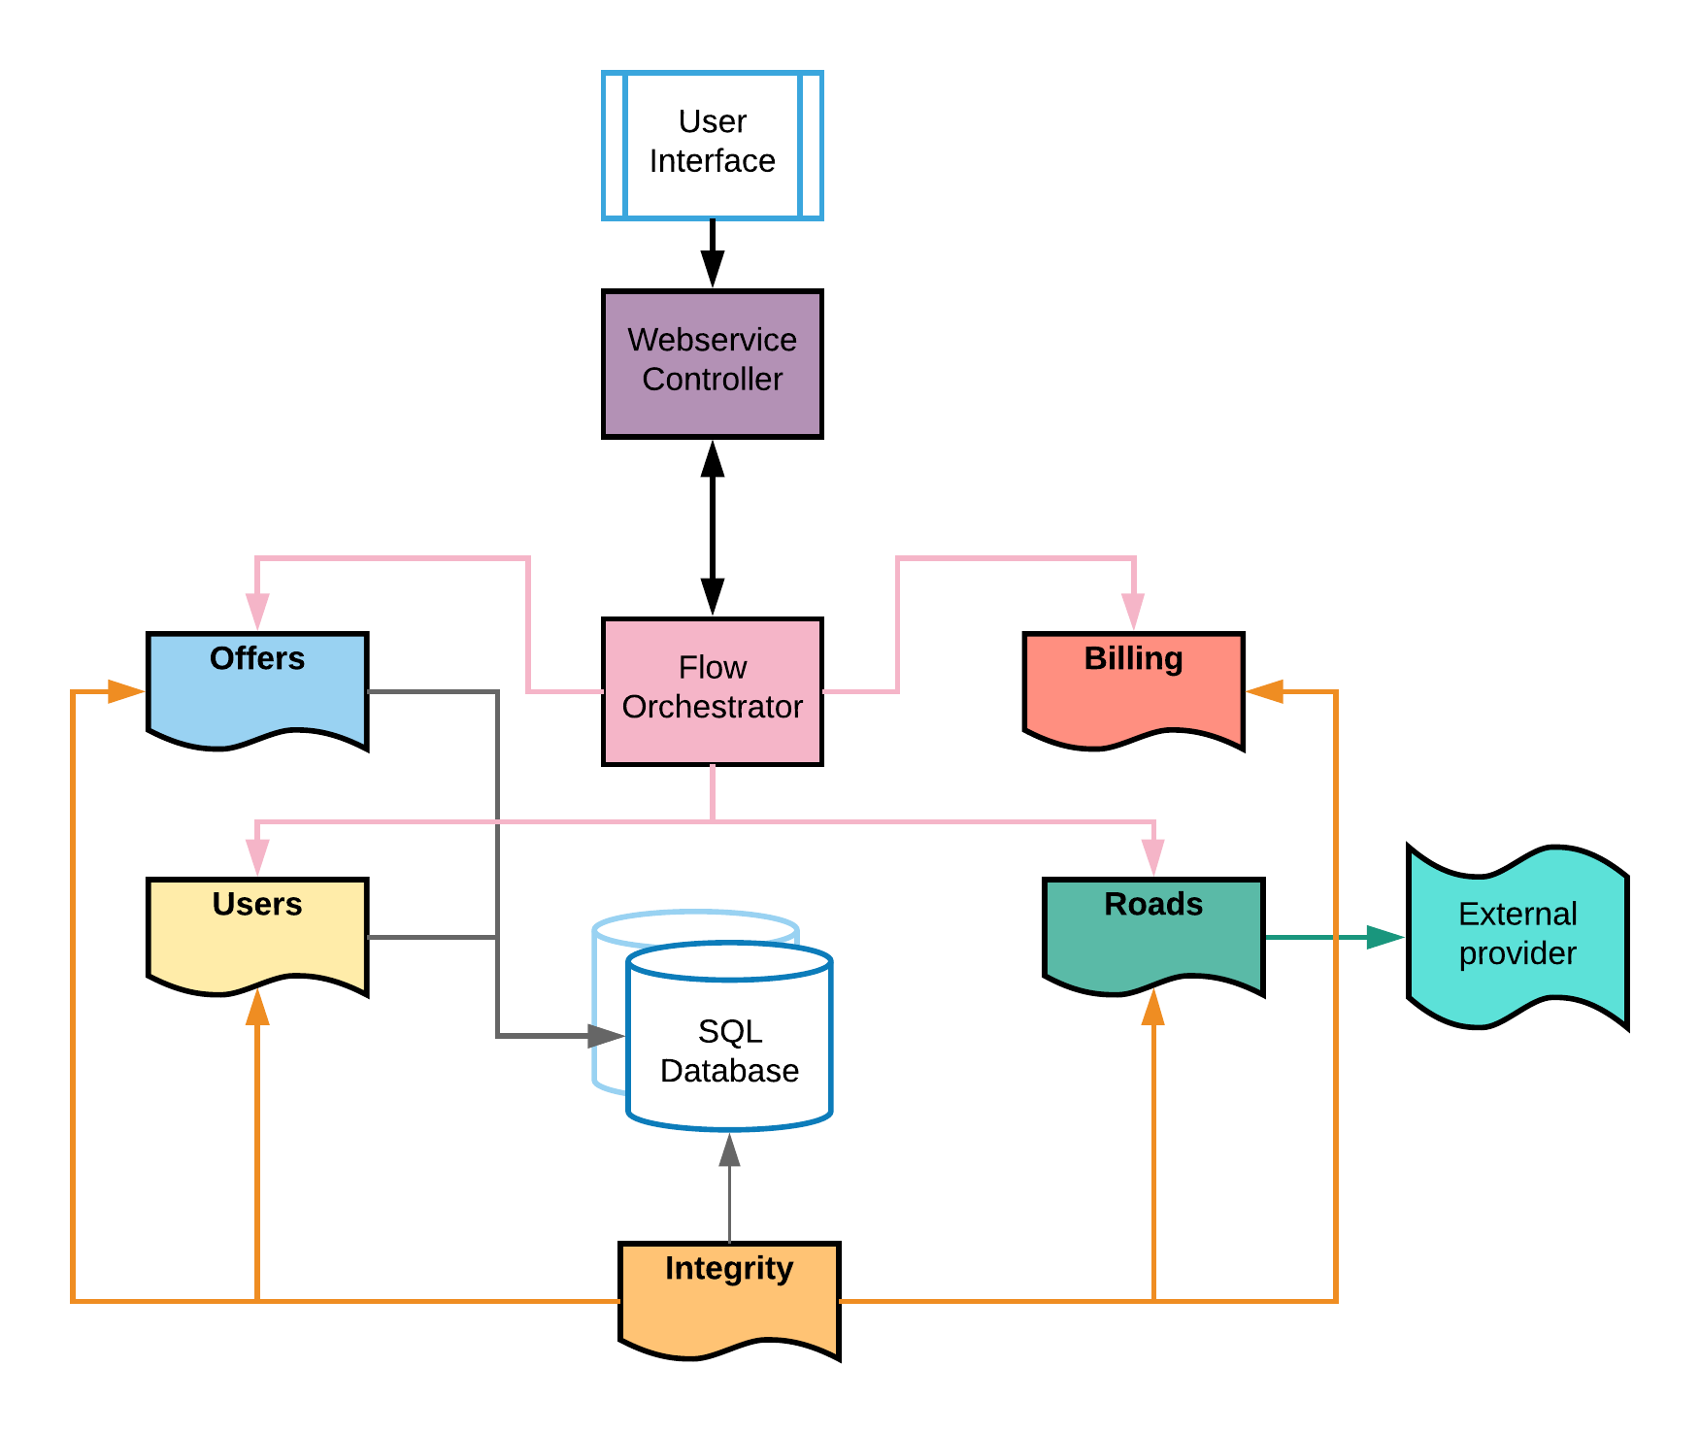
Architecture Overview
1
2
3
4

Slide 8
0.
TECHNOLOGICAL
CHOICES

Slide 9






Technological Choices
Java - Springboot
MySQL Database
phpMyAdmin
Docker
01

Slide 10




0.
LIVE
DEMO

Slide 11
0.
PLANNING VS RESULTS

Slide 12
Planning vs Results
What was planned
What was been achieved
Something
Something else
Blabla
Move
Hohohohoho
I’m so funny.
Something
Something more
Move
Blabla
Hahahahaha
It wasn’t funny.

Slide 13
0.
WORK
DISTRIBUTION

Slide 14
Work Distribution
Rudy
Xavier
TODO
TODO
TODO
TODO
Damien
Amandine
TODO
TODO
TODO
TODO

Slide 15
THANK YOU !

