Slide 1
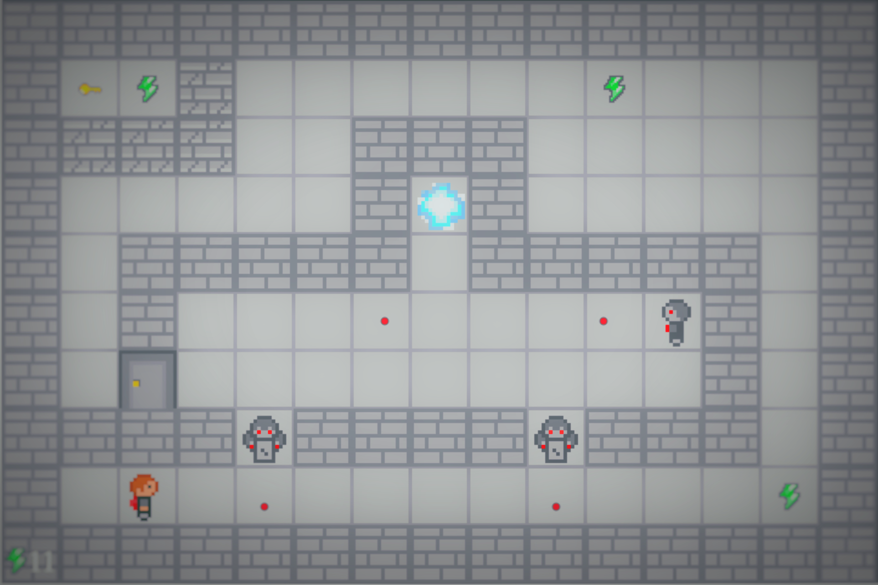
P o r ta k
F O R N A LI D a m i e n - B E N Z A A m a n d i n e

Slide 2






I. Presentation

Slide 3
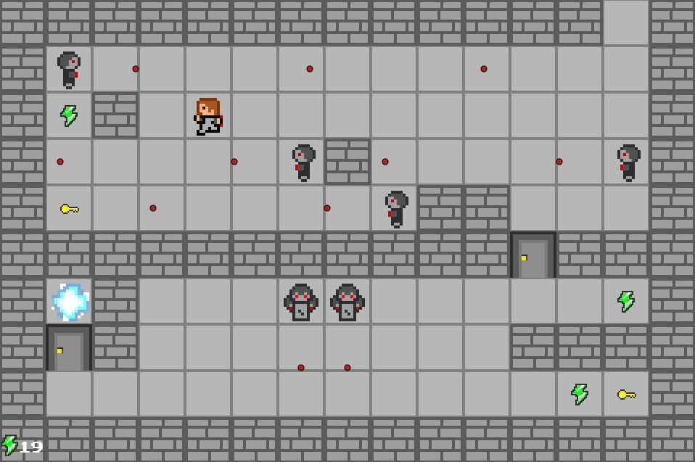
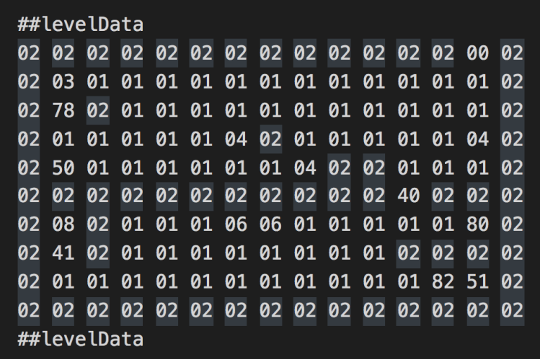
II. LEVEL DESIGN

Slide 4
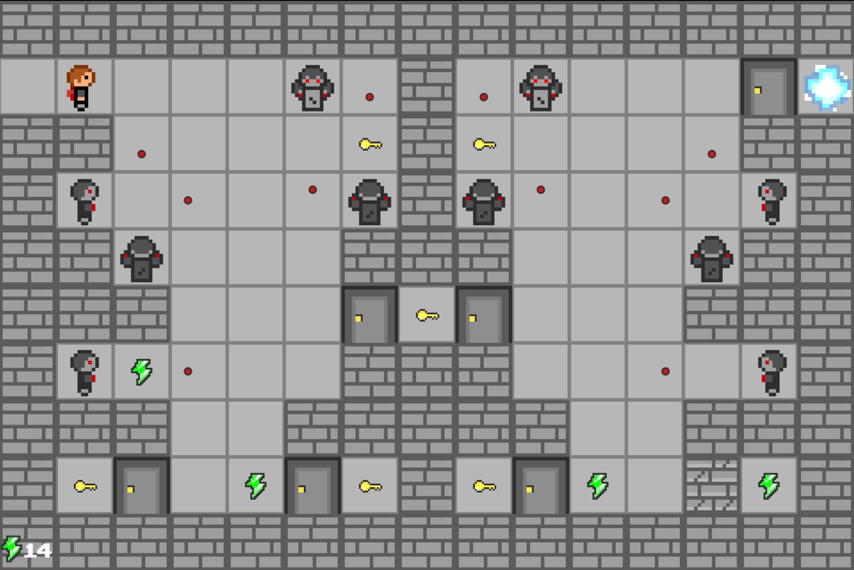
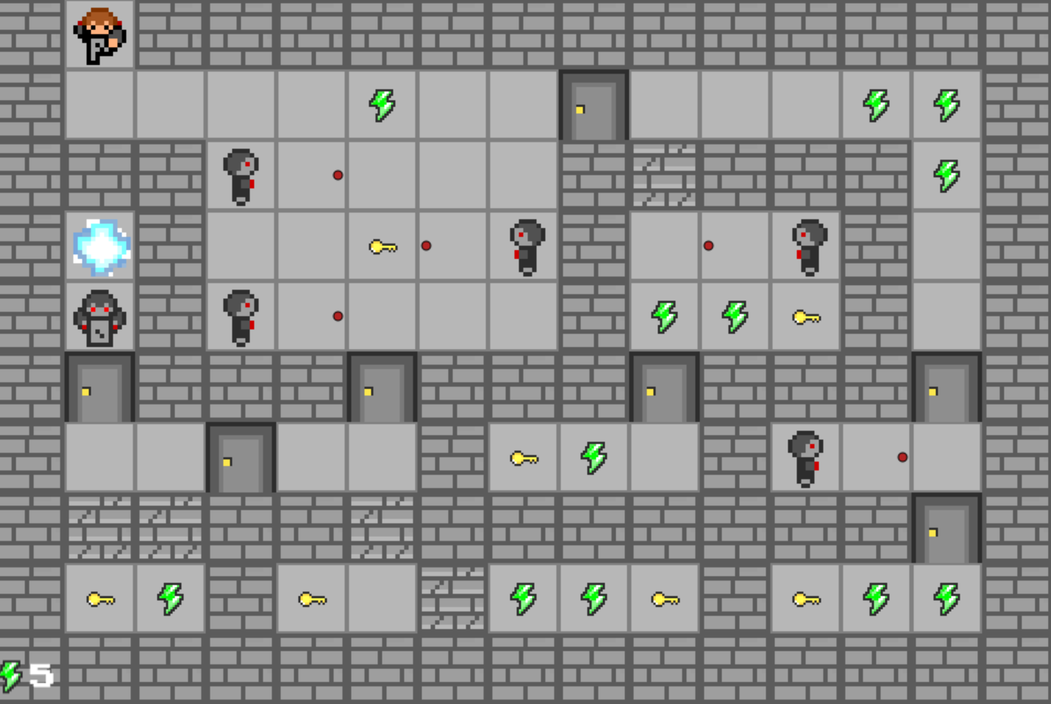
Z
III. POINTS FORTS et faibles

Slide 5
III. Demo
https://github.com/AmandineBenza/Portak

