Slide 1
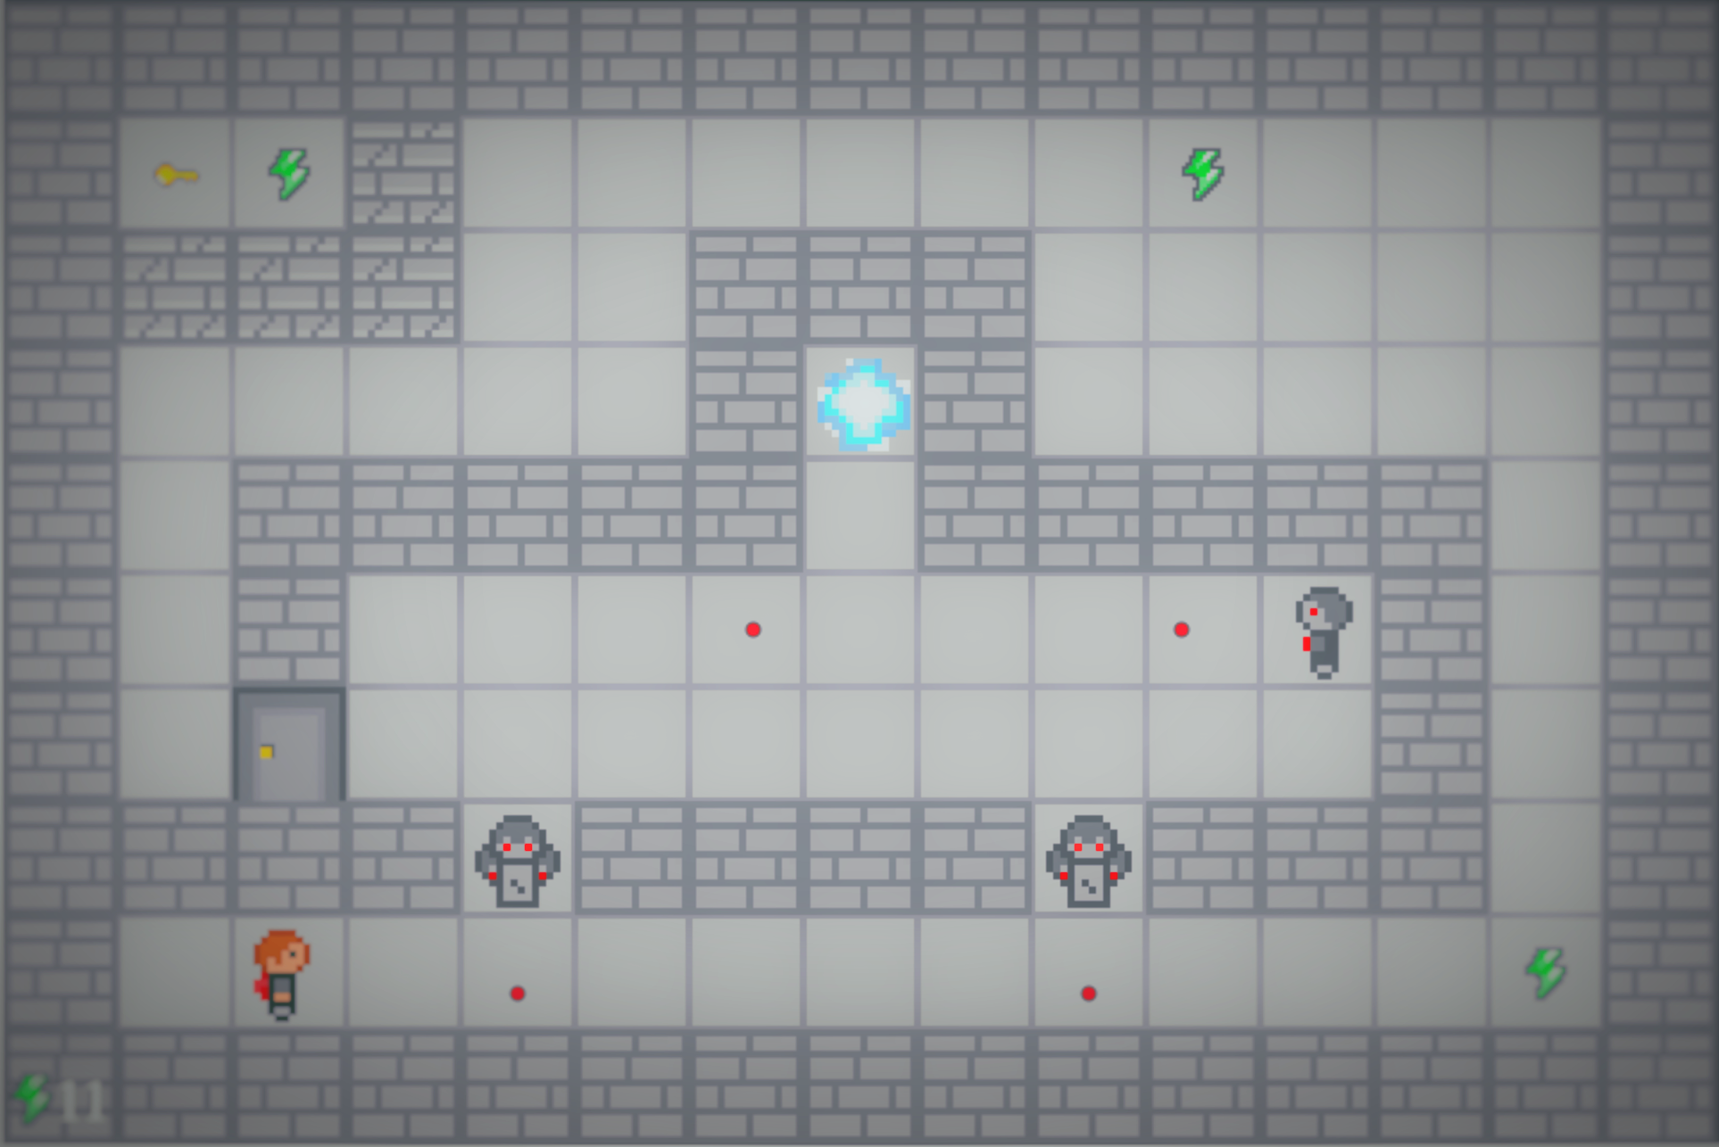
P o r ta k
F O R N A LI D a m i e n - B E N Z A A m a n d i n e

Slide 2
I. Presentation

Slide 3
II. FONCTIONALITES

Slide 4
III. Level design

Slide 5
IV. Demo

Slide 9
P o r ta k

