Slide 1







CURRENT AND FUTURE I.T TECHNOLOGY TRENDS
AMANDEEP SINGH KAUR
amandeep1552@gmail.com
14 FEB 2023

Slide 2



OUTLINE
Executive Summary
Introduction
Methodology
Results
Visualization – Charts
Dashboard
Discussion
Findings & Implications
Conclusion
Appendix

Slide 3

EXECUTIVE SUMMARY
Due to the constantly changing technologies and skill requirements in the job market, identifying future skill requirements is key. The main objective of this project is to analyze the survey data conducted by Stack Overflow in 2019 to identify and capture the trends for emerging skills in programming languages, databases, and web frameworks. Upon analysis, it was discovered that, with a few exceptions, many of the technologies used in 2019 are still desired in the following year. The emerging skills are JavaScript, HTML/CSS, Python and SQL in languages, MySQL, PostgreSQL and MongoDB in databases, and React.js, jQuery and Angular.js in web frameworks.

Slide 4

INTRODUCTION
In response to the constantly changing technologies and skill requirements in the job market, Stack Overflow, a popular website for developers, conducted an online survey in 2019 of software professionals worldwide. The survey aimed to understand the technologies that professionals are currently using and their plans to learn new ones in the coming year.
The objective of this project is to perform an exploratory analysis on survey data with an aim to answer following questions:
What were the top 5 programming languages and databases being used in 2019 and desired to be learned next year among survey respondents ?
What were the top platforms and web frameworks being utilized in 2019 and anticipated to be learned by survey respondents in 2020?
To answer these questions, statistical techniques are applied to data after transforming it with data wrangling techniques.

Slide 5

METHODOLOGY
As mentioned in introduction, Stack Overflow conducted an online survey of software professionals worldwide. The survey data was later open sourced by Stack Overflow. The actual data set has around 90,000 responses. The data set used in this project is a randomized subset that contains around 1/10th of the original data set.
The collected data is cleaned and preprocessed using Jupyter Notebook to prepare it for analysis. Subsequently, exploratory analysis techniques are employed to assess data distribution, detect outliers, and uncover correlations. Finally, all the information is brought together by developing a dashboard using IBM Cognos Analytics.

Slide 6
RESULTS
As part of the preprocessing phase:
154 duplicate rows were removed from the dataset.
Several columns contained missing values, which were imputed using the mean value for numerical columns and the mode value for categorical columns.
For compensation comparisons, a new column was created called 'NormalizedAnnualCompensation' using the 'CompTotal' and 'CompFreq' columns. The 'CompTotal' column indicates a developer's annual, monthly, or weekly pay based on the frequency specified in the 'CompFreq' column.
As part of the exploratory analysis phase:
Found that median age of respondents is 29 years and median compensation is 57,745$.
There are 9703 outliers in ‘ConvertedComp’ column which are removed from the data
As part of data visualization, many charts are developed which are presented in following slides

Slide 7
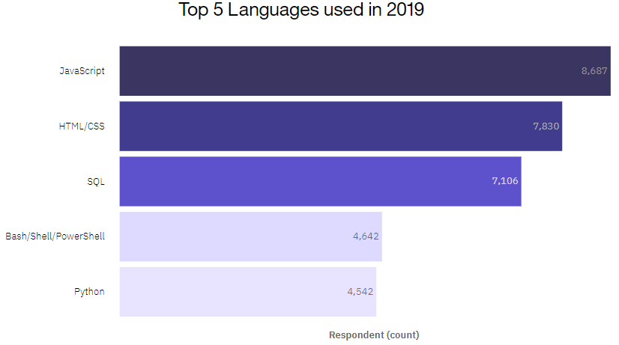
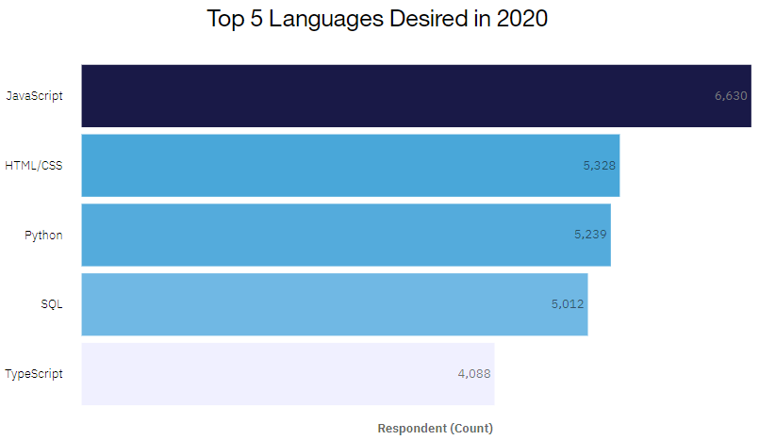
PROGRAMMING LANGUAGE TRENDS

Slide 8
PROGRAMMING LANGUAGE TRENDS - FINDINGS & IMPLICATIONS
Findings
In 2019, top 5 languages used were JavaScript, HTML/CSS, SQL, Python and Bash/Shell with JS being used almost 50% more than Python by respondents.
In 2020, top 5 languages desired are mostly same as top 5 used in 2019, except TypeScript is desired more than Bash/Shell.
Surprisingly, there is an increase in number of respondents desiring Python compared to the previous year.
Implications
Python is becoming increasingly sought after in comparison to previous year
JavaScript, HTML/CSS and SQL are still in-demand in 2020.
TypeScript promises to be more commonly used in 2020

Slide 9
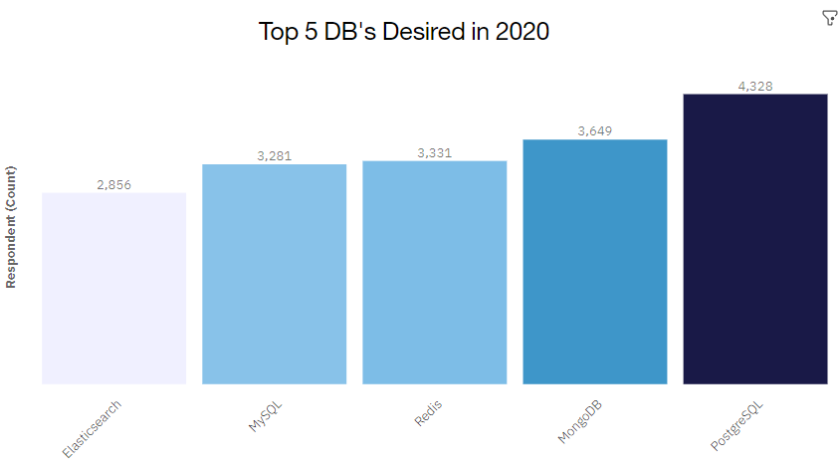
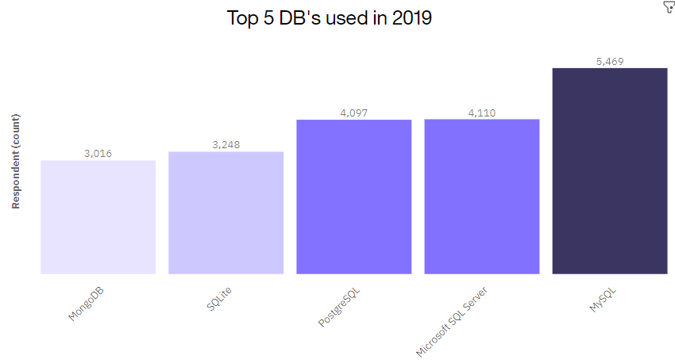
DATABASE TRENDS

Slide 10
DATABASE TRENDS - FINDINGS & IMPLICATIONS
Findings
In 2019, top 5 DB’s used were MySQL, Microsoft SQL Server, PostgreSQL, SQLite and MongoDB
In 2020, top 5 DB’s desired to learn are PostgreSQL, MongoDB, Redis, MySQL and Elasticsearch
The no. of respondents interested in learning PostgreSQL and MongoDB in 2020 is more in comparison to respondents using it in 2019.
Decrease by 40% for desire in MySQL
Implications
PostgreSQL and MongoDB are becoming increasingly sought after in 2020 in comparison to previous year
MySQL can become less popular in 2020
Redis and Elasticsearch promise to be more commonly used in 2020

Slide 11

DASHBOARD’s PERMANENT LINK
https://dataplatform.cloud.ibm.com/dashboards/e0680158-a9bd-4f38-9c98-18b5b4c9839f/view/6524a03b03ed37f765b7c0e407ca2d542f362408e7bbd107d2877b490d347697a96a4297c8274852dc455131f0ec1058ca

Slide 12
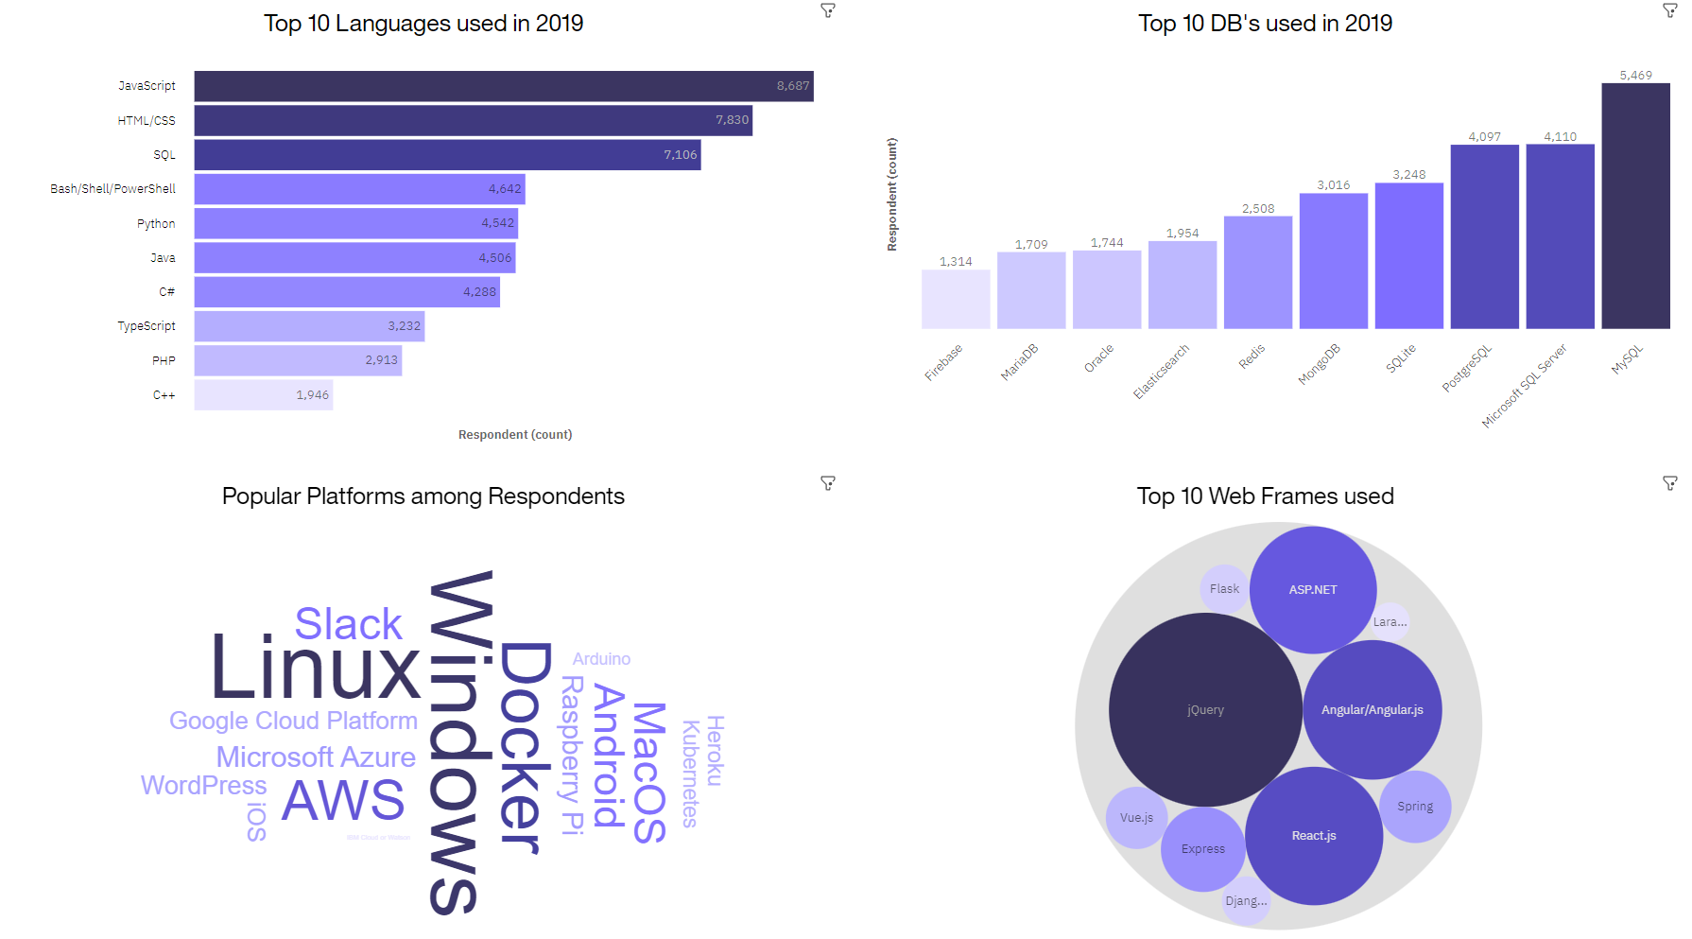
CURRENT TECHNOLOGY DASHBOARD

Slide 13
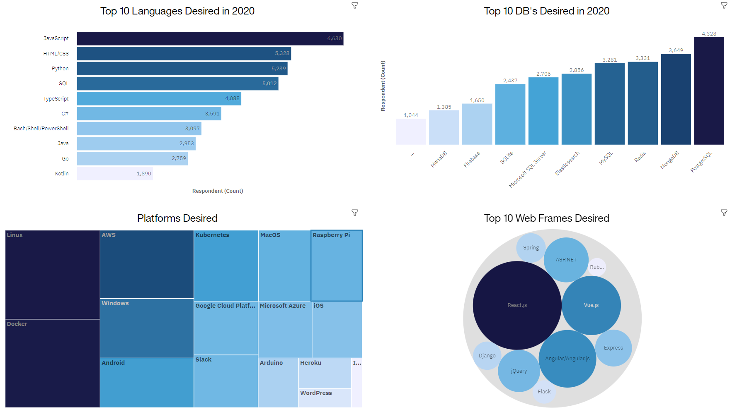
FUTURE TECHNOLOGY DASHBOARD

Slide 14
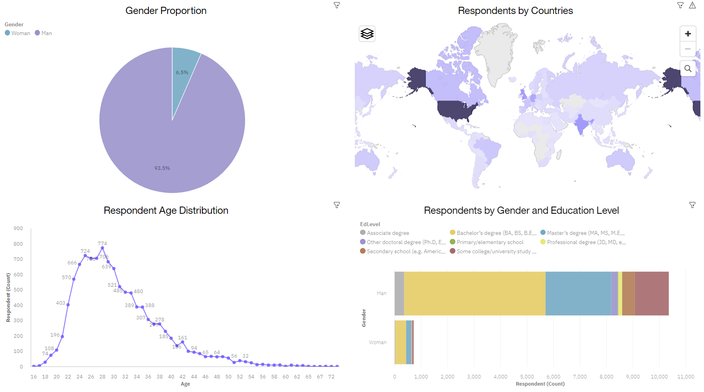
DEMOGRAPHICS DASHBOARD

Slide 15
DISCUSSION
The main goal was to identify future skill requirements and answer questions such as:
What are the top programming languages that promise to be more popular in 2020?
From the dashboard it is evident that Python, TypeScript, GO and Kotlin are four languages that are desired by more respondents in 2020 in comparison to respondents using it in 2019.
What are the top DB’s that promise to be more sought after in 2020?
PostgreSQL, MongoDB, Redis and Elasticsearch are four DB’s that has experienced surge in no. of respondents desiring it in 2020 as compared to respondents using it in 2019
What are the top platforms and web frameworks desired in 2020?
Top 5 platforms are Linux, Windows, Docker, AWS and Android
Top 5 web frameworks are React.js, Angular.js, Vue.js, jQuery and ASP.NET

Slide 16

CONCLUSION
The subset of survey data conducted by Stack Overflow was analyzed to identify top technologies used in 2019 and desired in 2020.
The exploratory analysis results show that most technologies being used in 2019 are still desired in 2020.
Python, PostgreSQL, MongoDB promise to experience upward trends in 2020

Slide 17
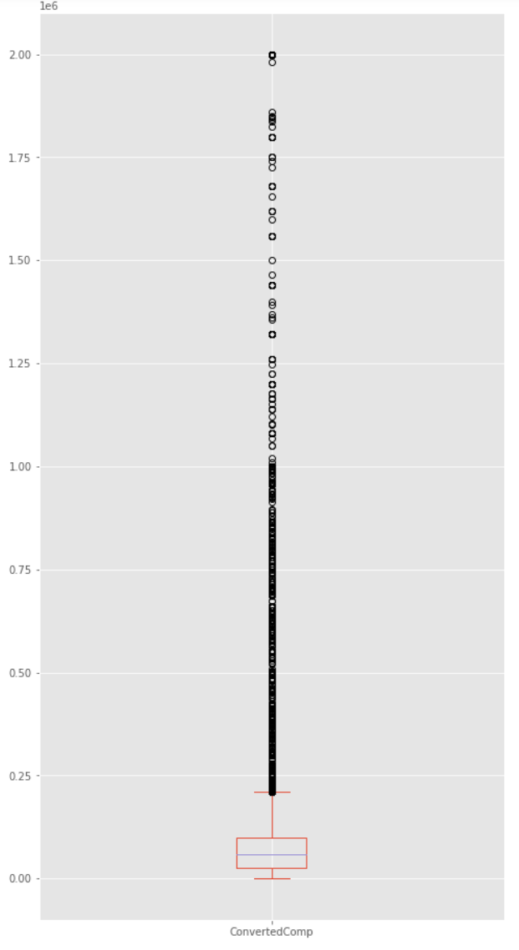

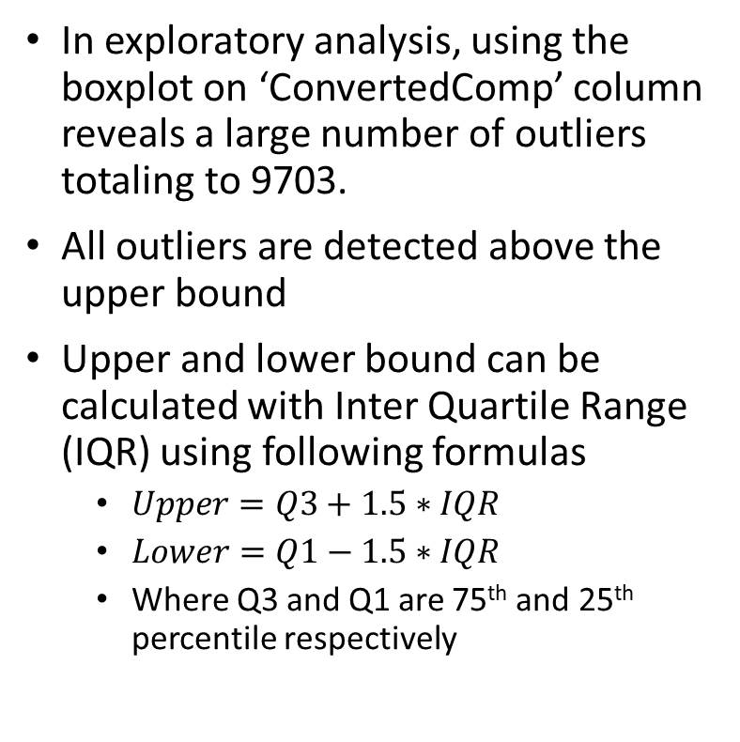
APPENDIX – OUTLIER DETECTION
In exploratory analysis, using the boxplot on ‘ConvertedComp’ column reveals a large number of outliers totaling to 9703.
All outliers are detected above the upper bound
Upper and lower bound can be calculated with Inter Quartile Range (IQR) using following formulas
$Upper=Q3+1.5∗IQR$
$Lower=Q1−1.5∗IQR$
Where Q3 and Q1 are 75th and 25th percentile respectively

Slide 18
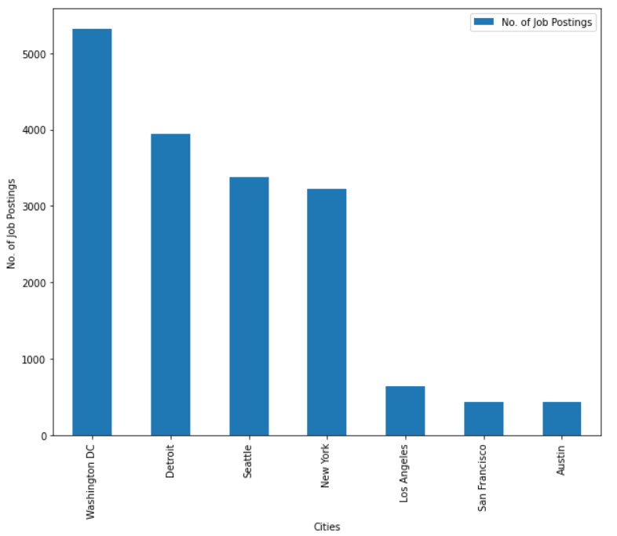
APPENDIX - JOB POSTINGS

Slide 19
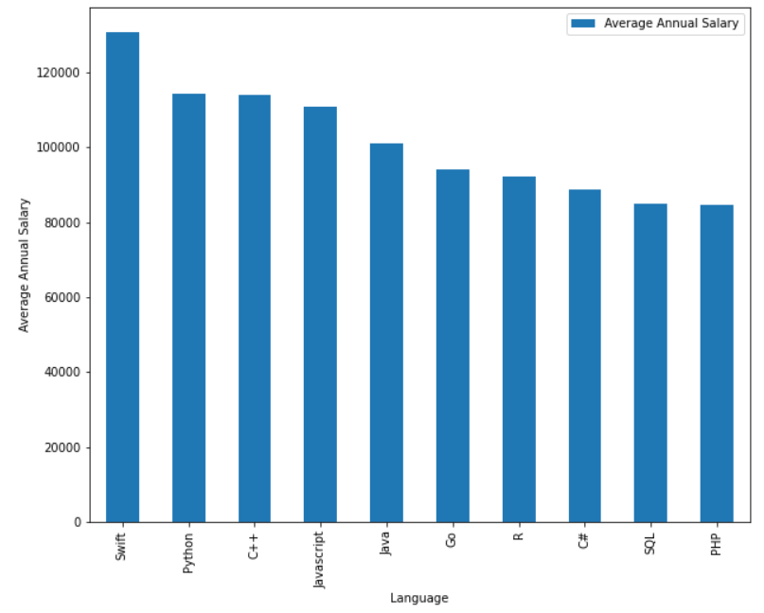
APPENDIX - POPULAR LANGUAGES

