Slide 1
Final Presentation YourCard

Slide 2
PROBLEM STATEMENT
YourCard – This commercial bank’s international travel card is very popular with not just its
own customers, but also many other bank customers. Business team is keen to provide
various card usage analysis as dashboard to consumers that shows consumer spend and
allows users to search easily.
Could your team help think and create personalized dashboard that consumer can access
from any of his / her devices/computers?

Slide 3
DESIGN THINKING STEPS INVOLVED:
Narrowed it down and listed the specific problem we’re aiming to solve.
Designed a prototype to test our solution by putting our ideas into action.
EMPATHIZE
IDEATE
TEST
DEFINE
PROTOTYPE
Gathered information through observation and first-hand experience.
Helped in understanding the emotions involved.
Worked within the time limit, brainstormed the ideas among team.
Tested our ideas and collected some of the feedbacks.

Slide 4
STEP-1 ETNOGRAPHIC RESEARCH
How often do you travel overseas?
When you last travelled overseas can you recall what methods you used for making purchases whilst you were overseas?
If you have not used a prepaid travel card, why not?
Do you recall what brand(s) of prepaid travel card you used?
Approximately how much money did you load (in total) onto your prepaid travel card?
How satisfied were you with the travel card?
What problems you faced while using the travel card?
Do you plan to use the prepaid travel card again on future overseas trips?

Slide 5
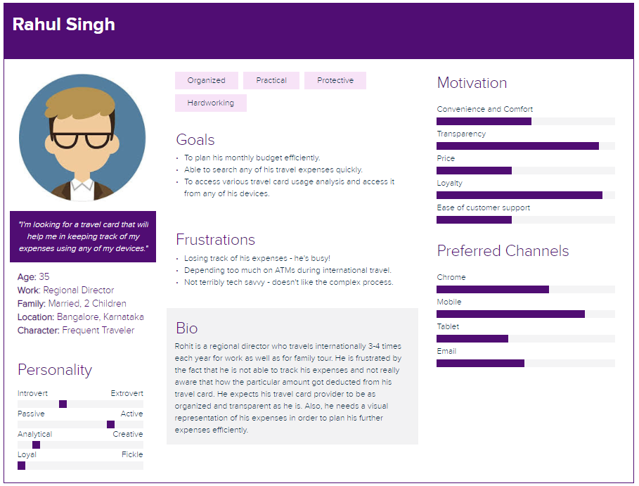
STEP-2 DEFINING USER’S PERSONA

Slide 6
STEP-3 IDEATE
Personalized dashboard
Visual representation of expenses in base currency
Responsiveness
Expense search functionality
Immediate customer care support
Easy and secured transactions
Displaying card usage features
COVID Insurance

Slide 7
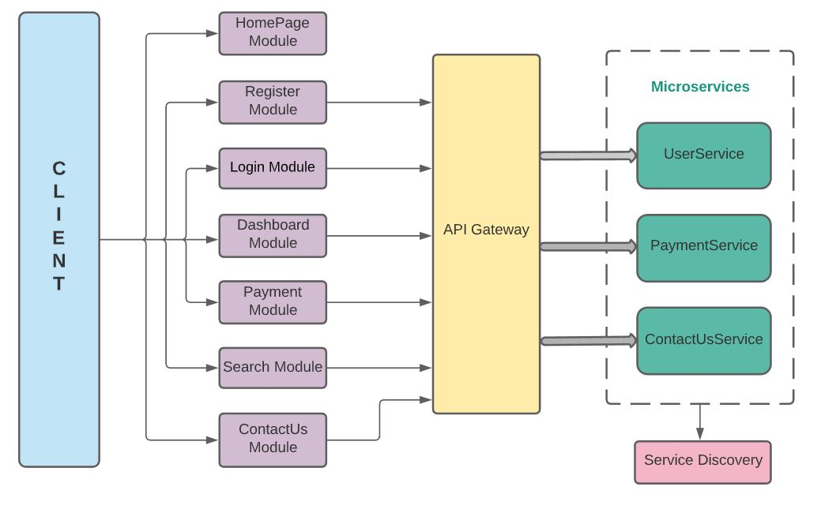
STEP-4 PROTOTYPE

Slide 8
STEP-5 TEST
Collected feedback from friends and family members.
Back-end Testing
JUnit and Mockito
Front-end Testing
- e2e Tests
Jasmine and Protractor
- Unit Tests
Jasmine and Karma

Slide 9

TECHNOLOGIES USED:
FRONTEND
Angular
Angular Material
BACKEND
Spring Boot
DATABASE
MongoDB
Microservices Patterns
JavaScript Charts
JWT Tokens
HTML5
CSS3
Swagger
DOCKER CONTAINER

Slide 10
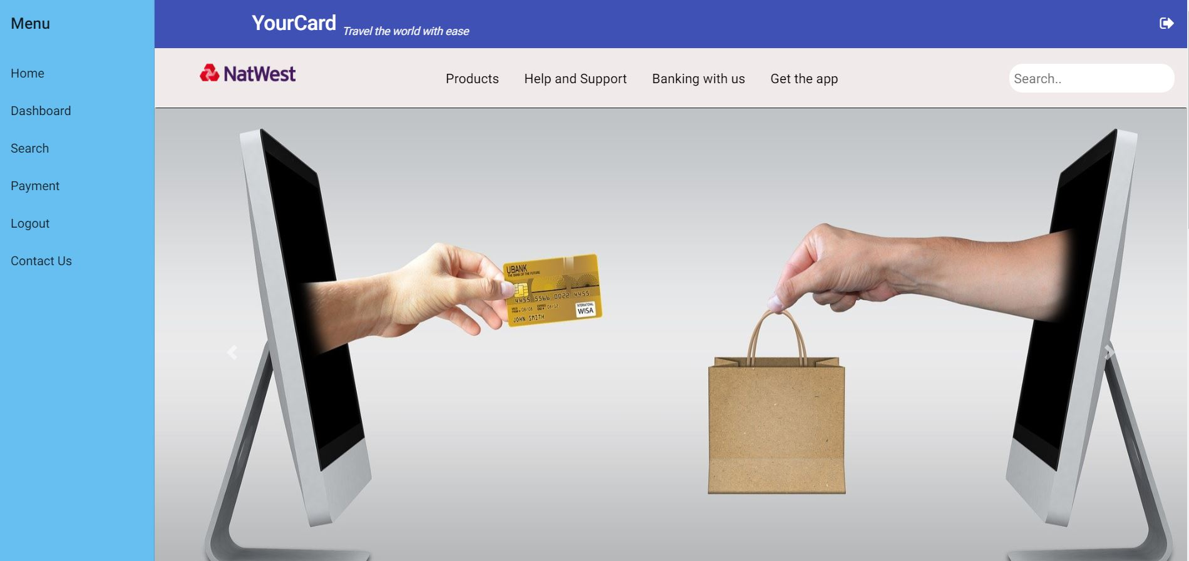
PROJECT DEMO:

Slide 11
FUTURE SCOPE:
Expand the card usage for other countries as well
Implement reward points functionality based on the transactions
Generate more detailed dashboard analysis report
Chatbot to solve customer queries fast
User friendly alerts : Security, offers and transaction
Add balance to travel card

Slide 12
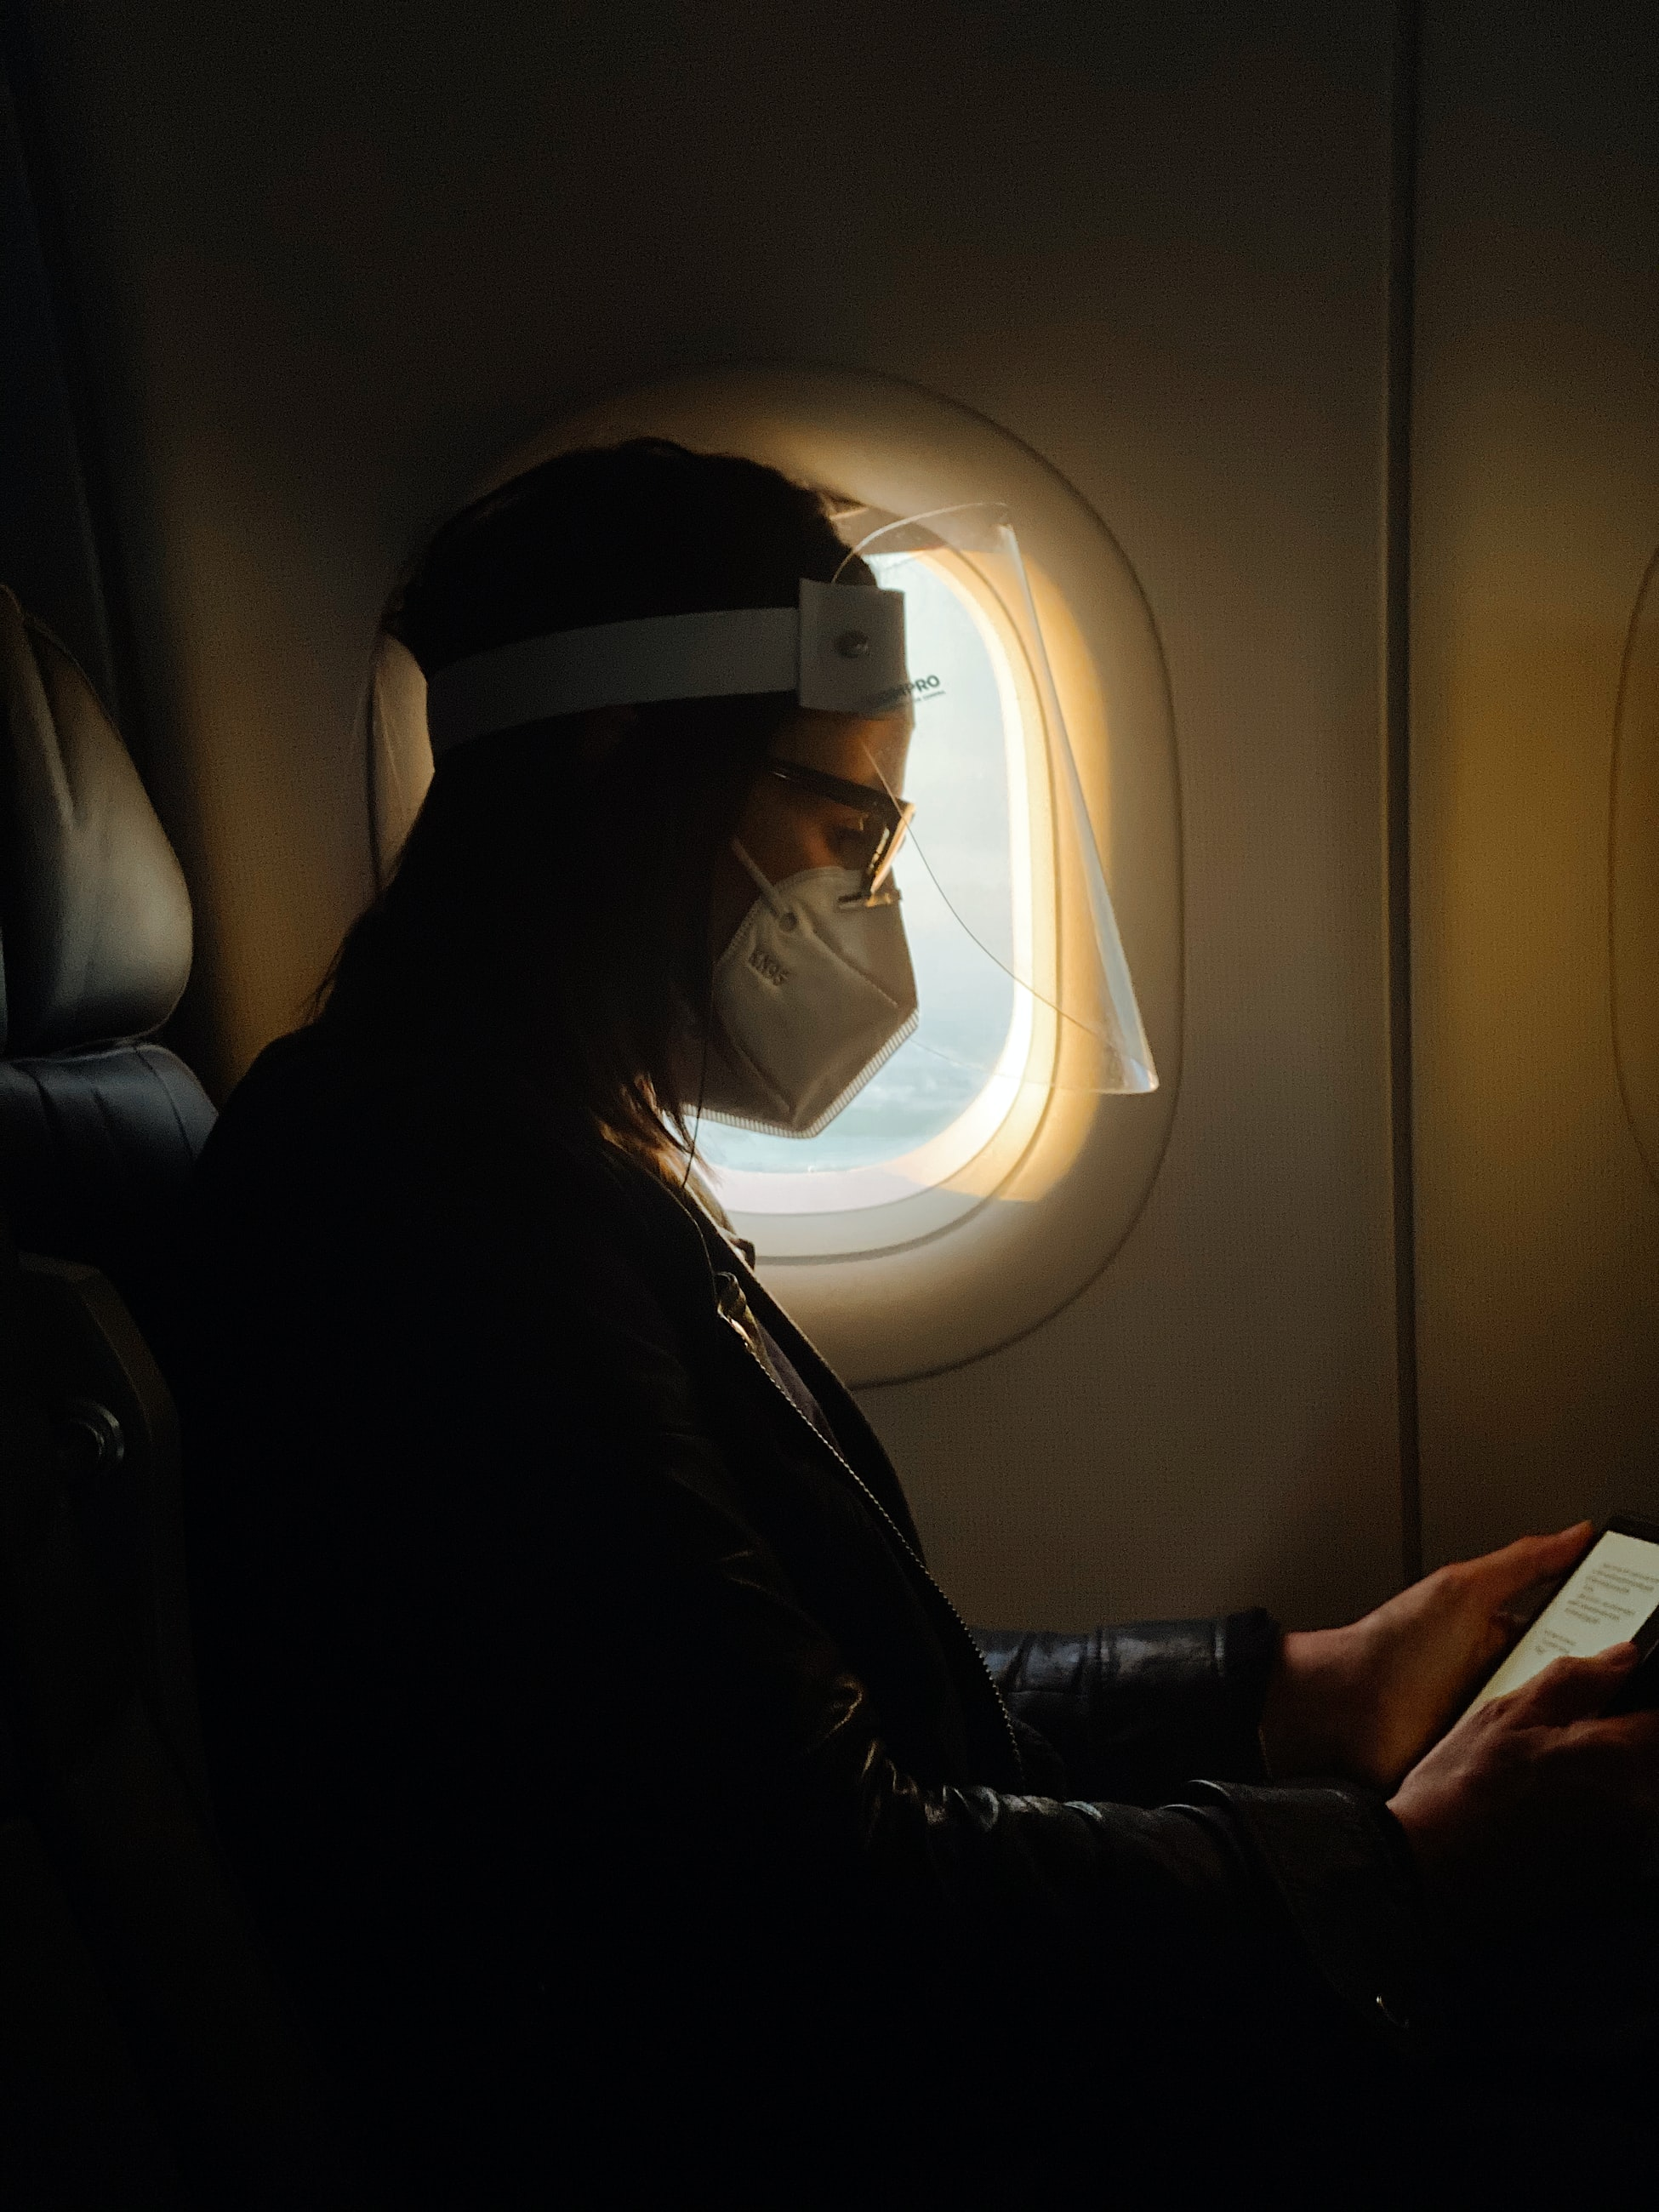
ANY QUESTIONS?

