Slide 1
Chapter 1
Preliminaries

Slide 2
Chapter 1 Topics
Reasons for Studying Concepts of Programming Languages
Programming Domains
Language Evaluation Criteria
Influences on Language Design
Language Design Trade-Offs
Language Categories
Implementation Methods
Programming Environments
Copyright © 2007 Addison-Wesley. All rights reserved.
1-<number>

Slide 3
Reasons for Studying Concepts of Programming Languages
Increased ability to express ideas
Improved background for choosing appropriate languages
Increased ability to learn new languages
Better understanding of significance of implementation
Overall advancement of computing
Copyright © 2007 Addison-Wesley. All rights reserved.
1-<number>

Slide 4
Scenario 1
Horizon Software Solutions is a small training company wants to develop an application for their employee’s management.
There are different types of employees like Permanent, Contract and Hourly Based. They are working for different designations like Technical Trainer, Soft Skill Trainer, Admin and Human Resources Team. All the employees were working for different departments based on their designation; Training, Admin and HR.
Assume HSS Team contacted a service provider company (XYZ) for this requirement, after requirements analysis XYZ Company divided the project into different modules (Employee Registration Module, Department Activities Module, Training Activities Module, Reports Module).
Copyright © 2007 Addison-Wesley. All rights reserved.
1-<number>

Slide 5
Scenario 2
Bernie's Café is a small coffee shop wants to develop an application for their ordering system. Consider the “coffee-order” process given below:
  Customer enter the coffee shop
  Queue in the line
  Waiter ask for order
  Make your order
  Pay
  Present loyalty card to collect points
Copyright © 2007 Addison-Wesley. All rights reserved.
1-<number>

Slide 6
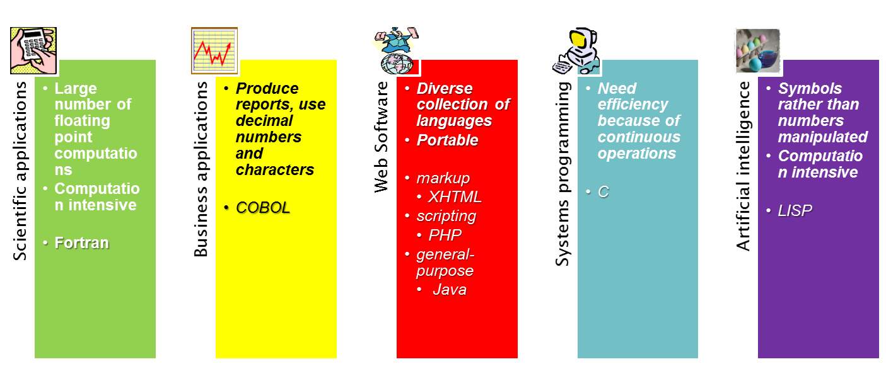
Programming Domains
Languages are typically not general-purpose
1-<number>

Slide 7
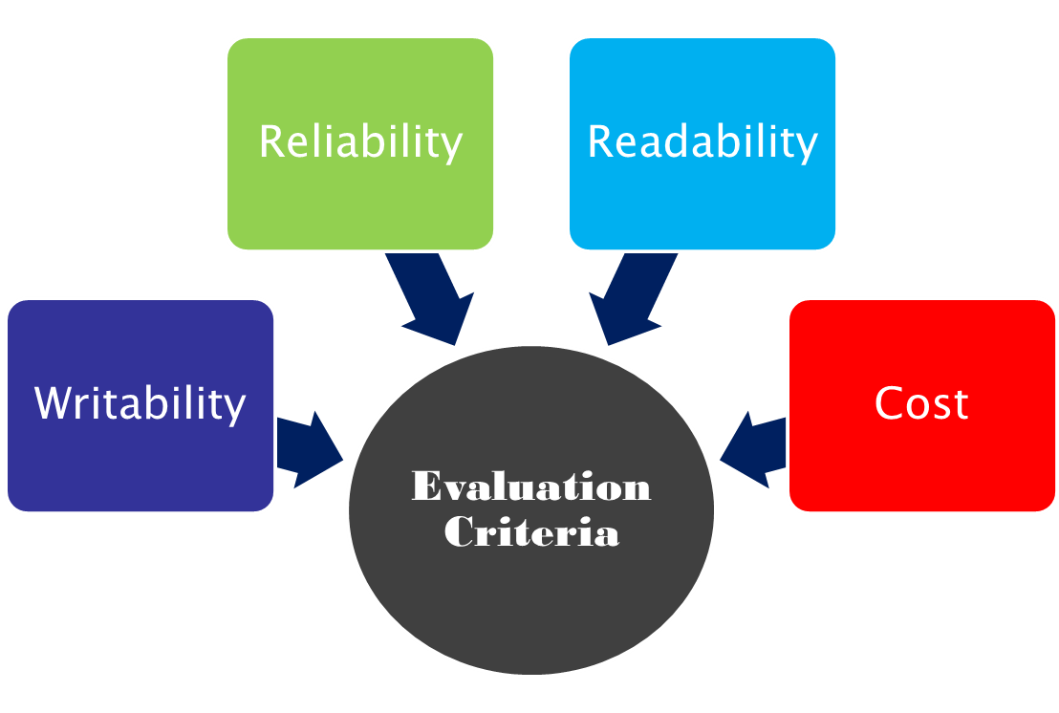
Language Evaluation Criteria
the ease with which programs can be read and understood
conformance to specifications
the ease with which a language can be used to create programs
the ultimate total cost
1-<number>

Slide 8
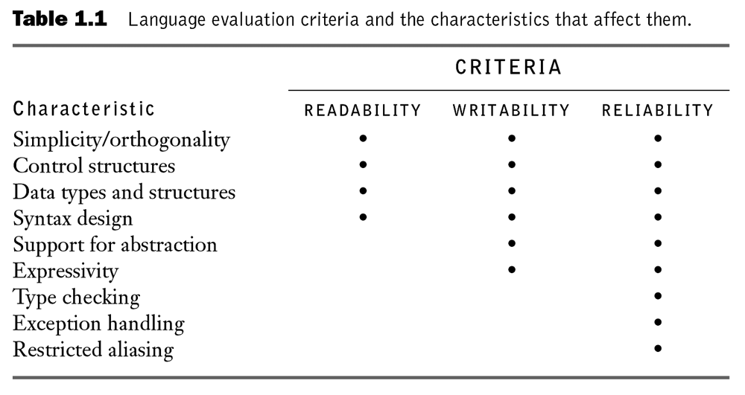
Language Evaluation Criteria
Copyright © 2007 Addison-Wesley. All rights reserved.
1–<number>

Slide 9
Evaluation Criteria: Readability
Overall simplicity
  A manageable set of features and constructs
  Few feature multiplicity (means of doing the same operation)
  Minimal operator overloading
Orthogonality
  A relatively small set of primitive constructs can be combined in a relatively small number of ways
  Every possible combination is legal
Data types and structures
  The presence of adequate facilities for defining data structures
Syntax considerations
  Identifier forms: flexible composition
  Special words and methods of forming compound statements
  Form and meaning: self-descriptive constructs, meaningful keywords
1-<number>
Copyright © 2007 Addison-Wesley. All rights reserved.
Notes:
Multiplicity: a++ a=a+1
The more orthogonal the design of a language, the fewer exceptions the language rules require. Fewer exceptions mean a higher degree of regularity in the design, which makes the language easier to learn, read, and understand

Slide 10
Evaluation Criteria: Readability-Orthogonality
Eg. 1: Pascal
  Procedures can have both variable and value parameters.
  Functions can return only unstructured types.
  Formal parameter types must be named; they cannot be complete type descriptions.
  Files and structured data cannot be passed by value.
Eg. 2: Data Type
  {Integer, float, char, double}, {array and pointers}
  More data structures can be created if type operators applied to others
not orthogonal!!
#include <stdio.h>
int *A[10];
int *B[10][10];
main(){
  printf("%d\n", &A[0]);
  printf("%d\n", &A[9]);
  A[0] = A[9];
  printf("%d\n", &A[0]);
  printf("%d\n", &B[0][0]);
  B[0][0] = B[9][9];
  printf("%d\n", &B[9][9]);
  printf("%d\n", &B[0][0]);
}
lack of orthogonality
orthogonality
#include <stdio.h>
struct student_record {
  void p; //illegal
  char Name[50];
};
void A[100]; //illegal
main() {}
1-<number>

Slide 11
Evaluation Criteria: Writability
Simplicity and orthogonality
  Few constructs, a small number of primitives, a small set of rules for combining them
Support for abstraction
  The ability to define and use complex structures or operations in ways that allow details to be ignored
Expressivity
  A set of relatively convenient ways of specifying operations
  Example: the inclusion of for statement in many modern languages
Copyright © 2007 Addison-Wesley. All rights reserved.
1-<number>
Notes:
Expressivity: easy to write a++ compare to a=a+1

Slide 12
Evaluation Criteria: Reliability
Type checking
  Testing for type errors by compiler or during execution
Exception handling
  Intercept run-time errors and take corrective measures
Aliasing
  Presence of two or more distinct referencing methods for the same memory location
Readability and writability
  A language that does not support “natural” ways of expressing an algorithm will necessarily use “unnatural” approaches, and hence reduced reliability
Copyright © 2007 Addison-Wesley. All rights reserved.
1-<number>

Slide 13
Evaluation Criteria: Cost
Training programmers to use language
Writing programs (closeness to particular applications)
Compiling programs
Executing programs
Language implementation system: availability of free compilers
Reliability: poor reliability leads to high costs
Maintaining programs
Copyright © 2007 Addison-Wesley. All rights reserved.
1-<number>

Slide 14
Evaluation Criteria: Others
Portability
  The ease with which programs can be moved from one implementation to another
Generality
  The applicability to a wide range of applications
Well-definedness
  The completeness and precision of the language’s official definition
Copyright © 2007 Addison-Wesley. All rights reserved.
1-<number>

Slide 15
Language Design Tradeoffs
Readability vs. Writability
  Perl is very flexible and expressive—very writable
  As a result, Perl is sometimes hard to read...
Writability vs. Reliability
  C and C++ both provide powerful and flexible
  use of pointers
  As a result, C and C++ can be unreliably used, producing core dumps, null pointer references, etc.
Copyright © 2007 Addison-Wesley. All rights reserved.
1-<number>
Dr. David Goldschmidt, The College of Saint Rose

Slide 16
Influences on Language Design
Computer Architecture
  Languages are developed around the prevalent computer architecture, known as the von Neumann architecture
Programming Methodologies
  New software development methodologies (e.g., object-oriented software development) led to new programming paradigms and by extension, new programming languages
SELF-READING!
Copyright © 2007 Addison-Wesley. All rights reserved.
1-<number>

Slide 17

Computer Architecture Influence:
Von Neumann Architecture
Imperative languages (most dominant)
  Data and programs stored in memory
  Memory is separate from CPU
  Instructions and data are piped from memory to CPU
  Basis for imperative languages:
    Variables mimic memory
    Assignment statements
    Arithmetic operations
    Iterative repetition
SELF-READING!
Copyright © 2007 Addison-Wesley. All rights reserved.
1-<number>
Dr. David Goldschmidt, The College of Saint Rose

Slide 18
Language Categories
Imperative languages:
  Evolved from the von Neumann architecture
  Focus on variables, assignment and arithmetic statements, and iterative constructs
  e.g. C, C++, Pascal, C#, Java, Visual BASIC, Perl,
  JavaScript, Ruby, etc.
  Additional tags:
    Visual languages, Scripting languages, Web-based languages
Copyright © 2007 Addison-Wesley. All rights reserved.
1-<number>
Dr. David Goldschmidt, The College of Saint Rose
Notes:
Imperative -- visual language = 4th GL

Slide 19
Language Categories
Functional languages:
  Apply (oft-recursive) functions to parameters
  Often an interpretive language
  e.g. LISP, Scheme
Logic languages:
  Rule-based approach to building a knowledge base
  Perform queries against knowledge base
  e.g. Prolog (also Semantic Web)
Copyright © 2007 Addison-Wesley. All rights reserved.
1-<number>
Dr. David Goldschmidt, The College of Saint Rose

Slide 20
Language Categories
Object-oriented languages:
  Evolved out of imperative languages
  Data abstraction, inheritance, polymorphism, late binding
  e.g. C++, Java, C#, Smalltalk, Eiffel
Markup languages:
  Web-based or application-specific markup languages specify layout of Web pages, database schemas, etc.
  e.g. XHTML, XML, XSLT, MathML, RDF, etc.
Copyright © 2007 Addison-Wesley. All rights reserved.
1-<number>
Dr. David Goldschmidt, The College of Saint Rose

Slide 21
Implementation Methods
Compilation
  Programs are translated into machine language
Pure Interpretation
  Programs are interpreted by another program known as an interpreter
Hybrid Implementation Systems
  A compromise between compilers and pure interpreters
Copyright © 2007 Addison-Wesley. All rights reserved.
1-<number>
Dr. David Goldschmidt, The College of Saint Rose

Slide 22

Layered Interface of Virtual Computers
Provides system resources
Set of instructions in processor
Interface of a computer  virtual computers(at higher level)
Copyright © 2007 Addison-Wesley. All rights reserved.
1-<number>

Slide 23
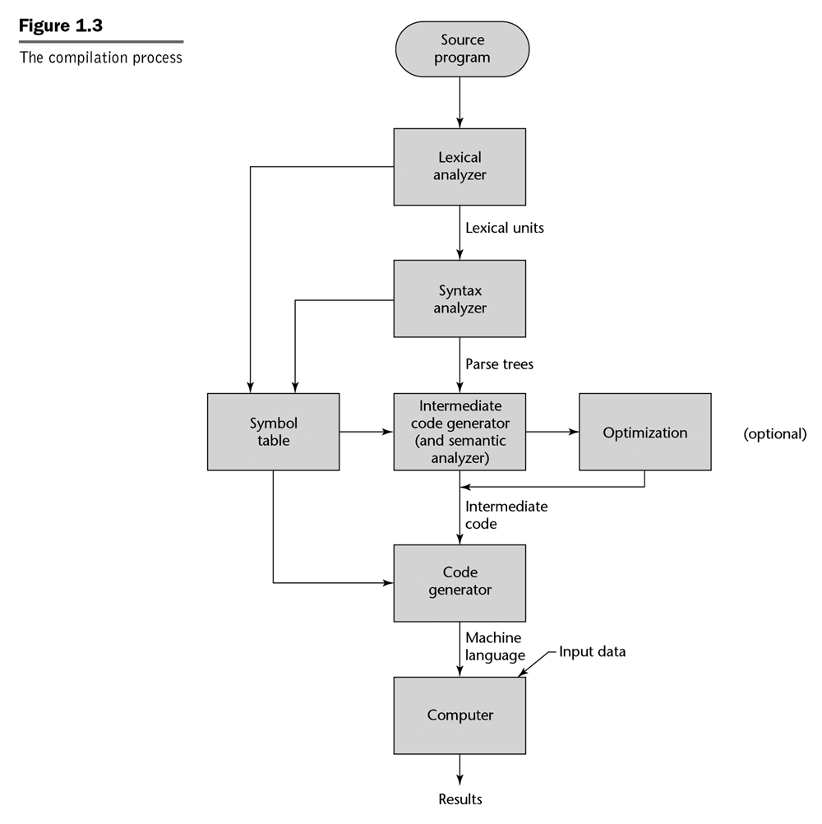
Compiled Languages
Slow translation, fast execution
Groups characters into
lexical units
Transforms lexical units into
parse trees representing the
syntactic structure of the program
Analyzes parse trees to
produce intermediate code
Transforms intermediate code
into executable machine code
Copyright © 2007 Addison-Wesley. All rights reserved.
1-<number>
Dr. David Goldschmidt, The College of Saint Rose

Slide 24
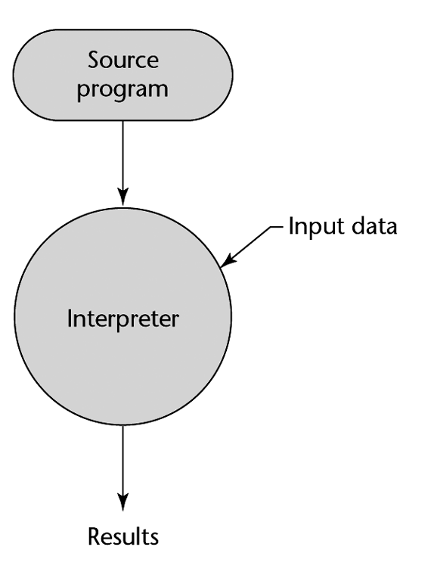

Interpreted Languages
No translation
Easier implementation of programs
  run-time errors can easily and immediately displayed
Slower execution
  10 to 100 times slower than compiled programs
Often requires more space
e.g. BASIC
REM COMMENT
LET X = 5
LET Y = 8
PRINT X
PRINT Y
LET Z = X
PRINT Z
...
Copyright © 2007 Addison-Wesley. All rights reserved.
Also JavaScript....
1-<number>
Dr. David Goldschmidt, The College of Saint Rose

Slide 25
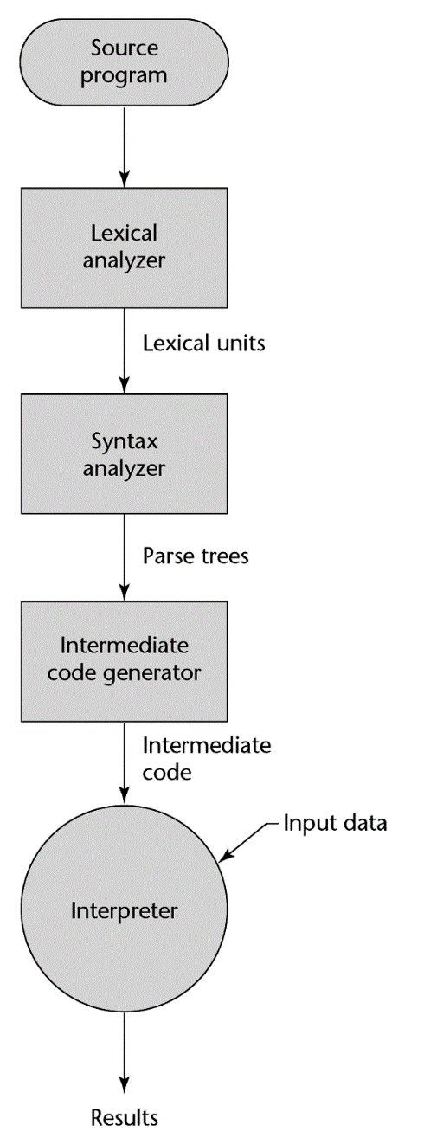

Hybrid Implementations
A compromise between compilers and pure interpreters
A high-level language program is translated to an intermediate language that allows easy interpretation
Faster than pure interpretation
09 AB 19 29 99 73 09 AB 19 29 99 73 09 AB 19 29 99 73 09 AB 19 29 99 73 09 AB 19 29 99 73 09
e.g. Java byte code
e.g. Java Virtual Machine (JVM)
Copyright © 2007 Addison-Wesley. All rights reserved.
Also Perl....
1-<number>
Dr. David Goldschmidt, The College of Saint Rose

Slide 26
Preprocessors
Preprocessor macros (instructions) are commonly used to specify that code from another file is to be included
A preprocessor processes a program immediately before the program is compiled to expand embedded preprocessor macros
A well-known example: C preprocessor
  expands #include, #define, and similar macros
Copyright © 2007 Addison-Wesley. All rights reserved.
1-<number>

Slide 27
Programming Environments
The collection of tools used in software development
UNIX
  An older operating system and tool collection
  Nowadays often used through a GUI (e.g., CDE, KDE, or GNOME) that run on top of UNIX
Borland JBuilder
  An integrated development environment for Java
Microsoft Visual Studio.NET
  A large, complex visual environment
  Used to program in C#, Visual BASIC.NET, Jscript, J#, or C++
Copyright © 2007 Addison-Wesley. All rights reserved.
1-<number>

