Slide 1

SQL

Slide 2

Agenda
What is Database /DBMS?
Difference between SQL/NoSQL
SQL
SQL queries
Instructions
CRUD Commands
Query Hands On

Slide 3


What is Database?
Any collection of related items stored together. e.g.: Facebook user base data, To-do lists, shopping list, contact/phone book
A database is an organized collection of structured information, or data, typically stored electronically in a computer system.

Slide 4
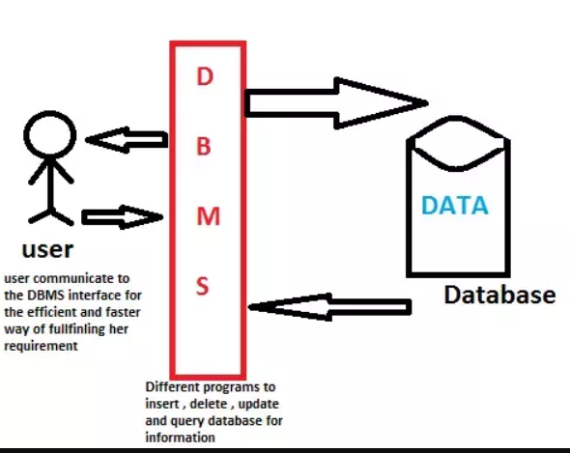
Database Management System
A database is usually controlled by a database management system (DBMS).
A special program that helps user create and maintain Database.
Manage large amounts of data easily
Handles Security
Backup of information
Importing/Exporting Data
Concurrency
Interact with other applications

Slide 5
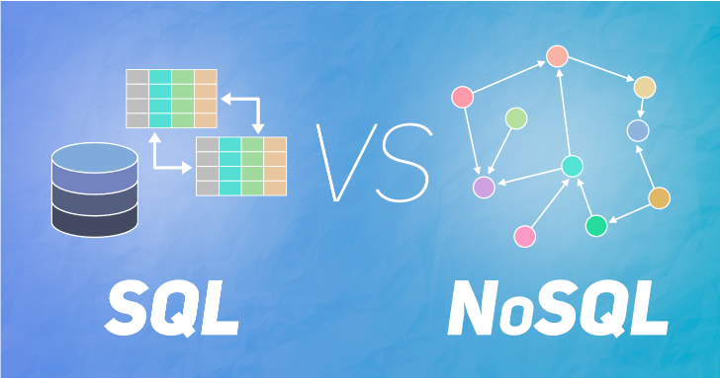
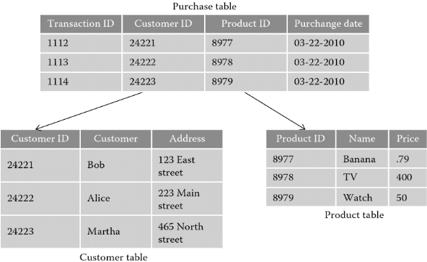
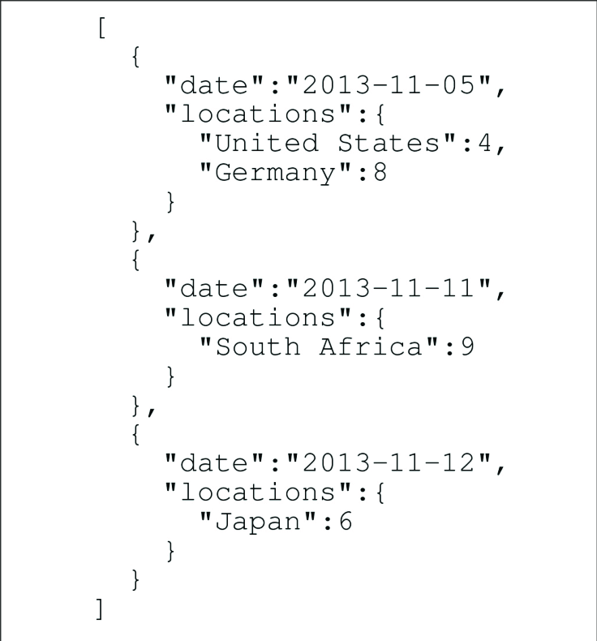
Type of DBs
Relational (SQL)
Organize data into one or more tables
Table has columns and rows
Each row can be identified by a unique key
Non relational (NoSQL aka not just SQL)
Store into anything but traditional table
JSON, XML documents etc.
Key value pair store

Slide 6
SQL
Language used for interacting with Relational DBMS
Used for
Create/manage Databases
Design/Create Database Tables
Create Read Update Delete
Various implementation for different RDBMS. (same concepts though)

Slide 7
SQL Queries
Data Query Language (DQL)
Query database for info (info retrieval)
Data Definition Language (DDL)
Define database schemas
Data Control Language (DCL)
User and permission management
Control access to the data
Data Manipulation Language (DML)
Insert update and delete data from database

Slide 8
Query: Set of instructions that are given to RDBMS so as to extract information we want
The term was likely first popularized by James Martin in his 1983 book Managing the Data-base Environment.
In computer programming, create, read, update, and delete [1] (CRUD) are the four basic functions of persistent storage.
Alternate words are sometimes used, such as retrieve instead of read, modify instead of update, or destroy instead of delete.
The acronym may be extended to CRUDL to cover listing of large data sets which bring additional complexity such as pagination when the data sets are too large to be easily held in memory.
CRUD
Wikipedia: https://en.wikipedia.org/wiki/Create,_read,_update_and_delete

Slide 9
Create — This would consist of a function which is called when a new library book is being added to the catalog. Provide values like “title”, “author”, and “isbn”.
After function call, there should be a new entry in the books resource corresponding to this book.
Additionally, the new entry is assigned a unique id, which can be used to access this resource later.
Read —To see all of the books currently in the catalog. This function call would not alter the books in the catalog - it would simply retrieve the resource and display the results. We would also have a function to retrieve a single book, for which we could supply the title, author, or ISBN.
Update — To change information about a book. The program calling the function would supply the new values for “title”, “author”, and “isbn”. After the function call, the corresponding entry in the books resource would contain the new fields supplied.
Delete — Function call to remove a library book from the catalog. The program calling the function would supply one or more values (“title”, “author”, and/or “isbn”) to identify the book, and then this book would be removed from the books resource. After this function is called, the books resource should contain all of the books it had before, except for the one/group just deleted.
eg: Library database

Slide 10
Example
Student ID | Name | Major_id | Advisor_id
bnh211 | Biman | 1 | 1
yhr278 | Yash | 2 | 2
yhr288 | Yash | Null | Null
Major_id | Branch_Name
1 | Robotics and Mechatronics
2 | Computer Science
Advisor_id | Advisor_Name
1 | Iskender Sahin
2 | Kayla Huang
NOT NULL: Can’t be null
UNIQUE: Have to be unique
Primary Key: Could be one column or multi column (can be composite but has to be unique & not null)
Natural Key: SSN Number
Surrogate Key: Something which is not linked outside
Foreign Key: Primary key of another table
Company_name | major_id | Students_recruited
Google | 1 | 2
Samsung | 2 | 10
Samsung | 1 | 12

Slide 11
Basic Data Types:
INT
DECIMAL (10,2)
VARCHAR (x)
DATE YYYY-MM-DD
TIMESTAMP YYYY-MM-DD HH:MM:SS
And more….( https://www.journaldev.com/16774/sql-data-types )
Note: SQL is not case sensitive.

Slide 12
Resources
Use MYSQL
Download from here https://dev.mysql.com/downloads/mysql/
or use the link (online and easy)
http://sqlfiddle.com/
Only database tables can be created once and then schema is reset.

Slide 13
These work with the sql server on PC:
CREATE DATABASE NYU;
SHOW DATABASES;
USE NYU;
SHOW TABLES;
To change DB
SHOW DATABASES;
USE NYU;
Create Table
CREATE TABLE student(
student_id VARCHAR(6) PRIMARY KEY,
first_name VARCHAR(10) NOT NULL,
major VARCHAR(20) DEFAULT 'undecided'
);
Or
CREATE TABLE student(
student_id VARCHAR(6) ,
name VARCHAR(20),
major VARCHAR(20),
PRIMARY KEY(student_id)
);
CREATE TABLE student(
student_id INT AUTO INCREMENT,
name VARCHAR(20),
major VARCHAR(20),
PRIMARY KEY(student_id)
);

Slide 14
Describe Table
DESCRIBE table_name;
eg: DESCRIBE student;
Modify Table;
ALTER TABLE tablename ADD colname type;
ALTER TABLE student ADD gpa decimal(3,2);
ALTER TABLE tablename DROP last_name;
Delete Table
DROP table table_name;
DROP table student;
Insert Data
Insert into tablename Values(d1,d2,d3);
insert into student values('vvt223','vishnu','cs');
insert into tablename (col1, ….,colx) values(val1,val2,….valx);
Insert into student (student_id,first_name) values('das968','darshan');

Slide 15
Update Data
update table_name
set col_name = 'value'
Condition based update
update table_name
set col_name = 'value’, col_2 = ‘xyz'
where col_x = 'some_val’ or col_y = 'something';
eg:
update student
set major = 'cs'
where student_id = ‘yhr288';
Delete Row
DELETE from student
where student_id = 'vvt223';

Slide 16
Select
SELECT *
FROM table_name;
SELECT col1,col2,…coln
FROM table_name;
SELECT col1,col2,…coln
FROM table_name
ORDER BY col1 DESC ,coln ASC;
SELECT col1,col2,…coln
FROM table_name
Where col_y = ‘something’
ORDER BY col1 DESC,coln
LIMIT n;
SELECT col1,col2,…coln
FROM table_name
WHERE col_x in (‘vvt223’,yhr288’);
SELECT * from table_name
WHERE col_name like ‘_A%’; --WildCard % ->any number of char, _ -> just one char

Slide 17
Question 1:
Select employees from worker table that belong to Admin Department and the result should be displayed in descending order of salary.

Slide 18
Comparison Operators
< lesser than
> greater than
<= lesser than or equal
>= greater or equal
= equal
<> Not equal
AND and
OR or

Slide 19
Alias
SELECT col_name AS abc from table_name;
Select Distinct
SELECT distinct col_name from table_name;
Change Text presentation
SELECT upper(col_name) from table_name;
Print Selective text from column
SELECT substring(col_name,start,stop) from table_name;
Print trimmed text
SELECT TRIM (col_name) from table_name;
Print replaced Text
SELECT REPLACE (col_name, 'original', 'new') from table_name;
Print combined columns
SELECT CONCAT (col_1, ' ‘, col_2) as final_col from table_name;

Slide 20
Questions
2.Print the complete name and department of employee ordered in ascending order by last name followed by first name.
Hint: Vishnu Thakral should be printed as Thakral Vishnu
3. Write an SQL query to print details of the Workers whose FIRST_NAME ends with ‘a’.
4. Fetch the different department names.

Slide 21
FUNCTIONS
COUNT
SELECT COUNT(col_name);
AVG
SELECT AVG(SALARY);
SUM
SELECT SUM(SALARY);
Aggregation
SELECT COUNT(col_name) FROM table_name
GROUP BY col_name;

Slide 22
Questions.
5. Find the average salary of employees in each department.
6. Select the rows for employees who joined in June of 2014.

Slide 23
Union
Select and display results from different queries in a single result.
Note: The number of returned rows and their data types should be same
SELECT first_name as some_name from worker
UNION
SELECT LAST_NAME from worker;
Result
Emp Id | Name | Role
1 | a | Developer
2 | b | Admin
Emp Id | Name | Role
3 | c | Manager
Emp Id | Name | Role
1 | a | Developer
2 | b | Admin
3 | c | Manager
Question 7.
Extract the amount of money spent by company in paying salary and bonus.

Slide 24
Joins
Combine rows from 2 or more tables based on similar column.
Eg:
Select w.WORKER_ID, w.FIRST_NAME, w.LAST_NAME, w.SALARY, b.bonus_amount
from worker w
join bonus b
on w.WORKER_ID = b.WORKER_REF_ID;
Emp Id | Name | Role
1 | a | Developer
2 | b | Admin
Emp Id | Salary
1 | 50000
Emp Id | Name | Role | Emp Id | Salary
1 | a | Developer | 1 | 50000

Slide 25
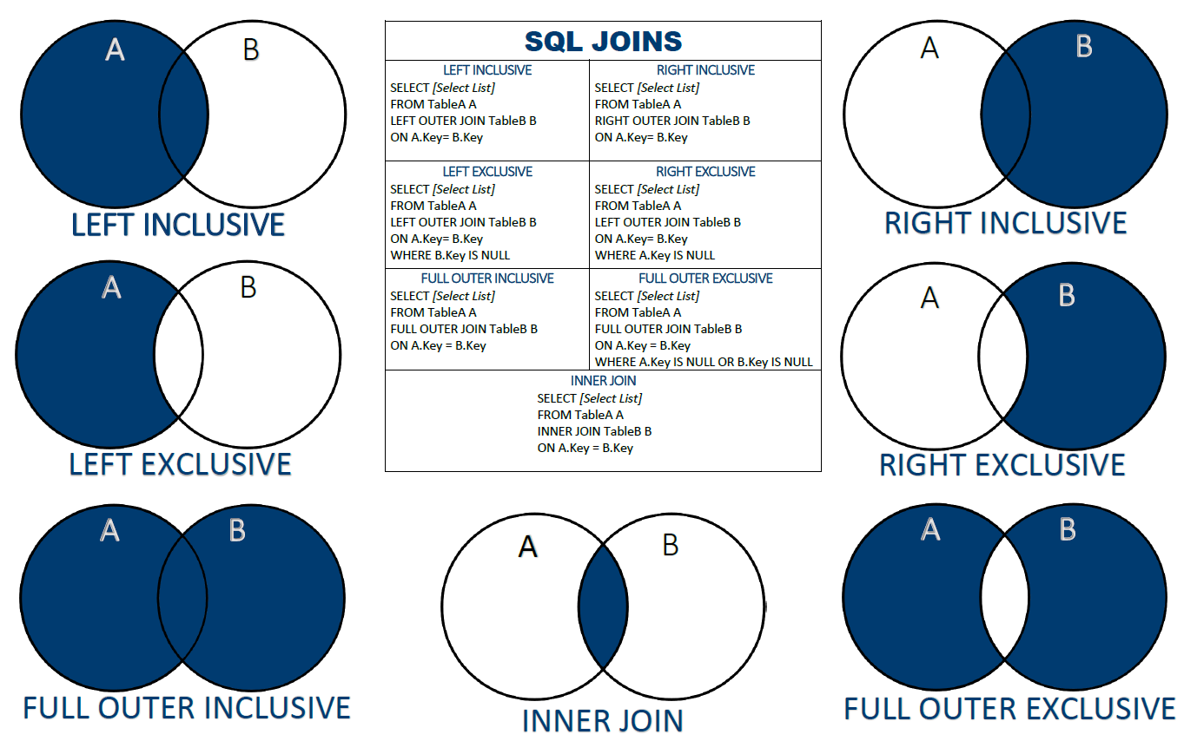
Types of Joins

Slide 26
Question 8
Select employee details who earn learn less than 100000 and have a bonus greater than 3000

Slide 27
Nested Queries
Use result from a query to make another query!
eg:
select w.WORKER_ID, w.FIRST_NAME, w.LAST_NAME, w.department,w.SALARY
from worker w
where w.worker_id in (
select b.WORKER_ref_ID from bonus b where bonus_amount>3000)
and worker.department = 'HR';

Slide 28
Questions
Q9
Select the employee first_name, last_name, salary and department of person who received the max bonus in 6th month of 2016.
Hint: The details related to Niharika Verma should get extracted from Worker table.

Slide 29
Case
Adds the functionality of if else condition or switch cases from normal programming.
Syntax: case when some_col < val then ‘a’ else ‘b’ end as some_name
Eg: select name, salary, case when salary>100000 then ‘well paid’ else ‘under paid’ end as cat from worker;
Question
Select Yes for compensated if bonus_amount >5000 else No from bonus table.

Slide 30
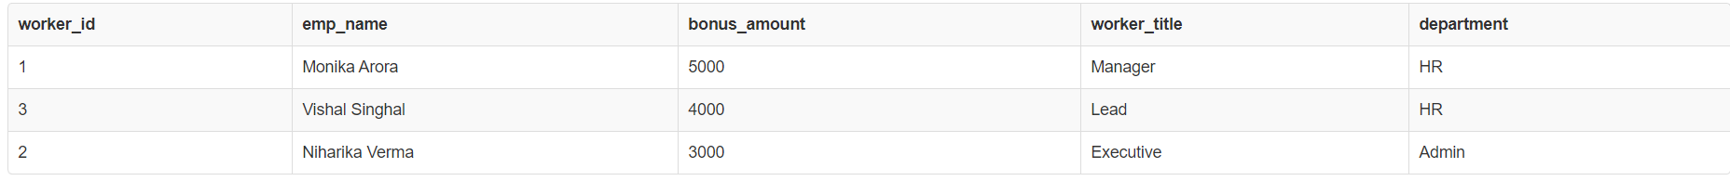
Assignment
Q10
Select the name, bonus, work_title and department of employee(s) who get the max bonus in their category of worker_title.
(Try using Joins and Subqueries)
Result set should be like below
For each agent calculate the number of customers he/she deals with and the total amount earned through commission.

Slide 31

Thank You!
Send queries to: datasciencebootcamp@nyu.edu
Provide Feedback at: link

