Slide 1
Design and Analysis of Algorithms
ASSIGNMENT-21
Group-2 Section-C
IIB2019004 Saloni Singla
IIB2019005 Sandeep Kumar
IIB2019006 Amanjeet Kumar

Slide 2
Problem:
The longest Zig-Zag subsequence problem is to find length of the longest subsequence of given sequence such that all elements of this are alternating.

Slide 3
01
Approach
Basic

Slide 4
ALGORITHM-1
During recursion, we will determine the state of the problem if,
State is 0 then we want an element smaller than it as subsequence is already been started
State is 1 then t we want an element greater than it as subsequence is already been started
State is 2 then we can take any element as subsequence is yet to be started.
Then in the Base case, when we have no further elements left. (n==0).
After knowing the state, either discard the number or include the number in the current sequence if the previous element is smaller with state = 1 or previous element is greater with state = 0 and if state =2 we take all of the possibilities.

Slide 5
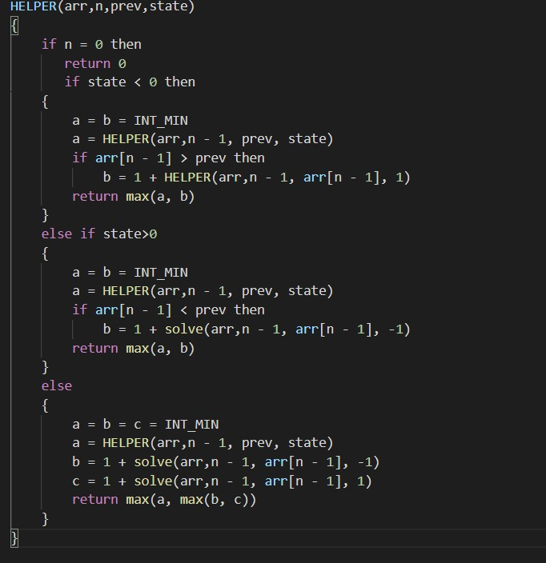
Pseudo Code :

Slide 6
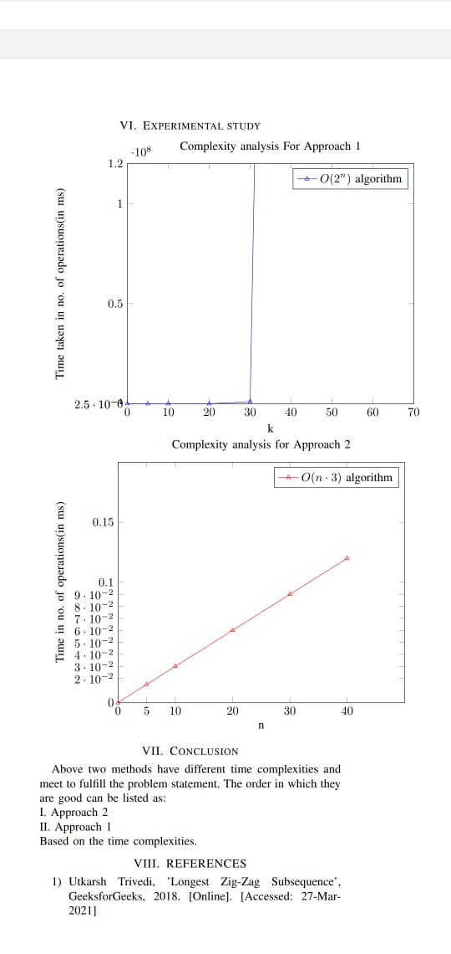
Time Complexity and Space Complexity Analysis
Time Complexity Analysis
The time complexity will beO(2^n)because it checks out allthe possibilities by recursing.
Space Complexity Analysis
The space complexity isO(n),for storing the input array.

Slide 7
02
Approach
Using DP

Slide 8
ALGORITHM-2
At start, we get to know about the state of the problem whether it is 0, 1 or 2.
To store the values of each element, there is a two dimensional matrix of size n x 3 (dp[n][3]).
2D matrix will store each element’s state in best possible way.
If the value of dp[i][state] is precalculated then directly pass on it for further calculation, else calculate dp[i][state] and store it for further use.
Finally we return the lenght of the subsequence.

Slide 9
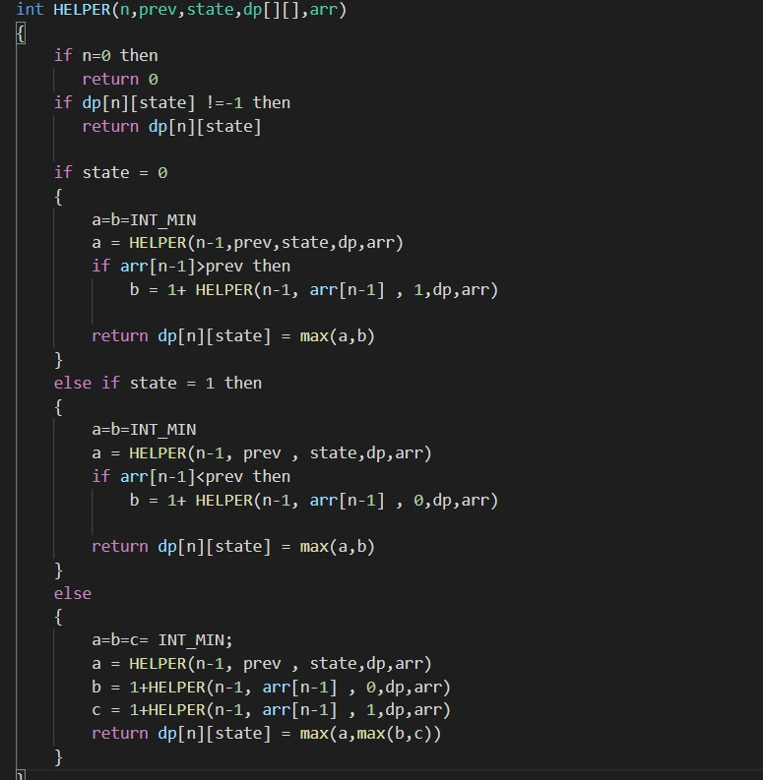
Pseudo Code :

Slide 10
Time Complexity and Space Complexity Analysis
Time Complexity Analysis
The time complexity will beO(n∗3)because we are in away doing memoization our approach 1 code and saving time by using values of the precalculated subproblems.
Space Complexity Analysis
The space complexity will beO(n)for input array andO(n∗3)for storing the values of each condition by dynamic programming.

Slide 11
CONCLUSION
Above two methods have different time and space complexities and meet to fulfill the problem statement. The order in which they are good can be listed as:
I. Approach 1
II. Approach 2
Based on the time complexities and space complexities.
REFERENCES
Utkarsh Trivedi, ’Longest Zig-Zag Subsequence’,GeeksforGeeks, 2018. [Online]. [Accessed: 27-Mar-2021]

