Slide 1

Operation Theatre
Efforts By:- Aman Kushwaha
Class:- XII – C

Slide 2
Acknowledgement
I have taken efforts in this project. However, it would not have been possible without the kind support and help of many individuals.
I would like to thank my principal Dr. M. Kannan and school for providing me with facilities required to do my project.
I am highly indebted to my Healthcare teacher, Mrs. Rita David, for her invaluable guidance which has sustained my efforts in all the stages of this project work.
I would also like to thanks my parents for their continuous support and encouragement.
My thanks and appreciation also go to my fellow classmates and the laboratory assistant in developing the project and to the people who have willingly helped me out with their abilities.

Slide 3
Certificate
This is to certify that "Healthcare Investigatory Project" on the Topic "Operation Theatre" has been successfully completed by Aman Kushwaha of class XII-C under the guidance of Mrs. Rita David in particular fulfilment of the curriculum of All India Senior School Certificate Examination (AISSCE) Leading to the award of annual examination of the year 2022-23.
Signature of the Healthcare Teacher
Signature of the External Examiner
Signature of the Healthcare Teacher

Slide 4
Index
Introduction
Main Content:-
Design and layout of the operation theater
Technology used in the operation theater
Sterilization processes
Infection control measures
Conclusion
Bibliography

Slide 5
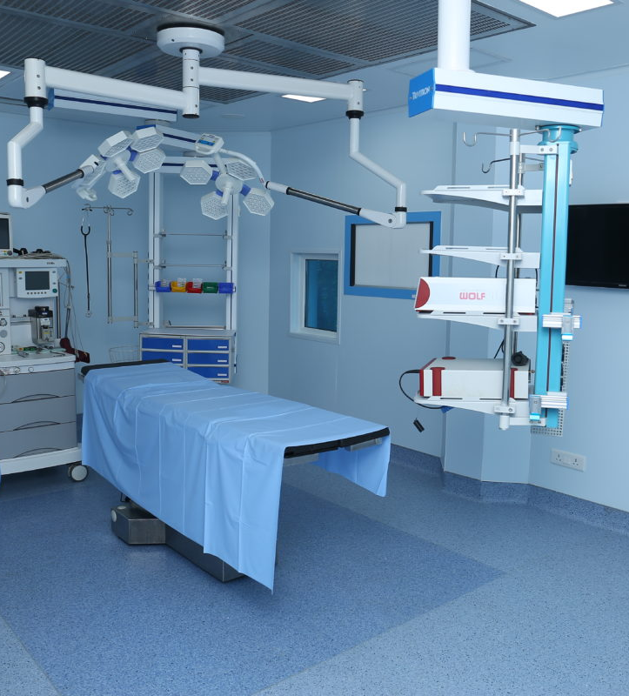
Introduction
An operation theater is a specialized space in a healthcare facility where surgical procedures are performed. It is equipped with advanced medical technology and is designed to ensure the safety and comfort of both the patient and the surgical team. The operation theater is typically a sterile environment with strict infection control measures in place to prevent the spread of infections. The surgical team wears personal protective equipment to protect themselves and the patient. The operation theater is used for a wide range of surgical procedures and plays a crucial role in the delivery of healthcare by allowing surgeons to perform complex procedures that can improve the health and well-being of patients.

Slide 6
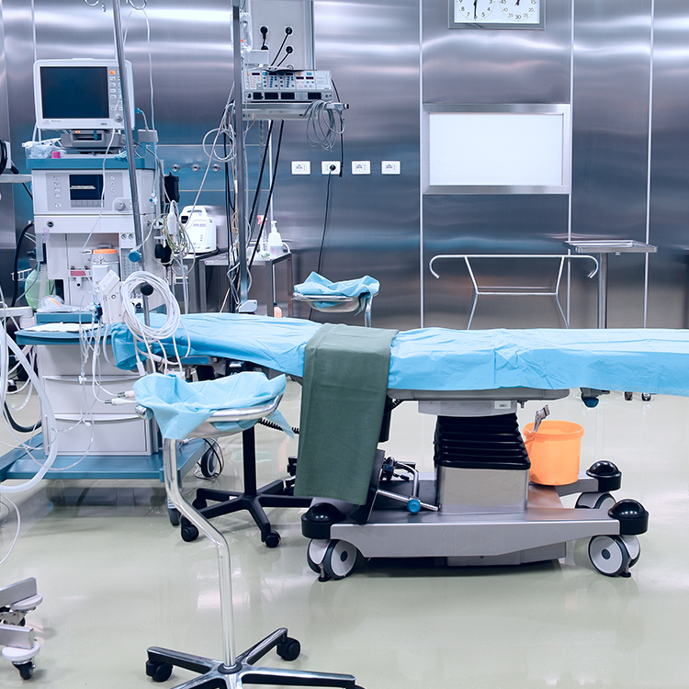
Design and layout of the operation theater
The design and layout of the operation theater are important considerations to ensure the safety and efficiency of surgical procedures. The operation theater should be designed to maximize the flow of people, equipment, and supplies, while minimizing the risk of infections and other complications.
Some key considerations in the design and layout of the operation theater include:
Size and shape
Lighting
Ventilation
Equipment and supplies
Sterile field

Slide 7
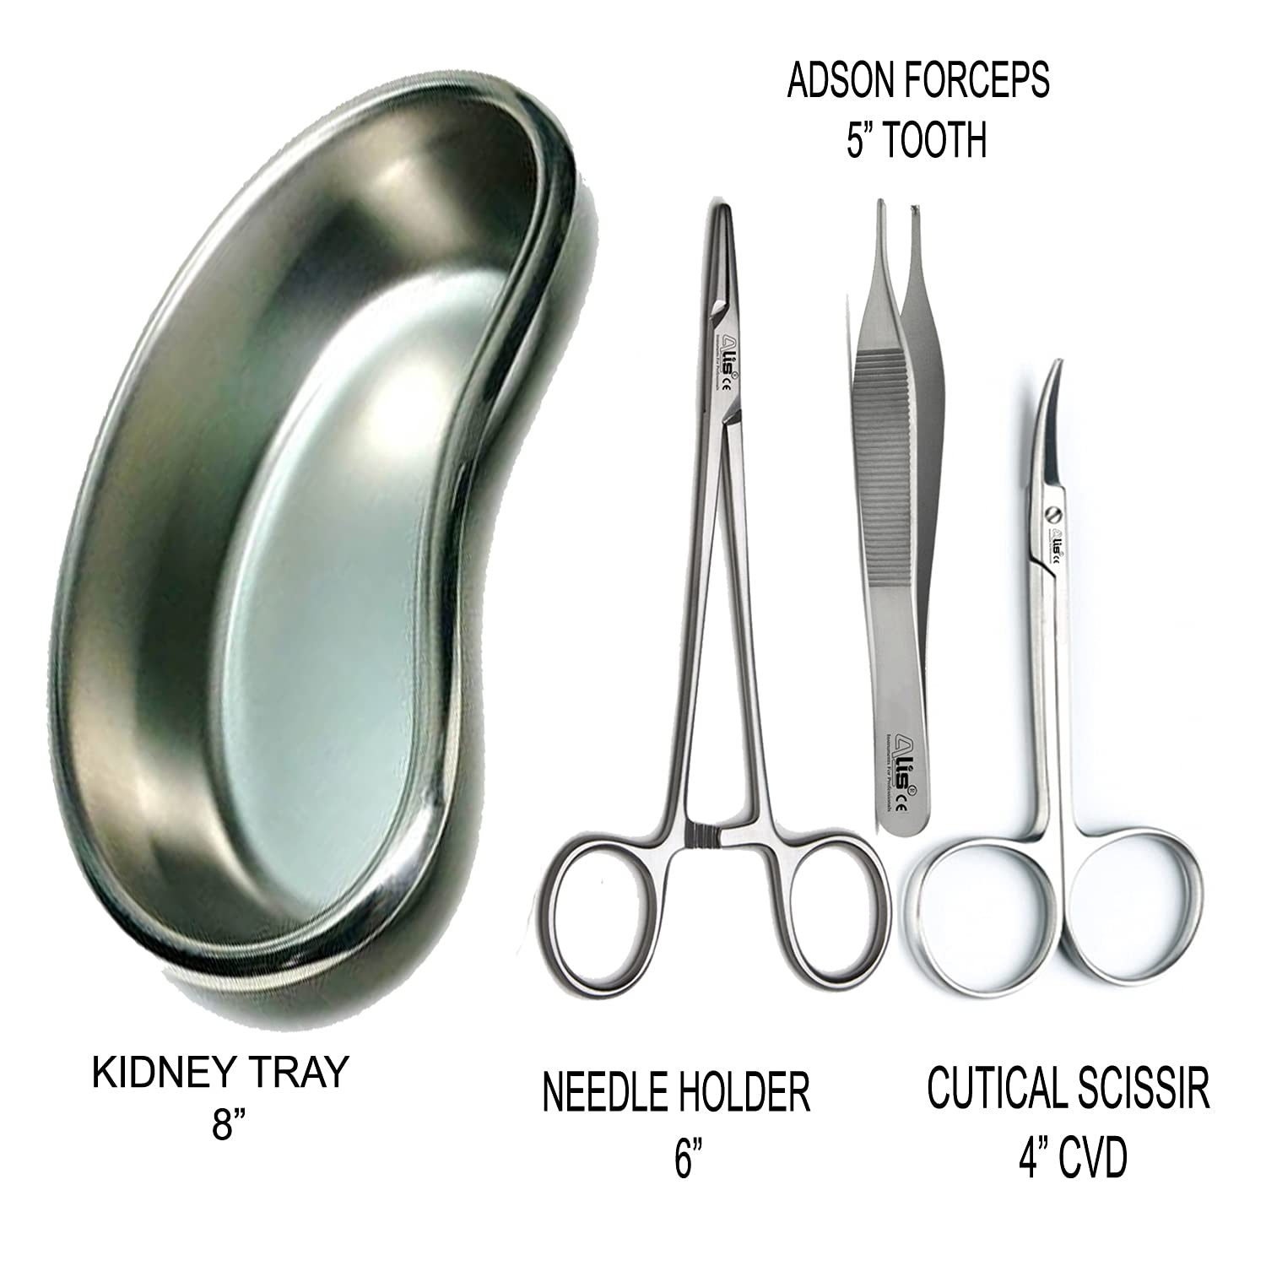
Technology used in the operation theater
Technology plays a vital role in the operation theater, providing the tools and equipment needed to perform complex surgical procedures safely and effectively. Some examples of the technology used in the operation theater include:
Surgical instruments
Monitoring equipment
Communication systems
Imaging equipment
Robotic surgery systems

Slide 8
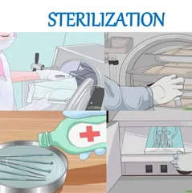
Sterilization processes
Sterilization is the process of removing or killing all forms of microorganisms, including bacteria, viruses, and fungi, on a surface or object. In the operation theater, sterilization is an important measure to prevent the spread of infections and to ensure the safety of the surgical team and patient.
There are several methods used to sterilize equipment and surfaces in the operation theater, including:
Heat sterilization
Chemical sterilization
Ionizing radiation
Filtration

Slide 9
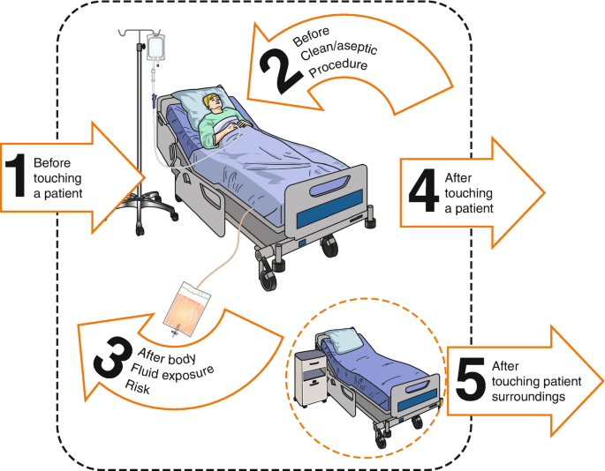
Infection control measures
Infection control measures are important in the operation theater to prevent the spread of infections and protect the patient, the surgical team, and other healthcare workers.
Some examples of infection control measures that may be used in the operation theater include:
Hand hygiene
Personal protective equipment (PPE)
Sterilization of equipment
Environmental cleaning
Isolation precautions

Slide 10

Conclusion
To conclude, the operation theater is a critical space in the healthcare system, where surgical procedures are performed. The design and layout of the operation theater, as well as the technology used, play important roles in ensuring the efficiency, safety, and effectiveness of surgical procedures. Sterilization processes and infection control measures are also crucial in preventing infections and maintaining the safety of the surgical team and patients. Overall, the operation theater is a complex and dynamic environment that requires careful planning and management to ensure the best outcomes for patients.

Slide 11
Bibliography
https://en.wikipedia.org/wiki/Operating_theater
https://www.google.com
https://consteril.com/sterilizing-medical-equipment/
https://otpotential.com/blog/new-occupational-therapy-tech-tools

