Slide 1
WEATHER WEB APP
Submitted By – Aman Kala
Section – k1
University roll no. - 2218312
Course – B.tech CSE
Semester - v

Slide 2
OVERVIEW OF THE PRESENTATION
Introduction
Working of the Project
Technology Used
Data Source
Benefits
Architecture Diagram

Slide 3
INTRODUCTION
The Proposed System provides the weather of
different cities around the World.
In this system the user can view Weather for which
they search for.
The system can track Local and National Weather.
The Proposed system uses OpenWeatherMap API for searching the Weather.

Slide 4
WORKING OF THE PROJECT
The User is asked to enter the name of the city.
User then clicks on Search which further calls the OpenWeatherMap API.
Weather conditions of place which include Temperature, Humidity, Wind Speed are displayed.
If user wishes to search weather for other cities he can re-enter the city name in search bar and press enter.
If user wishes to exit, he can simply close the application.
In this system don't need to setup weather station in each city on each country to get weather information. We can get those information including Temperature, Humidity etc. by using Weather API.

Slide 5
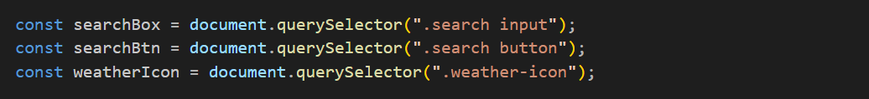
WORKING OF JAVASCRIPT
1.
These constants store the API key for OpenWeatherMap and the base URL for making API requests.
2.
These variables store references to HTML elements. searchBox represents the input field where the user can type the city name, searchBtn is the button to initiate the search, and weatherIcon is an image element to display the weather icon.

Slide 6
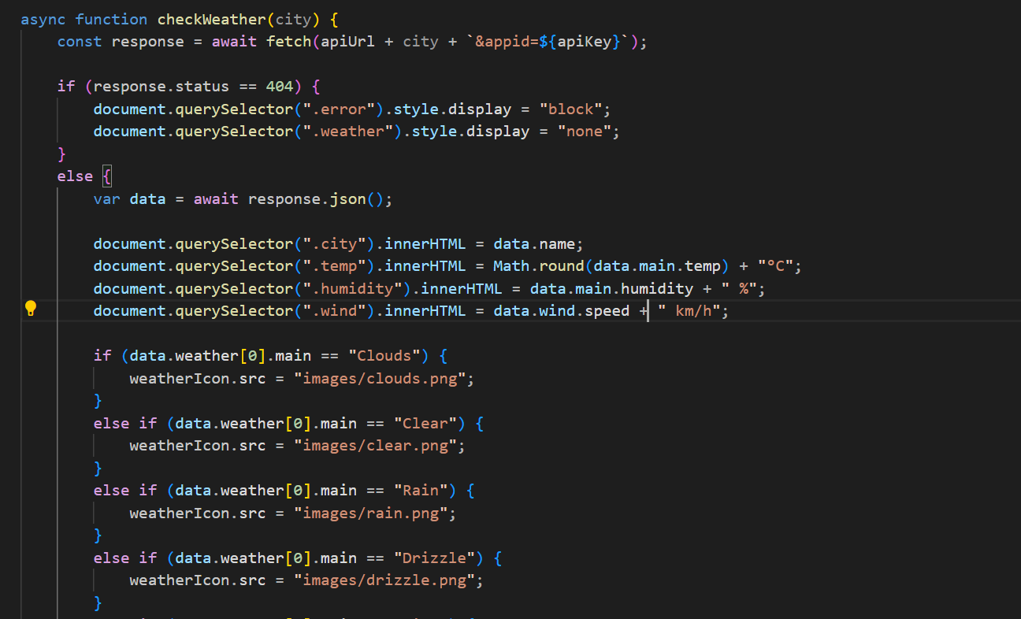
3.

Slide 7
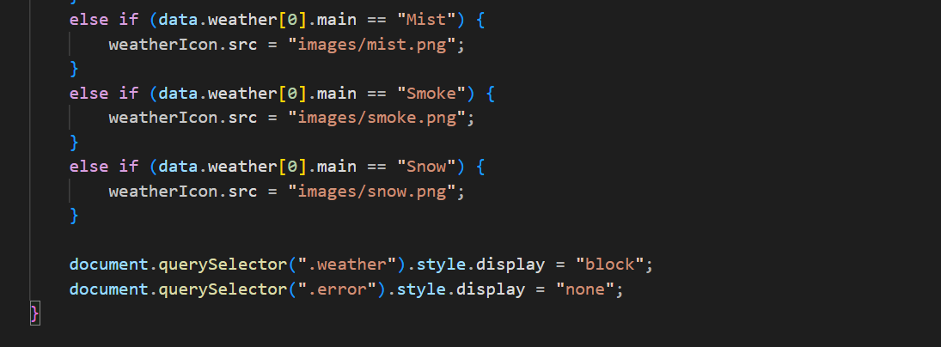
This function is declared as async to handle asynchronous operations like fetching data from the API. It takes a city name as a parameter, constructs the API URL, and makes a request to OpenWeatherMap. If the city is not found (404 status), it displays an error message; otherwise, it extracts and displays relevant weather information on the webpage.

Slide 8
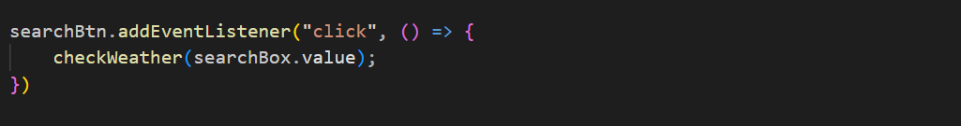
4.
This event listener is attached to the search button. When the button is clicked, it calls the checkWeather function with the value entered in the search input box.

Slide 9
TECHNOLOGY USED
Programming Languages :
1. HTML
2. CSS
3. JavaScript
API: OpenWeatherMap API

Slide 10
DATA SOURCE
This system uses OpenWeatherMap API to get the weather information.
OpenWeatherMap API , one of the world's largest API hub, is used by millions of developers to find, test, and connect to thousand of APIs.
The back-end of the application uses API from OpenWeatherMap API, which is an open source and enables anyone to download APIs for various purposes.

Slide 11
BENEFITS
The weather app enables you make better preparation for the day in relation to giving accurate daily weather.
We need Weather App to plan Journeys ahead, To plan meetings / commute timings.
A person travelling in a bus, train or flight may need to check the weather in his destination city.
The system provides you with details of the weather elements — Temperature, Wind speed, Humidity.

Slide 12
ARCHITECTURE DIAGRAM
User Device
Enter City Name
FRONTEND
Sending response
back to User
Request for Weather
Open OpenWeatherMap API
BACKEND
Current Weather Details

Slide 13
THANK YOU

