Slide 1
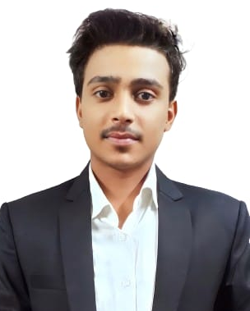
Aman Gupta
Contact
CAREER OBJECTIVE
Village :- Kuri
As a student with over two years of hands-on experience in full-stack web development, I have honed my skills in JavaScript and have a strong background in building marketable and responsive applications. My passion lies in solving complex problems and collaborating with cross-functional teams to drive innovation. I am eager to leverage my skills and knowledge to contribute to dynamic projects and learn from industry professionals.
Apart from this, I have also learned Python or Java programming language or am doing Flutter course for application.
Post Office :- Meyari
Police Station :- Nokha
Pin Code :- 802217
Phone No. :-
EDUCATION
+91 8252339216
B.Tech in computer Engineering 2022 pursuing RK.University rajkot 7.64 (Sgpa)
Email Id :-
74%, D.r. B. R. Ambedkar Computer (ADCA), Sasaram January 2022 - October 2022
kramangupta8552@gmail.com
Linkedin Id :-
12TH RANK:- Second (54%), R.K College, Dehri May 2021 - April 2022
linkedin.com/in/aman-gupta-0850782b2/
10TH RANK:- First (60%), SHU HIGH SCHOOL, MEYARI BAZAR March 2019 - April 2020
WORK EXPERIENCE
Hobbies
Java Programming
CodSoft, Virtual
Internship • Aug 2024 - Sep 2024 (1 month)
My first internship in codsoft on java programming in one month, in this internship i have many projects with internship experience. So i am very happy to this certificate.
Cycling
Painting
Traveling
SKILLS
Technical skills
Html , CSS , jQuery , (Laravel)
Language
Python programming
Java programming
Hindi ★★★★★
English ★★★☆☆
NON-Technical skills
Bhojpuri ★★★★★
Leadership , Communication Skills
Time management , Problem Solving
Ability to Work Under pressure
REFERENCE
Prof. Shalini jha
Professor CE/IT , Dept. RK. University
Email :- shalini.jha@rku.ac.in

