Slide 1

Compatibility Analysis of Different Level of Type-n Fuzzy Set
Project ID: 14326
By
Aman Kumar Roll# IT201510698
Puja Gupta Roll# CSE201519681
Under the guidance of
Dr. Santosh Kumar Das Kumar Das
Notes:
B-TECH PROJECT MID-SEM PRESENTATION 2011
BY KHUSHBU KHAN & ISAN SAHOO

Slide 2
TABLE OF CONTENTS
Introduction
Objective
Type -1 fuzzy set
Extension principle
Type-2 fuzzy set
Operation in type-2 fuzzy set
Project done so far
Results
Conclusion

Slide 3
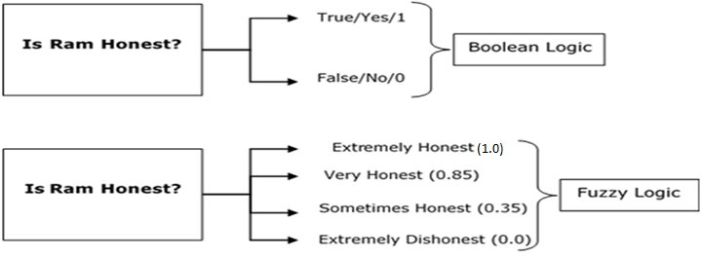
INTRODUCTION
Fuzzy logic is a form of many-valued logic in which the truth values of variables may be any real number between 0 and 1.
Fuzzy logic is based on degree of certainty.
Boolean logic vs fuzzy logic
Notes:
B-TECH PROJECT MID-SEM PRESENTATION 2011
BY KHUSHBU KHAN & ISAN SAHOO
3

Slide 4
OBJECTIVE
To analyse each layer of fuzzy set and coming across difficulty of each fuzzy set and by solving we are moving further type of fuzzy.

Slide 5
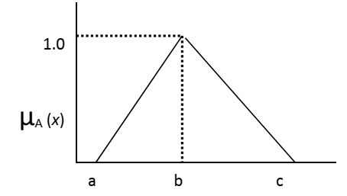
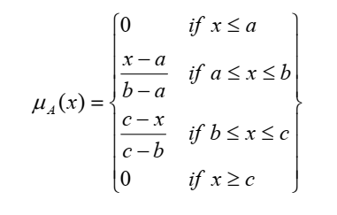
TYPE -1 FUZZY SET
In type-1 fuzzy set the every elements is having membership function which is denoted by µ_{A} (x), where µ_{A}(x) →[0, 1] .
Mathematical representation of type-1 fuzzy set
A={(x, µ_{A}(x)) |x ∈X}
In which 0≤ µ_{A}(x) ≤1.
Triangular membership function

Slide 6
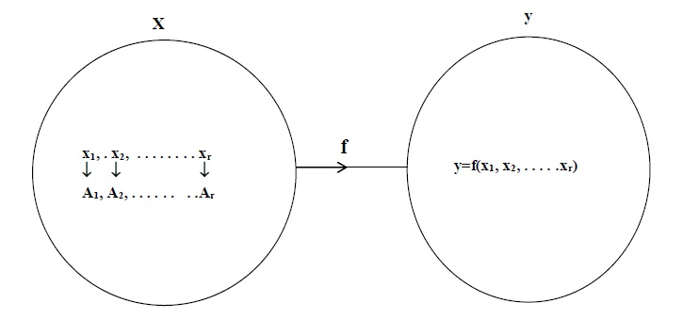
EXTENSION PRINCIPLE
Fig 3: Mapping function from x to y.
Mapping f: X→Y
where y=f(x₁, x₂, x₃, . . . . . x_{r})

Slide 7

CONTINUE
$\overline{B}$= {(y, µ$\overline{B}$(y)) | y=f ( x_{1,} x_{2,} x_{3,……….,}x_{n}) ∈ X}
µ$\overline{B}$(y) = $\underset{\left(x_{1 ,}x_{2….. ,x_{n }}\right) \text{∈}{ f}^{−1}}{Sup}{ }$(min [(µ_{Ā1}(x), µ_{Ā2}(x),.., µ_{Ān}(x)]), if $f^{−1}$(y) ≠0
0 , otherwise

Slide 8
TYPE-2 FUZZY SET
Type-2 fuzzy sets and systems generalize standard type-1 fuzzy sets and systems so that more uncertainty can be handled.
Type-2 fuzzy sets are able to handle such uncertainties because their membership functions are themselves fuzzy
Type-2 fuzzy set, mathematically denoted by,
Ā ={((x) ,µ_{Ā} (x)) | ∀_{x} ∈ X}
where µ_{Ā} (x)={u_{i,} µ_{ui} (x)}
In which 0 ≤ µ_{Ã}(x) ≤ 1

Slide 9
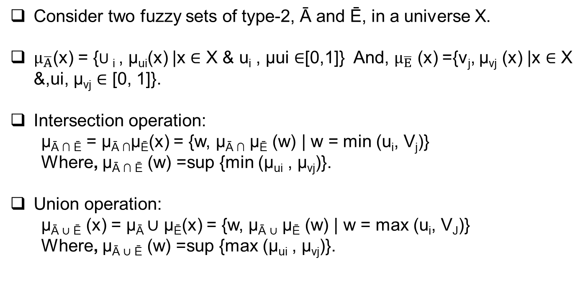
OPERATION IN TYPE-2 FUZZY SET
Consider two fuzzy sets of type-2, Ā and Ē, in a universe X.
$µ_{\overline{A}}$(x) = {U _{i} , µ_{ui}(x) |x ∈ Χ & u_{i} , µui ∈[0,1]} And, $µ_{\overline{E}}$ (x) ={v_{j}, µ_{vj} (x) |x ∈ Χ &,ui, µ_{vj} ∈ [0, 1]}.
Intersection operation:
µ_{Ā ∩ Ē} = µ_{Ā ∩}µ_{Ē}(x) = {w, µ_{Ā ∩} µ_{Ē} (w) | w = min (u_{i}, V_{j})}
Where, µ_{Ā ∩ Ē} (w) =sup {min (µ_{ui} , µ_{vj})}.
Union operation:
µ_{Ā ∪ Ē} (x) = µ_{Ā} ∪ µ_{Ē}(x) = {w, µ_{Ā ∪} µ_{Ē} (w) | w = max (u_{i}, V_{J})}
Where, µ_{Ā ∪ Ē} (w) =sup {max (µ_{ui} , µ_{vj})}.

Slide 10
PROJECT DONE SO FAR
For analysing problem with type-1 we have taken two function.
Raise and decrease function and in each function we have taken two sample of type-1 fuzzy set.
A,B is the sample from raise function and P,Q is the sample from decrease.
After taking two set in each function we analyse that some of uncertentity occur.
To remove this uncertentity we move toward type-2 by using extension principle .

Slide 11
CONTINUE
After discovering type-2 set we perform certain operation such as union and intersection.
While performing operations we analyse that it is very difficult to visualise because of its three dimension nature .
Just because till now only three dimension is being discovered and all further dimension are just a theoretical due to which we are unable to move in further type of fuzzy logic.

Slide 12
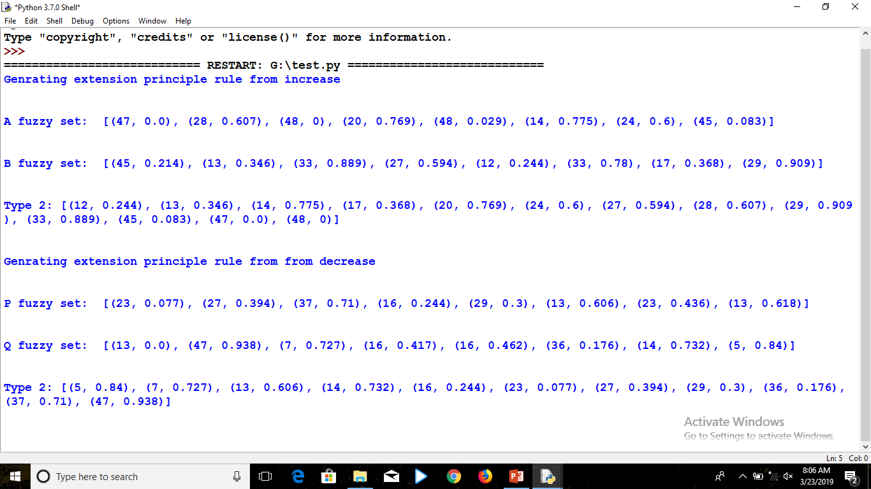
RESULTS

Slide 13
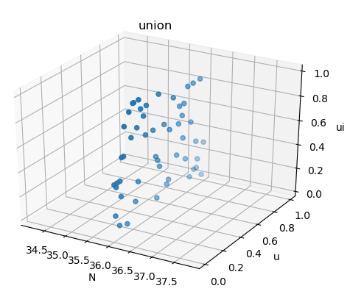
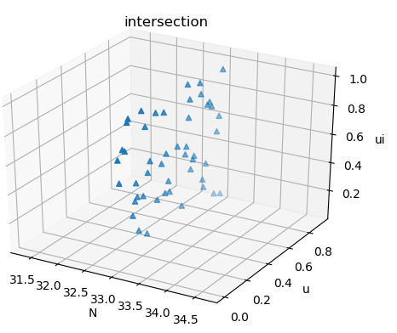
CONTINUE

Slide 14
CONCLUSION
We have concluded that when we move further type uncertentity can be solved but the complexity increases which is difficult to visualize

Slide 15
REFERENCES
[1] L.A. Zadeh, Fuzzy Sets, Information, 1965
[2] L.A. Zadeh,” Making computers think like people,” IEEE. Spectrum, 8/1984, pp. 26- 32.
[3] Ship-Peng Lo, “An adaptive-network based fuzzy inference system for prediction of work piece surface roughness in end milling”, Journal of Materials Processing Technology, Volume 142, Issue 3, pp. 665-675, 10 December 2003.
[4] Pappis, C., Mamdani, E., (1977) “A fuzzy controller for atraffic junction”, IEEE Transactions on Systems, Man and Cybernetics SMC-7, pp. 707-717
[5] Abbasi, M.M., Kashiyarndi, S., 2006. Clinical decision support systems: a discussion on different methodologies used in health care (2006)

Slide 16
Thanks!

