Slide 1
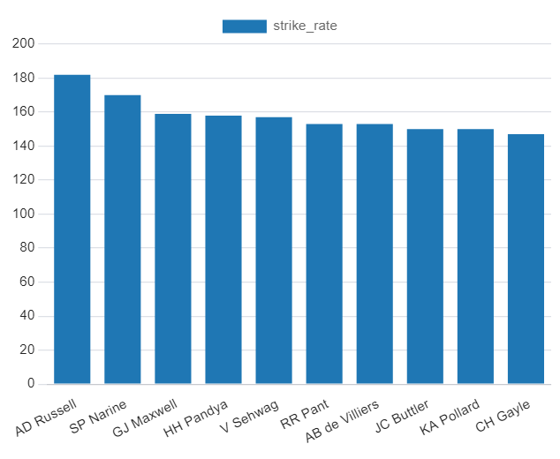
Top 10 (AGGRESSIVE) playeRs with Highest Strike Rate QUERY: (select batsman,count(ball) as total_balls,sum(batsman_runs) as run_scored,sum(batsman_runs)*100/count(ball) as strike_rate from iplballs where dismissal_kind= 'NA' group by batsman having count(ball)>=500 order by strike_rate desc limit 10;)

Slide 2
TOP 10 (AGGRESSIVE) PLAYERS WITH HIGHEST STRIKE RATE
batsman | total_balls | run_scored | strike_rate
AD Russell | 832 | 1517 | 182
SP Narine | 524 | 892 | 170
GJ Maxwell | 944 | 1505 | 159
HH Pandya | 850 | 1348 | 158
V Sehwag | 1735 | 2727 | 157
RR Pant | 1357 | 2077 | 153
AB de Villiers | 3150 | 4846 | 153
JC Buttler | 1136 | 1712 | 150
KA Pollard | 2001 | 3020 | 150
CH Gayle | 3226 | 4770 | 147

Slide 3
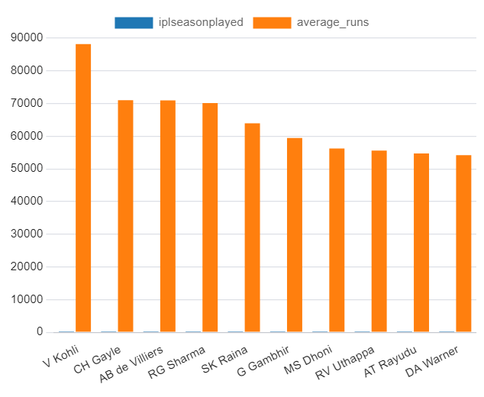
TOP 10 (ANCHOR) PLAYERS WITH HIGHEST AVERAGE RUNS Query: (select a.batsman as playername,sum(a.batsman_runs)/count(distinct(extract(year from b.date))) as average_runs,count(distinct(extract(year from b.date))) as iplseasonplayed from iplballs as a join iplmatch as b on a.batting_team in (b.team1,b.team2) where a.batsman_runs>=0 group by a.batsman having avg(a.batsman_runs) is not null and count(distinct(extract(year from b.date)))>2 order by average_runs desc limit 10;)

Slide 4
TOP 10 (ANCHOR) PLAYERS WITH HIGHEST AVERAGE RUNS
playername | average_runs | iplseasonplayed
V Kohli | 88170 | 13
CH Gayle | 71032 | 13
AB de Villiers | 70980 | 13
RG Sharma | 70148 | 13
SK Raina | 63925 | 13
G Gambhir | 59463 | 13
MS Dhoni | 56226 | 13
RV Uthappa | 55584 | 13
AT Rayudu | 54746 | 13
DA Warner | 54199 | 13

Slide 5
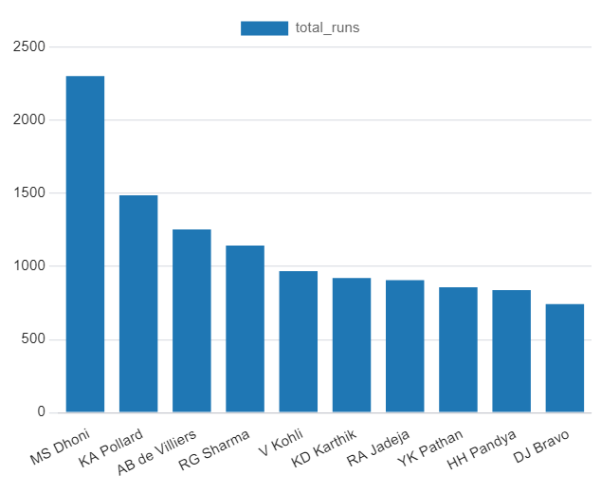
TOP 10 (HITTER)PLAYERS WITH HIGHEST RUNS QUERY: (select batsman,sum(batsman_runs) as total_runs from iplballs where over>15 group by batsman order by total_runs desc limit 10;)

Slide 6
TOP 10 (HITTER) PLAYERS WITH HIGHEST RUNS
batsman | total_runs
MS Dhoni | 2303
KA Pollard | 1487
AB de Villiers | 1254
RG Sharma | 1144
V Kohli | 968
KD Karthik | 921
RA Jadeja | 906
YK Pathan | 858
HH Pandya | 838
DJ Bravo | 742

Slide 7
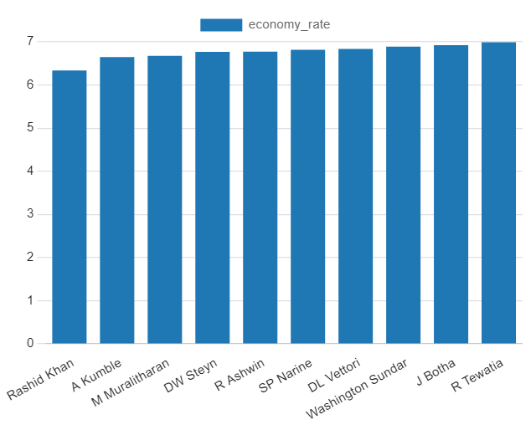
TOP 10 (ECONOMY) BLOWERS WITH HIGHEST ECONOMY QUERY: (select bowler,count(ball) as balls_delivered,sum(total_runs) as total_runs,sum(total_runs)*6.0/count(ball) as economy_rate from iplballs group by bowler having count(ball)>500 order by economy_rate asc limit 10;)

Slide 8
TOP 10 (ECONOMY) BLOWERS WITH HIGHEST ECONOMY RATE
bowler | balls_delivered | total_runs | economy_rate
Rashid Khan | 1490 | 1573 | 6.334228188
A Kumble | 983 | 1089 | 6.646998983
M Muralitharan | 1577 | 1755 | 6.677235257
DW Steyn | 2276 | 2568 | 6.769771529
R Ashwin | 3327 | 3756 | 6.773669973
SP Narine | 2824 | 3208 | 6.815864023
DL Vettori | 785 | 894 | 6.833121019
Washington Sundar | 660 | 758 | 6.890909091
J Botha | 709 | 818 | 6.922425952
R Tewatia | 587 | 684 | 6.991482112

Slide 9
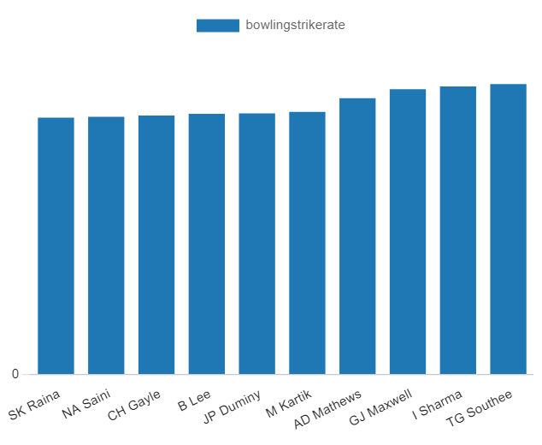
TOP 10 (WICKET TAKER) BOWLERS WITH BEST STRIKE RATE QUERY: (select bowler,count(ball) as ball_delivered,(sum(is_wicket)*1.0/count(ball)) * 6 as bowlingstrikerate,sum(is_wicket) as wickettaken from iplballs group by bowler having count(ball) > 500 order by bowlingstrikerate asc limit 10;)

Slide 10
TOP 10 (WICKET TAKER) BOWLERS WITH BEST STRIKE RATE
bowler | ball_delivered | bowlingstrikerate | wickettaken
SK Raina | 930 | 0.193548387 | 30
NA Saini | 587 | 0.194207836 | 19
CH Gayle | 584 | 0.195205479 | 19
B Lee | 916 | 0.19650655 | 30
JP Duminy | 701 | 0.196861626 | 23
M Kartik | 1182 | 0.197969543 | 39
AD Mathews | 807 | 0.208178439 | 28
GJ Maxwell | 558 | 0.215053763 | 20
I Sharma | 2018 | 0.217046581 | 73
TG Southee | 932 | 0.21888412 | 34

Slide 11
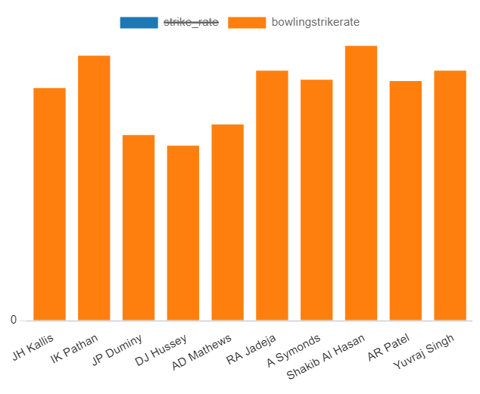
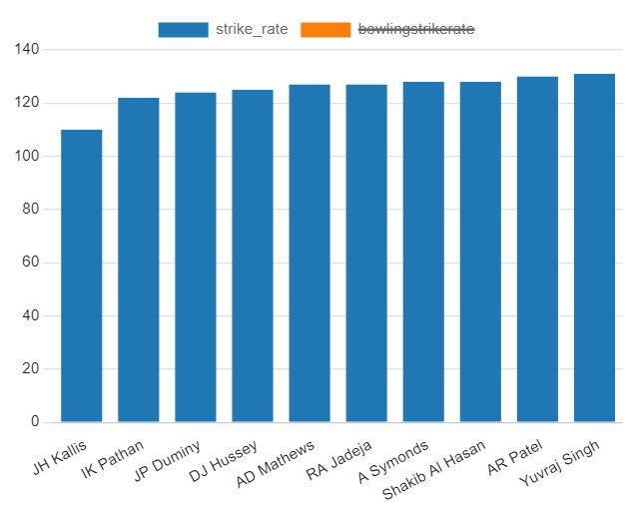
TOP 10 ALLROUNDERS WITH BEST STRIKE RATES QUERY:
(select a.player,a.strike_rate,b.bowlingstrikerate,a.total_balls,b.ball_delivered from batsman as a join bowlers as b on a.player=b.player where a.total_balls>=500 and b.ball_delivered>=300 order by (a.strike_rate+b.bowlingstrikerate) asc limit 10;)

Slide 12
TOP 10 ALLROUNDERS WITH BEST STRIKE RATES
player | strike_rate | bowlingstrikerate | total_balls | ball_delivered
JH Kallis | 110 | 0.24680378 | 2202 | 1799
IK Pathan | 122 | 0.281116895 | 928 | 2113
JP Duminy | 124 | 0.196861626 | 1631 | 701
DJ Hussey | 125 | 0.185758514 | 1052 | 323
AD Mathews | 127 | 0.208178439 | 568 | 807
RA Jadeja | 127 | 0.265313519 | 1686 | 2759
A Symonds | 128 | 0.255555556 | 755 | 540
Shakib Al Hasan | 128 | 0.291605302 | 579 | 1358
AR Patel | 130 | 0.254262056 | 694 | 2053
Yuvraj Singh | 131 | 0.265306122 | 2096 | 882

Slide 13
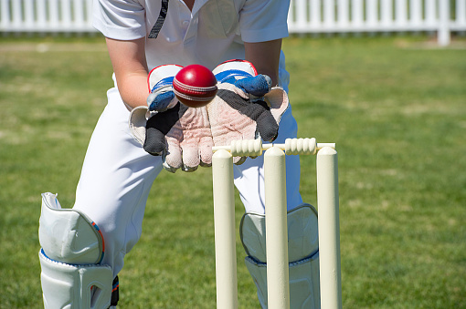
Criteria for Wicketkeeper
Some criteria to consider when selecting the best wicketkeepers for your T20 team:
Batting Ability: A wicketkeeper in T20 cricket should be a capable batsman. Look for wicketkeepers who have a good batting average and strike rate in T20 matches. They should be able to score quick runs and adapt to various batting positions in the lineup.
Wicketkeeping Skills: While batting is crucial, wicketkeeping skills are still vital. Look for wicketkeepers with good glovework, quick reflexes, and the ability to take catches and effect stumpings. They should also be reliable behind the stumps.
Versatility: A versatile wicketkeeper who can adapt to different game situations and conditions is valuable. They should be comfortable against both spin and pace bowling and have a solid technique.
Experience: Consider the experience of the wicketkeeper in T20 cricket, especially in high-pressure situations. Players with a track record of performing well in crucial moments can be an asset to the team.
Availability: Check the player's availability for the entire IPL season, as injuries or other commitments can disrupt the team's plans.

Slide 14
Additional Questions for Final Assessment
1.Get the count of cities that have hosted an IPL match?
Ans:33
Query: Select count(distinct(city)) from iplmatch ;
2.Create table deliveries_v02 with all the columns of the table ‘deliveries’ and an additional column ball_result containing values boundary, dot or other depending on the total_run (boundary for >= 4, dot for 0 and other for any other number) (Hint 1 : CASE WHEN statement is used to get condition based results) (Hint 2: To convert the output data of the select statement into a table, you can use a subquery. Create table table_name as [entire select statement].
Ans: create table deliveries_v02 as select *,
case
when total_runs >= 4 then 'boundary'
when total_runs = 0 then 'dot'
else 'other'
end as ball_result
from deliveries;

Slide 15
Additional Questions for Final Assessment
3.Write a query to fetch the total number of boundaries and dot balls from the deliveries_v02 table.
Ans: Select ball_result, count(*) as total_count from deliveries_v02 where ball_result in ('boundary', 'dot') group by ball_result;
4.Write a query to fetch the total number of boundaries scored by each team from the deliveries_v02 table and order it in descending order of the number of boundaries scored.
Ans: Select batting_team, sum(
case
when ball_result = 'boundary' then 1
else 0
end) as total_boundaries
from deliveries_v02 where ball_result ='boundary' group by batting_team order by total_boundaries desc;
5.Write a query to fetch the total number of dot balls bowled by each team and order it in descending order of the total number of dot balls bowled.
Ans: Select bowling_team,sum(
case
when ball_result = 'dot' then 1
else 0
end) as total_dot_balls
from deliveries_v02 where ball_result = 'dot' group by bowling_team order by total_dot_balls desc;

Slide 16
Additional Questions for Final Assessment
6.Write a query to fetch the total number of dismissals by dismissal kinds where dismissal kind is not NA.
Ans: select dismissal_kind , count(*) as total_dismissals from deliveries_v02 where dismissal_kind != 'NA' group bydismissal_kind order by total_dismissals desc;
7.Write a query to get the top 5 bowlers who conceded maximum extra runs from the deliveries table.
Ans: select bowler , sum(extra_runs) as total_extra_runs from deliveries where extra_runs > 0 group by bowler order by total_extra_runs desc limit 5;
8.Write a query to create a table named deliveries_v03 with all the columns of deliveries_v02 table and two additional column (named venue and match_date) of venue and date from table matches.
Ans: create table deliveries_v03 as select a.*, b.venue, b.date as match_date from deliveries_v02 as a join matches as b on a.match_id = b.match_id;

Slide 17
Additional Questions for Final Assessment
9.Write a query to fetch the total runs scored for each venue and order it in the descending order of total runs scored.
Ans: Select venue, sum(total_runs) as total_runs_scored from deliveries_v03 group by venue order by total_runs_scored desc;
10.Write a query to fetch the year-wise total runs scored at Eden Gardens and order it in the descending order of total runs scored.
Ans: Select extract(year from match_date) as year, venue, sum(total_runs) as total_runs_scored from deliveries_v03 where venue = 'Eden Gardens' group by year, venue order by total_runs_scored desc;

