Slide 1
Group Members
Aman Kumar 2018A8PS0764P
Jai Doshi 2018A7PS0012P
Anuj Yadav 2018A8PS0029P

Slide 2
Rotation-invariant convolutional neural networks for galaxy morphology prediction
Authors
Sander Dieleman - Electronics and Information Systems department, Ghent University, Sint-Pietersnieuwstraat 41, 9000 Ghent, Belgium
Kyle W. Willett - School of Physics and Astronomy, University of Minnesota, 116 Church St SE, Minneapolis, MN 55455, USA
Joni Dambre - Electronics and Information Systems department, Ghent University, Sint-Pietersnieuwstraat 41, 9000 Ghent, Belgium

Slide 3
Aim :
The Galaxy Zoo project was conceived to accelerate the task of classifying galaxy morphology using crowdsourcing. Around 900,000 images were classified by members of the public.
The model in the paper was developed for the Galaxy Challenge—an online competition organised by Galaxy Zoo and hosted on Kaggle—to build a model that could predict galaxy morphology, using the annotated images from the Galaxy Zoo project.
The dataset consisted, for each of the images, of 37 probability values, corresponding to the answers of 11 questions, calculated using the responses of the participants who classified the images. The problem was essentially a regression problem, in which given an image, the values of these probabilities had to be predicted.
The proposed model is able to reliably predict various aspects of galaxy morphology directly from raw pixel data, without requiring any form of handcrafted feature extraction.

Slide 4
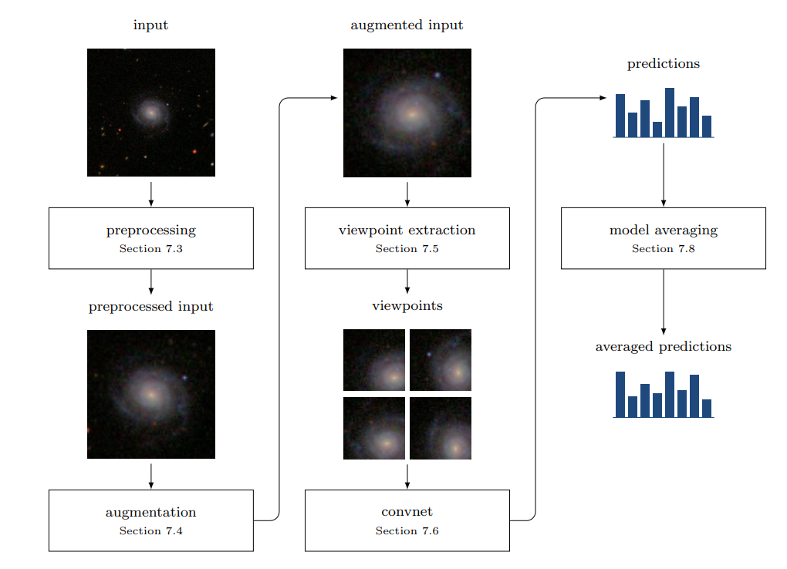
Methodology: Overview of Processing Pipeline
This pipeline consists of these steps:
Input preprocessing
Data augmentation
Viewpoint extraction
Neural Network
Obtaining preliminary results
Model averaging
Obtaining final prediction

Slide 5
Final Outcome :
Designed a Convolutional Neural Network model which is able to exploit rotational symmetry in the input images to predict the galaxy morphology, giving an accuracy of about 60-65% over training data (128000 examples), and 65-70% over testing data (100 examples).
The model is able to reliably predict various aspects of galaxy morphology directly from raw pixel data, without requiring any form of handcrafted feature extraction.
The model is able to achieve near-perfect accuracy for questions when the level of agreement is high. Classifications of the features which have low agreement are more difficult to answer for the model.
The novel approach implemented in the research paper for exploiting rotational symmetry was essential to achieve state-of-the-art performance.

Slide 6
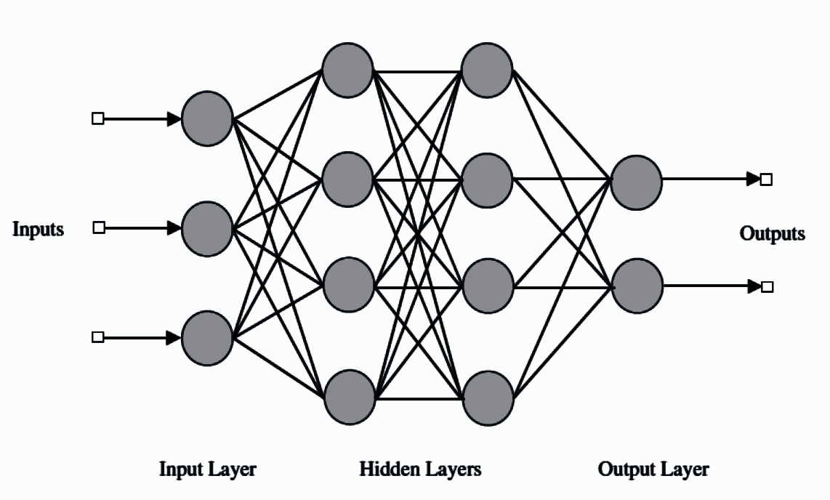
Deep Learning and Neural Networks
Application of traditional machine learning techniques requires handcrafted features, developing which demands a considerable amount of engineering skill and domain expertise. This, however, is not true for neural networks, which automatically learn these features from data using a general-purpose learning procedure.
Deep learning models consist of several layers of processing that form a hierarchy: each subsequent layer extracts a progressively more abstract representation of the input data and builds upon the representation from the previous layer, typically by computing a non-linear transformation of its input. The parameters of these transformations are optimized by training the model on a dataset.

Slide 7
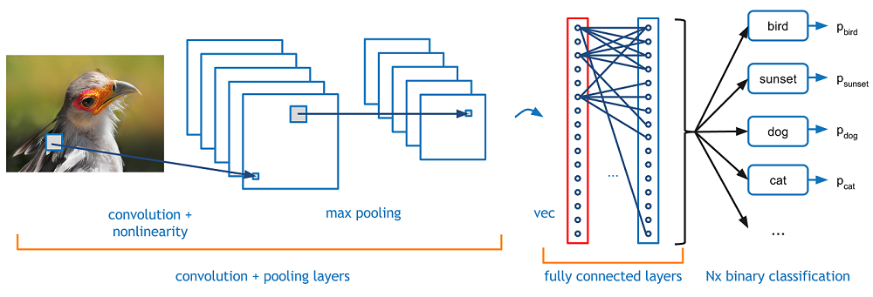
Convolutional Neural Networks
Regular neural networks do not scale well on images. The model overfits the training data and is not able to capture the general trend. Also, the number of parameters required can become very large.
Convolutional Neural Networks limit the connections of neurons to a smaller number of inputs by using the convolution operation. Local connectivity of neurons and sharing of parameters resolves these issue.

Slide 8
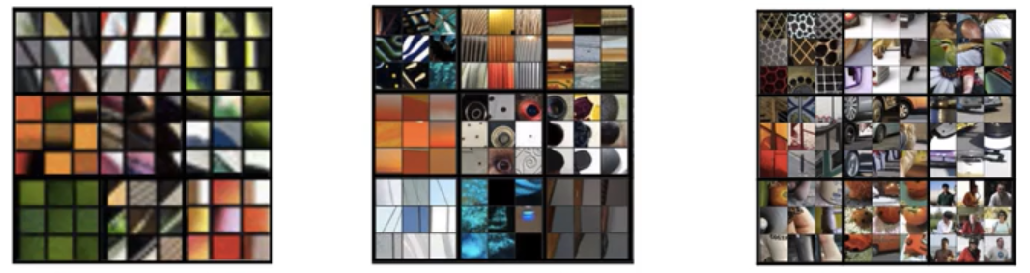
Convolutional Neural Networks
Over a number of iterations, the CNN learns to recognize useful features for image classification.
Additionally, max-pooling layers are used downsample images and gather information collectively from regions of the image.

Slide 9
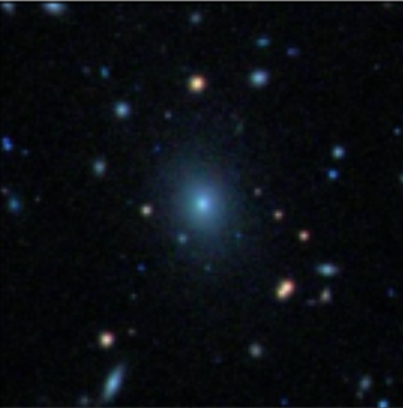
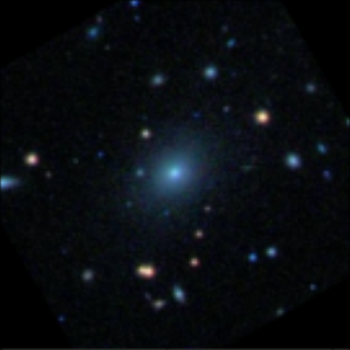
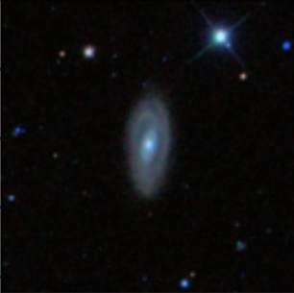
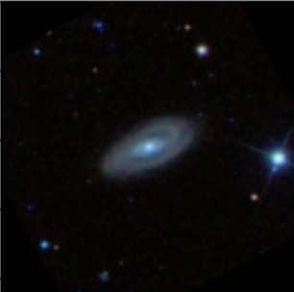
Rotational Symmetry
In case of images of galaxies, rotating an image does not affect its morphological classification. This rotational symmetry is exploited by applying the same set of feature detectors to various rotated versions of the input. This increases parameter sharing and hence have a positive effect on generalization performance.
In the paper, rotation was done during data augmentation, and then again at the time of extracting viewpoints.
Original Rotated

Slide 10
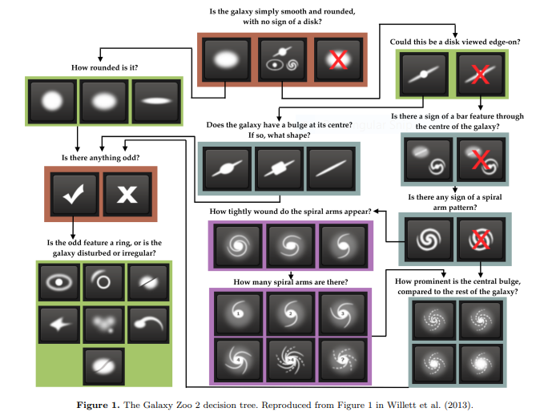
Dataset details : Galaxy Zoo
Galaxy Zoo is an online crowdsourcing project where users are asked to describe the morphology of galaxies based on colour images. . Participants are asked various questions, with the users’ answers determining which question will be asked next. More than half a million people have contributed classifications to Galaxy Zoo, with each image independently classified by 40 to 50 people The questions form a decision tree which is designed to encompass all points in the traditional Hubble tuning fork as well as a range of more irregular morphologies. The classification scheme has 11 questions and 37 answers in total.

Slide 11
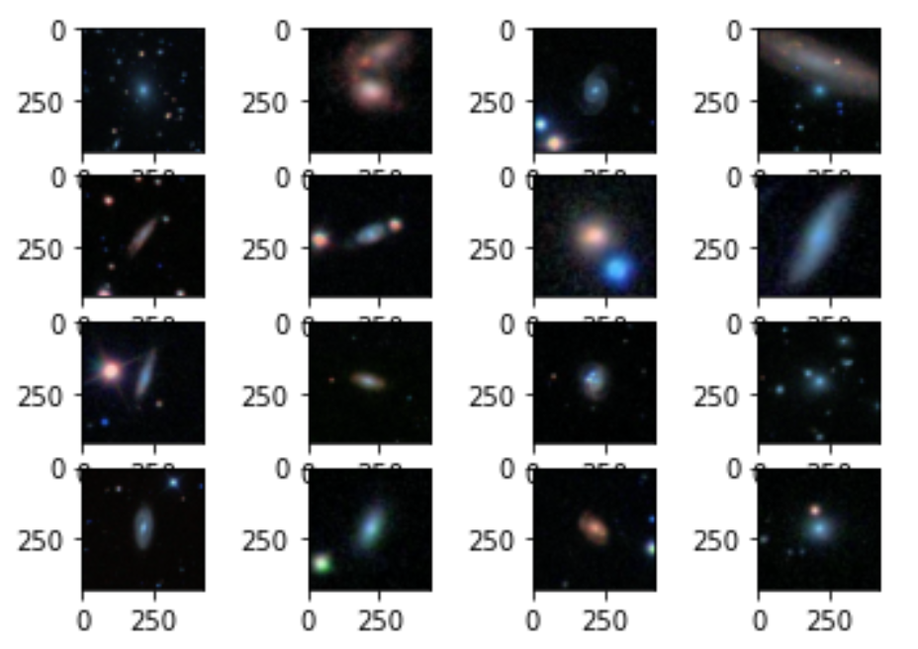
Dataset details : Galaxy Zoo
Images of galaxies and morphological data for the model training and evaluation were taken from the Galaxy Zoo 2 main spectroscopic sample. Galaxies were selected to cover the full observed range of morphology, colour, and size, since the goal was to develop a general algorithm that could be applied to many types of images in future surveys.
The final training set of data consisted of 61,578 JPEG colour images of galaxies, along with probabilities for each of the 37 answers in the decision tree. For the Challenge, an evaluation set of 79,975 images was provided, but with no morphological data. Each image is 424 by 424 pixels in size.
424x424 RGB images

Slide 12
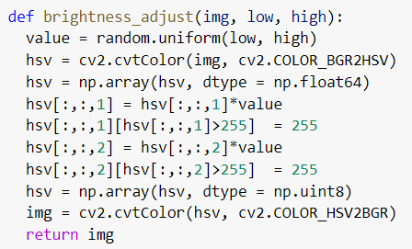
Data Augmentation
We were required to implement some of the functions for data augmentation from scratch as they were not available in any Python library, given the specific requirements of the research paper.
Various data augmentation techniques used are :
Rotation: random rotation between 0° and 360°.
Translation: the images were randomly shifted by between -4 to 4 pixels.
Scaling: the images were rescaled with a scale factor sampled log-uniformly between 1/1.3 and 1.3.
Flipping: the images were flipped with 0.5 probability.
Brightness adjustment: the brightness of the images was changed with a factor between 0.5 and 1.5.
Function for brightness adjustment

Slide 13
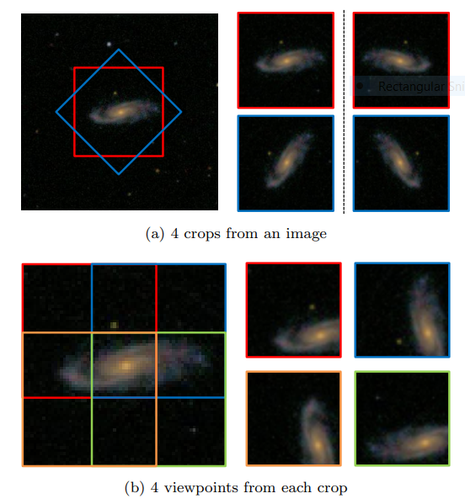
Preprocessing and Viewpoint extraction
The images were first cropped from 424 × 424 pixels to 207 × 207, and then downscaled to 69 × 69 pixels. This was done to speed up training without having any effect on performance. Since the galaxy was in the middle of the image, cropping the sides would not have any effect.
Viewpoint extraction consisted of:
Square crops at 0° and 45° which were then flipped to obtain 4 images in total.
Extracting four overlapping corner patches from each crop, and rotating them so that the galaxy centre is in the bottom right corner of each patch.
This gave 16 total rotated patches which constituted the viewpoints.

Slide 14
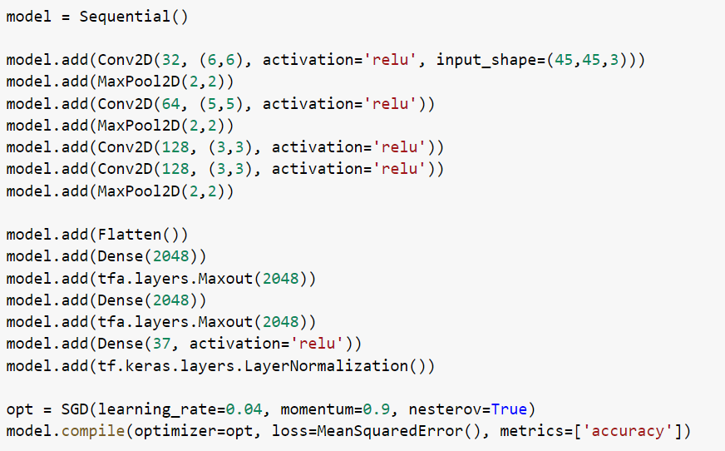

Network Architecture
The figure details the implementation of the architecture of the network .
RMSE, computed as follows:
was used to evaluate the loss function.

Slide 15
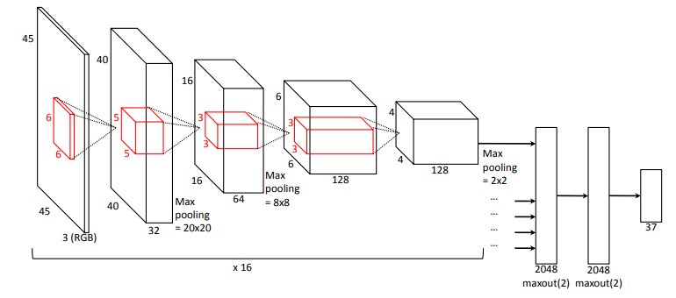
Network Architecture and Training
All aspects of the model were implemented using Python and the Keras library in Google Colab. Training the network described in the below figure took almost 2 hours in real time. Finally, the model and trained weights were saved in .json and .h5 file formats respectively to be used for further analysis.
Following values of hyperparameters were used for training the model:
Learning rate η = 0.04
Mini-batch descent was used with batch size of 16
Nesterov momentum was used with coefficient µ = 0.9
Number of epochs = 5
Size of training dataset = 8k images before viewpoint extraction

Slide 16
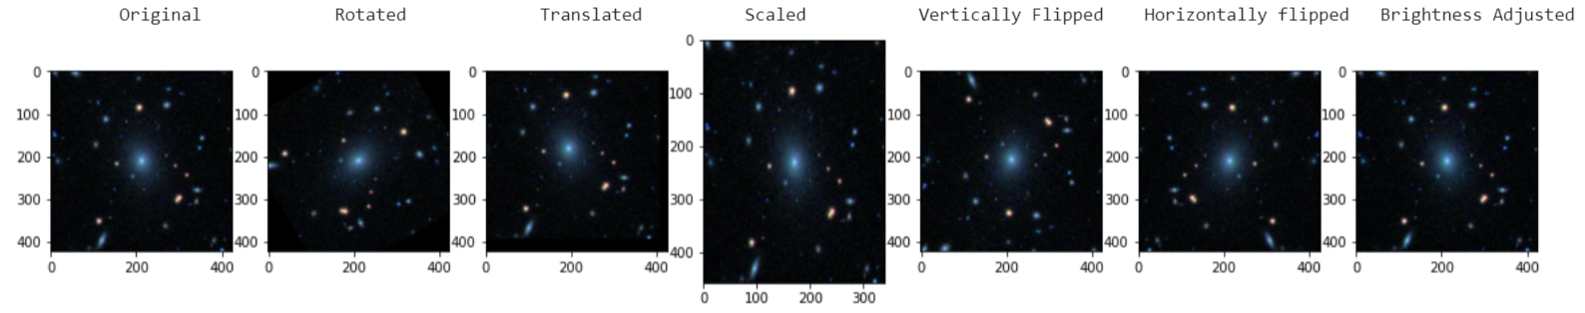
Results: Data Augmentation
As high computation power was required to perform data augmentation on the complete dataset, we were instructed to perform data augmentation as a second task.
We successfully applied all the data augmentation techniques mentioned in the research paper on a small dataset of 16 ( 424x424x3 ) images and extracted rotated, translated, scaled, flipped, brightness adjusted versions of the original image.

Slide 17
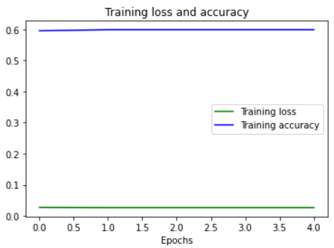
Results: Training error and accuracy
We tried to change the values of hyperparameters like learning rate, batch size, momentum, number of epochs to decrease the training error, but there was no solid improvement, so we finally kept the model same as in research paper.
It was found that there was no noticeable improvement in the training accuracy between each subsequent epoch.
We finally achieved an accuracy of about 60% over the training data, and 66% over the testing data. The RMSE error on the testing data was 0.02588
Training loss and accuracy vs number of epochs

Slide 18
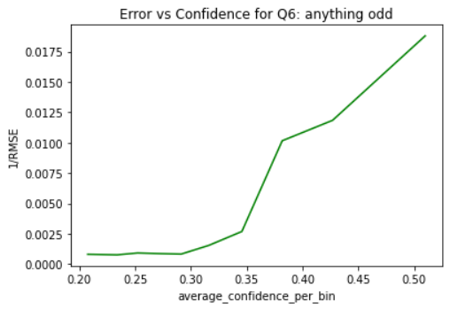

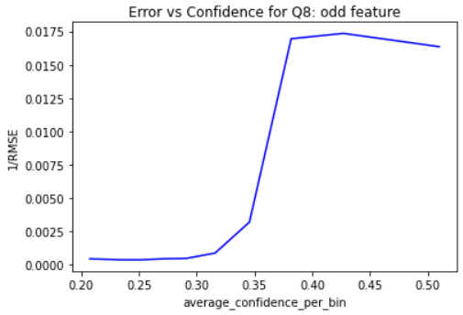
Results: Classification Accuracy Vs. Confidence
Confidence/agreement a(p) was calculated for each image as:
where where H(p) is entropy.
The images were then sorted according to value of agreement and divided into 10 bins, and the average agreement was calculated for each of these bins.
Instead of accuracy, 1/RMSE for calculated for each of the 10 bins for 2 features as it will show the same trend. 1/RMSE vs. Confidence was plotted the 2 features and they were found to be in agreement.
The plotted graphs clearly depicts the positive correlation between confidence level and classification accuracy of a feature.

Slide 19
Challenges Faced in Implementation
In the paper, certain aspects, such as a detailed explanation of how the brightness of images was to be changed, were not specified, and we had to research them on our own.
The original paper was implemented using the Theano library. However, we implemented the model in Keras. Hence, even though the code for the original paper was available, we could not take much help from it.
For some of the libraries that we used for data augmentation, the documentation available was not of good quality.
Although, the size of the dataset provided contain more than 60,000 images but we were only able to use 8,000 images as more processing power and computation time was required.

Slide 20
Challenges Faced in Implementation
Due to constraints on RAM in Google Colab, we were not able to train on the complete dataset, and even with the limited dataset, we were only able to train for 5 epochs.
Due to the limited training, we were not able to achieve the accuracy reported in the original paper.
The method for calculating the training accuracy for plotting classification accuracy versus confidence level of a particular feature was not mentioned in the research paper, therefore we have shown the trends based on root mean squared error and confidence level.
Some of functions were not available in any of the Python libraries so we implemented our own functions that served the required specifications in the research paper.

Slide 21
Future Scope
Since the performance of CNNs is largely proportional to the size of the dataset, even the extensive data augmentation techniques used are not enough and a larger dataset would be required for a significant improvement in performance.
The network can be improved in such a way that it can also classify images that have not been preprocessed by humans, while also learning important features such as radial symmetry from such images.
Since there is a strong correlation between confidence levels of the answers and accuracy of the model, we can try to build up a training dataset that consists of images that are labelled by experts so that the model is not affected by errors in the annotation of images.

Slide 22
Learning Outcomes
Work Habits
Developed strong work habits and attitude towards meeting deadlines.
Team Work
Learned to work in a team, help and seek help from team members and collaborate with each other.
1
4
2
Worked on a Real Life Project
Worked on relevant project that has real-life applications.
Learning new concepts
We learnt many new techniques and concepts (thanks to this project) which are not a part of the regular curriculum .
3

Slide 23
A NOTE OF THANKS . . .
We would like to thank Dr. Surekha Bhanot and Dr. Bijoy Krishna Mukherjee for giving us this wonderful opportunity to work on this project.
We would also like to thank our hardworking TAs as interacting with them was a great experience. We were able to clarify all our difficulties and also learn a lot from them.
It would not have been possible without your guidance and support.
THANK YOU . . .

