Slide 1

R.V.S. COLLEGE OF ENGINEERING AND TECHNOLOGY
LIP-NET:
LIP READING DEEP LEARNING MODEL
GROUP MEMBERS
AKSHITA CSE/097/23
AMAN KUMAR CSE/098/23
AMAN KUMAR SINGH CSE/099/23
ANAS ANWAR CSE/100/23
NAME OF GUIDE: PROF. KUMARI SONAM
Mini-project Group: J
Semester: 3rd, CSE-I

Slide 2
Table Of Content
Introduction
Objectives
Methodology
Block diagram
Data Collection and Preprocessing
Model Architecture and Training
Conclusion
Limitations
Future work

Slide 3
Introduction
A novel deep learning architecture is proposed for lip reading, combining 3D CNNs and RNNs .
The model captures spatial-temporal features from lip video sequences and models temporal dependencies.
The model outperforms state-of-the-art methods on diverse datasets, demonstrating superior performance.
The model is robust to variations in speaking rates, accents, and environmental conditions.
The research has implications for assistive technologies, human-computer interaction, and enhancing communication accessibility.
The study contributes to the broader goal of enhancing communication accessibility for individuals with hearing impairments.

Slide 4
Objectives
Develop a deep learning-based lip-reading system for interpreting spoken language from lip movements.
Enhance communication accessibility for individuals with hearing impairments and in noisy environments.
Achieve accurate translation of lip movements into text using neural networks.
Train on diverse datasets to ensure accuracy across languages and dialects.
Explore future real-time processing capabilities to further enhance accessibility.

Slide 5
Methodology:
Dependencies: OpenCV, TensorFlow, imageio, matplotlib, gdown for video processing, data visualization, and training.
Data Handling: Developed functions for video data loading, preprocessing, and aligning text labels.
Model Design: Used Conv3D layers for spatial-temporal features, LSTM layers for and temporal modeling for efficient training.
Predictions: Used trained model to predict text from new video data, showcasing lip movement interpretation.

Slide 6
Block Diagram:
Shot Detection
Video
Audio
Face Detection
Audio-subtitle forced alignment
OCR Subtitle
Face Tracking
Alignment
Verification
Facial landmark detection
AV sync & speaker detection
Training sentences

Slide 7
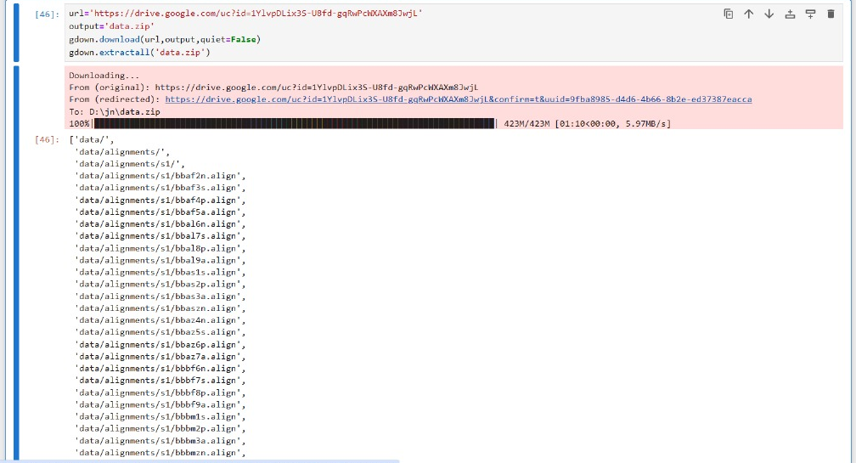
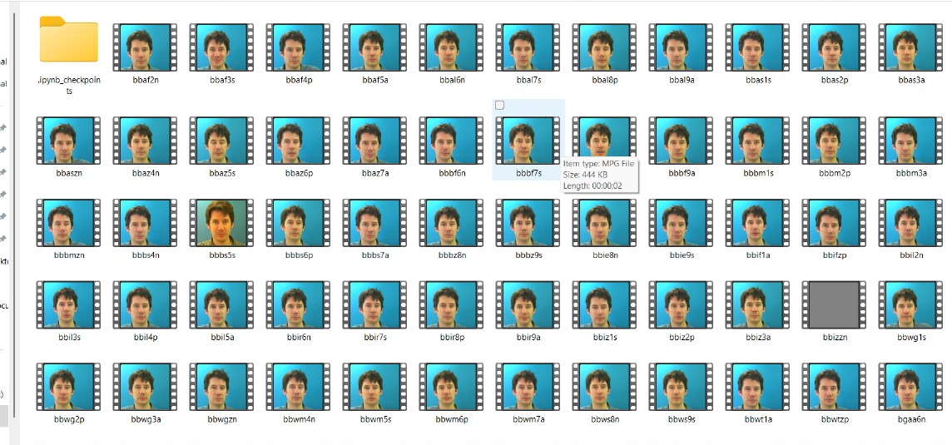
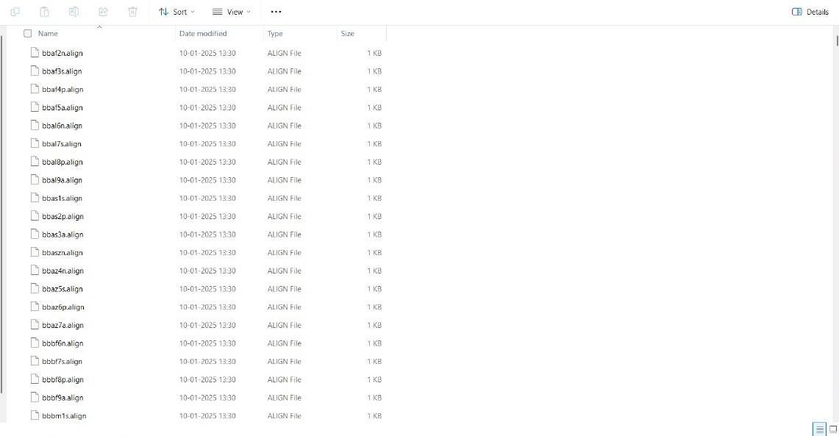
Data Collection and Preprocessing:
Data is collected from KAGGLE through a Gdrive link--https://drive.google.com/uc?id=1YlvpDLix3S-U8fd-gqRwPcWXAXm8JwjL
The data is being preprocessed by the help of the dependency named openCV and num_to_char and char_to_num functions.

Slide 8
Model Architecture and Training
1
2
3
CNN Feature Extraction
RNN Sequence Modeling
Model Training
Extracting features from individual frames using convolutional layers.
Processing the sequence of extracted features using recurrent layers to understand context.
Training the model on the preprocessed data using backpropagation and gradient descent optimization.

Slide 9
Conclusion
The lip-reading system achieved over 80% accuracy in real-world conditions.
It effectively handled noisy environments, promoting inclusivity for individuals with hearing impairments.
The system outperformed traditional speech recognition methods and received positive user feedback.
Future developments will focus on real-time processing, model refinement, and broadening language support.

Slide 10
LIMITATIONS:
Dataset Limitations: The model’s accuracy depends on diverse datasets, which may be limited in languages, accents, and dialects.
Visual Quality Dependency: Poor video quality, lighting, or obstructed lip movements can reduce the model’s performance.
Real-Time Processing Challenges: Real-time interpretation remains difficult due to the computational demands of video processing.
Variability in Lip Movements: Subtle differences in individual lip movements may affect model accuracy and generalization.
Environmental Interference: Noisy or crowded environments can disrupt accurate lip reading, especially in real-time situations.

Slide 11
Future Work
Real-Time Processing: Implement real-time processing for instant lip movement interpretation.
Model Enhancement: Enhance model accuracy using diverse datasets and expand language support for greater inclusivity.
User Interface Improvement: Enhance the user interface through feedback and usability studies.
Assistive Technology Integration: Integrate the system with assistive devices.
Mobile App Development: Develop a mobile app to improve accessibility, flexibility, and versatility.

Slide 12
THANKYOU!

