Slide 1
Quicksort Implementation by Serial and Parallel
Aman Kumar - 201911018
Harsh Vardhan - 201911022

Slide 2
What is Quicksort ?
Quicksort is a Divide and Conquer algorithm. It picks an element as pivot and partitions the given array around the picked pivot.
How Quicksort Works ?
Pivot Selection - Pick an element, called a pivot, from the array (usually the leftmost or the rightmost element of the partition).
Partitioning- Reorder the array so that all elements with values less than the pivot come before the pivot, while all elements with values greater than the pivot come after it (equal values can go either way).
Recursion - Recursively apply the above steps to the sub-array of elements with smaller values than pivot and separately to the sub-array of elements with greater values than pivot

Slide 3
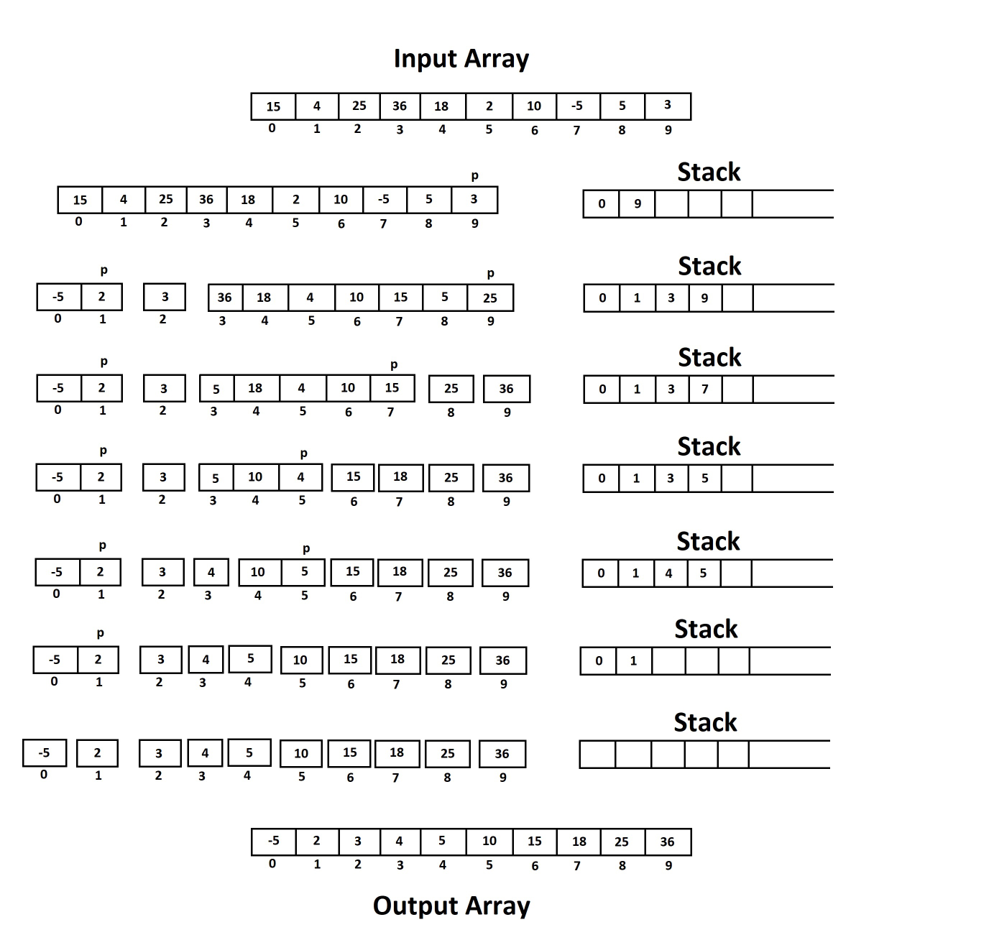
Serial Execution

Slide 4
Challenges Faced
Recursion Not Supported
Designing an Iterative Algorithm
Parallelization of Iterative Algorithm
Address Management with Stack
Thread Synchronization to avoid multiple access of data.
Dynamic Allocation of Number of threads and blocks.

Slide 5
Optimization Strategy
The serial code is implemented by the help of the one stack, hence the performance of this algorithm will fall with increase in input size.
To optimize the strategy into parallel execution use of two stacks has been done in order to separately and parallely perform the execution of partition.
Left and right partition will each have a stack of their own so we can run these both partitions parallely to achieve better computational time.

Slide 6
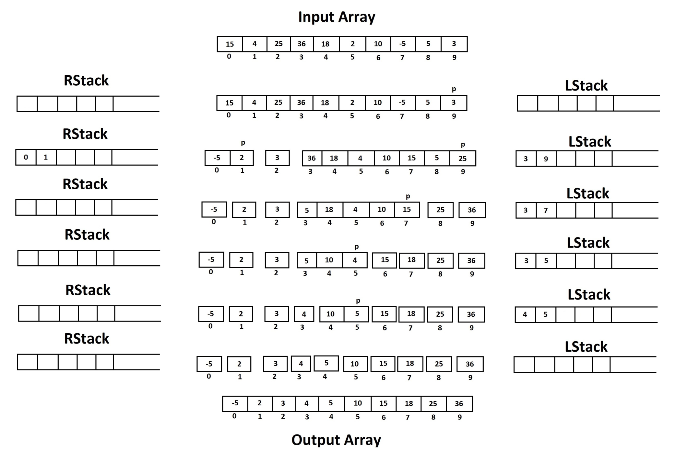
Parallel Execution

Slide 7
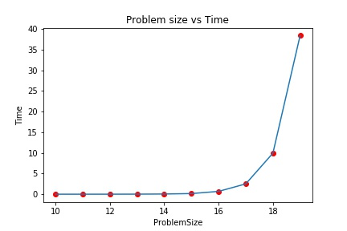
Serial Execution Time
Input Size (2^n) | Time (second)
10 | 0.000295
11 | 0.000839
12 | 0.002943
13 | 0.015218
14 | 0.045432
15 | 0.151952
16 | 0.682315
17 | 2.496395
18 | 9.932307
19 | 38.378501

Slide 8
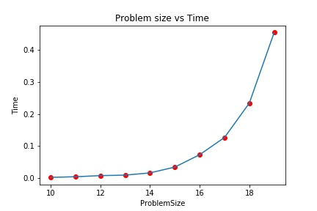
Parallel Execution Time
Input Size (2^n) | Time (second)
10 | 0.002095
11 | 0.004144
12 | 0.007616
13 | 0.009131
14 | 0.016168
15 | 0.034294
16 | 0.072944
17 | 0.126581
18 | 0.233966
19 | 0.454057

Slide 9
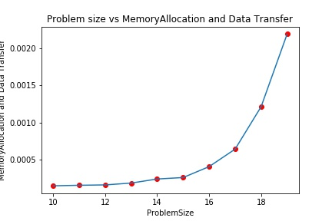
Memory Allocation and Data Transfer
Input Size (2^n) | Memory Allocation (CudaMalloc) | Data Transfer (CudaMemCpy)
10 | 0.000111 | 0.000030
11 | 0.000113 | 0.000035
12 | 0.000104 | 0.000049
13 | 0.000099 | 0.000079
14 | 0.000102 | 0.000131
15 | 0.000098 | 0.000155
16 | 0.000118 | 0.000283
17 | 0.000100 | 0.000538
18 | 0.000174 | 0.001039
19 | 0.000262 | 0.001935

Slide 10
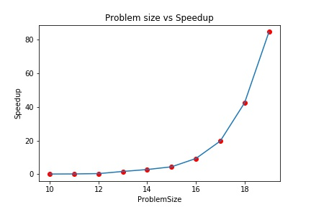
Speedup
Input Size (2^n) | Time Serial | Time Parallel
10 | 0.000295 | 0.002095
11 | 0.000839 | 0.004144
12 | 0.002943 | 0.007616
13 | 0.015218 | 0.009131
14 | 0.045432 | 0.016168
15 | 0.151952 | 0.034294
16 | 0.682315 | 0.072944
17 | 2.496395 | 0.126581
18 | 9.932307 | 0.233966
19 | 38.378501 | 0.454057
*Time in Seconds

Slide 11
Thank You

