Slide 1
SWE DevOps
Name: Aman Lath
Email: amanlath643@outlook.com
Phone: 7876135017
Experience: Fresher

Slide 2


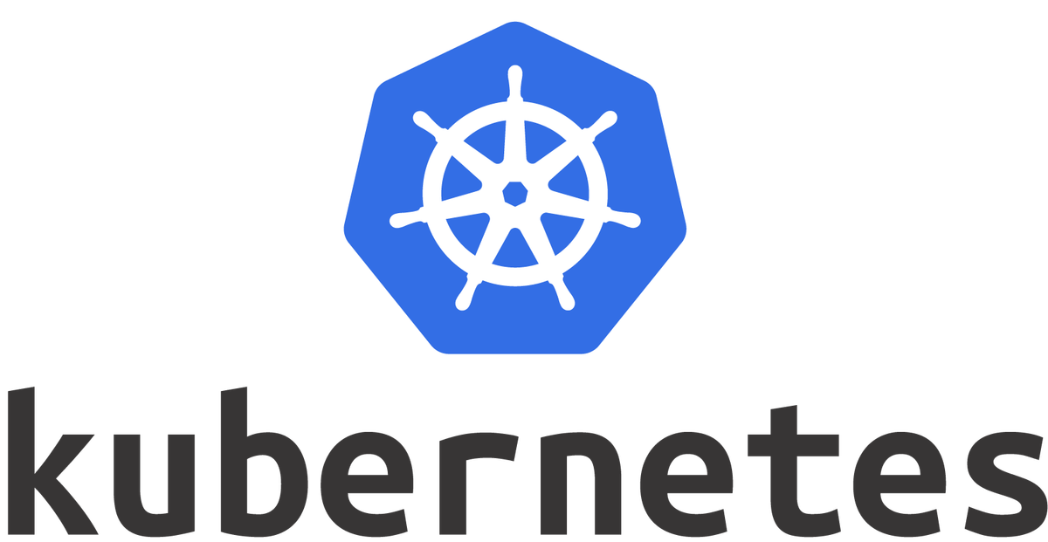





EC2 Instance
Frontend Cluster
Backend Cluster
Jenkins
Database Cluster
Load Balancer
Cache Cluster
USER

Slide 3
Cost breakdown and optimizations
Tool | Type | Cost
Amazon EC2 | t4.large | Rs.1190/month
Jenkins | Open Source | Free
Kubernetes | Open Source | Free
RabbitMQ | Open Source | Free
Grafana | Open Source | Free
Prometheus | Open Source | Free
HashiCorp Vault | Open Source | Free
Github | Open Source | Free
 | Total Cost | Rs.1190/month
 | Saving | Rs.10

Slide 4
Challenges
Deciding on a scalable and secure architecture that fits your requirements and workload.
Balancing simplicity and flexibility while ensuring future scalability.
Identifying open-source alternatives for proprietary tools.
Managing costs while ensuring high availability and performance.
Configuring database replication and load balancer failover for fault tolerance.
Ensuring the caching layer and message queue are resilient to failures.

