Slide 1

RevuMind V2
AI-Powered Review Intelligence Platform
Electronics & Communication Engineering | Year 3
Subject: Machine Learning (V2 Upgrade) | Stack: PyTorch + Transformers + XGBoost
github.com/ananaymeena3/RevuMind
Notes:
Introduce project: RevuMind V2 is an upgraded Review Intelligence Platform. It shifts from traditional text baselines to a complete 7-model deep learning and gradient boosted cascade, extracting fine-grained business insights.

Slide 2

Project Overview
The Goal of RevuMind V2
Platform Ingestion
Transform thousands of customer reviews into structured, actionable business insights.
Key Capabilities:
🏷️ RoBERTa Overall Sentiment
📍 spaCy TRF Named Entity Boundaries
🔍 DeBERTa Aspect-Based Polarity
📈 XGBoost Helpfulness Regression
Dataset: Amazon Fine Food Reviews
Ingests local dataset at archive/Reviews.csv
Raw size: ~300MB containing 500k+ reviews
Ingested Columns (Step 1):
• ProductId & Score (Stars)
• Summary & Text (Reviews)
• HelpfulnessNumerator & Denominator
• Time (Unix Timestamp)
Focus: 100% Text Intelligence
Notes:
Explain the shift: the platform focuses entirely on text intelligence now. We ingest raw files from the local archive directory, parsing text columns, ratings, helpfulness votes, and timestamps.

Slide 3

Redesigned Repository Structure
revumind/
├── core/ # Database configurations
├── db/ # ORM Schemas & models
├── pipeline/ # Ingestion, inference, ETL
│ ├── preprocess.py
│ ├── train_all.py
│ └── inference.py
├── models/ # Model wrappers & weights
│ ├── sentiment/ | ner/ | embeddings/
│ └── absa/ | topics/ | helpfulness/
├── utils/ # Text stats & readability
└── visualization/ # Streamlit UI layers
Pipeline & Concerns Isolation
Feature-Based Architecture
Each ML component (Sentiment, NER, Topic Model) is a self-contained directory containing model loading, evaluation, and weights configurations.
Pipeline Architecture
Separates ingestion (preprocess.py) from model wrappers, inference orchestrators (inference.py), database connections, and dashboards.
Graceful Fallbacks
All deep learning wrappers fall back to lightweight models or rule-based heuristics to allow instant CPU-bound local debugging.
Notes:
Walk through the feature-based repository design. We isolate database connection setups (core/) from models, pipelines, and visualizations. Each model directory holds its training and inference wrappers.

Slide 4

Data Ingestion & Text Preprocessing
1
2
3
4
Chunk Ingestion
Noise Stripping
Language Filter
Unified Text
preprocess.py
Streams Reviews.csv in chunks to prevent memory limits.
Cleans HTML tags, URLs, and strips emoji/unicode symbols.
Applies heuristic character ratio limits to isolate English reviews.
Merges Summary + Text into a clean review text format.
Notes:
Explain Step 2 Preprocessing: We clean raw inputs in chunks, remove HTML/URLs/emojis, apply custom ASCII filters to keep English, and merge fields into a clean review text for downstream modeling.

Slide 5
State-of-the-Art Deep Learning Models
Overall Tone
Aspect-Based Focus
RoBERTa (Sentiment)
spaCy TRF + DeBERTa (NER / ABSA)
Fine-tuned classification head for positive, negative, and neutral.
spaCy Transformer extracts entity boundaries (Brands, Features).
Handles negation and context better than VADER rules.
DeBERTa ABSA evaluates sentiment for each specific aspect.
Outputs confidence scores for overall sentiment classification.
Resolves mixed sentiments (e.g., 'vivid screen but slow charging').
★ Embeddings: all-MiniLM-L6-v2 maps text to 384-dimensional vectors for semantic searches
Notes:
Explain the core deep learning stack: RoBERTa for overall sentiment, spaCy Transformer + DeBERTa for aspect sentiment mapping, and Sentence-Transformers for semantic vector search.

Slide 6

Topic Modeling & Helpfulness Prediction
BERTopic Modeling (Step 7)
XGBoost Helpfulness Regressor (Step 9)
Ingests 384-dimensional Sentence Embeddings.
Predicts the continuous helpfulness ratio (0.0 to 1.0).
Reduces space using UMAP projections.
Calculates text stats (word/sentence count, character lengths).
Clusters data points using HDBSCAN density models.
Extracts Flesch Reading Ease & Flesch-Kincaid Grade scores.
Extracts topic keywords using class-based TF-IDF.
Incorporate features: Sentiment score, aspect count, topic assigned.
Maps reviews to coherent feedback groups (e.g. Battery).
Saves fitted scaler and booster trees to disk.
Notes:
Outline the machine learning processes: BERTopic coordinates clusters using UMAP + HDBSCAN + c-TF-IDF. XGBoost regression models helpfulness scores from engineered tabular features (lengths, readability, sentiment).

Slide 7

DB Ingestions, Cohort Summaries & Insights
Database Ingestion Pipeline
Step 8 BART Summaries & Step 10 Insights
DB Pipeline: ingest_to_db.py
Ingests raw reviews, feeds them through the inference engine, and populates SQLAlchemy relational database tables.
ORM Schemas:
• products & reviews (core data)
• review_embeddings (384-d vectors)
• entities & aspect_sentiments
• topics & summaries (aggregations)
Grouped BART Summaries
Groups reviews by cohort (product, sentiment type, or topic cluster) and generates concise executive summaries using BART weights.
Business Insights Engine
Aggregates positive praises vs. negative complaints and automatically synthesizes actionable business recommendations to resolve pain points.
Notes:
Describe the connection: ingest_to_db.py orchestrates DB insertion. ExecutiveSummarizer runs BART to summarize review clusters, while the Insights engine generates praises, complaints, and product recommendations.

Slide 8
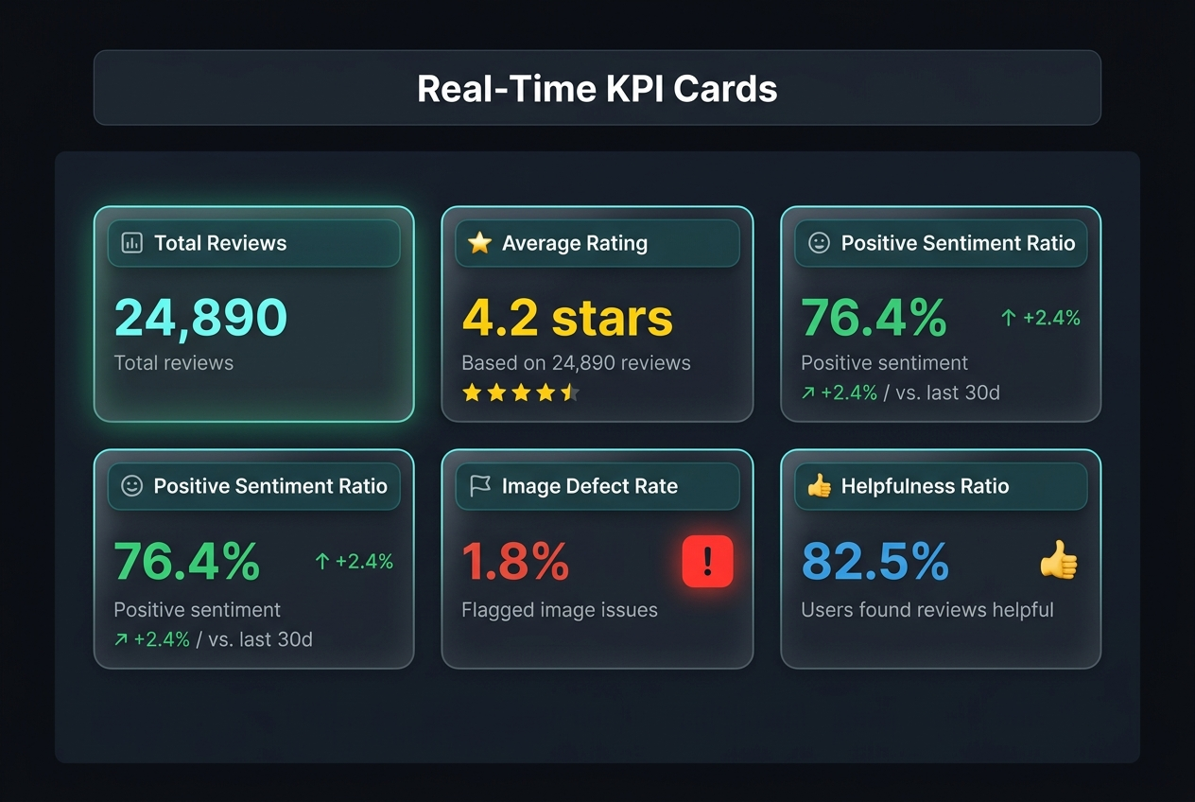
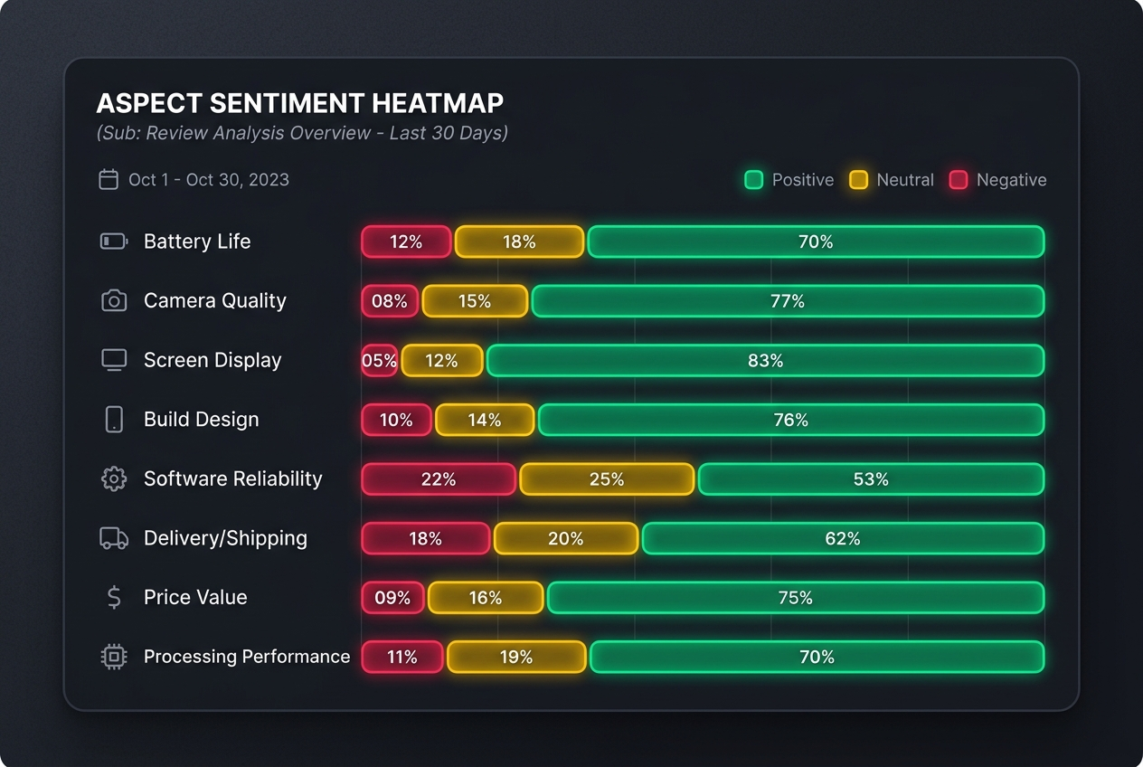
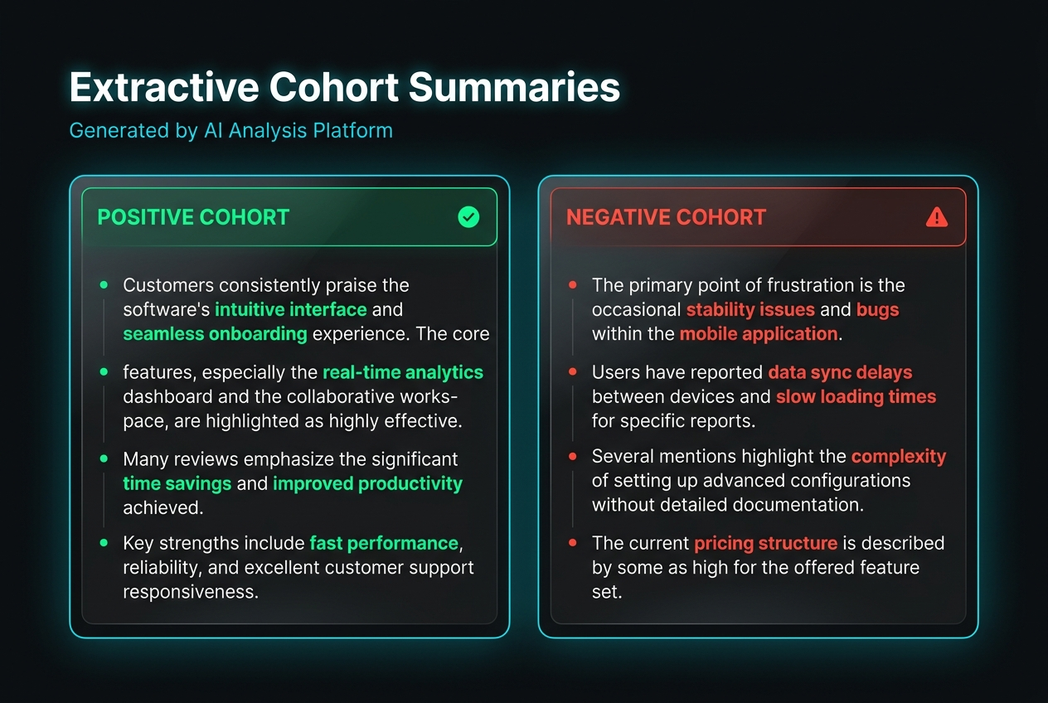
Visual Dashboard Layer (Step 11)
Real-Time KPI Cards
Aspect Sentiment Heatmap
Extractive Cohort summaries
Monitors review volumes, sentiment ratios, and helpfulness metrics dynamically.
Displays positive, neutral, and negative metrics across key product aspect features.
Renders executive summary blocks generated from review cohorts.
Notes:
Review the dashboard implementation: We updated dashboard.py to load real data directly from the SQLite database. It runs interactive charts, filters products dynamically, and includes a fallback mode.

Slide 9

V2 Tech Stack & Commands
V2 Tech Stack
How to Run Pipelines
PyTorch & Transformers
RoBERTa, DeBERTa, BART
1
Setup DB Tables
python revumind/db/init_db.py
spaCy & regex Matchers
NER entity boundary mapping
Run Training Pipeline
2
python revumind/pipeline/train_all.py --sample_size 5000
XGBoost & Scikit-Learn
Regressor & fallbacks
3
Ingest Reviews to DB
SQLAlchemy & pgvector
ORM database schemas
python revumind/pipeline/ingest_to_db.py --sample_size 100
4
Run Interactive UI
Streamlit & Plotly
Interactive dashboard layer
streamlit run revumind/visualization/dashboard.py
Notes:
Highlight execution commands: Run init_db.py to configure schemas, run train_all.py to fit topics/helpfulness, run ingest_to_db.py to run the ML cascade and load DB rows, then launch Streamlit.

Slide 10


Future Scalability & Conclusion
Future Scaling Path
Multi-Tenant isolation
Tenant database schemas to support multiple business accounts.
Distributed Streaming Pipelines
Integrate Kafka + Flink to process reviews in near real-time.
Conversational RAG Agent
Expose vector embeddings to LLMs so users can query the reviews.
Knowledge Distillation
Distill models into student models to cut GPU hosting costs.
RevuMind V2 provides a production-ready AI Review Intelligence system | PyTorch · Transformers · XGBoost · FastAPI
Notes:
Wrap up: RevuMind V2 upgrades from classical baselines to a production 7-model NLP cascade. Future targets include multi-tenant databases, Kafka stream ingestion, RAG conversational agents, and student model compression.

