Slide 1
PARALLEL PROGRAMMING PARADIGM
GROUP – 34
ASHRAY KASHYAP( 2020B3A70494G )
NAMAN AJAY MARKHEDKAR( 2020B5A71862G )
MOHAMMED AMAN ( 2020B3A70607G )
SAAHIR VAIDYA ( 2020B3A71142G )

Slide 2
THE PROBLEM STATEMENT
In a multiprocessor system executing a single set of instructions (SIMD), data parallelism is achieved when each processor performs the same task on different distributed data. Data parallelism is parallelization across multiple processors in parallel computing environments. It focuses on distributing the data across different nodes, which operate on the data in parallel. It can be applied on regular data structures like arrays and matrices by working on each element in parallel.
Eg) Parallelised Merge Sort 🡺
Intermediate step in Merge Sort : Merge step
1 | 3 | 12 | 28
2 | 10 | 15 | 21
Array A
Array B

Slide 3
WHAT DID WE EXPLORE?
In Milestone #1, we focused on extracting parallel programming features from languages Rust and C++ and compared the serial and parallel execution time accordingly.
In Milestone #2 , we will try to implement the above features in C++ and rust by using the following features of C++ .
🡪 Threads.
🡪 #include <execution> header file.
🡪 OpenMP (omp) API for the for loops in C++.
🡪 hpx header file ( implemented in C++ 20 )
In Rust we will use the following features:
Rayon
Threads
We applied the above ways to parallelise the code and compared the serial vs parallel execution time for various inputs. We also compared the serial vs parallel execution time as a function of number of inputs to a code.

Slide 4
Additional Information
Q] Why did we choose C++ as our domain language (Merits)?
Ans ) 1) C++ is a widely known language and understood by majority of people.
2) C++ is a multi-domain language i.e , it can be used in various fields like Image Processing, Data Mining and Real Time Systems etc.
And we can use Parallelism in these fields and make our work faster. There are many libraries in C++ 20 which aid in doing so.
RESULTS : 1) For smaller inputs 🡺 Serial Programming is better as there is no considerable difference between serial and parallel programming for smaller inputs and parallel programming is also resource intensive.
2) ) For larger inputs 🡺 Parallel Programming is better and more the number of cores or threads, lesser the execution time of the program.

Slide 5
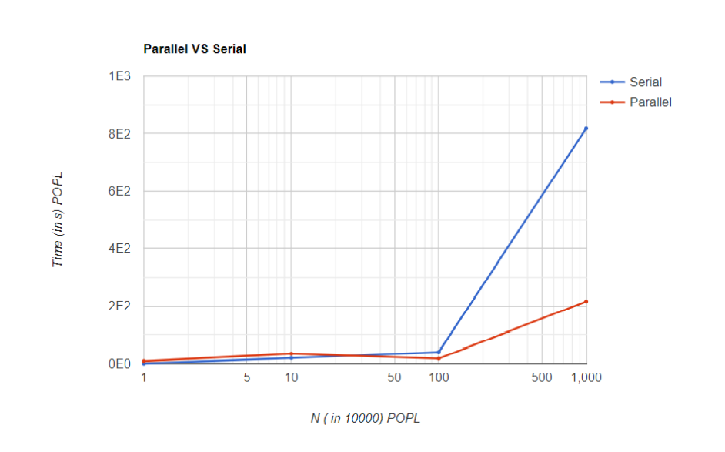
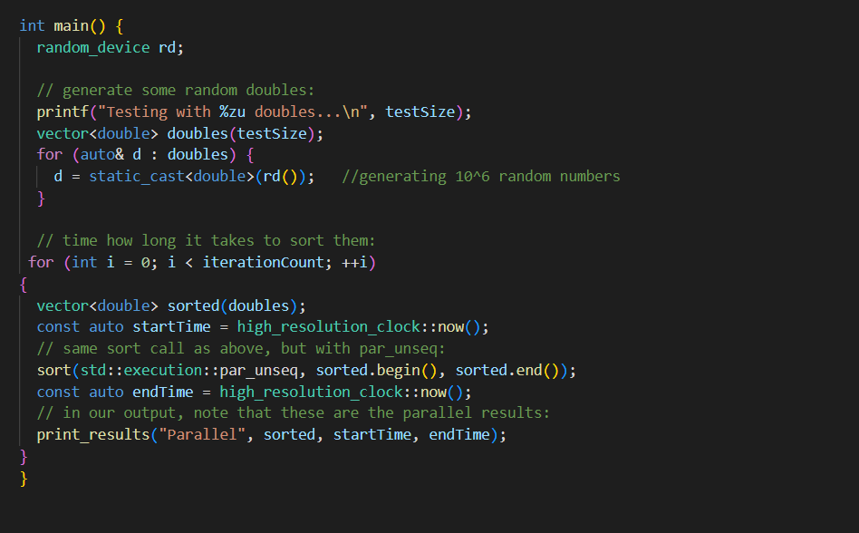
Code snippet for parallel programming
Graphical representation

Slide 6
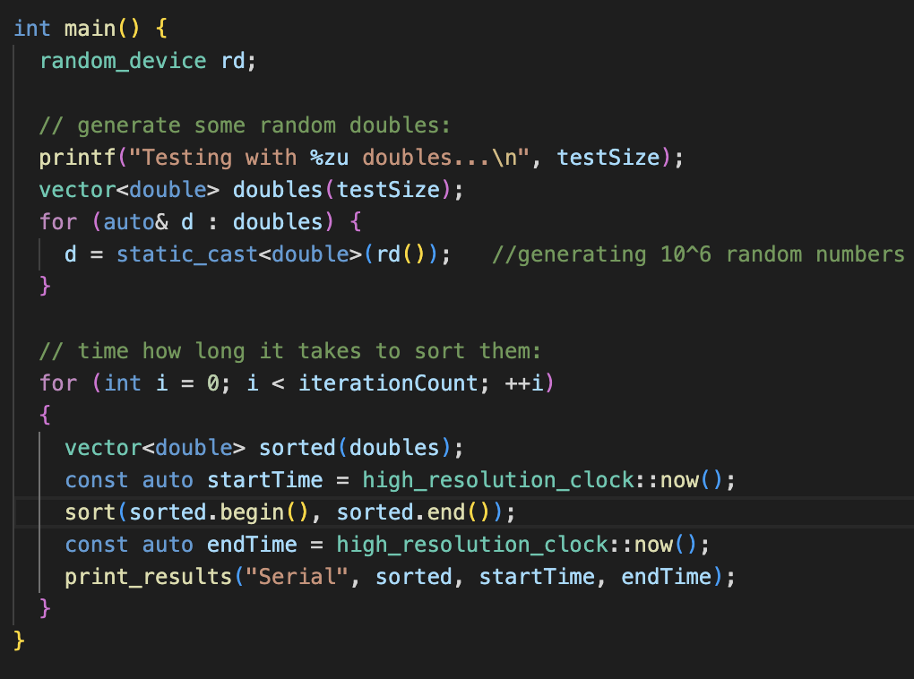
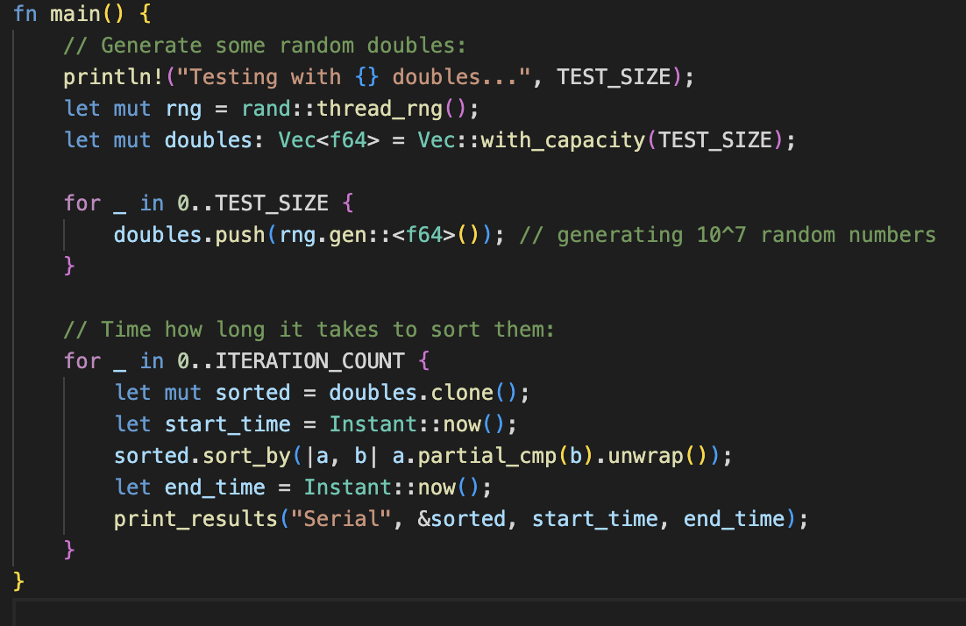

Slide 7
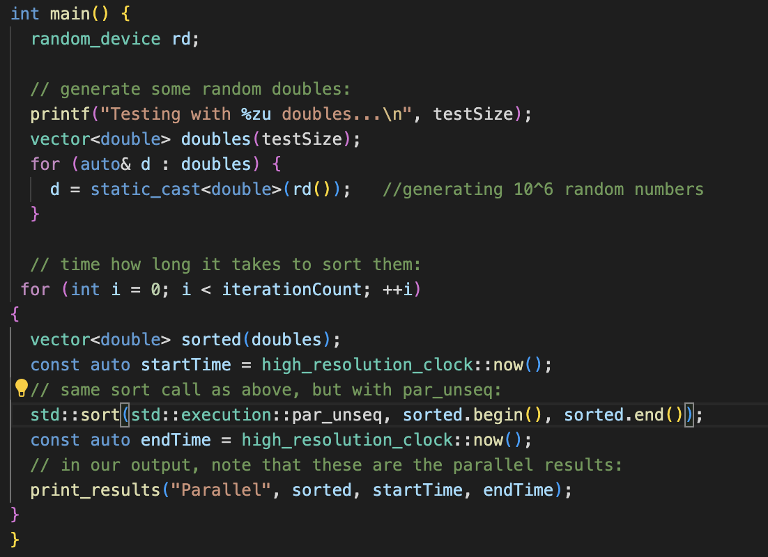
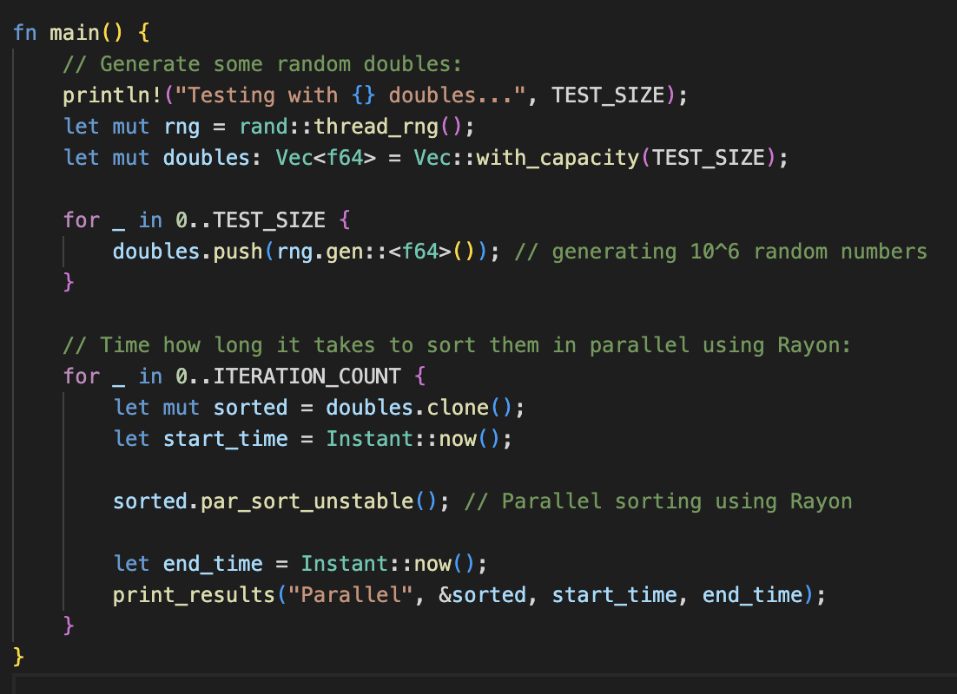

Slide 8
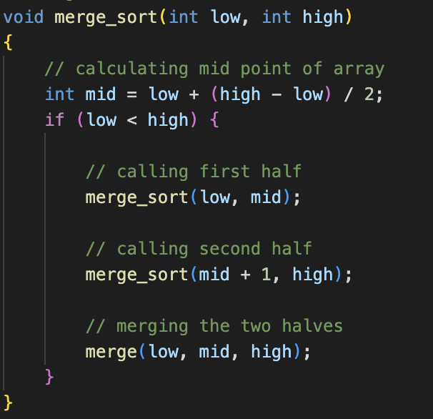
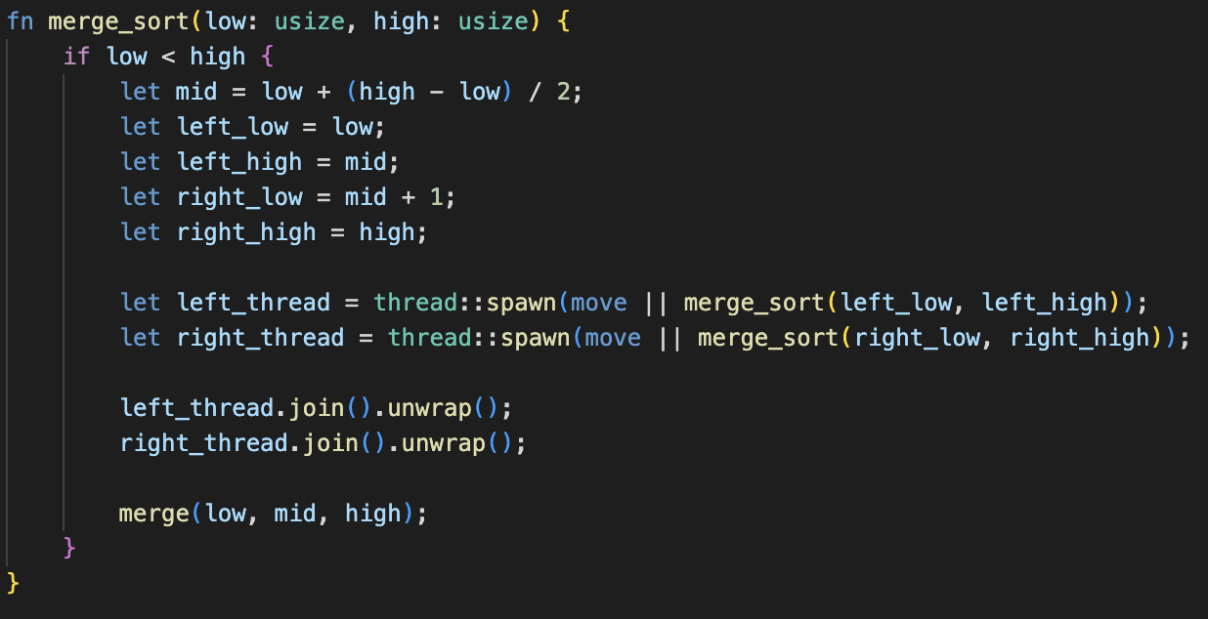

Slide 9
