Slide 1


EcoBoat: Design and Experimental Validation of
an Autonomous Body-Board Boat For Cleaning
Water Bodies
Aman Ansari ¹ , Saifullah Khan ¹, Rahul Kulkarni ¹, P.B. Sujit ¹
¹ Department of Electrical Engineering and Computer Science, Indian Institute of Science Education and Research Bhopal

Slide 2
Motivation
Physical Cleaning of water bodies requires significant human effort to clean garbage, algae, debris and other foreign substances. Therefore a robotic system is needed to clean water bodies.
Existing solutions are not cost-effective for cleaning both swimming pools and lakes.
Solution: Develop a cost-effective Autonomous Surface Vehicle (ASV) for efficient water cleaning.
Proposed Approach: Design an ASV for collecting floating garbage and debris. For swimming pool cleaning, use ultrasonic sensors to detect boundaries and obstacles. For lake cleaning, implement geofencing with GPS to define the cleaning area and use ultrasonic sensors for obstacle detection. Employ a random walk pattern with boundary-following behaviour within the designated area for efficient coverage.

Slide 3
Design Iterations

Slide 4
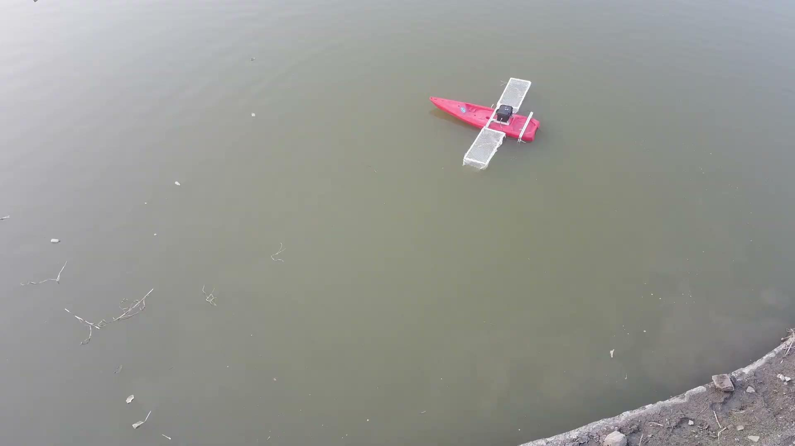

Slide 5
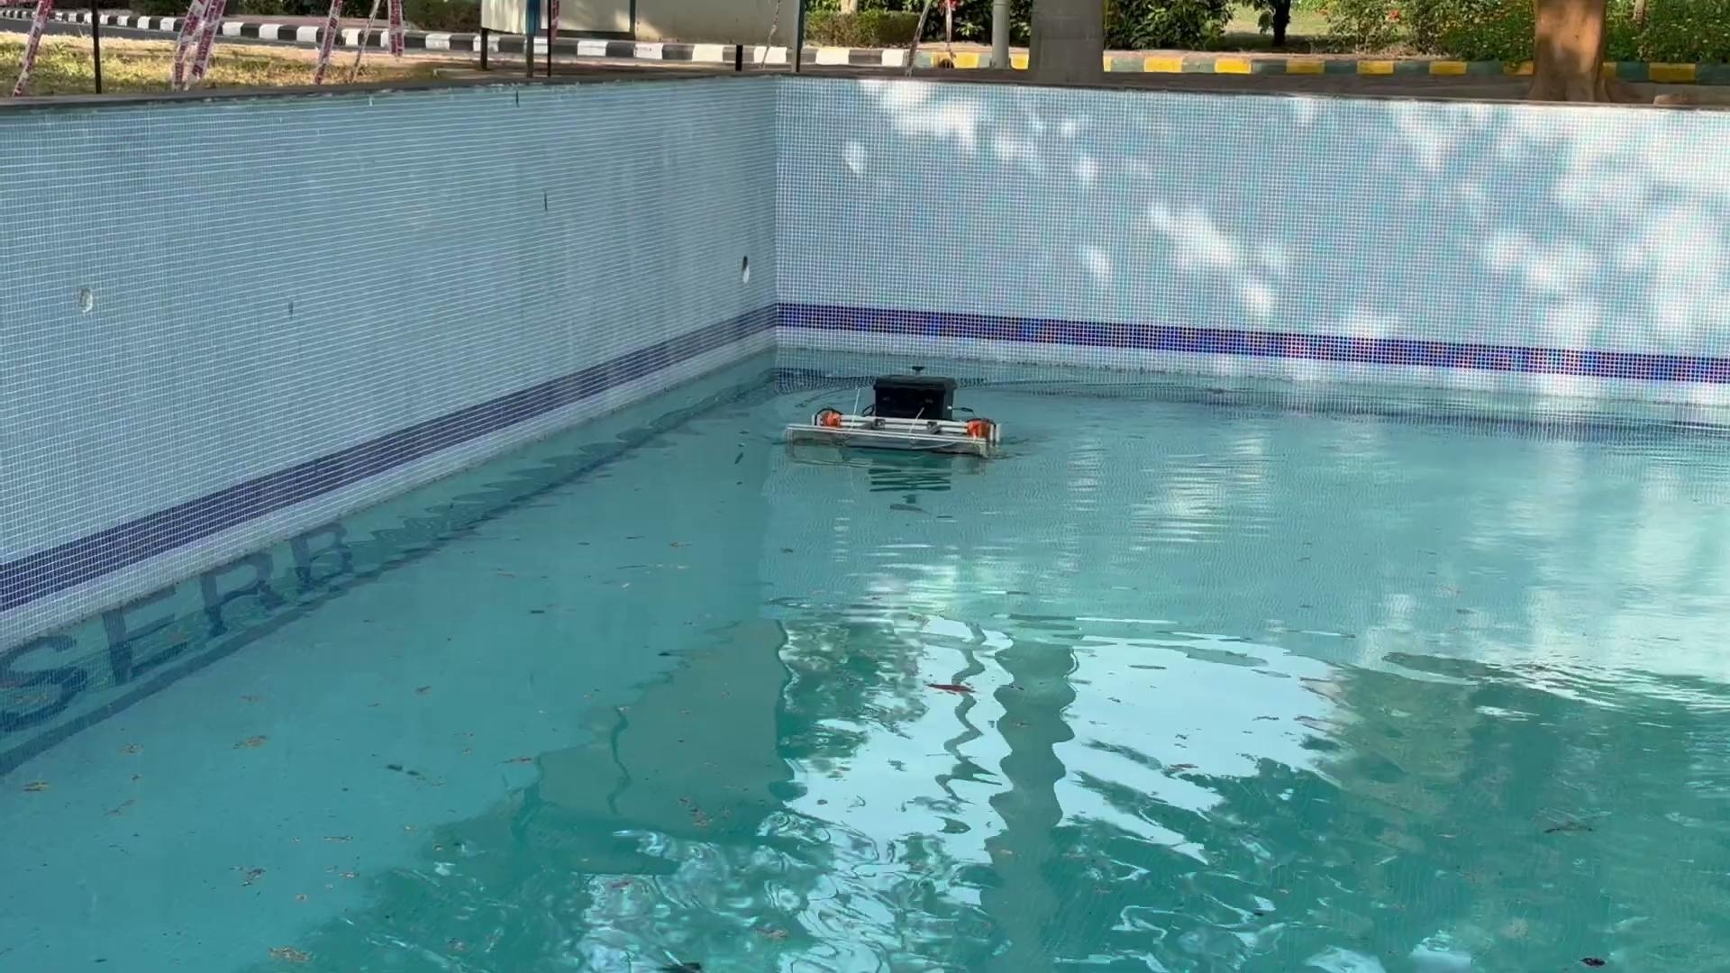

Slide 6
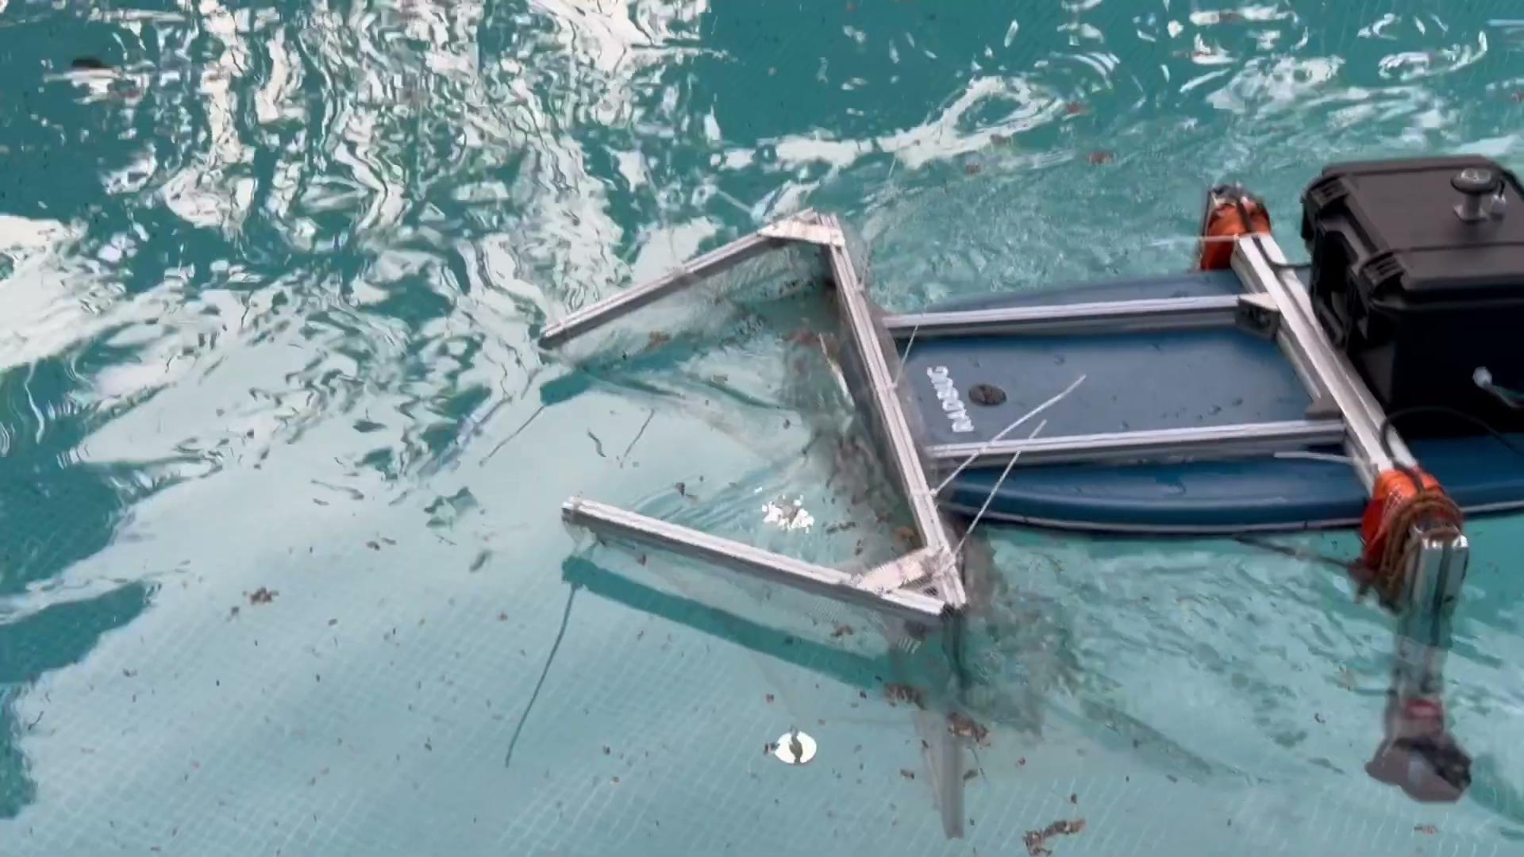

Slide 7
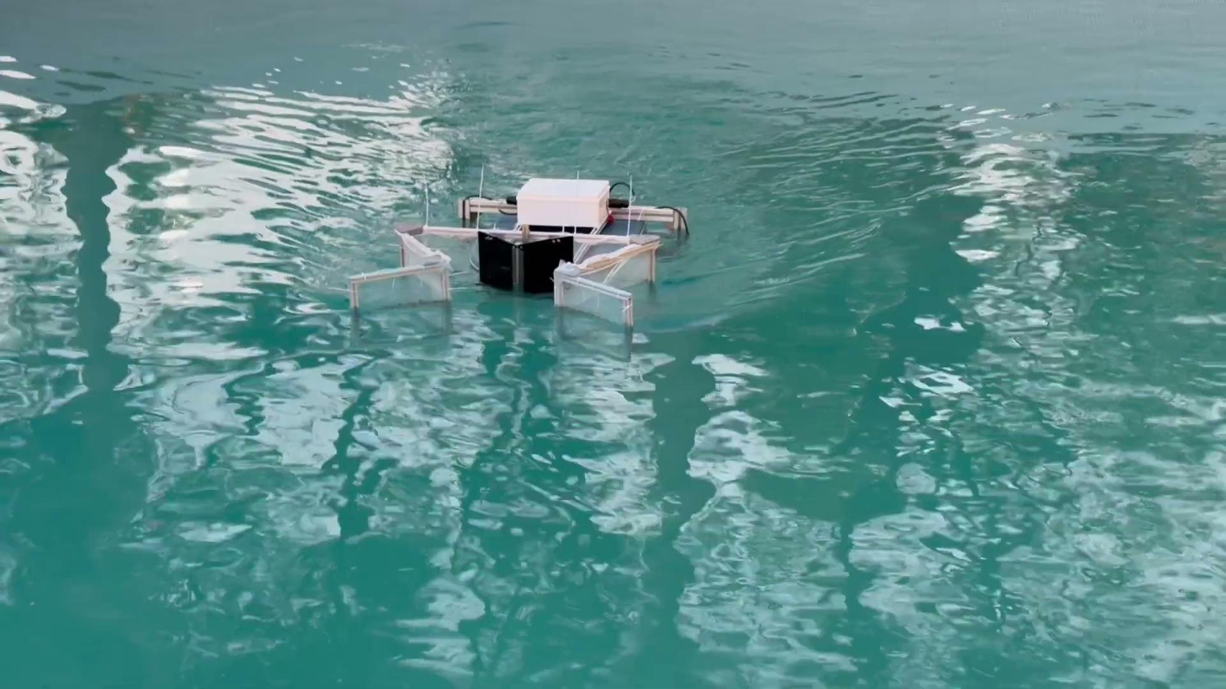

Slide 8
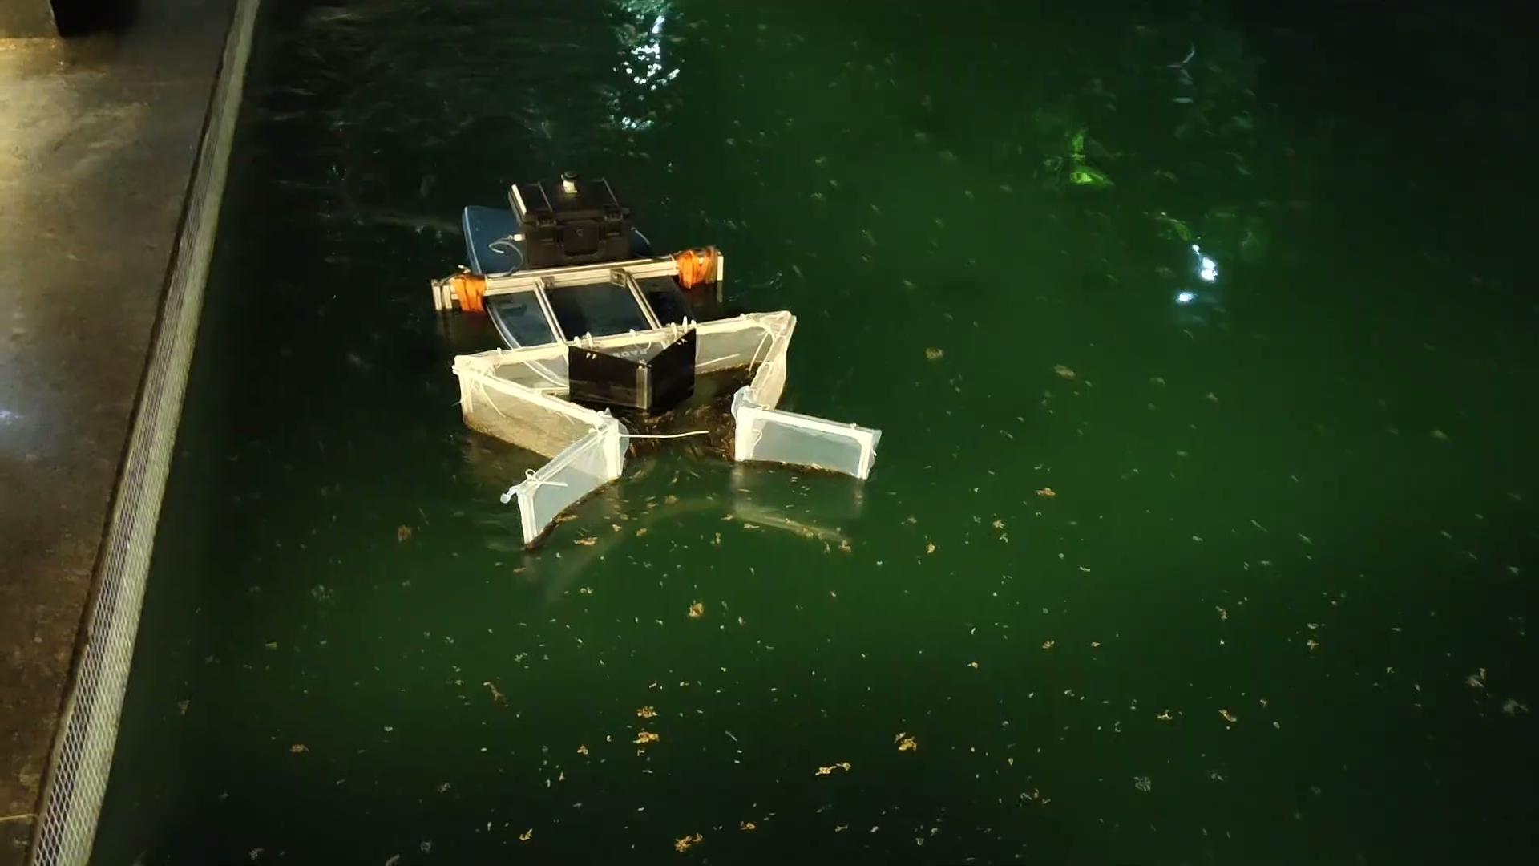
Tesla-valve Inspired Collection Mechanism
This collection mechanism was successful in collecting and retaining more garbage.

Slide 9

EcoBoat at Lower Lake, Bhopal
EcoBoat cleaning a geo fenced area at Lower Lake

Slide 10
Lessons Learned
Major issues faced during experimentation and their solutions are:
When the ASV stops, the absence of inward water flow, which previously held the collected garbage in place, may cause the debris to escape from the net.
Solution: A closing mechanism can be installed to prevent this from happening.
The bulky collection structure was challenging to handle both before and after use.
Solution: Make it foldable and use less bulky material.
There was a slight delay in executing the control signal when an obstacle or geofence was detected.
Solution: The control logic can be optimized, and low-latency communication protocols can be implemented. Additionally, connecting the sensors directly to the main computer instead of using an intermediate microcontroller can reduce latency and potential points of failure.

Slide 11

Thank You

