Slide 1
Github Codespaces

Slide 2
What is Github Codespaces?
Github Codespaces are instant cloud developer environments.
Code spaces provide you with a machine you can access through a browser or your ide where you can write run debug and test.

Slide 3
Why should anyone care?
The goal is to write the code not to manage python 2.7 or any other pythons (or somehow local dev management)

Slide 4
Where is it?
Codespaces are available any where you can connect to the Internet.
You only need to have access to a browser.

Slide 5
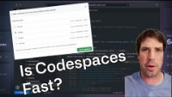

Slide 6
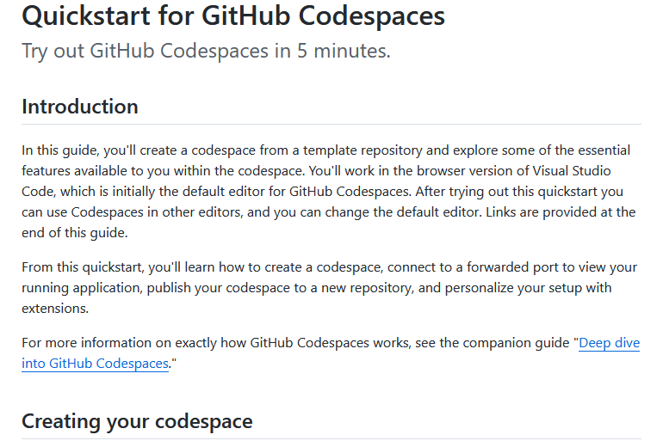

Github website
https://docs.github.com/en/codespaces/getting-started/quickstart

Slide 7

Thank you

