Slide 1
SENG 321 Lab 5
January 31 2022

Slide 2
A Quick Intro to GH Actions
CI/CD platform to automate your build-test-deployment pipeline.
Create workflows triggered by other events in repository
E.g. initiates a specific workflow to add labels when a team member creates a new issue.

Slide 3
What is CI/CD?
Continuous Integration: new code changes to software regularly built, tested, merged into shared repo.
Continuous Delivery/Deployment: changes to an application automatically tested for errors, and deployed into a live production environment / released to customers.

Slide 4
What is a Workflow?
Configurable & automated process to run tasks.
Can be triggered manually or set to a schedule.

Slide 5
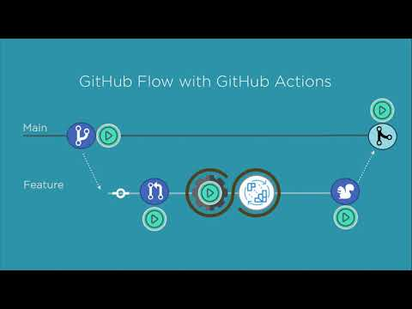

Slide 6
GH Actions Resources (if you’re interested)
Documentation: https://docs.github.com/en/actions/learn-github-actions/understanding-github-actions

Slide 7
This Week’s Labs:
Please update me on:
The general states of your projects
The requirements you have been able to find
How far your group has gotten on A2
Challenges
Tomorrow: Codespaces Tutorial and work session.

