Slide 1






Lecture 1:
Introduction to Backend Development
Course - Web Development - III
By -
Love Porwal
welcome@krmangalam.edu.in
Sohna Road,Gurugram,Haryana 122103

Slide 2

Table of Contents
What is Backend Development
Frontend vs Backend
Client-Server Architecture
What is Node.js?
Why use Node.js?
Real-world Applications of Node.js
References
The End
2

Slide 3

Can a website work properly with only design and buttons?
3

Slide 4
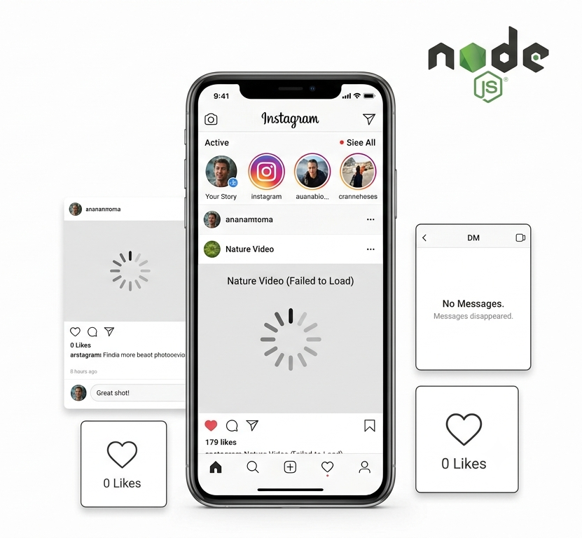
What if Instagram worked like this?
You open Instagram
Photos are visible
But…
Login does not work
Comments are not saved
Messages disappear
Likes are never counted
Videos never load
4

Slide 5
What is Backend Development?
Backend Development refers to the server-side of an application.
It is responsible for:
Processing user requests
Performing business logic
Connecting databases
Authentication
Sending responses to users
The backend is invisible to users but powers every application.
Examples:
Login system
Payment Gateway
User Registration
Sending OTP
Order Management
5

Slide 6
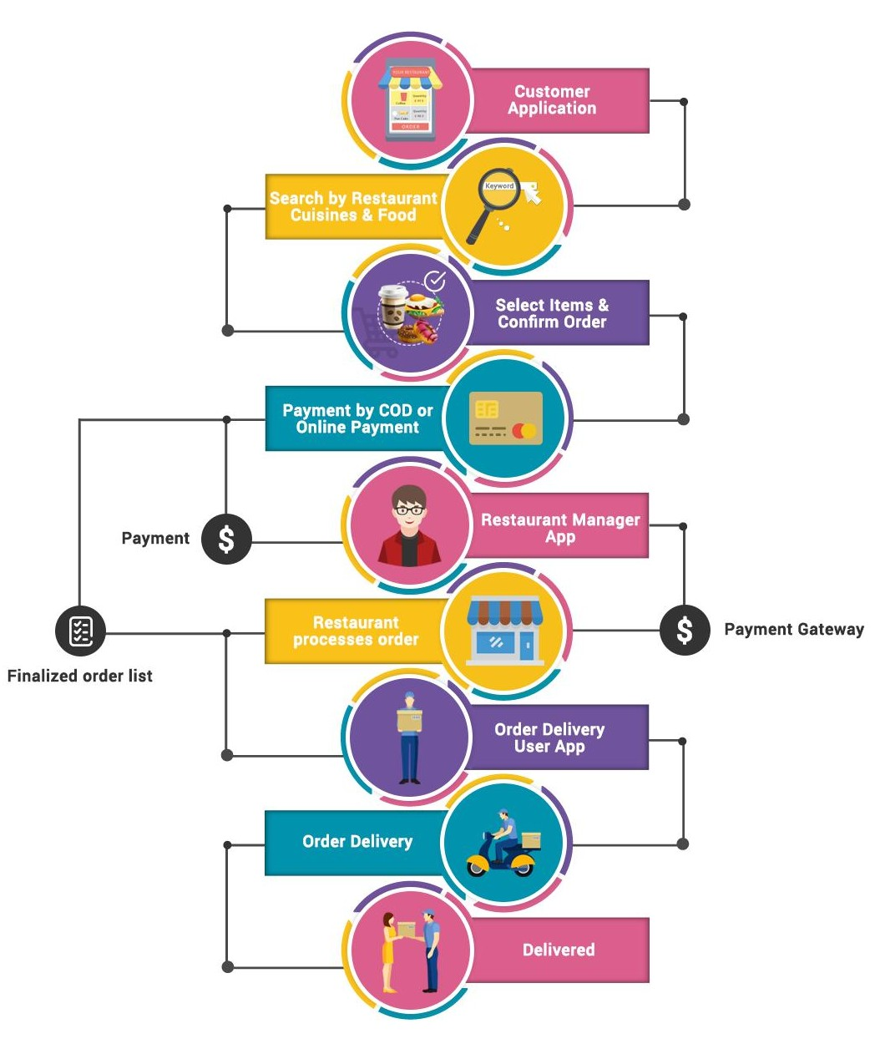
Why Does Backend Matter?
Real-World Example:
Instagram's backend stores 500M+ user profiles, processes millions of uploads/day, and handles authentication for 2B+ monthly users
Food delivery: create order, assign rider, track payment
Banking: validate login, verify balance, transfer money
6

Slide 7
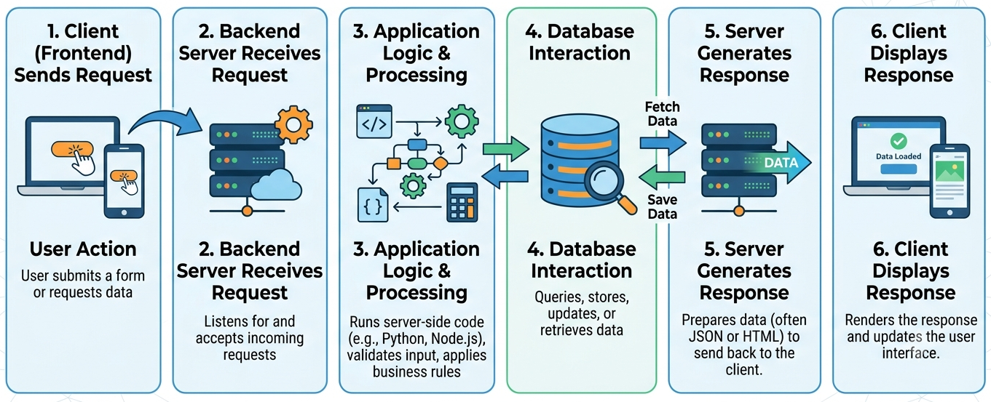
How Backend Fits in Your App
7

Slide 8
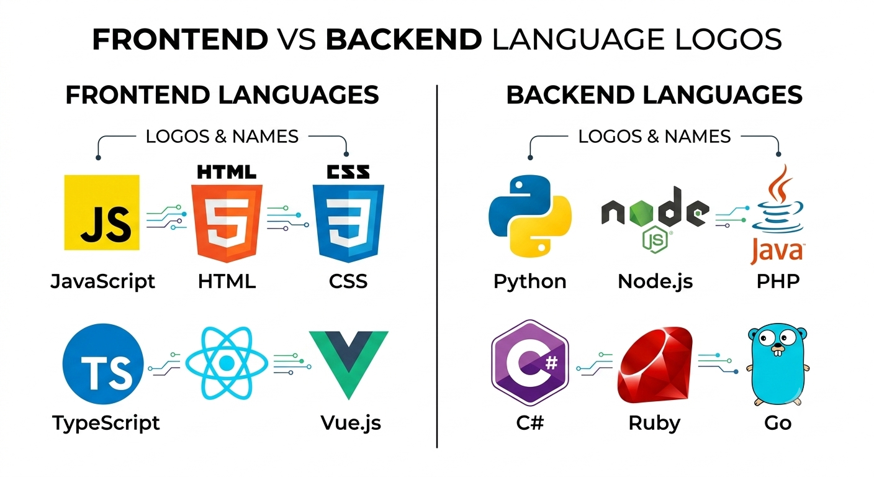
Frontend vs Backend
Frontend is what users see and interact with (React, Vue, HTML/CSS). Backend is the invisible infrastructure that processes requests, manages data, and provides APIs.
8

Slide 9
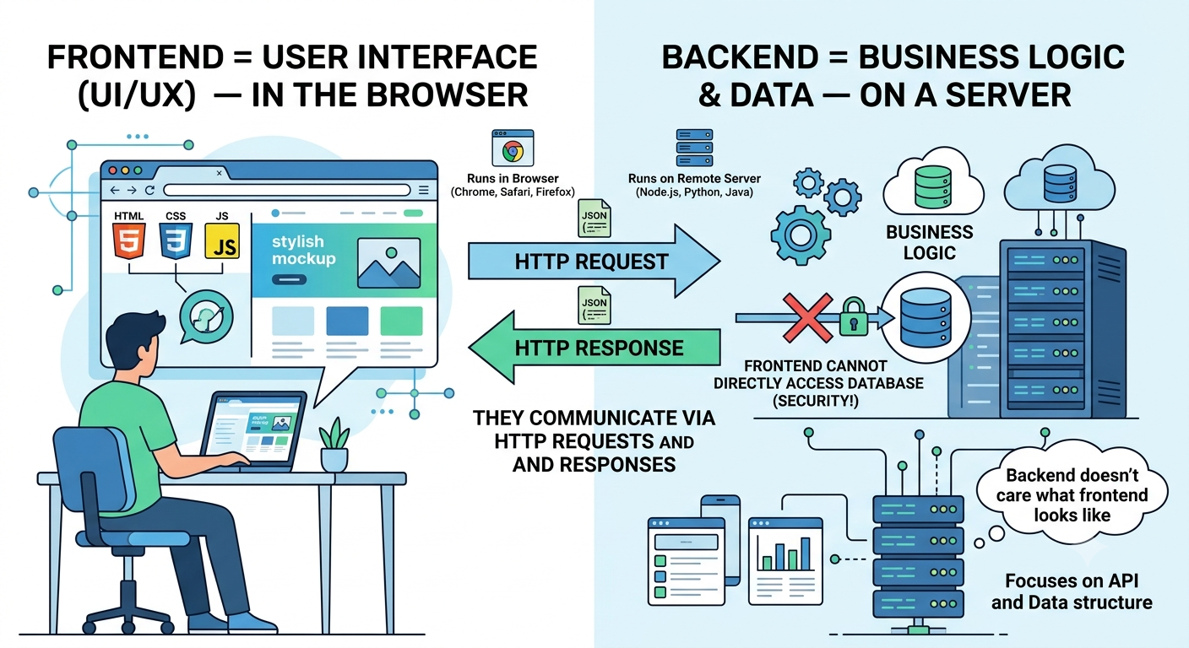
Why Separation Matters
9

Slide 10
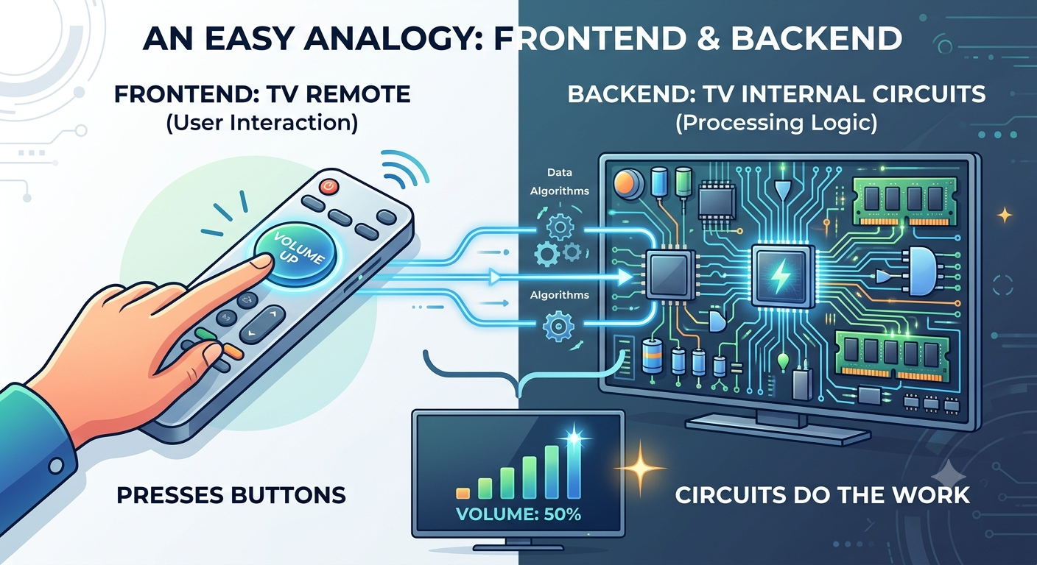
How Frontend & Backend Work Together
Easy Analogy:
Frontend = TV remote,
Backend = TV internal circuits.
You press buttons, circuits do the work
10

Slide 11
Frontend VS Backend
Frontend | Backend
Runs in browser | Runs on server
Visible to user | Hidden from user
Handles UI | Handles logic
HTML, CSS, JS | Node.js, Python, Java
Client-side | Server-side
11

Slide 12
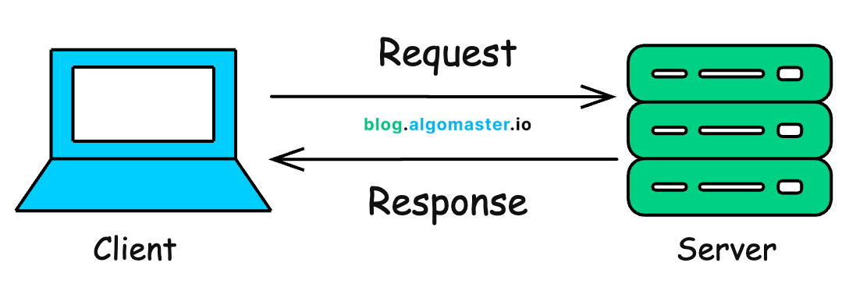
Client-Server Architecture
A model where a Client (browser/app) sends requests to a Server (your app), which processes them and sends responses back. The fundamental pattern of all web applications.
Frontend
Backend
User
12

Slide 13
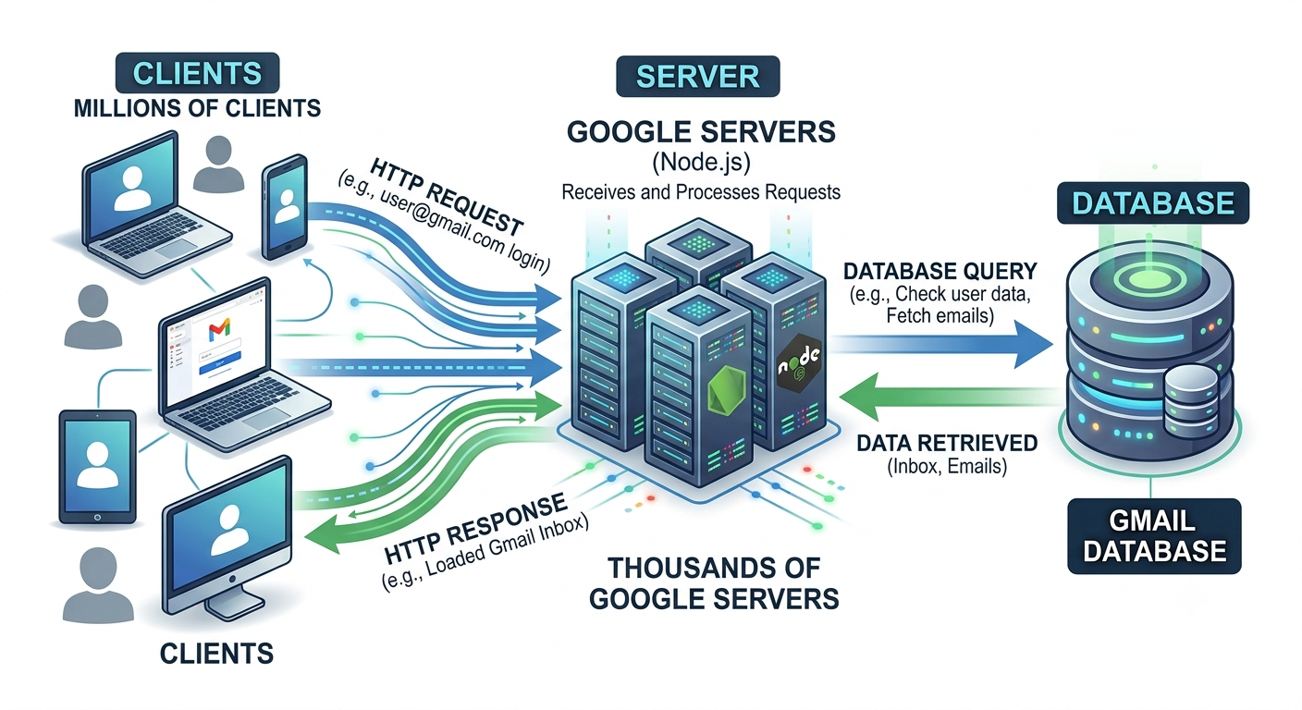
Why This Architecture?
13

Slide 14
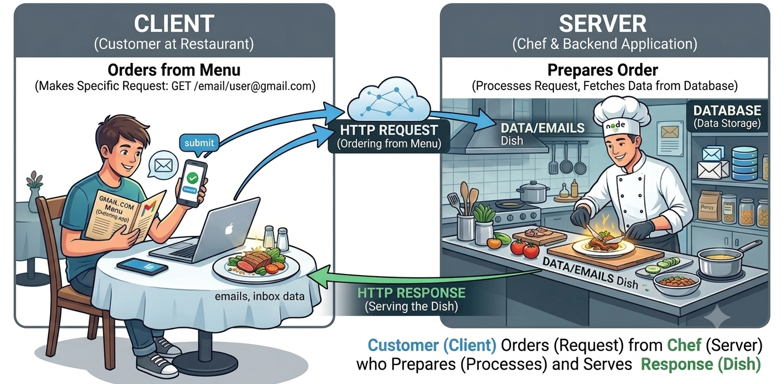
Request-Response Cycle
Easy Analogy:
Client-server = customer at restaurant.
Customer (client) orders from menu, chef (server) prepares, serves response (dish)
14

Slide 15

What is Node.js?
Node.js is a JavaScript runtime environment that lets you write server-side code. It's JavaScript escaping the browser cage and running on servers.
Key Points:
Created by Ryan Dahl in 2009
Built on Google Chrome's V8 JavaScript engine
Single-threaded, event-driven, non-blocking I/O
Comes with npm (2M+ packages)
Runs on Windows, macOS, Linux
15

Slide 16
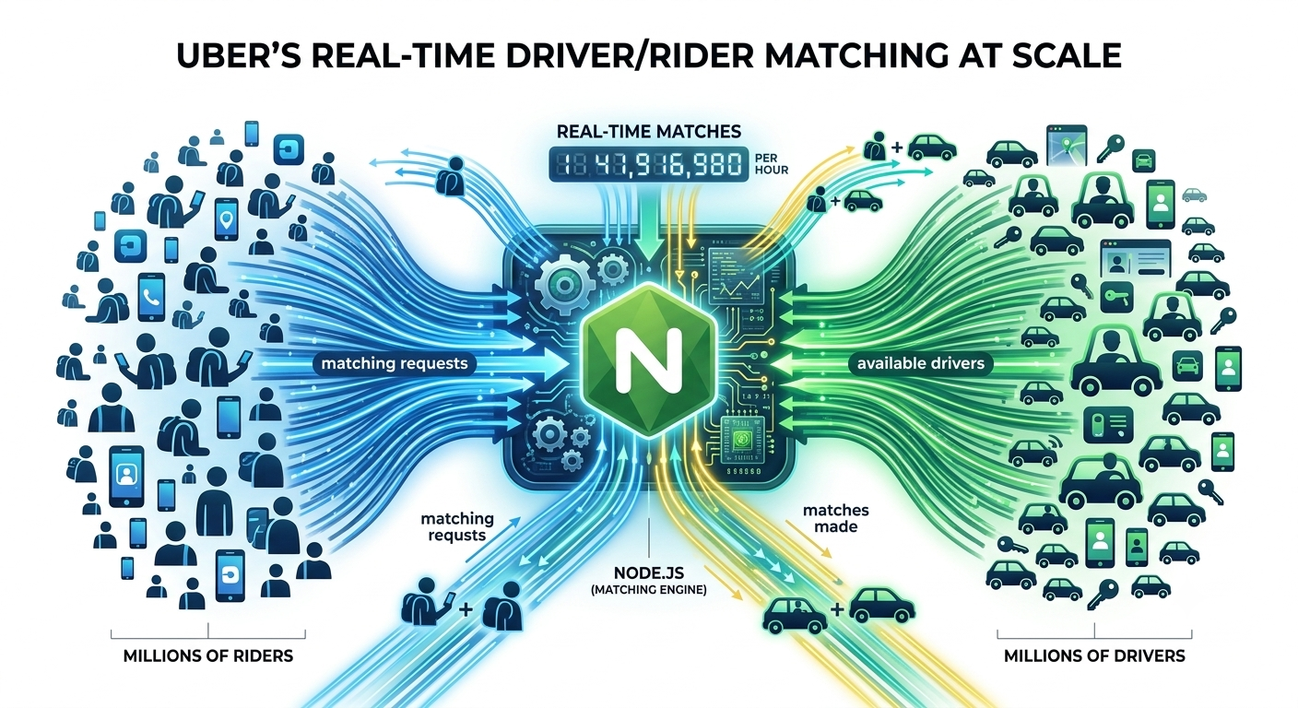
Why Node.js Exists
Before Node.js, you needed different languages for frontend (JS) and backend (Python/Java). Node.js unified them
Real-World Example
Netflix rewrote their backend in Node.js, reduced startup time by 70%.
Uber uses Node for real-time driver/rider matching across millions.
16

Slide 17
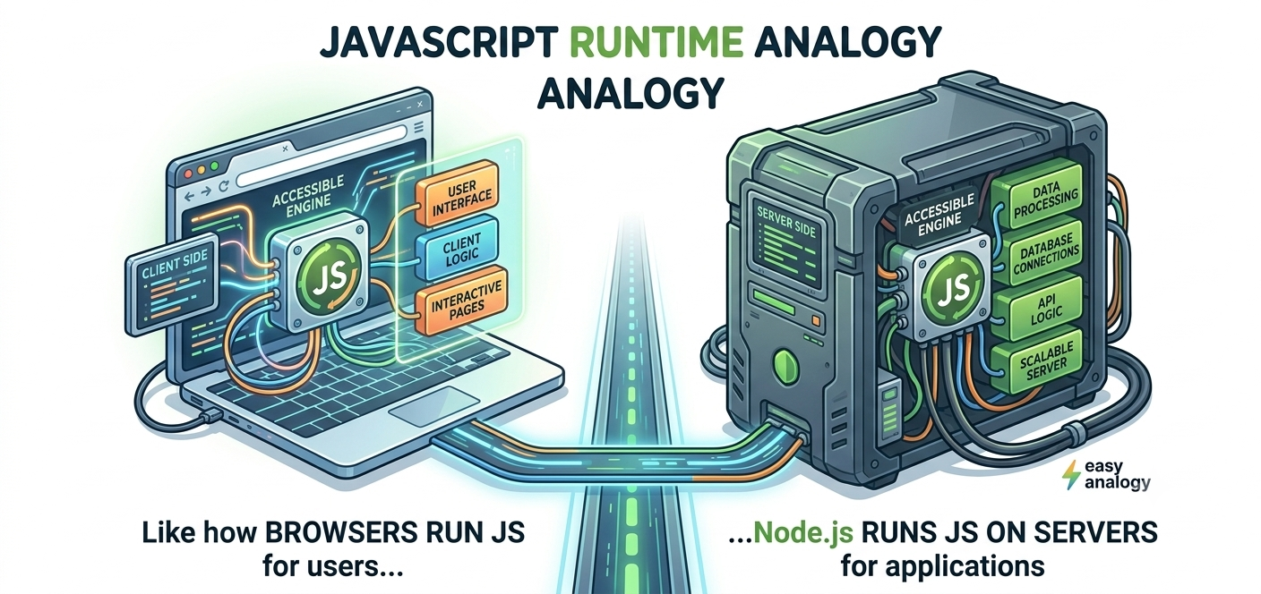
How Node.js Works
Easy Analogy:
Node.js = JavaScript runtime.
Like how browsers run JS in your browser, Node.js runs JS on servers
17

Slide 18
Why Use Node.js?
Node.js is ideal for building fast, scalable backend applications. It's used by companies handling billions of requests.
Key Points:
JavaScript everywhere = one language for full-stack development
High performance = handles 10,000+ concurrent connections
npm ecosystem = instantly install any library you need
Event-driven = perfect for real-time apps
Lightweight = low memory footprint per server
18

Slide 19

| Check Your Understanding
Question : What is the primary purpose of a backend in a web application?
Options : A. Handle user interface and styling
B. Process requests, manage data, handle authentication
C. Run JavaScript in the browser
D. Display HTML on the screen
Answer : B. Process requests, manage data, handle authentication
Explanation:
The frontend displays the UI. The backend processes all the business logic, stores/retrieves data from the database, handles security, and provides APIs for the frontend to consume.
19

Slide 20
| Check Your Understanding
Question : Which one is a backend responsibility?
Options : A. Rendering HTML in browser
B. Creating beautiful UI with CSS
C. Validating user password and querying database
D. Handling click events in JavaScript
Answer : B. Validating user password and querying database
Explanation:
Only the backend should validate passwords (never trust client-side validation!). Only the backend should access the database directly. The client cannot and should not do these tasks.
20

Slide 21
| Check Your Understanding
Question : Why can't frontend code directly access the database?
Options : A. It's too complicated
B. Frontend uses a different programming language
C. Databases don't support JavaScript
D. Security: exposing database credentials to client is dangerous
Answer : D. Security: exposing database credentials to client is dangerous
Explanation:
If you put database credentials in frontend code, every user can see them (view page source!). Attackers could drop your entire database. Backend MUST be the only one accessing the database.
21

Slide 22
| References
Node.js Official Documentation : Comprehensive and official documentation for Node.js runtime, modules, APIs, file system, HTTP, Express integration basics, and backend development concepts. 🔗 Node.js Official Docs
W3Schools – Node.js Tutorial : Beginner-friendly Node.js tutorials with easy explanations, examples, and hands-on practice for backend development fundamentals. 🔗 W3Schools Node.js Tutorial
freeCodeCamp – Node.js Course : Free practical tutorials and project-based learning resources for Node.js, Express.js, REST APIs, and backend development. 🔗 freeCodeCamp Node.js Resources
22

Slide 23
Thanks
For
Watching
Course - Web Development - III
welcome@krmangalam.edu.in
23
Sohna Road,Gurugram,Haryana 122103

