Slide 1






Lecture 2:
HTTP Fundamentals
Course - Web Development - III
By -
Love Porwal
welcome@krmangalam.edu.in
Sohna Road,Gurugram,Haryana 122103

Slide 2

Table of Contents
What is HTTP
HTTP Request & Response Cycle
HTTP Methods (GET, POST, PUT, DELETE)
Status Codes
HTTP Headers
References
The End
2

Slide 3

Have you ever ordered food from Zomato or Swiggy? What actually happens after you press the 'Order Now' button?
3

Slide 4
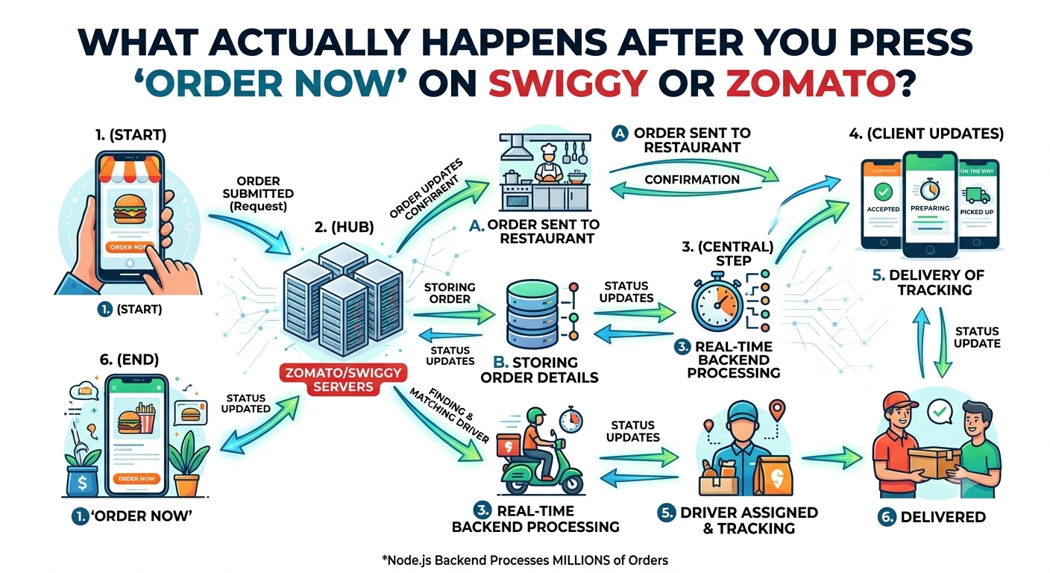
4

Slide 5
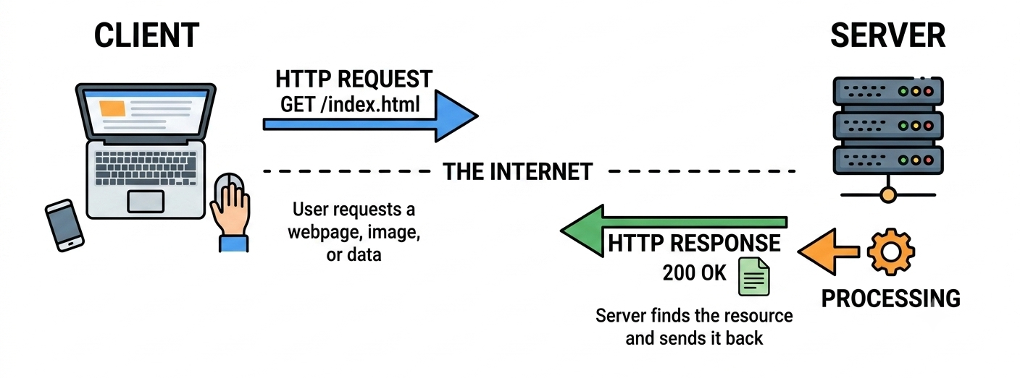
What is HTTP?
HTTP (HyperText Transfer Protocol) is the foundation of web communication. It defines how messages are formatted and transmitted between clients and servers. Every time you visit a website, HTTP is working.
5

Slide 6

Why HTTP Matters
Use Case:
Every web interaction uses HTTP. Knowing HTTP is crucial for building APIs and debugging network issues
Real-World Example:
When you submit a form on a website, HTTP carries that data to the backend.
When Netflix streams a movie, HTTP(S) carries the video frames. Every ping, every request, every response uses HTTP.
6

Slide 7
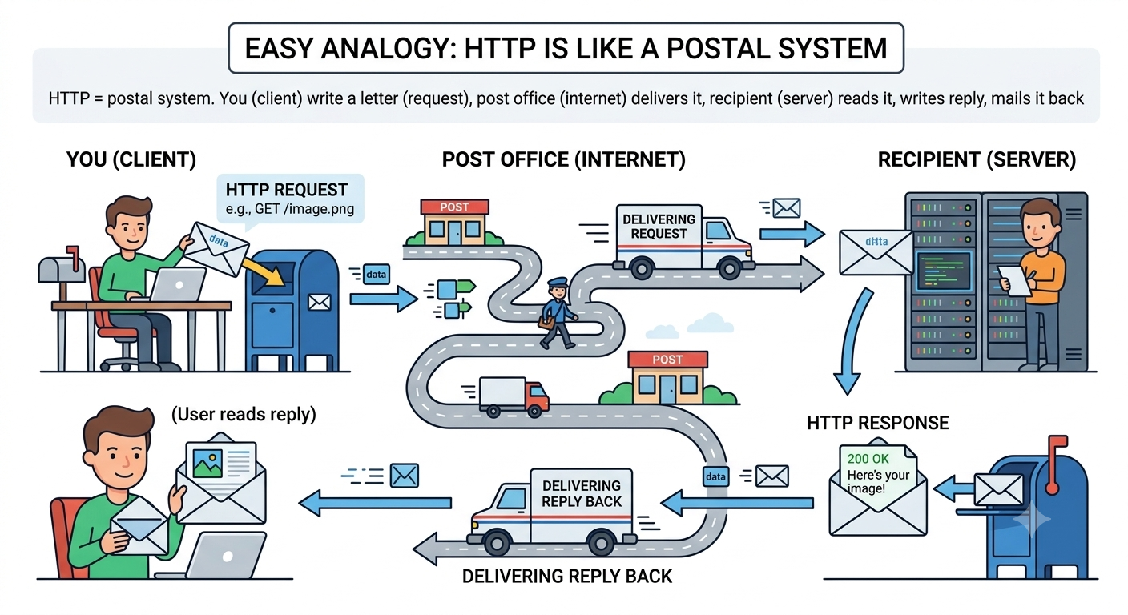
How HTTP Works
7

Slide 8
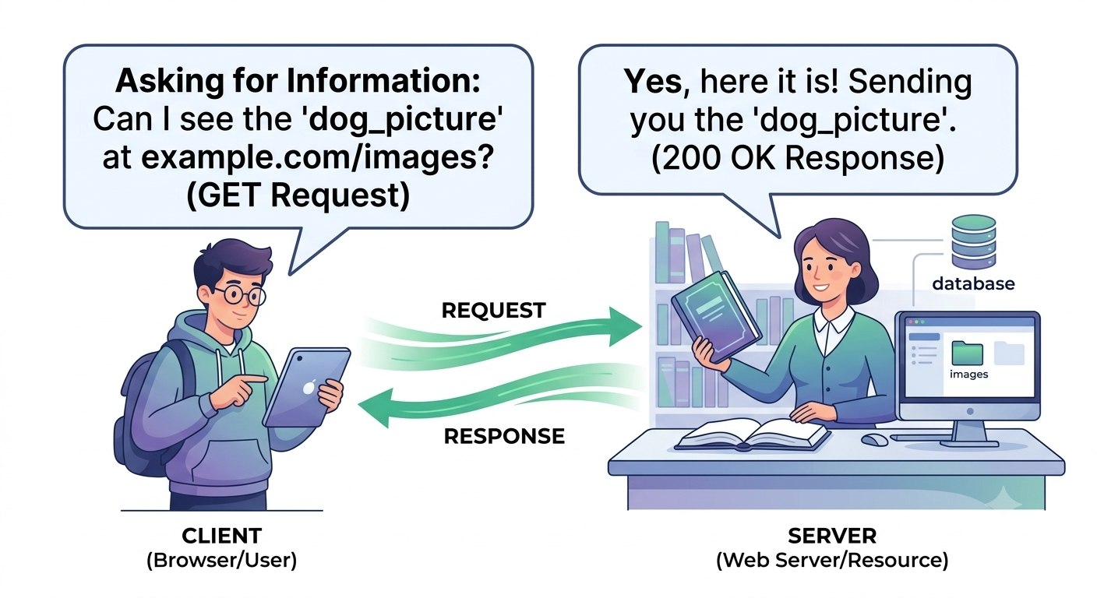
HTTP Request Structure
An HTTP Request is a message sent by the browser (client) to the server asking for some information or requesting an action.
8

Slide 9
HTTP Request Structure
1. Method
An HTTP Request has 4 main parts
It tells the server what you want to do.
Examples:
GET, POST, PUT, PATCH, DELETE
HTTP Request/
│
├── Method
├── URL
├── Headers
└── Body (Optional)
2. URL
It tells where the request should go.
Examples:
https://api.college.com/students
4. Body (Optional)
The body contains the actual data sent to the server.
Example:
{
"name": "Rahul",
"age": 21
}
3. Headers
Headers provide extra information about the request.
Example :
Content-Type: application/json
Authorization: Bearer xyz123
9

Slide 10
HTTP Request & Response Cycle
1
2
3
4
5
→
→
→
→
User Action
DNS Resolve
TCP Connect
HTTP Request
Server Process
User types URL or clicks link in browser
Domain name → IP address lookup
Browser opens connection to server port 80/443
Browser sends GET/POST request with headers & body
Server runs code, queries DB, prepares response
10

Slide 11
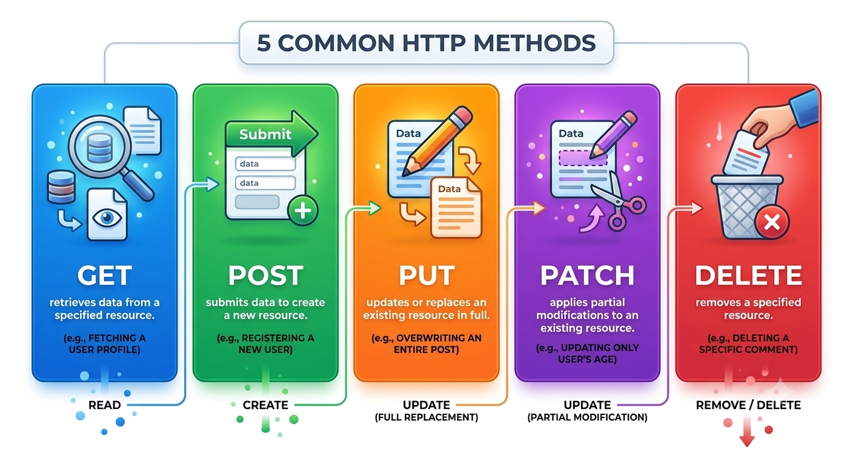
HTTP Methods
HTTP methods are verbs telling the server what action you want. GET, POST, PUT, PATCH, DELETE are the main ones. Each has a specific purpose and meaning.
11

Slide 12
HTTP Methods
Method | Purpose | Has Body? | Idempotent? | Example Use
GET | Retrieve data | No | Yes | Fetch user list
POST | Create a new resource | Yes | No | Register a user
PUT | Replace entire resource | Yes | Yes | Update full profile
PATCH | Partially update a resource | Yes | Yes | Change only email
DELETE | Remove a resource | No | Yes | Delete a post
HEAD | Like GET but no response body | No | Yes | Check if file exists
OPTIONS | Describe available methods (CORS) | No | Yes | CORS preflight check
12

Slide 13
HTTP Status Codes
HTTP Status Codes are 3-digit numbers sent by the server to tell the client whether the request was successful or not.
They're essential for error handling.
HTTP Request → Response
Browser (Client)
│
│ HTTP Request
▼
Server
│
│ HTTP Status Code + Response
▼
Browser
13

Slide 14
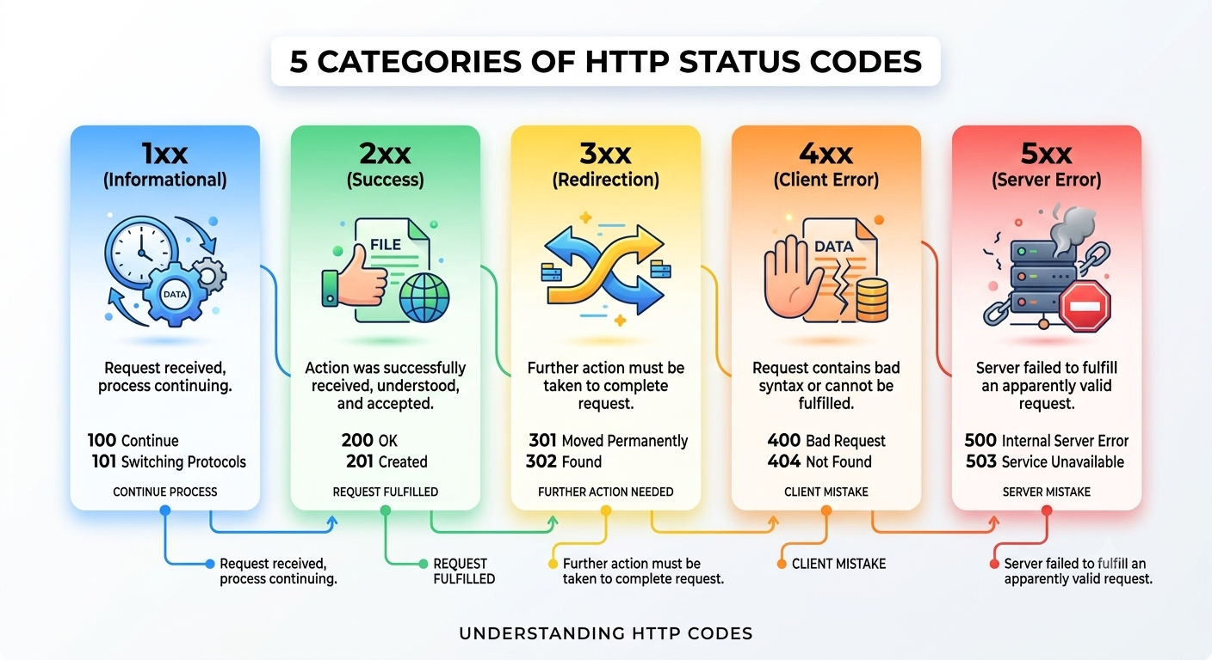
HTTP Status Codes
14

Slide 15
HTTP Headers
Headers are key-value pairs carrying metadata about the request or response. They tell the server and client extra information beyond just the data.
Imagine you are sending a courier parcel:
The parcel contains your gift (the main data), but there is also a label attached with:
Sender Name
Receiver Address
Fragile
Weight
These labels don't change the gift, but they tell the courier how to handle it.
HTTP Headers work exactly like these labels.
They carry extra information about the request or response.
15

Slide 16
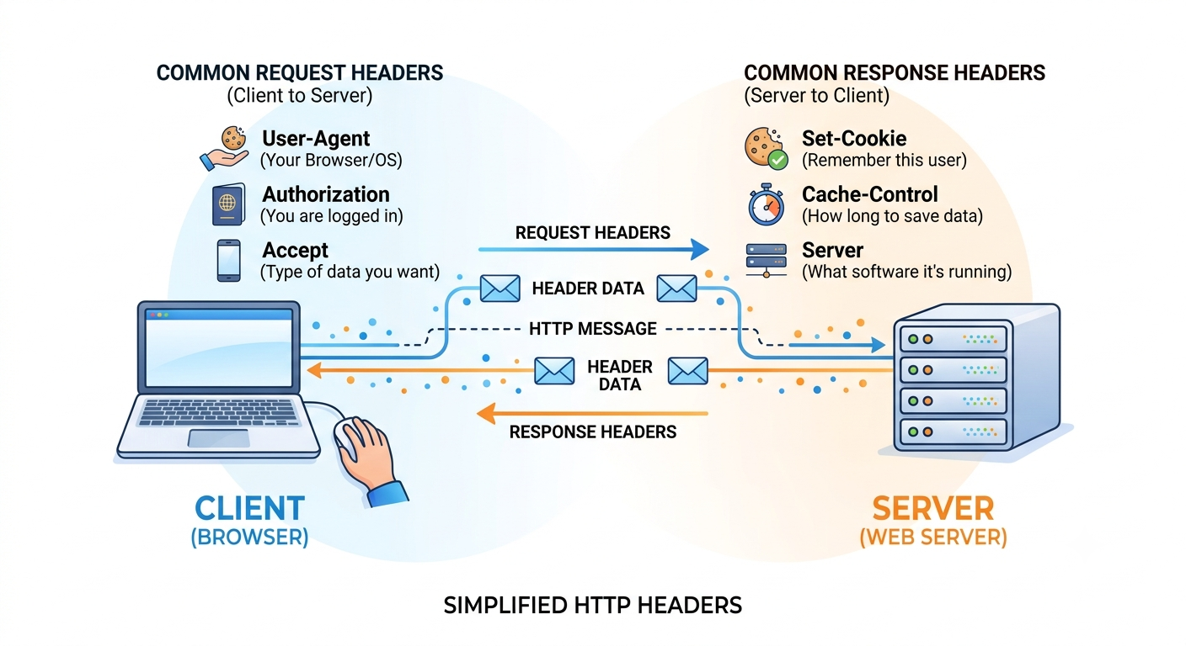
HTTP Headers
16

Slide 17

| Check Your Understanding
Question : Which HTTP method should you use to create a new user?
Options : A. GET /api/users
B. POST /api/users
C. DELETE /api/users
D. PUT /api/users
Answer : B. POST /api/users
Explanation:
POST is for creating new resources. GET retrieves, PUT replaces, DELETE removes. Always use the semantically correct method. POST /api/users with user data in body creates a new user.
17

Slide 18
| Check Your Understanding
Question : What does a 404-status code mean?
Options : A. Server error
B. Bad request
C. Resource not found
D. Unauthorized access
Answer : C. Resource not found
Explanation:
404 specifically means the server couldn't find the resource you asked for (wrong URL, deleted item, etc.). 400 = bad request format, 401 = need authentication, 500 = server bug.
18

Slide 19
| Check Your Understanding
Question : Why should you set Content-Type: application/json in your request header?
Options : A. It's just a suggestion
B. It has no real purpose
C. Only needed for responses
D. It tells server how to parse the request body you're sending
Answer : D. It tells server how to parse the request body you're sending
Explanation:
Content-Type in request tells SERVER what format the body is in (JSON, form data, plain text, etc.). Without it, server doesn't know how to parse body. Frontend must match Content-Type to actual body format.
19

Slide 20
| Check Your Understanding
Question : What's the difference between PUT and PATCH?
Options : A. PUT replaces entire resource, PATCH updates only specific fields
B. No difference, they're identical
C. PATCH is faster
D. PUT is for DELETE operations
Answer : A. PUT replaces entire resource, PATCH updates only specific fields
Explanation:
PUT expects complete replacement data. If you PUT a user and only send name field, you lose all other fields. PATCH updates only the fields you send. PATCH is safer for partial updates.
20

Slide 21
| References
Node.js Official Documentation : Comprehensive and official documentation for Node.js runtime, modules, APIs, file system, HTTP, Express integration basics, and backend development concepts. 🔗 Node.js Official Docs
W3Schools – Node.js Tutorial : Beginner-friendly Node.js tutorials with easy explanations, examples, and hands-on practice for backend development fundamentals. 🔗 W3Schools Node.js Tutorial
freeCodeCamp – Node.js Course : Free practical tutorials and project-based learning resources for Node.js, Express.js, REST APIs, and backend development. 🔗 freeCodeCamp Node.js Resources
HTTP Status : Every HTTP status code explained. 🔗 https://httpstatuses.com/
21

Slide 22
Thanks
For
Watching
Course - Web Development - III
welcome@krmangalam.edu.in
22
Sohna Road,Gurugram,Haryana 122103

