Slide 1






Lecture 3:
Node.js Runtime & NPM
Course - Web Development - III
By -
Love Porwal
welcome@krmangalam.edu.in
Sohna Road,Gurugram,Haryana 122103

Slide 2

Table of Contents
Installation of Node.js
Running JavaScript with Node
Introduction to NPM
NPM Registry
package.json
Installing Packages (Local vs Global Packages)
package-lock.json
Useful NPM Commands
References
The End
2

Slide 3

Can You Run a Car Without an Engine?
3

Slide 4
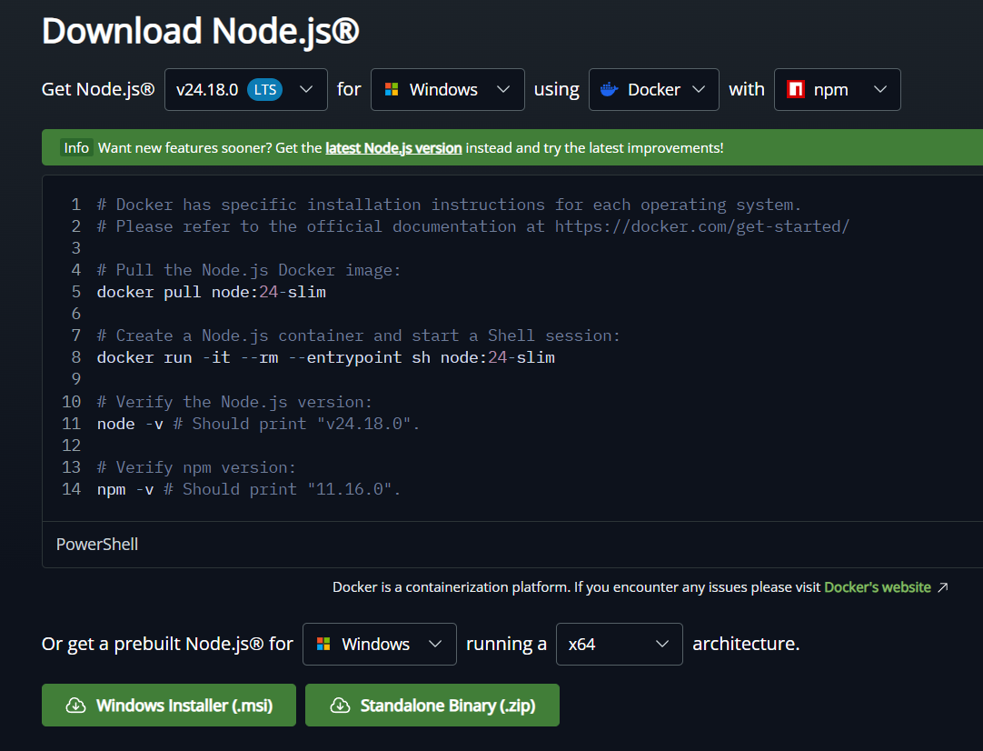
Installation of Node.js
Node.js installation brings JavaScript runtime to your computer. It's the gateway to backend development — without it, you can only write frontend code.
Key Points:
Download from nodejs.org (choose LTS version — most stable)
Run installer (Windows .msi, macOS .pkg, Linux package manager)
npm (Node Package Manager) comes automatically
Verify: node --version and npm --version
Now you can run any JavaScript on your computer
4

Slide 5

Why Install Node.js?
Use Case :
Node.js unlocks backend development. You can now write server code, build APIs, create CLI tools, all in JavaScript
Real-World Example :
Without Node.js, you're limited to browser JavaScript (frontend only). With Node.js, you can build complete full-stack applications in JavaScript
5

Slide 6
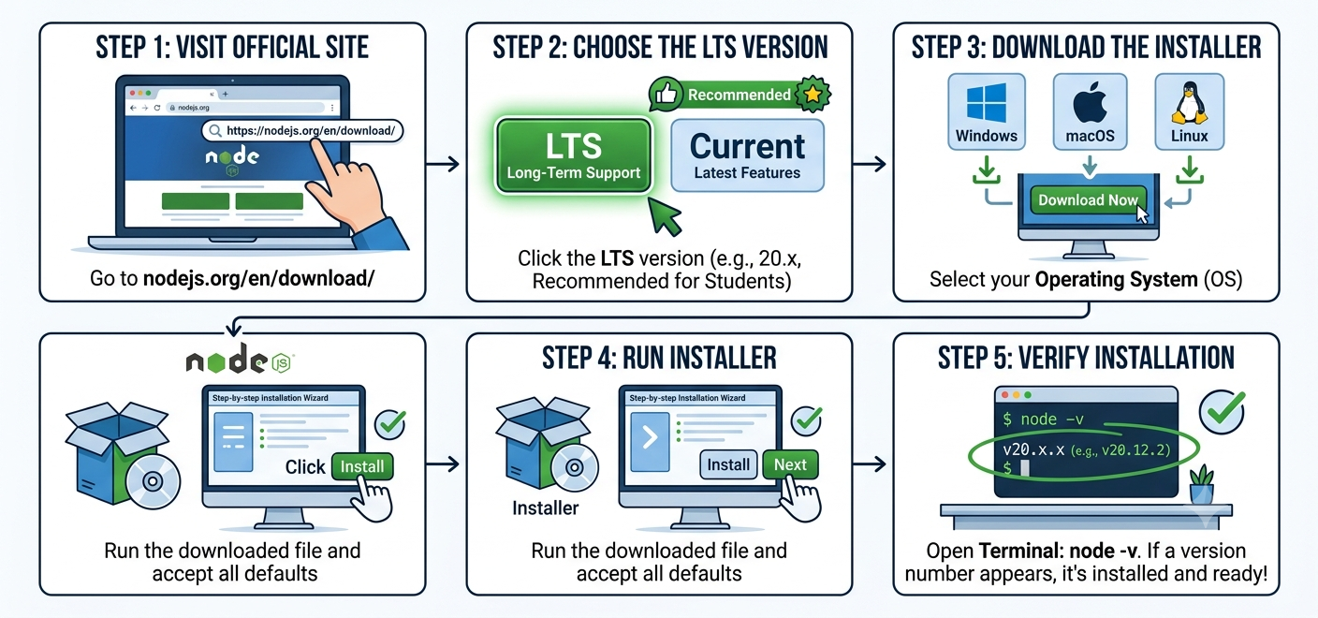
Installing Node.js Step-by-Step
6

Slide 7
Verifying Node.js Installation
Run these commands in your terminal after installation:
// Check Node.js version
node --version
// Output: v20.11.0 (your version may differ)
// Check npm version
npm --version
// Output: 10.2.4
// Open Node.js interactive shell
node
> 2 + 2
4
7

Slide 8
Running JavaScript with Node.js
Your first Node.js script — save as hello.js:
// hello.js
console.log('Hello, Node.js!');
// Using a variable
const name = 'Web Development II';
console.log(`Welcome to ${name}`);
// Simple function
function greet(studentName) {
return `Hello, ${studentName}! Ready to learn Node.js?`;
}
console.log(greet('Alice'));
// Run it:
// node hello.js
8

Slide 9

What is NPM?
NPM (Node Package Manager) is the world's largest software library for JavaScript.
It lets you install, manage, and share reusable code packages (libraries).
There are 2M+ packages available
It helps developers:
Install packages
Update packages
Remove packages
Share their own packages
Simple Definition:
NPM is a tool used to install and manage JavaScript packages.
9

Slide 10

Why NPM Matters
Use Case :
Without npm, you'd code everything from scratch. npm gives you instant access to libraries solving every problem imaginable
Real-World Example :
Express (50M+ downloads/week) = web server in one command.
Mongoose = database toolkit.
Axios = HTTP requests. All instantly available via npm
10

Slide 11
NPM Registry — What is it?
The npm registry is a public online database of JavaScript packages.
Located at: https://www.npmjs.com
Anyone can publish a package to the registry.
Packages can be: libraries, frameworks, CLI tools, utilities.
Examples of popular packages:
Package Name | Package Use Case
Express | web framework (50M+ weekly downloads)
React | UI library
nodemon | auto-restart development tool
mongoose | MongoDB ODM
dotenv | environment variable loader
11

Slide 12
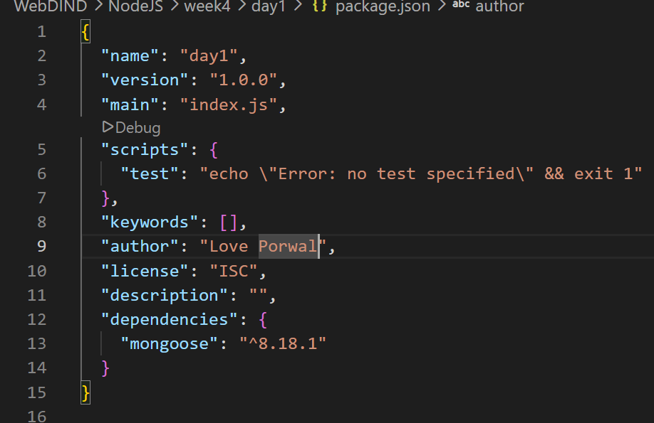
What is package.json?
package.json is a JSON file in your project root that describes your project and lists all its dependencies. It's like a resume for your Node.js project.
Why Important:
Collaboration
Deployment
Version management
Automation
12

Slide 13
Creating & Using package.json
Easy Analogy:
package.json = project blueprint.
Lists all ingredients (packages) your app needs
How to Use It:
npm init -y (create with defaults)
Edit manually or npm install <package> (adds to dependencies)
Each package gets entry: "express": "^4.18.2"
Share package.json, others run npm install to recreate setup
Never commit node_modules, only package.json + package-lock.json
13

Slide 14
npm init — Creating a New Project
Initialise a project using npm init:
// Interactive setup — asks questions
npm init
// package name: (my-app)
// version: (1.0.0)
// description: My Node.js API
// entry point: (index.js)
// test command:
// author: Alice
// license: (ISC)
// Skip questions — use defaults for everything
npm init -y
// Creates package.json instantly with defaults
// Check what was created
cat package.json
14

Slide 15
Installing Packages
Core npm install commands:
// Install and save to 'dependencies' (needed in production)
npm install express
npm install express mongoose dotenv cors
// Install as 'devDependency' (dev tools only)
npm install --save-dev nodemon jest
// shorthand:
npm i -D nodemon jest
// Install a specific version
npm install express@4.18.2
// Install all deps listed in package.json
npm install
// Install globally (available in any project)
npm install -g nodemon
15

Slide 16
Local vs Global Packages
Local Package
Global Package
Installed in node_modules/ inside the project
Listed in package.json dependencies
Only available in that project
Shared via package.json (not node_modules)
Used for: express, mongoose, axios, dotenv
Install: npm install <package>
Installed in system-wide npm directory
Available as CLI commands anywhere
NOT listed in package.json
Must be installed separately on each machine
Used for: nodemon, create-react-app, eslint
Install: npm install -g <package>
16

Slide 17
package-lock.json — Why It Exists
package-lock.json is automatically generated by npm install.
It records the EXACT version of every installed package and all its sub-dependencies.
Ensures every developer on the team installs identical versions.
Prevents 'works on my machine' problems caused by version drift.
Should ALWAYS be committed to Git — never add to .gitignore.
package.json = what you want (ranges).
package-lock.json = what you actually got (exact versions).
17

Slide 18
Useful NPM Commands — Quick Reference
Command | Description
npm init -y | Create package.json with defaults
npm install <pkg> | Install package + save to dependencies
npm install -D <pkg> | Install as devDependency
npm install -g <pkg> | Install globally
npm uninstall <pkg> | Remove a package
npm update | Update all packages within SemVer ranges
npm list | List installed packages in current project
npm list -g | List globally installed packages
npm outdated | Check which packages have newer versions
npm run <script> | Run a script defined in package.json
npm audit | Check for known security vulnerabilities
npm cache clean --force | Clear the npm cache
18

Slide 19
| Check Your Understanding
Question : What command installs a package as devDependency?
Options : A. npm install package
B. npm install --save-dev package
C. npm install -g package
D. npm add package
Answer : B. npm install --save-dev package
Explanation:
devDependencies are for development only (jest for testing, nodemon for auto-restart). Production deployment skips them. npm install -D is shorthand.
19

Slide 20
| Check Your Understanding
Question : What does caret (^) in ^4.18.2 allow?
Options : A. Only version 4.18.2 exactly
B. Any 4.x.x version up to <5.0.0
C. Any version after 4.18.2
D. Only 4.18.3 and above
Answer : B. Any 4.x.x version up to <5.0.0
Explanation:
Caret allows MINOR and PATCH updates. ^4.18.2 accepts 4.19.0, 4.20.0, etc., but not 5.0.0 (breaking change). Safe for getting new features while avoiding breaks.
20

Slide 21
| Check Your Understanding
Question : Why should you NOT commit node_modules to GitHub?
Options : A. It's too big (100MB+) and wastes storage
B. npm install recreates it anyway from package.json
C. Both a and b
D. No real reason
Answer : C. Both a and b
Explanation:
node_modules can be 100MB+, wasting bandwidth. Plus it's redundant — anyone with package.json can run npm install to recreate identical node_modules. Always add node_modules to .gitignore.
21

Slide 22
| Check Your Understanding
Question : What's the difference between package.json and package-lock.json?
Options : A. package.json lists version ranges, package-lock.json locks exact versions installed
B. They're identical
C. package-lock.json is outdated
D. Only one is needed
Answer : A. package.json lists version ranges, package-lock.json locks exact versions installed
Explanation:
package.json: "^4.18.2" (get latest 4.x). package-lock.json: records exactly what was installed (4.18.2, not 4.19.0). Both committed to Git. Ensures reproducible builds.
22

Slide 23
| References
Node.js Official Documentation : Comprehensive and official documentation for Node.js runtime, modules, APIs, file system, HTTP, Express integration basics, and backend development concepts. 🔗 Node.js Official Docs
W3Schools – Node.js Tutorial : Beginner-friendly Node.js tutorials with easy explanations, examples, and hands-on practice for backend development fundamentals. 🔗 W3Schools Node.js Tutorial
freeCodeCamp – Node.js Course : Free practical tutorials and project-based learning resources for Node.js, Express.js, REST APIs, and backend development. 🔗 freeCodeCamp Node.js Resources
npm Docs : Official npm documentation and CLI reference.
🔗 https://docs.npmjs.com/
23

Slide 24
Thanks
For
Watching
Course - Web Development - III
welcome@krmangalam.edu.in
24
Sohna Road,Gurugram,Haryana 122103

