Slide 1






Lecture 4:
Node.js Modules
Course - Web Development - III
By -
Love Porwal
welcome@krmangalam.edu.in
Sohna Road,Gurugram,Haryana 122103

Slide 2

Table of Contents
What are Modules
Types of Modules
Core Modules
Local Modules
Third-party Modules
Module Export/Import Methods
CommonJS vs ES Modules
References
The End
2

Slide 3

Can you build an entire LEGO city using just one giant block?
3

Slide 4
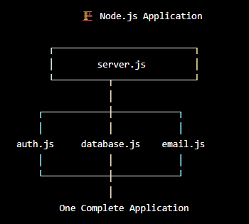
What Are Modules?
Modules are self-contained units of code. Each file in Node.js is a separate module with private scope. Variables don't leak globally unless you export them.
Key Points:
Encapsulation = hide implementation, expose API only
Reusability = write once, use in many files
Organization = code broken into logical units
Scope isolation = avoid global namespace pollution
Clear dependencies = see what each module needs
4

Slide 5
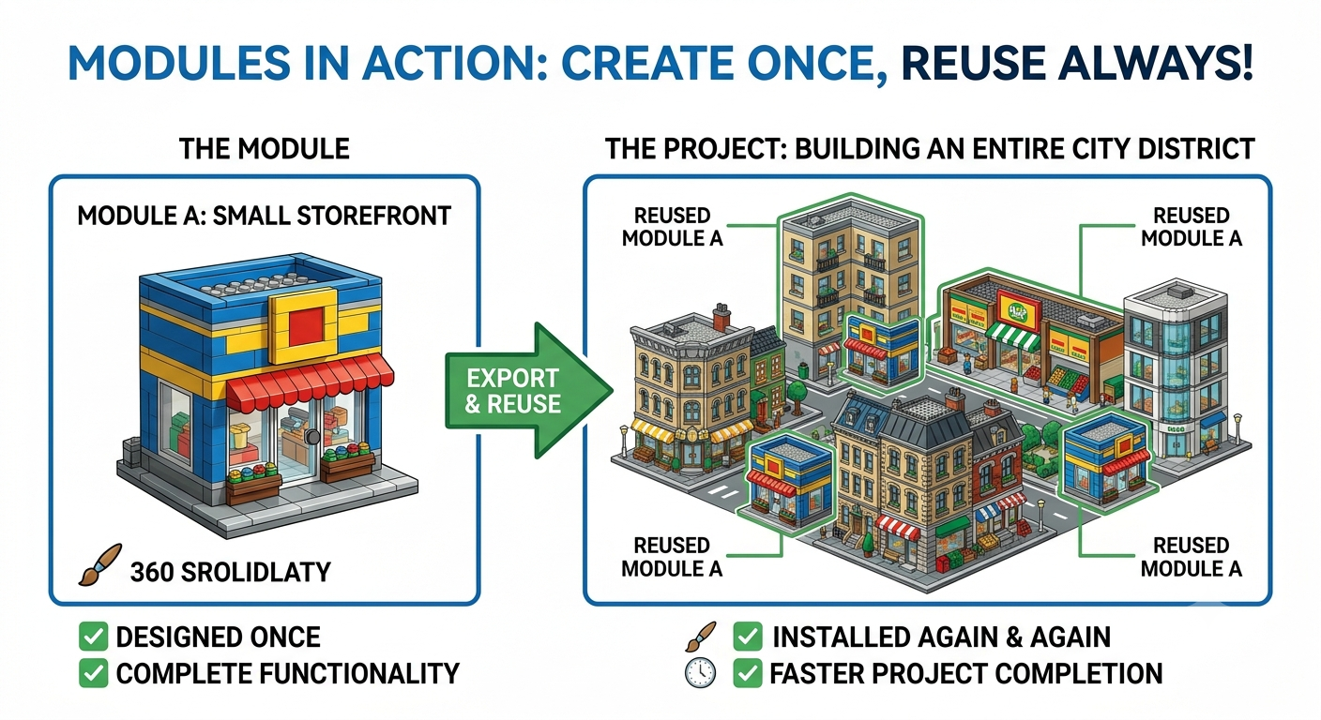
Why Modules Matter
Use Case :
Without modules, all code would be global. Variables clash. Difficult to maintain. Can't reuse code. Modules solve all these problems
Why Important :
Scalability
Maintainability
Reusability
Testability
5

Slide 6
Types of Modules
There are three kinds:
Core Modules
Local Modules
Third-party Modules
Built into Node.js.
No installation needed.
Examples: fs, http, path, os, crypto, dns, url
Files you create in your project.
Import with relative path: require('./myModule')
Installed via npm from the npm registry.
Examples: express, mongoose, axios, dotenv
6

Slide 7
Core Modules — No Installation Needed
Core modules are compiled into the Node.js binary — no npm install required.
Import with: const module = require('module-name');
Module Name | Module Usecase
fs | file system read/write/delete operations
http | create HTTP servers and clients
path | file path manipulation utilities
os | operating system info
dns | domain name resolution
7

Slide 8
Local Modules — Creating a Module
Create a reusable module — save as mathUtils.js:
// mathUtils.js
// Public functions — exported
function add(a, b) { validate(a,b); return a + b; }
function subtract(a, b) { validate(a,b); return a - b; }
function multiply(a, b) { validate(a,b); return a * b; }
function divide(a, b) {
if (b === 0) throw new Error('Cannot divide by zero');
return a / b;
}
module.exports = { add, subtract, multiply, divide };
8

Slide 9
Local Modules — Using a Module
Import and use your custom module:
// app.js
const math = require('./mathUtils'); // relative path
console.log(math.add(10, 5)); // 15
console.log(math.subtract(10, 5)); // 5
console.log(math.multiply(10, 5)); // 50
console.log(math.divide(10, 5)); // 2
// Destructuring import
const { add, multiply } = require('./mathUtils');
console.log(add(3, 4)); // 7
// Error handling
try {
console.log(math.divide(10, 0)); // throws error
} catch (err) {
console.error('Error:', err.message);
}
9

Slide 10
Third-Party Modules — npm Packages
Third-party modules are installed from the npm registry using npm install.
They are stored in the node_modules/ folder.
Import just like core modules — Node checks node_modules automatically.
Example — using the 'chalk' package for colored terminal output:
// app.js
npm install chalk@4 (v4 uses CommonJS)
const chalk = require('chalk');
console.log(chalk.green('Success!'));
console.log(chalk.red.bold('Error!'));
10

Slide 11

CommonJS Pattern (require/module.exports)
CommonJS is Node.js's default module system.
Use require() to import, module.exports to export.
Synchronous loading, Works everywhere in Node.js.
11

Slide 12

Why CommonJS Dominates
Use Case :
It's the Node.js standard since the beginning. Every npm package uses it.
Works with all Node versions. Simple and powerful
Real-World Example :
99% of npm packages use CommonJS.
Your code must too for compatibility.
Express, MongoDB, every major library expects CommonJS
12

Slide 13
CommonJS Modules Examples — require / exports
// math.js — creating a module
function add(a, b) { return a + b; }
function multiply(a, b) { return a * b; }
module.exports = { add, multiply };
// app.js — importing the module
const math = require('./math');
console.log(math.add(3, 4)); // 7
console.log(math.multiply(3, 4)); // 12
// Import core module
const fs = require('fs');
13

Slide 14
ES Modules Examples — import / export
// math.mjs (or set type: module in package.json)
export function add(a, b) { return a + b; }
export function multiply(a, b) { return a * b; }
export default { add, multiply };
// app.mjs — importing ES module
import { add, multiply } from './math.mjs';
import math from './math.mjs';
console.log(add(3, 4)); // 7
console.log(multiply(3, 4)); // 12
// package.json: { "type": "module" }
14

Slide 15
CommonJS vs ES Modules
Feature | CommonJS | ES Modules
Syntax | require() / module.exports | import / export
File extension | .js or .cjs | .mjs or .js (with type:module)
Loading | Synchronous | Asynchronous
Default in Node | Yes (traditional) | Supported since Node 12+
Browser support | No (needs bundler) | Yes (native)
15

Slide 16
| Check Your Understanding
Question : What is the difference between require() and require('./filename')?
Options : A. No difference
B. They're opposite in meaning
C. require() is for JavaScript, require('./filename') for Node.js
D. require() imports core modules, require('./filename') imports local files
Answer : D. require() imports core modules, require('./filename') imports local files
Explanation:
First require('./db') creates module and caches result. Second require('./db') returns cached version (doesn't re-execute file). This means all files share the same instance. Important for singletons like database connections.
16

Slide 17
| Check Your Understanding
Question : What is module caching in Node.js?
Options : A. Once required, module result is cached and reused for all future requires
B. Keeping modules in RAM for speed
C. Deleting old modules
D. Nothing important
Answer : A. Once required, module result is cached and reused for all future requires
Explanation:
require('fs') = core module, no path needed. require('./math') = local file in current directory. require('../db') = file in parent directory. Path tells Node.js where to look.
17

Slide 18
| Check Your Understanding
Question : Why is ESM (import/export) not yet the Node.js default?
Options : A. package.json lists version ranges, package-lock.json locks exact versions installed
B. ESM is worse
C. CommonJS came first, npm has 20 years of CommonJS packages
D. There's no reason
Answer : C. CommonJS came first, npm has 20 years of CommonJS packages
Explanation:
2M+ npm packages written in CommonJS. Switching would break everything. Node.js supports ESM now (with .mjs or type:module), but CommonJS is default for compatibility. New projects can use ESM.
18

Slide 19
| References
Node.js Official Documentation : Comprehensive and official documentation for Node.js runtime, modules, APIs, file system, HTTP, Express integration basics, and backend development concepts. 🔗 Node.js Official Docs
W3Schools – Node.js Tutorial : Beginner-friendly Node.js tutorials with easy explanations, examples, and hands-on practice for backend development fundamentals. 🔗 W3Schools Node.js Tutorial
freeCodeCamp – Node.js Course : Free practical tutorials and project-based learning resources for Node.js, Express.js, REST APIs, and backend development. 🔗 freeCodeCamp Node.js Resources
npm Docs : Official npm documentation and CLI reference. 🔗 https://docs.npmjs.com/
19

Slide 20
Thanks
For
Watching
Course - Web Development - III
welcome@krmangalam.edu.in
20
Sohna Road,Gurugram,Haryana 122103

