Slide 1






Lecture 5:
Core Modules in Node.js
Course - Web Development - III
By -
Love Porwal
welcome@krmangalam.edu.in
Sohna Road,Gurugram,Haryana 122103

Slide 2

Table of Contents
What are Core Modules
OS Module
Path Module
FS Module
Crypto Module
DNS Module
References
The End
2

Slide 3

What's Inside Your Smartphone?
3

Slide 4
Just like a smartphone comes with built-in features, Node.js also comes with built-in tools. These tools are called Core Modules.
Smartphone Feature | Node.js Core Module
File Manager | Fs
Internet/Wi-Fi | http
Maps/Address | path
Device Information | Os
Security Lock | Crypto
Internet Lookup | dns
4

Slide 5
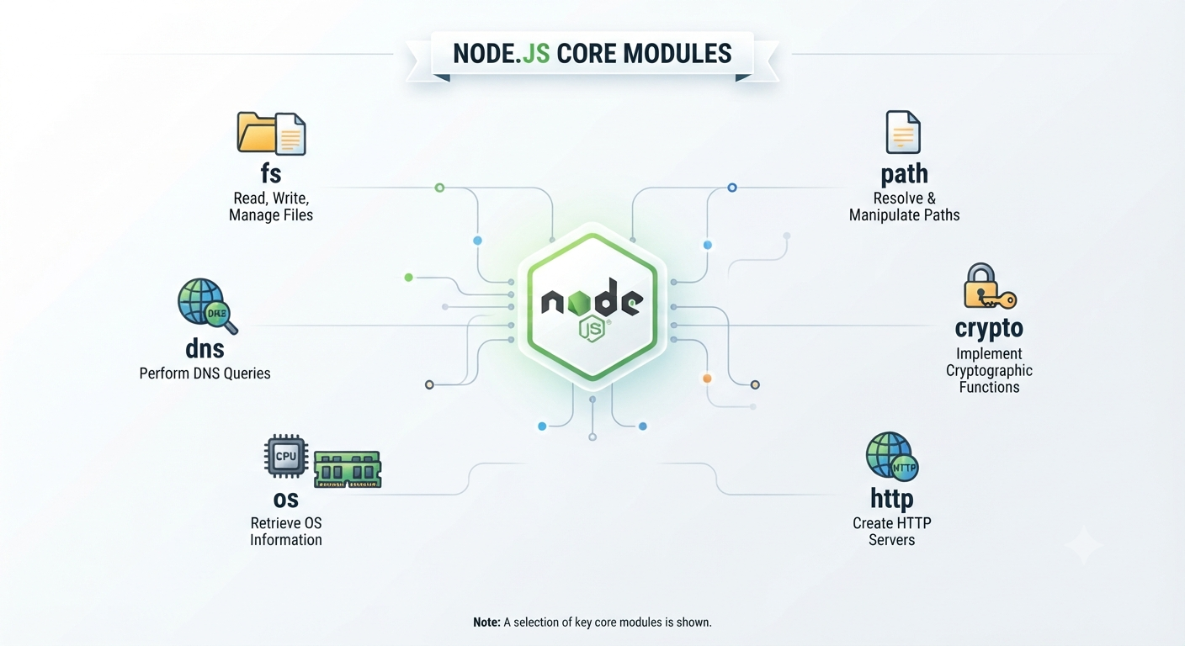
What are Core Modules?
Core Modules are built-in modules provided by Node.js.
They are available immediately after installing Node.js.
No installation required
Ready to use
Simple Definition:
Core Modules are pre-built modules that help developers perform common tasks without installing additional packages.
5

Slide 6
Why Core Modules Matter
💻 os
📂 path
🗂️ fs
Platform, CPU, memory, hostname, home directory info
Cross-platform file path operations (join, resolve, extname)
Read, write, delete files and directories — sync & async
🌐 dns
🔐 crypto
🔗 http
Resolve domain names to IP addresses and DNS records
Hashing, HMAC, encryption, random bytes, tokens
Create servers with http.createServer and make http request
6

Slide 7
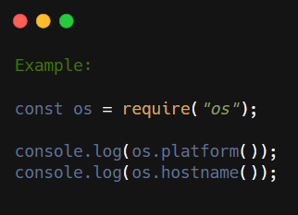
The OS Module
The OS (Operating System) module provides information about your computer.
It can tell:
Computer Name
Operating System
CPU Architecture
Free Memory
Total Memory
Real-Life Use:
Check system information
Monitor server resources
7

Slide 8
OS Module — Explore Your System
const os = require('os');
console.log('Platform: ', os.platform()); // 'linux' | 'win32' | 'darwin'
console.log('Arch: ', os.arch()); // 'x64' | 'arm64'
console.log('Hostname: ', os.hostname());
console.log('Home Dir: ', os.homedir()); // /home/alice
console.log('Temp Dir: ', os.tmpdir()); // /tmp
// CPU information
const cpus = os.cpus();
console.log('CPU Count: ', cpus.length);
console.log('CPU Model: ', cpus[0].model);
// Memory (bytes → MB/GB)
const totalGB = (os.totalmem() / 1024**3).toFixed(2);
const freeGB = (os.freemem() / 1024**3).toFixed(2);
console.log(`Memory: ${freeGB} GB free of ${totalGB} GB total`);
8

Slide 9
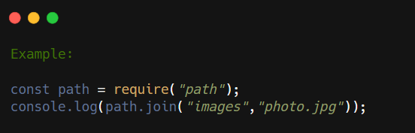
The Path Module
The Path Module helps work with file and folder paths.
Common Uses:
Join folder paths
Get file extension
Get file name
Normalize file paths
Real-Life Use:
Managing files and folders
9

Slide 10
Path Module — File Path Utilities
const path = require('path');
// Join paths (handles OS separators automatically)
const full = path.join('/home', 'alice', 'projects', 'app.js');
console.log(full); // /home/alice/projects/app.js
// Resolve to absolute path (from cwd)
console.log(path.resolve('src', 'index.js'));
// Extract parts of a path
const file = '/home/alice/app.js';
console.log(path.basename(file)); // app.js
console.log(path.basename(file, '.js')); // app (strip extension)
console.log(path.dirname(file)); // /home/alice
console.log(path.extname(file)); // .js
10

Slide 11
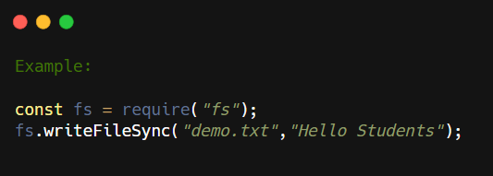
The FS (File System) Module
The FS Module allows Node.js to interact with files.
It can:
Read files
Create files
Update files
Delete files
Real-Life Use:
Save reports
Read configuration files
Manage documents
11

Slide 12
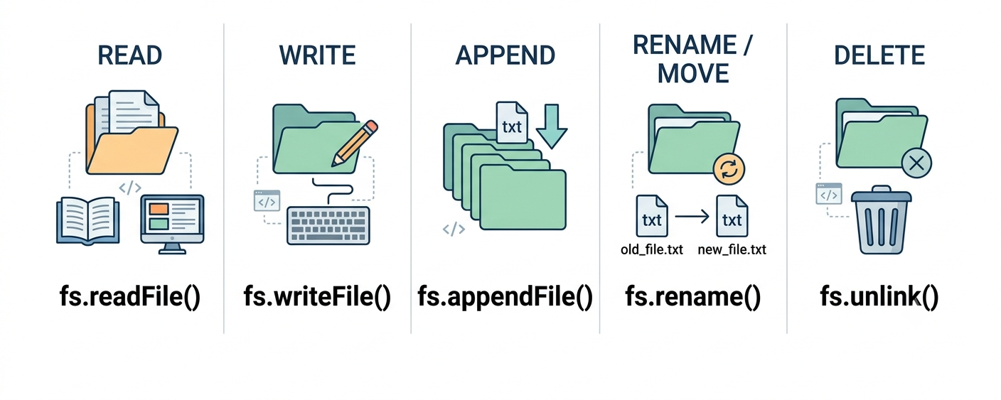
Why FS Module
12

Slide 13
FS — Reading Files
Three ways to read a file:
const fs = require('fs');
// 1. Async with callback (classic Node.js style)
fs.readFile('data.txt', 'utf8', (err, data) => {
if (err) { console.error('Error:', err.message); return; }
console.log('Content:', data);
});
// 2. Synchronous (blocks the event loop!)
try {
const data = fs.readFileSync('data.txt', 'utf8');
console.log('Content:', data);
} catch (err) {
console.error('Error:', err.message);
}
13

Slide 14
FS — Reading Files
Three ways to read a file:
const fs = require('fs');
// 3. Promises with async/await (recommended)
const fsP = require('fs/promises');
async function readData() {
try {
const data = await fsP.readFile('data.txt', 'utf8');
console.log('Content:', data);
} catch (err) {
console.error('Error:', err.message);
}
}
readData();
14

Slide 15
FS — Writing Files
const fs = require('fs');
// writeFile — creates or OVERWRITES the file
fs.writeFile('output.txt', 'Hello World!\n', (err) => {
if (err) throw err;
console.log('File written!');
});
// writeFile with JSON data
const user = { name: 'Alice', role: 'admin' };
fs.writeFile('user.json', JSON.stringify(user, null, 2), (err) => {
if (err) throw err;
console.log('JSON file saved!');
});
15

Slide 16
FS — Appending & Delete/unlink Files
const fs = require('fs');
// appendFile — adds to existing content
const logEntry = `[${new Date().toISOString()}] Server started\n`;
fs.appendFile('server.log', logEntry, (err) => {
if (err) throw err;
console.log('Log updated!');
});
// Delete a file
fs.unlink('temp.txt', (err) => {
if (err && err.code !== 'ENOENT') throw err;
console.log('File deleted!');
});
16

Slide 17
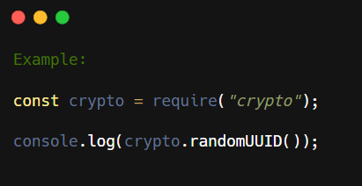
The Crypto Module
The Crypto Module provides security features.
It can:
Encrypt data
Generate hashes
Create random values
Real-Life Use:
Password hashing
Secure authentication
17

Slide 18

Why Crypto Module Matters
Use Case:
Security foundation. Never store passwords plain text. Never send unverified data. Crypto module provides the tools. Without it, your app is vulnerable
Why Important:
Security.
Data integrity
Authentication
Authorization
18

Slide 19
Crypto Module — Hashing & random ID
const crypto = require('crypto');
// SHA-256 hash (use for data integrity, NOT raw passwords)
const hash = crypto
.createHash('sha256')
.update('my secret data')
.digest('hex');
console.log('SHA-256:', hash);
// UUID-like random ID
const uuid = crypto.randomUUID();
console.log('UUID:', uuid);
19

Slide 20
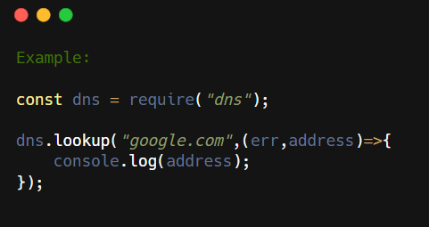
The DNS Module
The DNS Module converts domain names into IP addresses.
Why Important:
Network operations
Email infrastructure
Domain verification
Real-Life Use:
Find server IP addresses
Network applications
20

Slide 21

Why DNS Module Matters
Network applications need DNS. Email servers check MX records. Auth systems verify domain ownership. Network debugging needs hostname lookups
21

Slide 22
DNS Module — Domain Resolution
const dns = require('dns');
// Lookup IP for a domain (uses OS resolver)
dns.lookup('google.com', (err, address, family) => {
if (err) throw err;
console.log('IP Address:', address); // 142.250.80.46
console.log('IPv' + family); // IPv4
});
// Reverse lookup (IP → hostname)
dns.reverse('8.8.8.8', (err, hostnames) => {
if (err) throw err;
console.log('Hostname:', hostnames[0]); // dns.google
});
22

Slide 23

| Check Your Understanding
Question : Which core module would you use to get the current system memory?
Options : A. fs
B. crypto
C. dns
D. os
Answer : D. os
Explanation:
os.totalmem() and os.freemem() return memory information. fs is for files, crypto for hashing, dns for domains. OS module is for system information.
23

Slide 24
| Check Your Understanding
Question : What does path.join() do that path concatenation with '+' doesn't?
Options : A. Handles OS-specific path separators (/ vs \)
B. Faster performance
C. Same thing
D. Validates file exists
Answer : A. Handles OS-specific path separators (/ vs \)
Explanation:
Windows uses backslashes, Unix uses forward slashes. path.join('a', 'b') returns 'a\b' on Windows and 'a/b' on Unix. String concatenation breaks cross-platform compatibility.
24

Slide 25
| Check Your Understanding
Question : Why should you use fs/promises instead of fs callbacks?
Options : A. Promises are faster
B. Callbacks are deprecated
C. Promises enable async/await for cleaner code
D. Promises avoid errors
Answer : C. Promises enable async/await for cleaner code
Explanation:
fs.readFile has callback (old style). fs/promises.readFile returns promise (modern). Promises + async/await are more readable: const data = await readFile(). Callbacks lead to nested code (callback hell).
25

Slide 26
| Check Your Understanding
Question : What's the difference between crypto.createHash and crypto.createHmac?
Options : A. No difference, same thing
B. HMAC is for passwords only
C. Hash is faster
D. Hash is one-way, HMAC uses a secret key and is verifiable
Answer : D. Hash is one-way, HMAC uses a secret key and is verifiable
Explanation:
createHash('sha256').update(password) hashes one-way (good for passwords). createHmac uses secret key (good for API signing, message verification). Different tools for different jobs.
26

Slide 27
| References
Node.js Official Documentation : Comprehensive and official documentation for Node.js runtime, modules, APIs, file system, HTTP, Express integration basics, and backend development concepts. 🔗 Node.js Official Docs
W3Schools – Node.js Tutorial : Beginner-friendly Node.js tutorials with easy explanations, examples, and hands-on practice for backend development fundamentals. 🔗 W3Schools Node.js Tutorial
freeCodeCamp – Node.js Course : Free practical tutorials and project-based learning resources for Node.js, Express.js, REST APIs, and backend development. 🔗 freeCodeCamp Node.js Resources
Node.js FS : File system module complete API reference. 🔗 https://nodejs.org/api/fs.html
27

Slide 28
Thanks
For
Watching
Course - Web Development - III
welcome@krmangalam.edu.in
28
Sohna Road,Gurugram,Haryana 122103

