Slide 1






Lecture 6:
Process Object & CLI
Course - Web Development - III
By -
Love Porwal
welcome@krmangalam.edu.in
Sohna Road,Gurugram,Haryana 122103

Slide 2

Table of Contents
Understanding the Process Object
Process Properties
Understanding process.argv
Understanding process.env
Environment Variables with process.env
process.argv vs process.env
References
The End
2

Slide 3

If I open Google Maps without entering a destination, can it guide me anywhere?
3

Slide 4

Similarly, when we run a Node.js program, sometimes our program also needs information from us. We pass that information through the Command Line Interface (CLI).
4

Slide 5
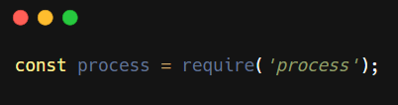
Understanding the Process Object
The Process Object is a built-in object in Node.js.
It provides information about the currently running application.
It helps us:
Read command-line arguments
Access environment variables
Get current working directory
Exit the program
Simple Definition:
The Process Object is a built-in Node.js object that provides information and control over the currently running program.
5

Slide 6
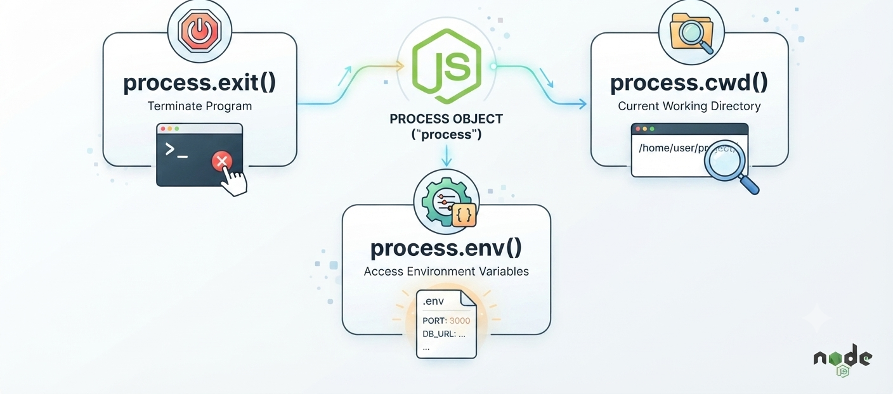
Why the Process Object
Easy Analogy:
Process object = control center for your app.
Check version, detect OS, monitor memory, listen to events, control lifecycle
6

Slide 7
Process Object — Practical Examples
// No require needed — process is global
console.log('Node version:', process.version); // v20.11.0
console.log('Platform: ', process.platform); // linux
console.log('PID: ', process.pid); // 12345
console.log('Working dir: ', process.cwd());
// Environment variables
console.log('PATH:', process.env.PATH);
console.log('USER:', process.env.USER);
// Listening to process events
process.on('exit', (code) => {
console.log(`Process exiting with code ${code}`);
});
7

Slide 8
Process Properties
Common Process Properties
Property | Purpose
process.argv | Command-line arguments
process.env | Environment variables
process.cwd() | Current working directory
process.pid | Process ID
process.platform | Operating system
process.version | Node.js version
8

Slide 9
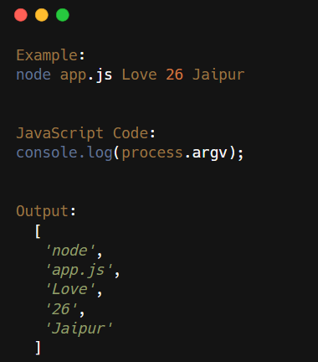
Understanding process.argv
process.argv is an array that contains the command-line arguments passed when Node.js is started. It's how you make your scripts configurable from the terminal.
9

Slide 10
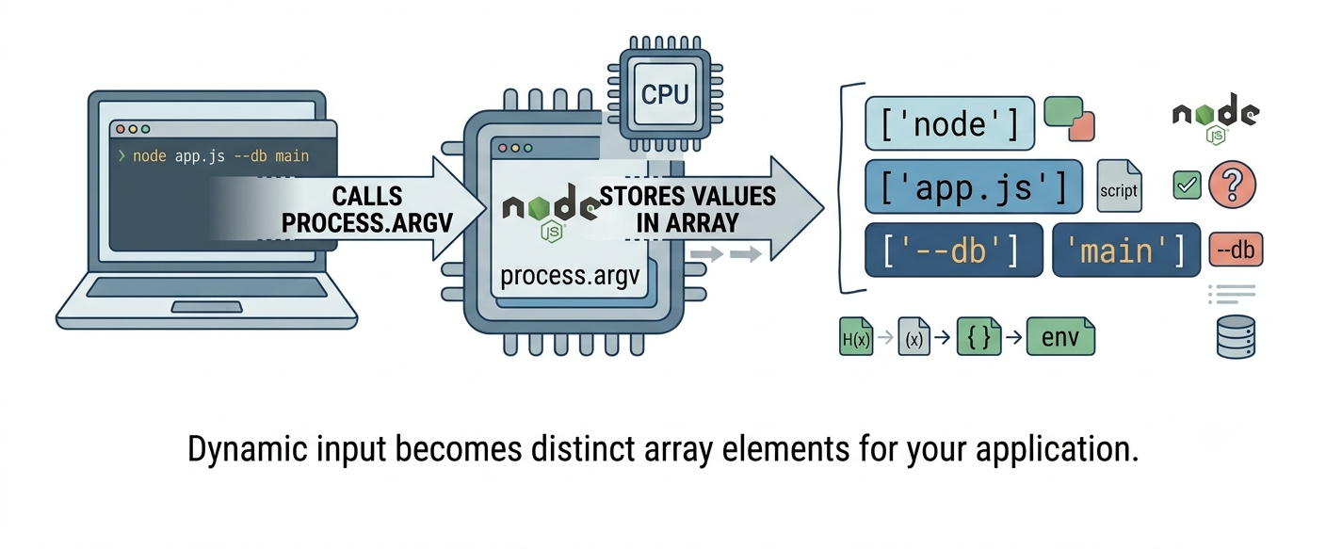
Why process.argv
Easy Analogy:
process.argv = instructions from user.
Like command-line flags in Linux. Process reads what user wants, acts accordingly
10

Slide 11
process.argv — Practical Examples
Save as greet.js and run from terminal:
// greet.js
const args = process.argv; // full array
const name = args[2] || 'Student'; // 3rd element
const course = args[3] || 'Node.js'; // 4th element
console.log(`Hello, ${name}!`);
console.log(`Welcome to ${course}.`);
console.log(`You passed ${args.length - 2} argument(s).`);
// Run in terminal:
// node greet.js Alice 'Web Dev II'
// → Hello, Alice!
// → Welcome to Web Dev II.
// → You passed 2 argument(s).
11

Slide 12
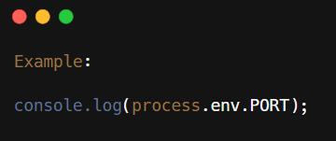
Understanding process.env
process.env stores environment variables.
These are configuration values provided by the operating system or a .env file.
Examples:
Database URL
API Keys
Secret Keys
Port Number
Why Use It:
Keep sensitive information secure
Avoid hardcoding values in your code
12

Slide 13
Environment Variables with process.env
Environment variables store configuration outside your code.
They keep secrets (API keys, passwords) out of source code.
Access with: process.env.VARIABLE_NAME
ALWAYS add .env to .gitignore — never commit secrets to Git!
// Using .env file with dotenv package:
npm install dotenv
// Create .env file:
PORT=3000
DB_URL=mongodb://...
// In your code:
require('dotenv').config()
// Then access:
process.env.PORT // '3000'
13

Slide 14
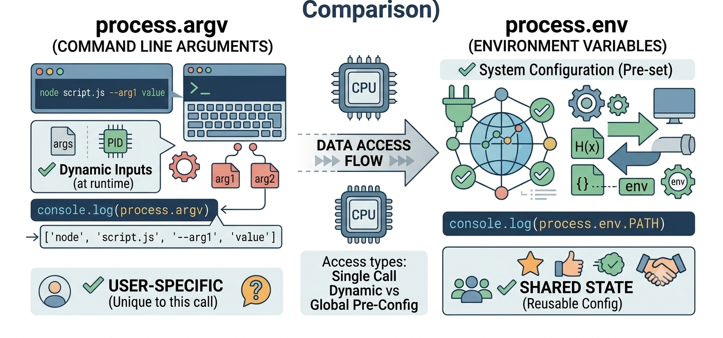
process.argv vs process.env:
Two ways to pass config: argv for per-run values, process.env for persistent/secret values.
argv visible in 'ps' (UNSAFE for secrets!). env hidden (SAFE for secrets!)
14

Slide 15

| Check Your Understanding
Question : What is always at process.argv[0] and process.argv[1]?
Options : A. User arguments
B. Node path and script path
C. Environment variables
D. Random values
Answer : B. Node path and script path
Explanation:
process.argv[0] is ALWAYS path to node executable. argv[1] is ALWAYS path to script. User arguments start at argv[2]. Never changes.
15

Slide 16
| Check Your Understanding
Question : How do you skip the first two elements of process.argv?
Options : A. process.argv[2]
B. process.argv.slice(2)
C. Destructure [,, ...rest]
D. Both b and c work
Answer : D. Both b and c work
Explanation:
process.argv.slice(2) returns new array from index 2 onward. Destructuring [,, ...rest] = process.argv achieves same thing. Both valid, choose what's readable.
16

Slide 17
| Check Your Understanding
Question : What type are all values in process.argv?
Options : A. String
B. Number
C. Boolean
D. Array
Answer : A. Strings
Explanation:
All process.argv values are STRINGS, even if you pass numbers. 'node app.js 42' gives argv[2]='42' (string). Must convert: Number('42') or parseInt('42')
17

Slide 18
| References
Node.js Official Documentation : Comprehensive and official documentation for Node.js runtime, modules, APIs, file system, HTTP, Express integration basics, and backend development concepts. 🔗 Node.js Official Docs
Node.js Globals : Node.js global objects documentation. 🔗 https://nodejs.org/api/globals.html
Process Object : Node.js process object full API reference. 🔗 https://nodejs.org/api/process.html
dotenv Package : Managing environment variables with dotenv. 🔗 https://www.npmjs.com/package/dotenv
18

Slide 19
Thanks
For
Watching
Course - Web Development - III
welcome@krmangalam.edu.in
19
Sohna Road,Gurugram,Haryana 122103

