Slide 1






Lecture 7:
HTTP Server Development
Course - Web Development - III
By -
Love Porwal
welcome@krmangalam.edu.in
Sohna Road,Gurugram,Haryana 122103

Slide 2

Table of Contents
The HTTP Module
Creating Your First Server
req and res Objects
Routing
GET Request
POST Request — Receiving Body
Error Handling in HTTP Servers
References
The End
2

Slide 3

When you open YouTube, where does the webpage come from?
3

Slide 4
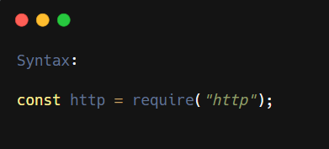
Understanding the HTTP Module
The HTTP Module is a built-in Node.js module.
It helps us:
Create web servers
Receive client request
Send responses
Build APIs
Simple Definition:
The HTTP Module allows Node.js to create and manage web servers.
4

Slide 5
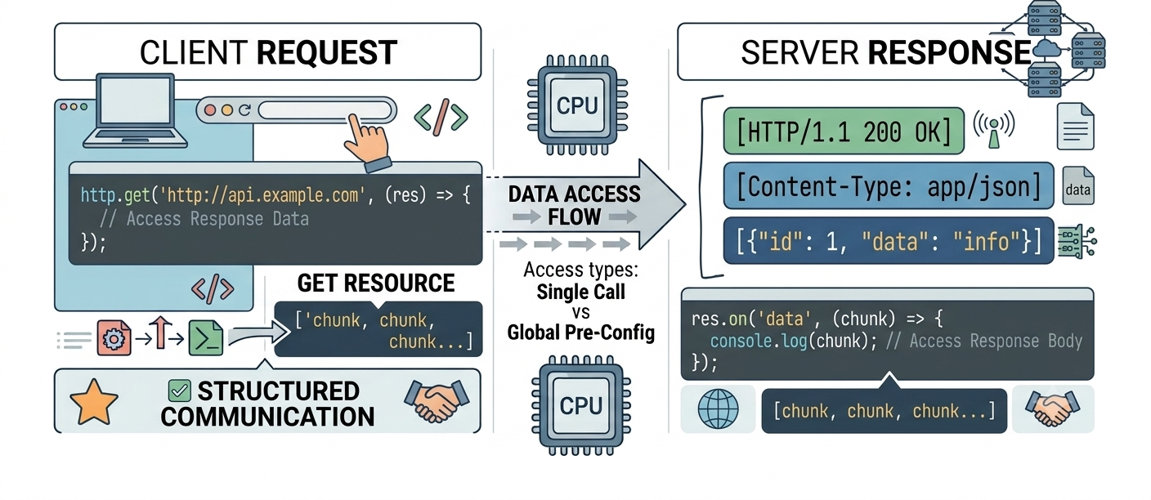
Why HTTP Module
Express is built ON TOP of this. Understanding native HTTP teaches how frameworks work.
5

Slide 6
Creating Your First HTTP Server
The minimal Node.js web server:
const http = require('http');
// Create server — callback fires on every request
const server = http.createServer((req, res) => {
// Write response body
res.write('<h1>Welcome to Node.js!</h1>');
res.write('<p>Your first HTTP server is running.</p>');
// End the response (required!)
res.end();
});
// Start listening on port 3000
server.listen(3000, () => {
console.log('Server running at http://localhost:3000');
});
// Visit: http://localhost:3000 in your browser
6

Slide 7
Understanding req and res Objects
📥 req.url
📋 req.method
📌 req.headers
The URL path requested, e.g. '/api/users'. Does NOT include hostname.
HTTP method string: 'GET', 'POST', 'PUT', 'DELETE'
Object with all request headers (lowercase keys)
📤 res.writeHead
✍️ res.write
🏁 res.end
Set HTTP status code and response headers
Write a chunk of the response body
Finish and send the response. REQUIRED or client hangs!
7

Slide 8
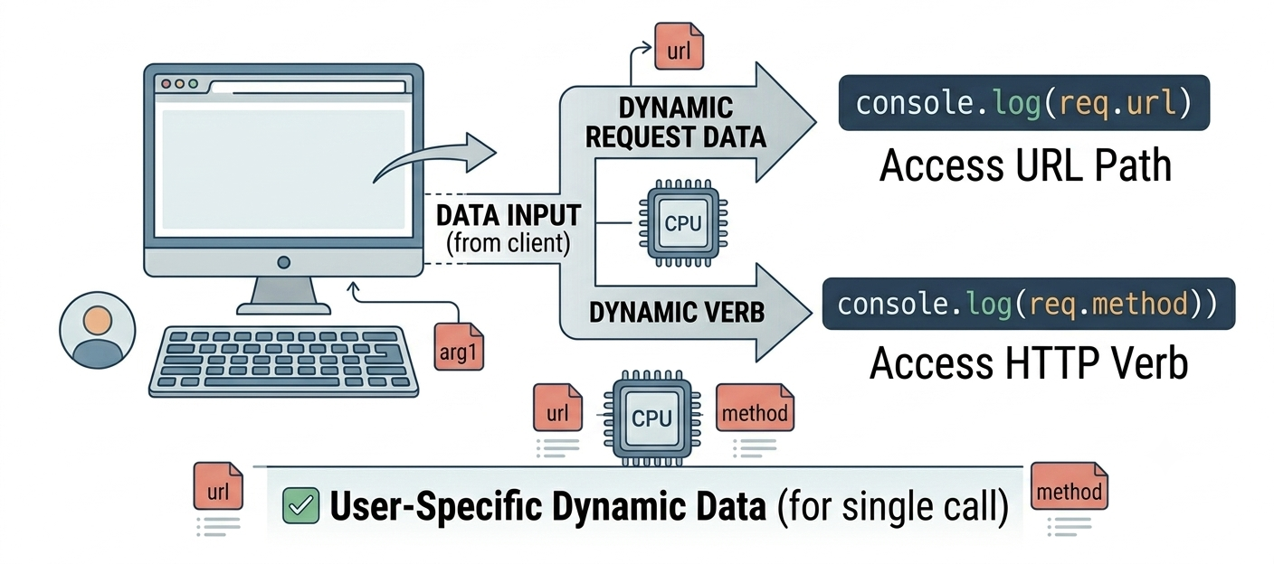
The Request Object
A Request is a message sent by the client (browser) to the server.
It tells the server:
What do I want?
Which page?
Which method?
Any extra information?
Simple Definition:
The Request Object (req) contains everything the client sends to the server.
8

Slide 9
Handling Requests
const http = require('http');
const server = http.createServer((req, res) => {
//Access Request Object
const url = req.url;
const method = req.method;
console.log(`${method} ${url}`); // Log every request
});
server.listen(3000);
9

Slide 10
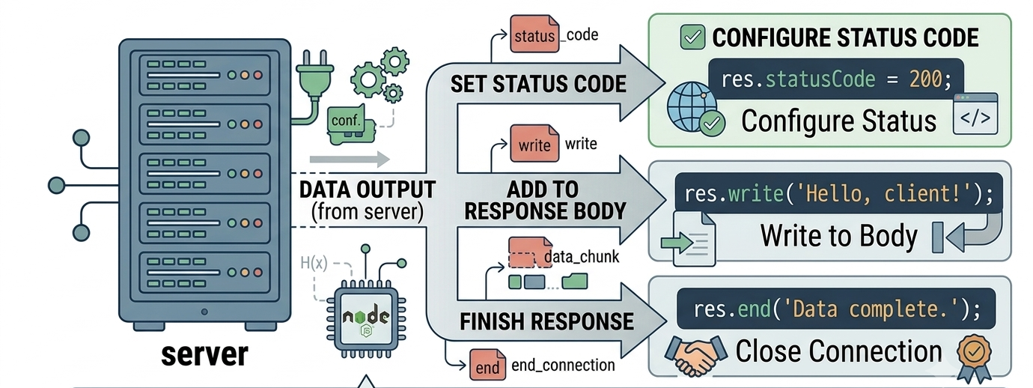
The Response Object
A Response is the message sent back by the server to the client.
It can send:
Text
HTML
JSON
Status Code
Simple Definition:
The Response Object (res) is used to send data back to the client.
10

Slide 11
Handling Responses — Multiple Types
Serving HTML, JSON, and plain text:
const http = require('http');
const server = http.createServer((req, res) => {
if (req.url === '/') {
res.writeHead(200, { 'Content-Type': 'text/html' });
res.end(`
<h1 style='color:navy'>Hello from Node.js!</h1>
<p>Built with pure Node.js http module.</p>
`);
} else {
res.writeHead(404, { 'Content-Type': 'application/json' });
res.end(JSON.stringify({ error: 'Route not found' }));
}
});
server.listen(3000, () => console.log('Running on :3000'));
11

Slide 12
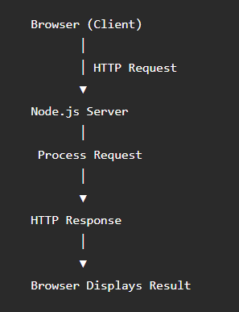
Routing Requests
How Communication Happens
Routing means deciding what response to send based on the requested URL.
Every request needs to go somewhere. Routing directs it to right handler.
Key Points:
Check req.url for path
Check req.method for action
Route GET /api/users → fetch users
Route POST /api/users → create user
PUT /users/5 → update user
Route DELETE /api/users/5 → delete user
12

Slide 13
GET Request — Retrieve Data
Handle GET requests with an in-memory data store:
const http = require('http');
// In-memory data store
const students = [
{ id:1, name:'Alice', course:'Node.js', grade:'A' },
{ id:2, name:'Bob', course:'Node.js', grade:'B' },
{ id:3, name:'Charlie', course:'Node.js', grade:'A+'},
];
const server = http.createServer((req, res) => {
if (req.method === 'GET' && req.url === '/api/students') {
res.writeHead(200, { 'Content-Type': 'application/json' });
res.end(JSON.stringify({ count: students.length, students }));
}
else if (req.method === 'GET' && req.url === '/api/students/count') {
res.writeHead(200, { 'Content-Type': 'application/json' });
res.end(JSON.stringify({ count: students.length }));
}
13

Slide 14
GET Request — Serving Data
Handle GET requests with an in-memory data store:
else {
res.writeHead(404, { 'Content-Type': 'application/json' });
res.end(JSON.stringify({ error: 'Not Found' }));
}
});
server.listen(3000, () => console.log('API running on :3000'));
14

Slide 15
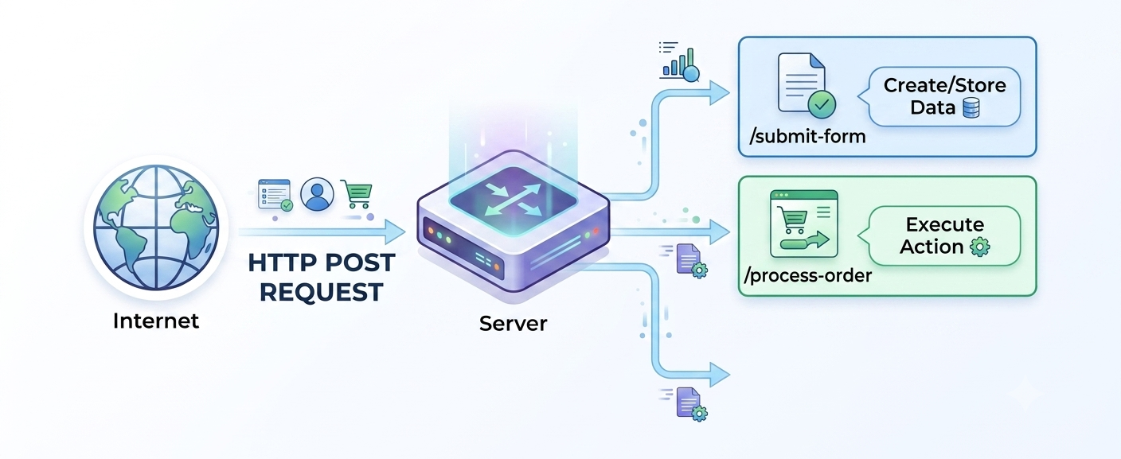
Handling POST Requests & Body Streaming
The server reads data sent by the client.
Key Points:
POST has body (data payload)
Body comes as stream
req.on('data'): new chunk arrived
req.on('end'): all chunks received
Streaming is memory efficient
Perfect for large uploads
15

Slide 16
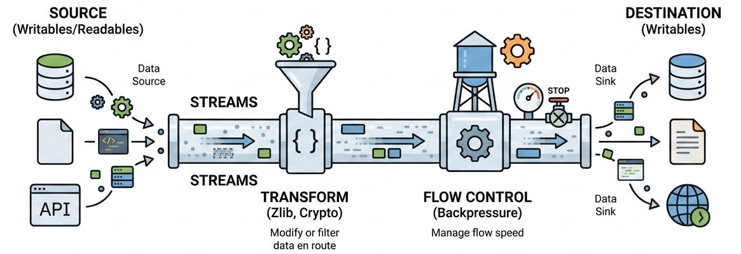
Why Streaming Matters
Use Case:
Body could be huge (1GB file). Can't load entire thing into RAM. Stream reads 64KB chunks. Efficient memory usage. User uploads progress. Handles large payloads
Why Important:
Memory efficiency, large file handling, performance, scalability
Real-World Example:
1GB file upload: streaming reads 64KB at a time (constant memory).
16

Slide 17
POST Request — Receiving the Body
POST body arrives as a stream of chunks:
const http = require('http');
const server = http.createServer((req, res) => {
if (req.method === 'POST' && req.url === '/api/students') {
let rawBody = '';
// Collect incoming data chunks
req.on('data', (chunk) => {
rawBody += chunk;
res.writeHead(413, {'Content-Type':'application/json'});
res.end(JSON.stringify({ error: 'Payload too large' }));
});
17

Slide 18
POST Request — Receiving the Body
POST body arrives as a stream of chunks:
// All data received
req.on('end', () => {
parseAndRespond(rawBody, res);
});
req.on('error', (err) => {
res.writeHead(400, {'Content-Type':'application/json'});
res.end(JSON.stringify({ error: err.message }));
});
}
});
server.listen(3000);
18

Slide 19

Error Handling in HTTP Servers
Error Handling means detecting problems and sending an appropriate response to the client.
Why is it Important?
Prevents application crashes
Helps users understand the problem
Makes applications reliable
Improves user experience
Simple Definition:
Error Handling is the process of detecting errors and responding with meaningful messages instead of crashing the application.
19

Slide 20
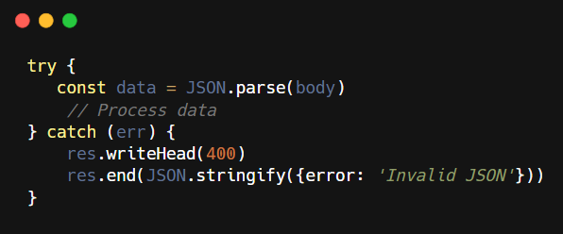
Handling Errors
Easy Analogy:
Error handling = safety net.
Catch errors before they crash.
Return proper status. Log for later. Keep server running
How to Use It:
20

Slide 21

| Check Your Understanding
Question : What must you always call to complete an HTTP response?
Options : A. res.write()
B. res.writeHead()
C. res.end()
D. res.send()
Answer : C. res.end()
Explanation:
res.end() signals response complete. Client waits forever if you forget. res.write() is optional (for body). res.writeHead() is optional (for headers). res.end() is REQUIRED always
21

Slide 22
| Check Your Understanding
Question : In what order must you call res.writeHead() and res.write()?
Options : A. Either order works
B. writeHead first, then write
C. write first, then writeHead
D. Only need one or the other
Answer : B. writeHead first, then write
Explanation:
HTTP response = status/headers first, then body. writeHead() sets status/headers and sends them. write() sends body. Can't change headers after write() starts.
22

Slide 23
| Check Your Understanding
Question : What's the difference between req.url and req.method?
Options : A. url is path (what), method is verb (how)
B. Same thing
C. method is path, url is verb
D. No difference in practice
Answer : A. url is path (what), method is verb (how)
Explanation:
req.url='/api/users' tells you WHAT resource. req.method='POST' tells you WHAT ACTION. Both needed for routing. GET /api/users vs POST /api/users are completely different
23

Slide 24
| References
Node.js Official Documentation : Comprehensive and official documentation for Node.js runtime, modules, APIs, file system, HTTP, Express integration basics, and backend development concepts. 🔗 Node.js Official Docs
Node.js HTTP : Official Node.js http module documentation. 🔗 https://nodejs.org/api/http.html
24

Slide 25
Thanks
For
Watching
Course - Web Development - III
welcome@krmangalam.edu.in
25
Sohna Road,Gurugram,Haryana 122103

