Slide 1






Lecture 8:
API Testing & Debugging
Course - Web Development - III
By -
Love Porwal
welcome@krmangalam.edu.in
Sohna Road,Gurugram,Haryana 122103

Slide 2

Table of Contents
Introduction to API Testing Tools
API Testing — Postman
Testing GET/POST Requests
API Testing — ThunderClient
References
The End
2

Slide 3

How Does a Chef Taste Food Before Serving It?
3

Slide 4
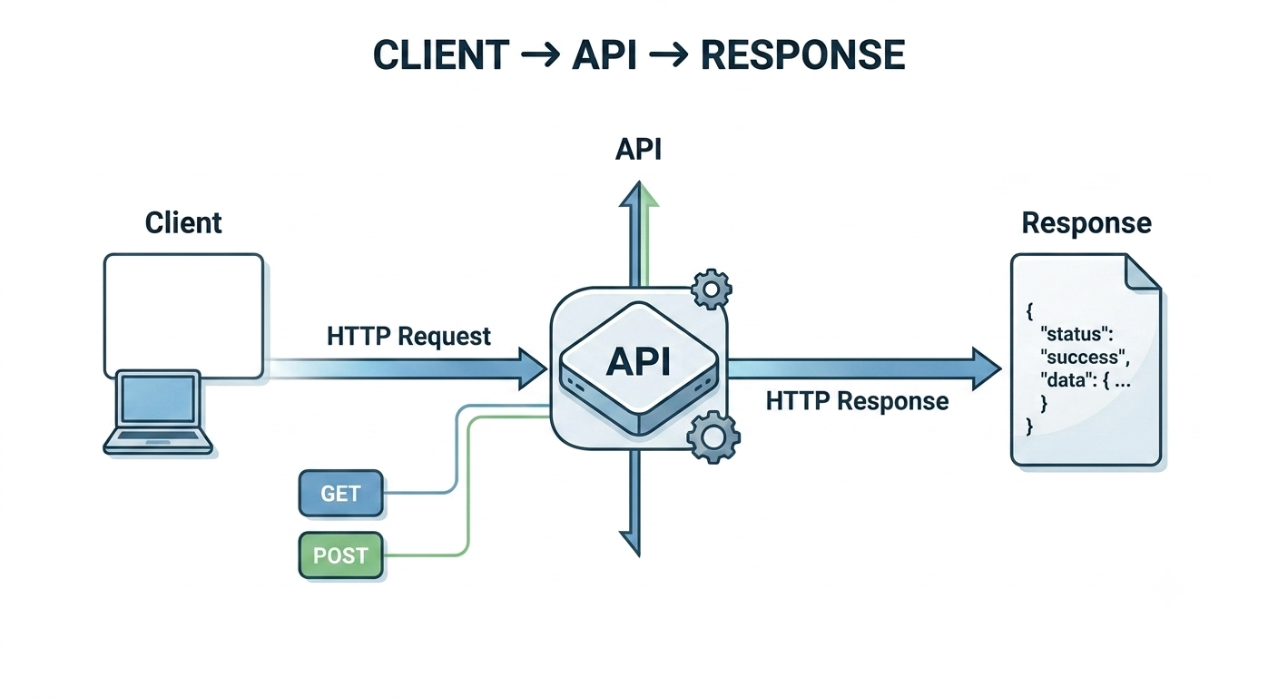
What is API Testing?
API Testing is the process of checking whether an API works correctly.
It helps us verify:
Is the API responding?
Is the data correct?
Are errors handled properly?
Are status codes correct?
Simple Definition:
API Testing is the process of sending requests to an API and verifying that it returns the correct response.
4

Slide 5
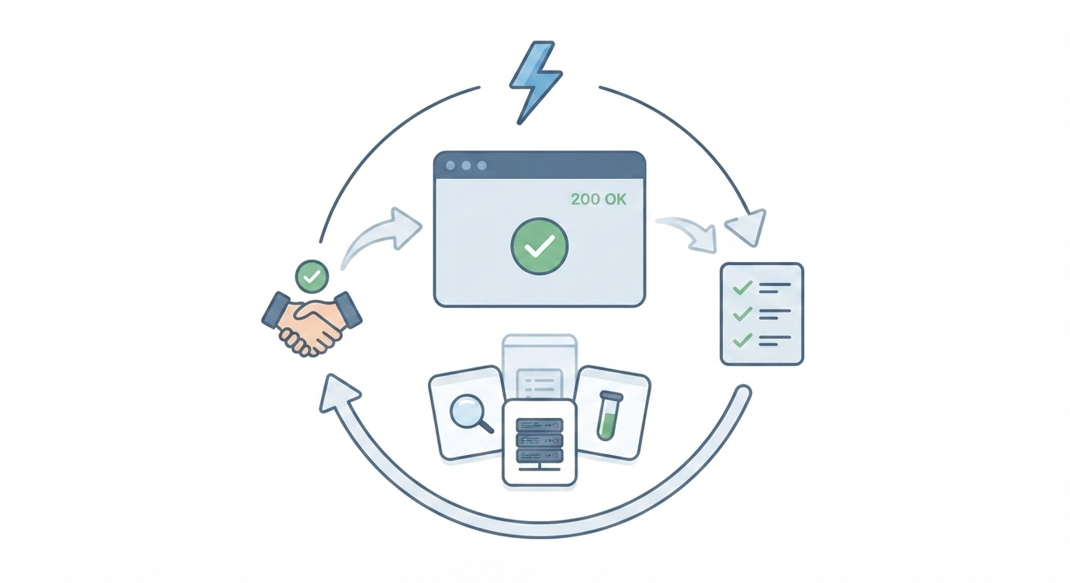
What is Debugging?
Debugging is the process of finding, identifying, and fixing errors (bugs) in a program..
5

Slide 6

Introduction to Postman
Postman is one of the most popular API testing tools.
It allows developers to:
Send HTTP requests
View responses
Test APIs without a frontend
Debug backend applications
Supported Methods:
GET
POST
PUT
PATCH
DELETE
6

Slide 7
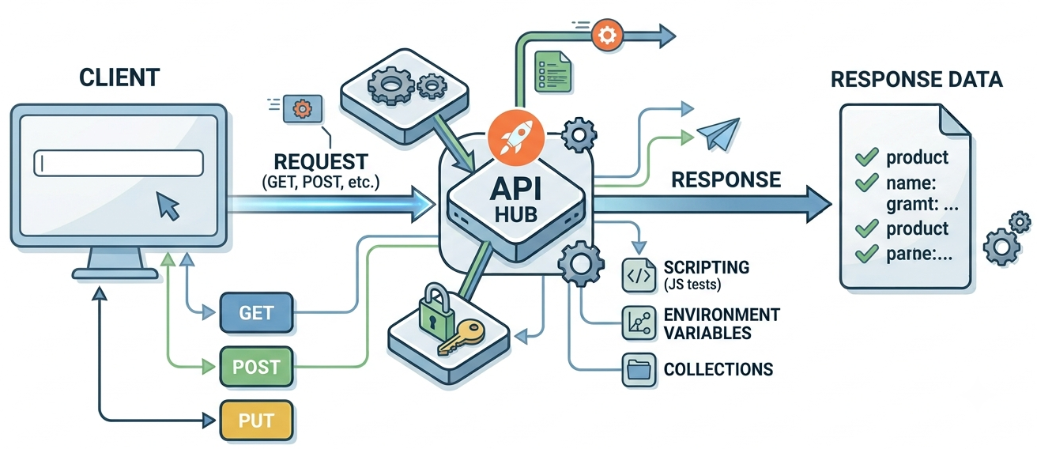
Getting Started with Postman
Easy Analogy:
Postman = professional testing workspace.
Download, install, start testing. Intuitive UI makes learning easy
How to Use It:
Download from postman.com
Create free account (or skip for desktop)
Click 'New' → 'Request'
Enter URL and method
Click 'Send' → see response
7

Slide 8
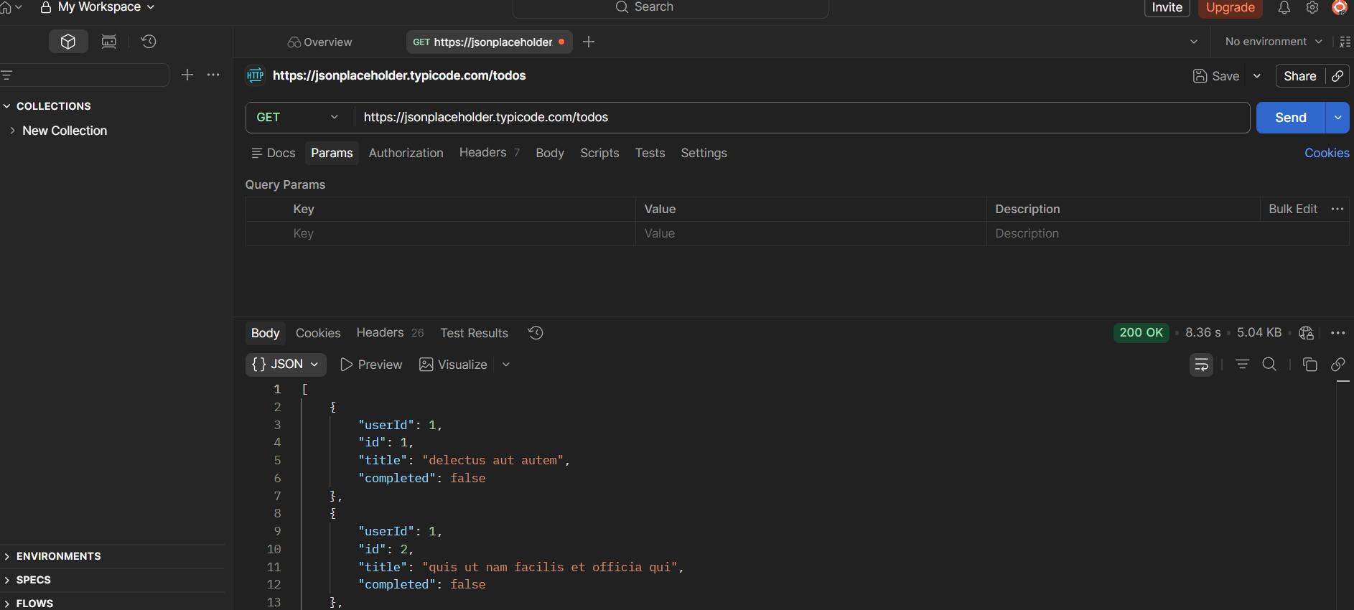
Creating GET Requests in Postman
Used to retrieve data.
Key Point:
Select Method: GET
Enter URL: http://localhost:3000/api/users
Add Params: key/value pairs (optional)
Click Send
View response in panel below
8

Slide 9
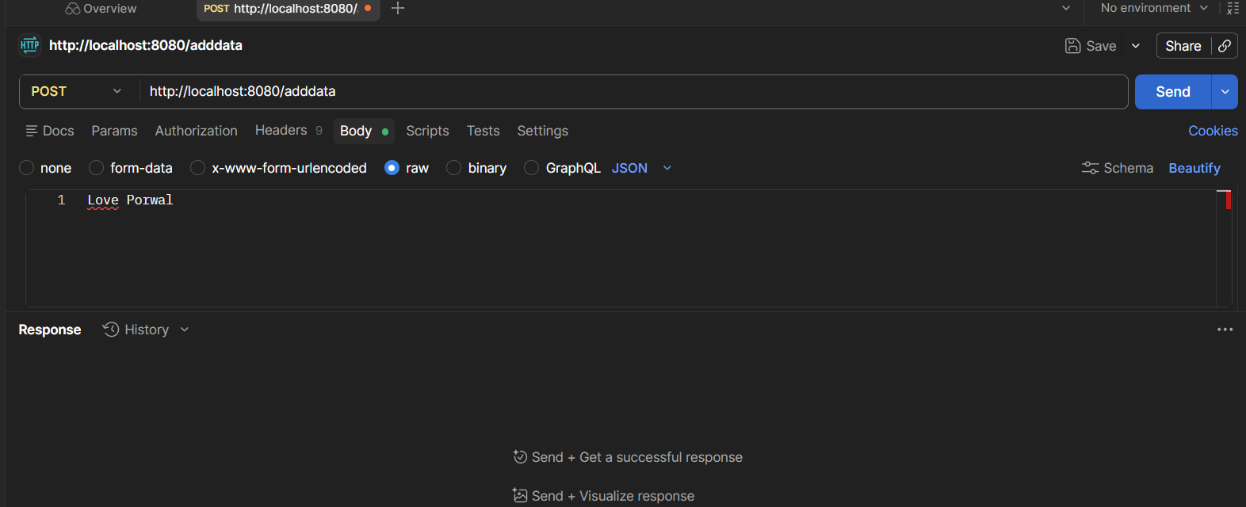
Creating POST Requests in Postman
Create resources by sending data in body.
Key Points:
Select Method: POST
Enter URL
Headers: Content-Type: application/json
Body tab: raw JSON data
Click Send
9

Slide 10

ThunderClient: VS Code Alternative
Thunder Client is a lightweight API testing extension for Visual Studio Code.
It allows you to:
Test APIs directly inside VS Code
Send GET, POST, PUT, DELETE requests
View request and response details
Save API collections
Why Use Thunder Client?
Fast
Lightweight
No need to switch applications
10

Slide 11
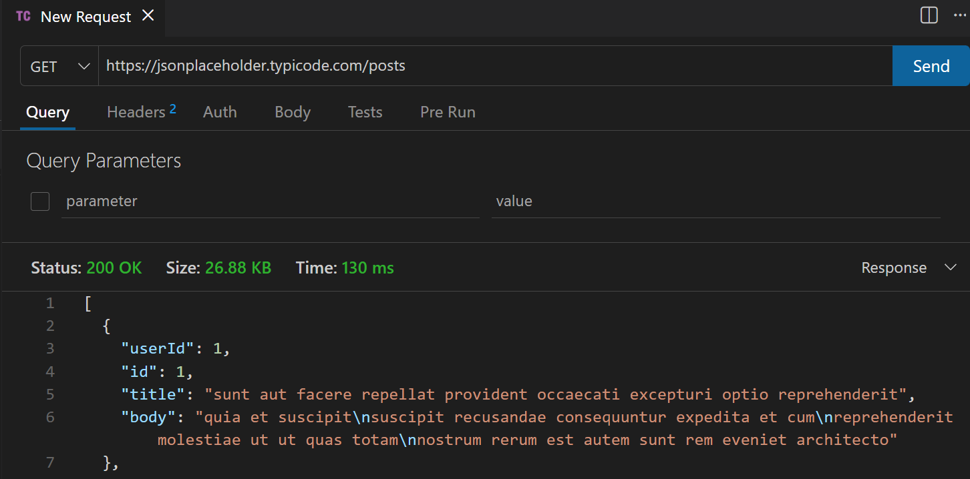
Using ThunderClient
Easy Analogy:
ThunderClient = Postman inside VS Code. Same workflow, integrated editor
How to Use It:
Install: VS Code Extensions → Thunder Client
Click Thunder icon in sidebar
New Request: method, URL, headers, body
Send: same response viewing
Same collections and environments
11

Slide 12

| Check Your Understanding
Question : How does Node.js receive the body of a POST request in the http module?
Options : A. req.body is populated automatically
B. req.json() returns the parsed body
C. Via req.on('data') chunks collected until req.on('end') fires
D. The body is in req.query
Answer : C. Via req.on('data') chunks collected until req.on('end') fires
Explanation:
The raw Node.js http module receives the request body as a stream. You listen to 'data' events to collect chunks into a string, then 'end' to know all data has arrived. Frameworks like Express handle this automatically with middleware.
12

Slide 13
| Check Your Understanding
Question : Why is testing APIs important before frontend is done?
Options : A. It's not important
B. Frontend dictates API
C. Waste of time
D. Find bugs early, don't wait for frontend, verify API works
Answer : D. Find bugs early, don't wait for frontend, verify API works
Explanation:
Test API in isolation: know it works. Don't blame frontend for API bugs. Catch issues early: cheaper to fix. Parallel development: frontend team can mock responses.
13

Slide 14
| References
Node.js Official Documentation : Comprehensive and official documentation for Node.js runtime, modules, APIs, file system, HTTP, Express integration basics, and backend development concepts. 🔗 Node.js Official Docs
Postman Docs : Postman API testing learning centre. 🔗 https://learning.postman.com/docs/
ThunderClient : ThunderClient VS Code extension homepage. 🔗 https://www.thunderclient.com/
14

Slide 15
Thanks
For
Watching
Course - Web Development - III
welcome@krmangalam.edu.in
15
Sohna Road,Gurugram,Haryana 122103

