Slide 1


Slide 2
What is ERP?
Enterprise Resource Planning
ERP is a business software system that support business or enterprise throughout the organizing, planning, maintaining, tracking and utilization of organization resources (Man, Machine, Material and Money)

Slide 3
Example of ERP System:
Oracle Finance
People Soft
BANN
JD Edwards
SAP

Slide 4
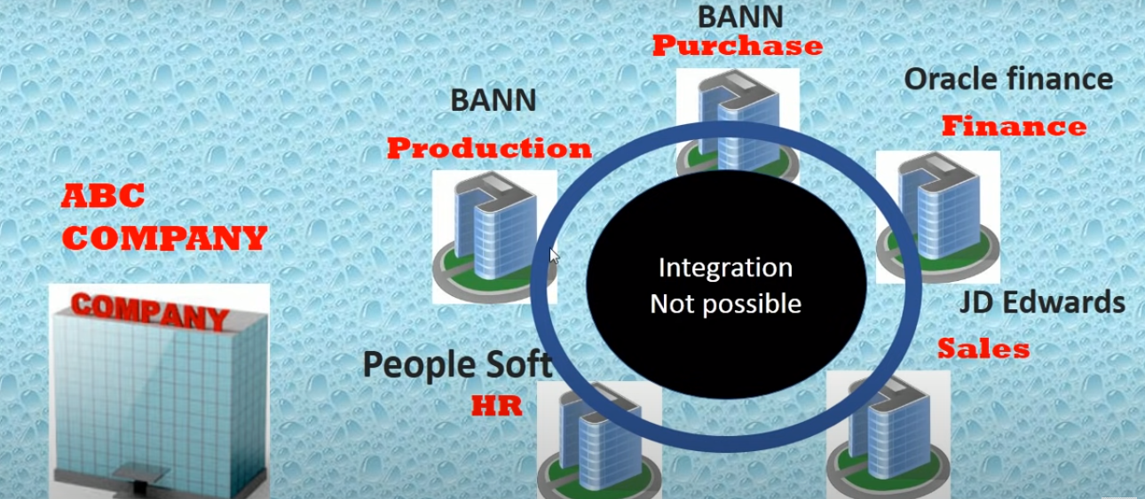
Integration:

Slide 5
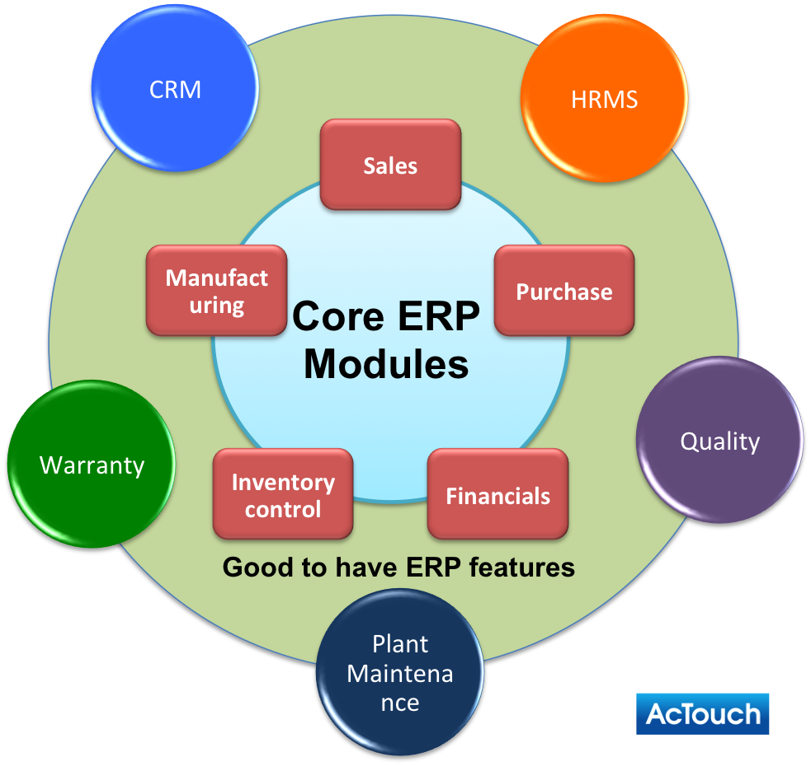
ERP System

Slide 6
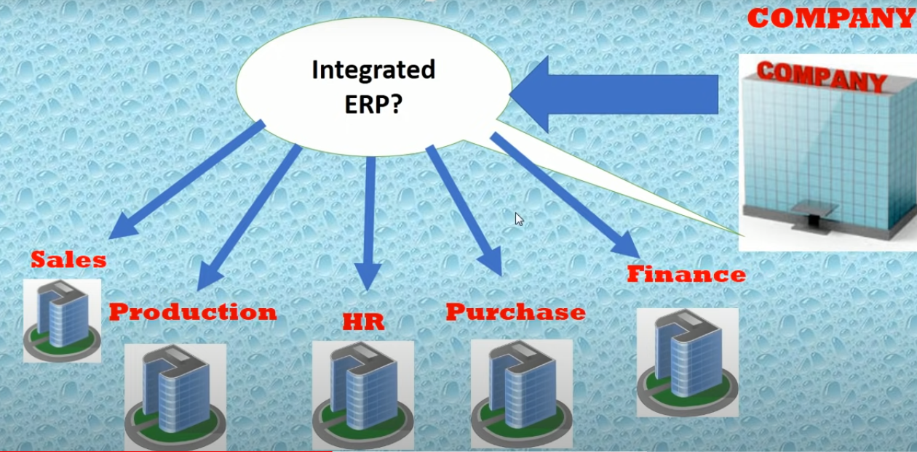
What we are looking for:

Slide 7
What is SAP?
Systems Applications Products in Data Processing

Slide 8
SAP History
SAP Founded in and around 1972 by five IBM engineers Hopp, Wellenreuther, Hector, Tschira and Plattner.
In that time the name was SAP AG.

Slide 9
SAP Layer History
SAP R/1:– The first version of SAP software was launched in and around 1972 known as the “R/1 system. R” stands for real-time data processing. it is one tier architecture in which three layers Presentation, Application, and Database are installed in one system/server
(One – Presentation + Application + Database)
SAP R/2:– In 1980 second version of SAP R/2 was released. with IBM’s database and a dialogue-oriented business application. SAP R/2 to handle different languages and currencies. R/2 is 2 tier architecture in which three layers of Presentation, Application, and Database are installed in two separate servers.
(Server one – Presentation, Server two – Application + Database
SAP R/3:– SAP upgraded R/2 to R/3. SAP R/3 is the client/server version of the software and it is 3 tier architecture in which three layers of Presentation, Application, and database are installed in three servers/systems.
Server one – Presentation, Server Two – Application, server Three – Database

Slide 10
SAP System: What is R/3 layer Architecture?
SAP R/3 is one of the main product of SAP, Where R stands for Real time and the 3 related to three tier application architecture.

Slide 11
Three Layers are:
Presentation Layer
Application Layer
Database Layer

Slide 12
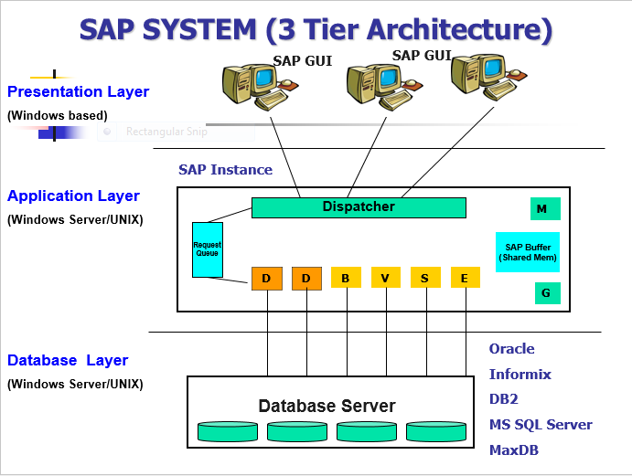

Slide 13
Transport Requests in Repository
Client 900
Client 901
Application
data
User
accounts
Application
data
User
accounts
Client dependent
Customizing
Client dependent
Customizing
Source: Author‘s design
Client independent customizing
FI
CO
PP
TR
PS
HR
BC
KM
PA
FS
…
Transport request 1
Transport request 2

Slide 14
SAP NETWEAVER
An open platform for managing and configuring business application for the development of workbench application

Slide 15
SAP MODULES
Two types :
1. Functional Module
2. Technical Module

Slide 16
Functional Module
FICO – Finance & Control
PP – Production Planning
MM – Material Management
SD – Sales & Distribution
WM – Warehouse Management
QM – Quality Management
HR – Human Resources
CRM – Customer Relationship Management

Slide 17
Technical Module
ABAP – Advanced business applications programming
XI – Exchange Infrastructure
Net viewer
Basis
BIW – Business Information Warehousing

Slide 18
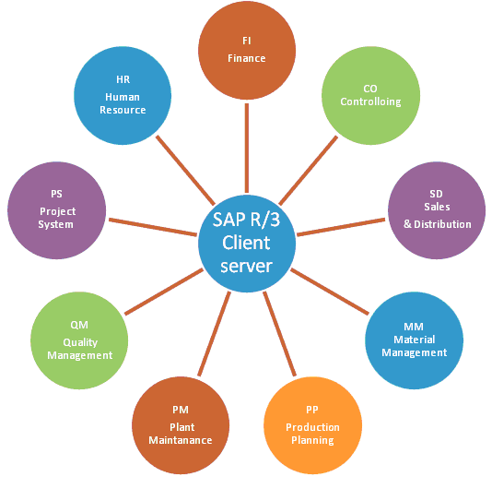
SAP Modules:

Slide 19
What is ABAP?
Advanced Business Application Programming Language
Basically this is the Back end of SAP

Slide 20
ABAP Programming
1. ABAP Report
2. Dialog Programming(Transaction)

Slide 21
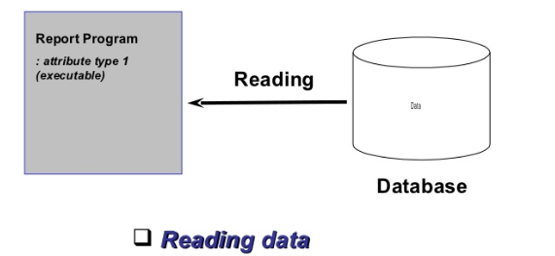
ABAP Programming: Report

Slide 22
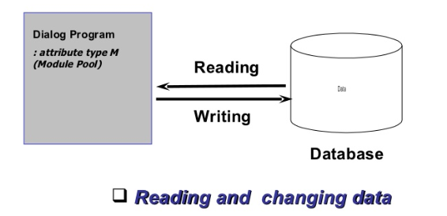
ABAP Programming: Dialog

Slide 23
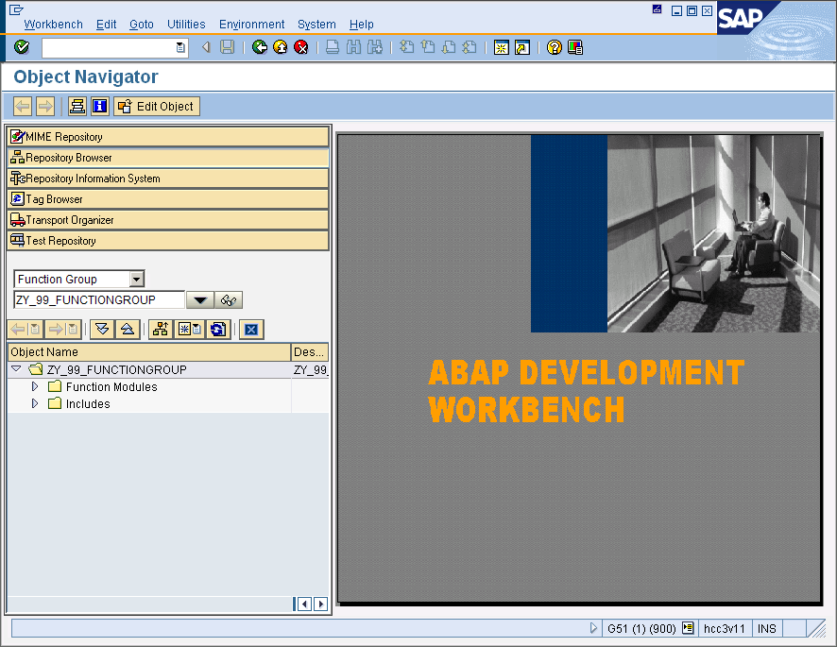
Object Navigator
Object Navigator integrates all development tools
Toolbar
(context sensitive)
Browsers
(independent)
Working space
(context sensitive)
Navigation tree
(independent)

