Slide 1
Day 2: Introduction to Visualizations

Slide 2
Summarize

Slide 3
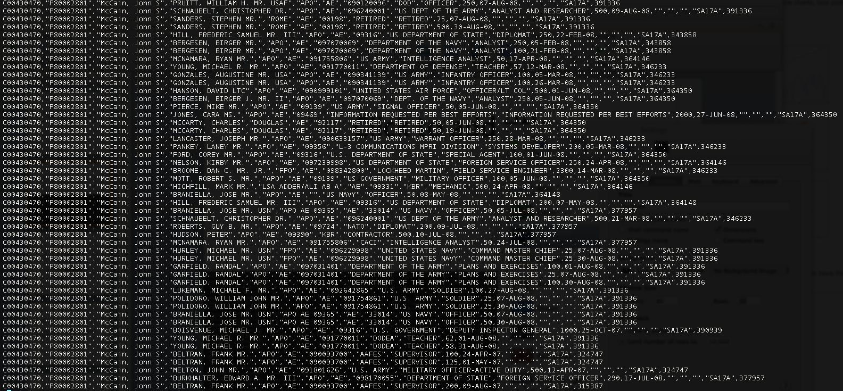
Complex

Slide 4
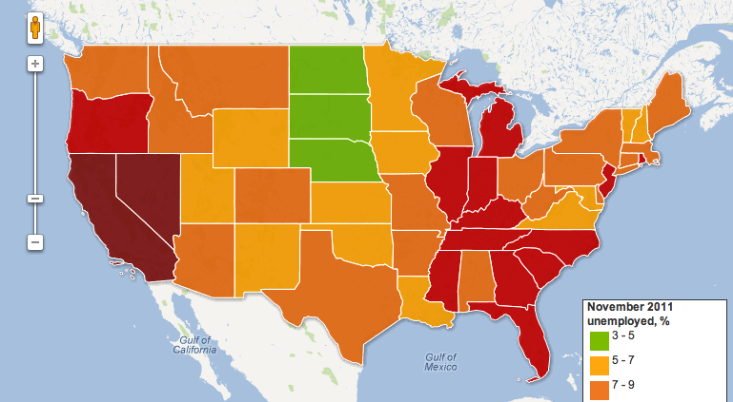
http://www.guardian.co.uk/news/datablog/2011/oct/07/us-jobless-unemployment-data

Slide 5
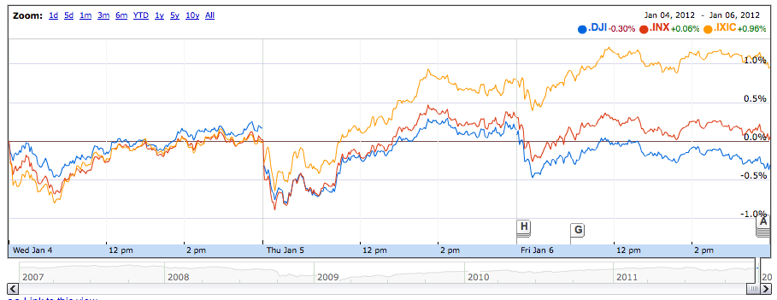
finance.google.com

Slide 6
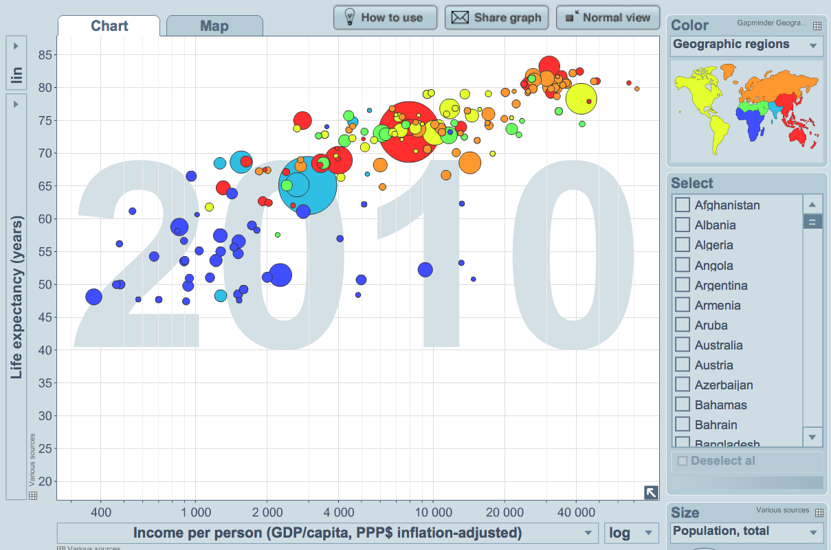
http://www.gapminder.org/

Slide 7
Bad “Visualizations”

Slide 8
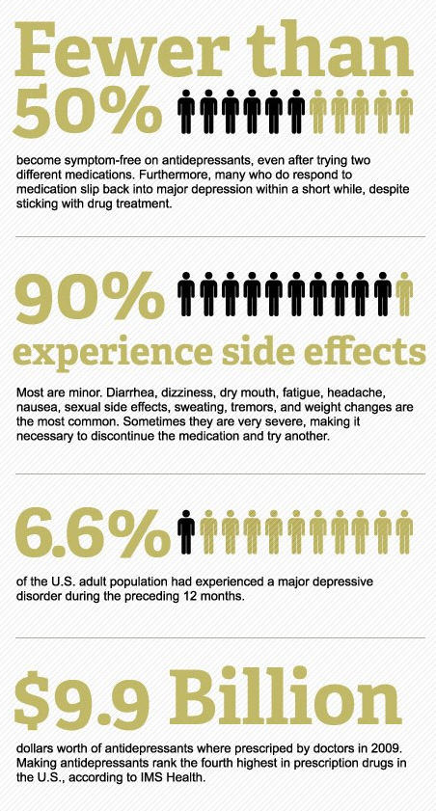
http://psychcentral.com/blog/archives/2011/06/29/an-epidemic-of-bad-infographics-depression/

Slide 9
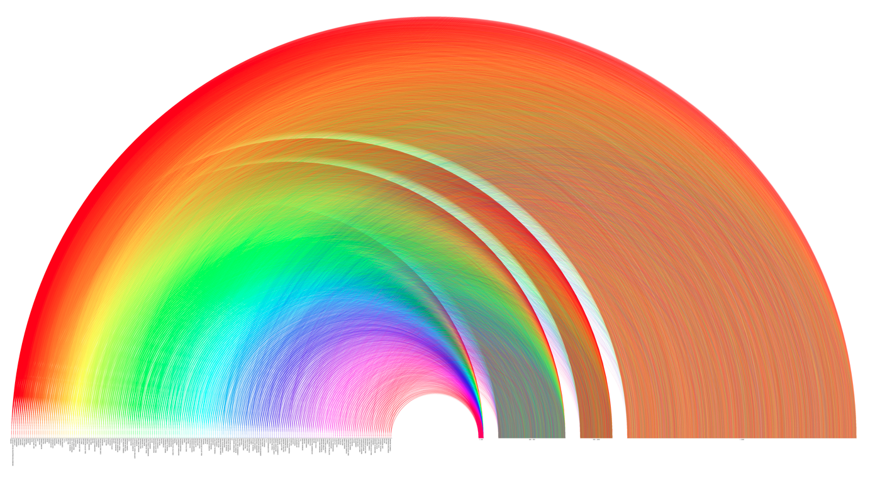
http://www.pitchinteractive.com/election2008/jobarcs.html

Slide 10
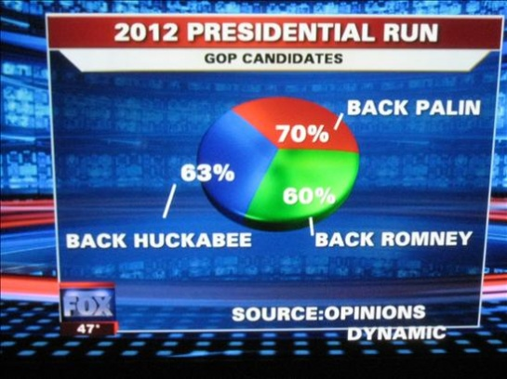
http://visualizeit.wordpress.com/category/bad-visualization/

Slide 11
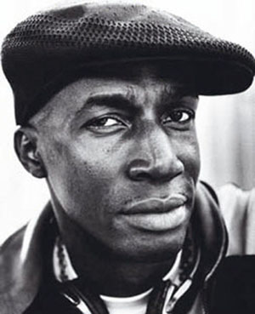
“The Message”
Grandmaster Flash (1982)

Slide 12


Slide 13
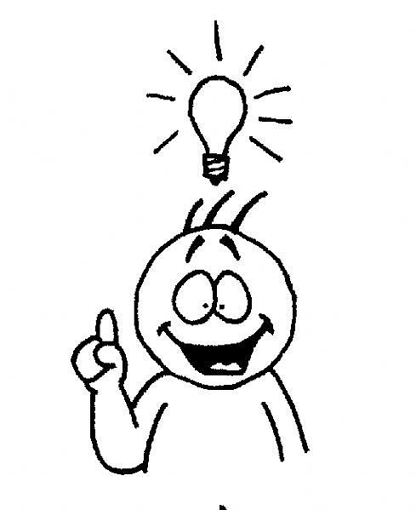
http://www.julieelder.com/wp-content/uploads/2010/11/understand_full.jpg

Slide 14
The Basics

Slide 15
blog.okcupid.com

Slide 16
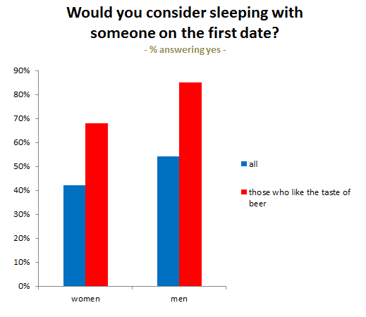
Box Plot
http://blog.okcupid.com
Notes:
categories

Slide 17
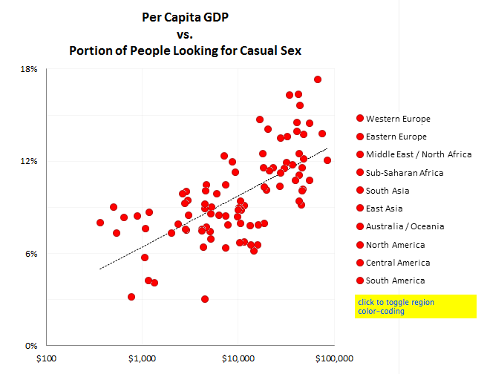
Scatter Plot
http://blog.okcupid.com
Notes:
Two variables, usually to see if there exists a trend between the two variable

Slide 18
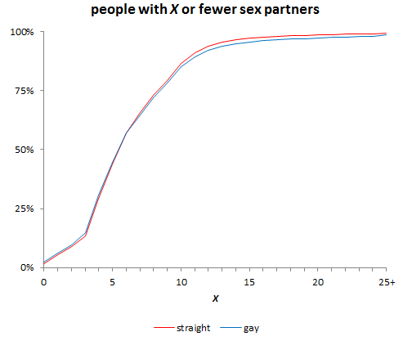
Line Graph
http://blog.okcupid.com
Notes:
X axis is strictly increasing series. Lines drawn between points because we expect trends.

Slide 19
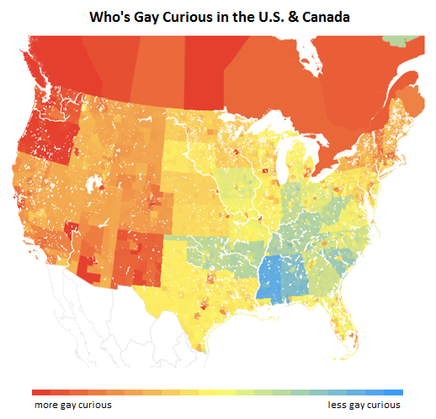
Choropleth Plots
http://blog.okcupid.com
Notes:
Map.

Slide 20
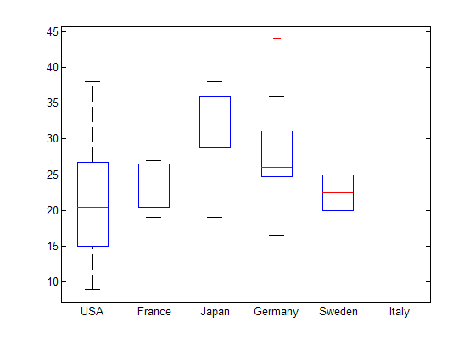
Box Plots

Slide 21

Animation

Slide 22
How matplotlib Draws
Notes:
Confused me for a long time. Super powerful, so every has a lot of options. Documentation isn’t great.

Slide 23
Figure object
Figure

Slide 24
Subplot object
Draw in here
Subplot
Draw in here
Figure

Slide 25
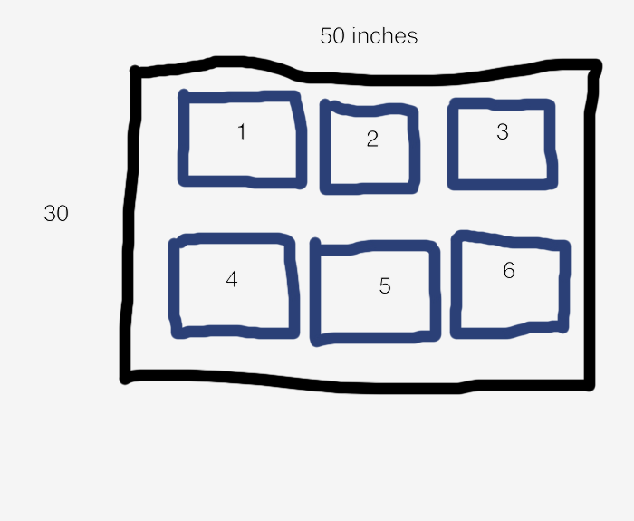
figure.add_subplot(2, 3, 1)
2
rows
3 columns

Slide 26
figure.add_subplot(2, 3, 1)
2
rows
3 columns

Slide 27
figure.add_subplot(2, 3, 1)
2
rows
3 columns

Slide 28
Charting library.
Plot
Bar
Scatter
…
They end up drawing…

Slide 29
Lines
Subplot
Figure

Slide 30
Boxes
Subplot
Figure

Slide 31
Polygons
Subplot
Figure

Slide 32
One thing to remember is that because it’s a drawing library. Draws on top of whatever is there.

Slide 33
Overlaps
Subplot
Figure

Slide 34
Overlaps
Subplot
Figure

Slide 35
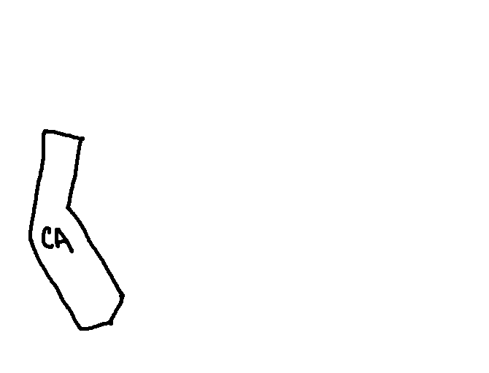
How Maps are Drawn

Slide 36
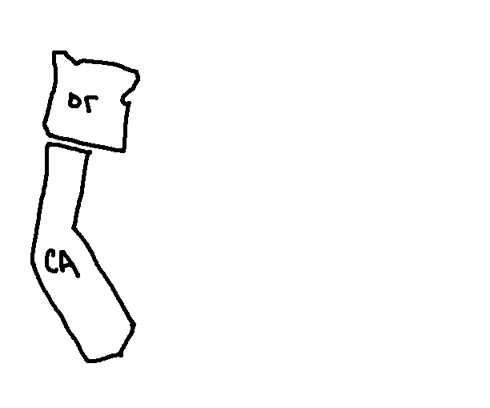
How Maps are Drawn

Slide 37
Helper Functions
FIPS
draw_county(subplot, county_id, color)
draw_state(subplot, state, color)

