Slide 1
How I learned to stop visualizing and love statistics

Slide 2
You have a hunch

Slide 3
Visualizations => sanity check
Statistics => quantify the hunch
(Visualizations => storytelling)

Slide 4
Someone says: “Obama got more small campaign contributions than McCain”

Slide 5
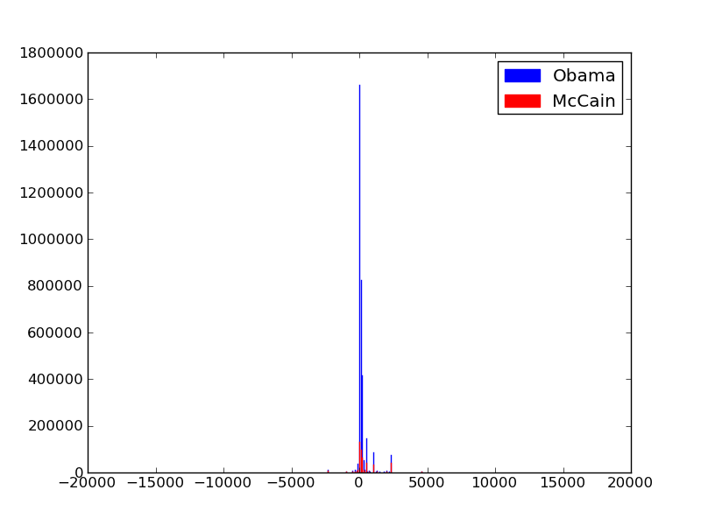

Slide 6
???

Slide 7
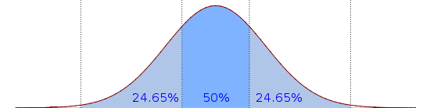
Notes:
https://en.wikipedia.org/wiki/File:Boxplot_vs_PDF.svg

Slide 8
Median
Notes:
https://en.wikipedia.org/wiki/File:Boxplot_vs_PDF.svg

Slide 9
25%
75%
Notes:
https://en.wikipedia.org/wiki/File:Boxplot_vs_PDF.svg

Slide 10
Inner Quartile Range
Notes:
https://en.wikipedia.org/wiki/File:Boxplot_vs_PDF.svg

Slide 11
Whiskers / Extremes
Notes:
https://en.wikipedia.org/wiki/File:Boxplot_vs_PDF.svg

Slide 12
Outliers
Notes:
https://en.wikipedia.org/wiki/File:Boxplot_vs_PDF.svg

Slide 13
Box-and-Whiskers Plot

Slide 14
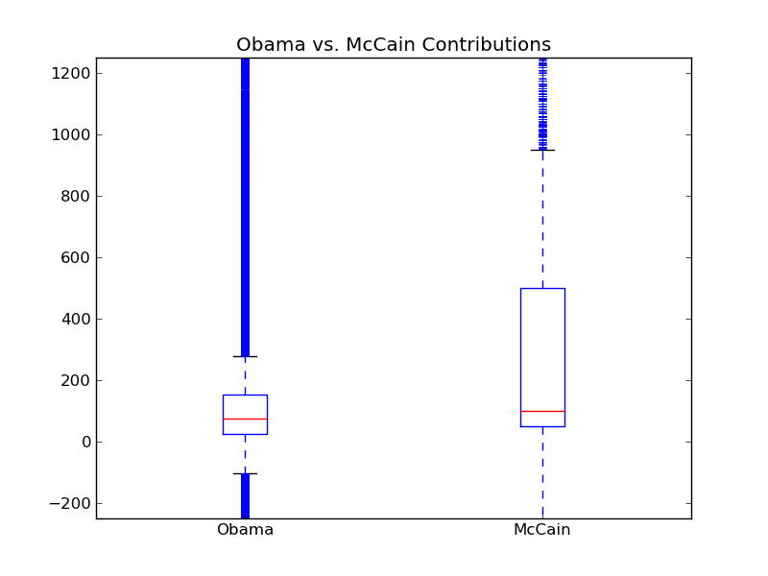

Slide 15
???

Slide 16
T-Test: Compare Averages
Effect size: |avg1 – avg2|
Significance: trust measured effect size?

Slide 17
Effect Size (how different are they?)

Slide 18
Obama
McCain

Slide 19
avg2
avg1
Obama
McCain

Slide 20
avg2
avg1
Obama
McCain

Slide 21
avg2
avg1
Effect Size
Obama
McCain

Slide 22
Significance (should I trust the difference?)

Slide 23
Obama
McCain

Slide 24
Obama
McCain

Slide 25
Amount of
Overlap
Number of
Samples
Obama:
> 1,000,000
+
McCain:
> 1,000,000

Slide 26
Given the amount of overlap and the number of samples, what is the probability we’ll think the candidates are different when they are actually the same?
low? significant
high? don’t trust the difference

Slide 27
Significance is binary
Pick a threshold: .01? .05?
Is p > threshold, or < threshold?
p < .05? significant
p > .05? don’t trust the difference

Slide 28
There is no such thing as “Extremely Significant”
Effect sizes can be extreme or not
Significance is binary: trust result, or not?

Slide 29
T-Test is Just One Test
Just compares averages
For more: https://en.wikipedia.org/wiki/Statistical_hypothesis_testing#Common_test_statistics

Slide 30
Correlation, Linear Regression

Slide 31
County Health Rankings
Every county in USA
Years of Potential Life Lost (YPLL): early morbidity
less is good
more is bad
Median income, % population w/ diabetes,
% population under 18, …

Slide 32
What is correlated with early death in a community?
Burgers
Sleep
Education
Exercise
# Rappers
Your theory here

Slide 33
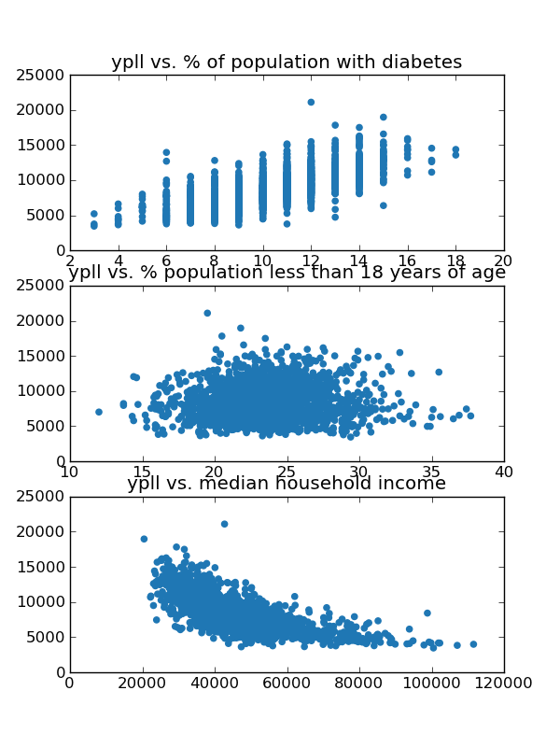
Notes:
We have scatterplots of the data
We can look at them and tell if they are correlated somehow. This is positive this is negative this is a blob
But how do we quantify it?
Correlation scores. There are lots of them. They each make assumption about the relationship between x and y. Linear? Parabolic? Arbitrary function?
Good---so we’re going to expect linear regression to give us three things: a line, a correlation amount, and significance.
The one we will use today is called linear regression, assumes the relationship is linear, and tries to fit a line. <animate line>
You end up with a ‘best-fit’ line that you can use to predict y from x in the future, and a correlation score: how well does the line fit.

Slide 34
Line coefficients:
y = mx + b
Correlation amount:
R² (0 to 1)
Significance:
p < .05?

Slide 35
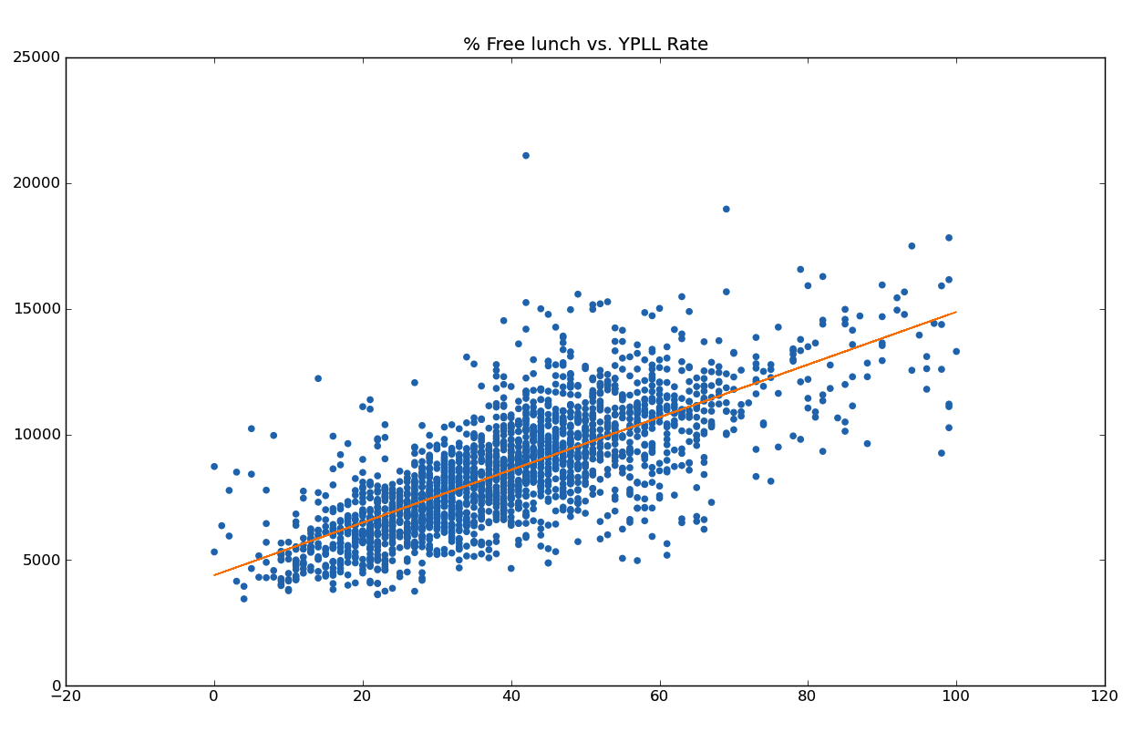

Slide 36

Decrease amount of free lunch
=>
Reduce early morbidity!
Notes:
http://2.bp.blogspot.com/_V5gBGYc5EYM/TLJHJCSkcxI/AAAAAAAAB1w/NdJxNoIEELU/s1600/unhappy-boy.jpg

Slide 37
Correlation != Causation
Correlation
Causal Hunch
Randomized Trial
T-Test!

Slide 38
Lab Time!

