Slide 1
Pipeline
Crazy raw data
Cleaned, structured data
Exploratory data analysis
Verify Hunches
Data Product (tm hammer@cloudera)
Different companies fit into different subsets of the pipeline
locu is the first segment (100% accuracy)
visible measures is full pipeline, at huge scale
Hadapt, makes exploratory and verifying faster

Slide 2
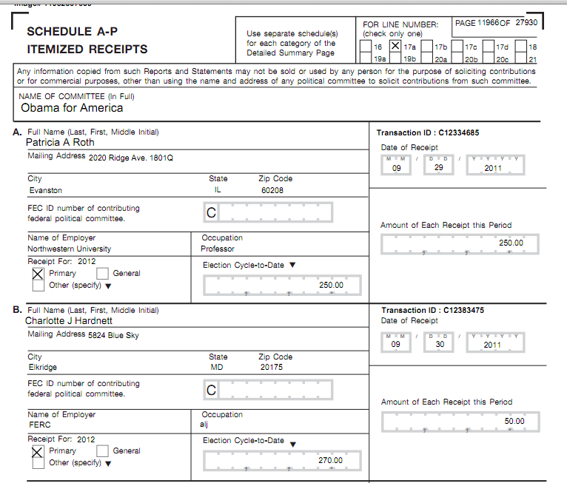

Slide 3
OMG IT’S THE LAST DAY!

Slide 4
Recap
Overview

Slide 5
Raw Data
Cleaned, Structured Data
Exploratory Data Analysis
Verify Hunches (stats)
Data Product

Slide 6
Raw Data
C00420224,"P80002983","Cox, John H","BROWN, CHARLENE","EAGLE RIVER","AK","99577","","STUDENT",25,01-MAR-07,"","","","SA17A",288757
C00420224,"P80002983","Cox, John H","KELLY, RAY","HUNTSVILLE","AL","35801","ARKTECH","RETIRED",25,25-JAN-07,"","","","SA17A",288757
C00420224,"P80002983","Cox, John H","CINGEL, KEITH","SEVERN","AL","20999","SANTA CLAUS","SNOWMAN",50,17-MAY-07,"","","","SA17A",305408
C00420224,"P80002983","Cox, John H","DUNAWAY, JONATHON","DEATSVILLE","AL","36022","CSC","TECHNICAL MANAGER",10,18-JAN-07,"","","","SA17A",288757
C00420224,"P80002983","Cox, John H","TERRY, R.S. MR. SR.","SHEFFIELD","AL","35660","RETIRED","",25,18-JAN-07,"","","","SA17A",288757
C00420224,"P80002983","Cox, John H","CANADY, DALE","PHOENIX","AZ","85051","RETIRED","",25,11-JAN-07,"","","","SA17A",288757
C00420224,"P80002983","Cox, John H","LORENZ, DWIGHT","SUN CITY","AZ","85351","NONE","RETIRED",20,12-JAN-07,"","","","SA17A",288757
C00420224,"P80002983","Cox, John H","STEWART, MICHAEL","CHANDLER","AZ","85224","DYNAMIC ENERGY","TECHNICIAN",5,11-JAN-07,"","","","SA17A",288757
C00420224,"P80002983","Cox, John H","ROSENTHAL, ARNOLD","CAREFREE","AZ","85277","RETIRED","",10,11-JAN-07,"","","","SA17A",288757
C00420224,"P80002983","Cox, John H","VADNAIS, DOROTHY","SAN DIEGO","CA","92116","","RETIRED",10,10-JAN-07,"","","","SA17A",288757C00420224,"P80002983","Cox, John H","BROWN, CHARLENE","EAGLE RIVER","AK","99577","","STUDENT",25,01-MAR-07,"","","","SA17A",288757
C00420224,"P80002983","Cox, John H","KELLY, RAY","HUNTSVILLE","AL","35801","ARKTECH","RETIRED",25,25-JAN-07,"","","","SA17A",288757
C00420224,"P80002983","Cox, John H","CINGEL, KEITH","SEVERN","AL","20999","SANTA CLAUS","SNOWMAN",50,17-MAY-07,"","","","SA17A",305408
C00420224,"P80002983","Cox, John H","DUNAWAY, JONATHON","DEATSVILLE","AL","36022","CSC","TECHNICAL MANAGER",10,18-JAN-07,"","","","SA17A",288757
C00420224,"P80002983","Cox, John H","TERRY, R.S. MR. SR.","SHEFFIELD","AL","35660","RETIRED","",25,18-JAN-07,"","","","SA17A",288757
C00420224,"P80002983","Cox, John H","CANADY, DALE","PHOENIX","AZ","85051","RETIRED","",25,11-JAN-07,"","","","SA17A",288757
C00420224,"P80002983","Cox, John H","LORENZ, DWIGHT","SUN CITY","AZ","85351","NONE","RETIRED",20,12-JAN-07,"","","","SA17A",288757
C00420224,"P80002983","Cox, John H","STEWART, MICHAEL","CHANDLER","AZ","85224","DYNAMIC ENERGY","TECHNICIAN",5,11-JAN-07,"","","","SA17A",288757
C00420224,"P80002983","Cox, John H","ROSENTHAL, ARNOLD","CAREFREE","AZ","85277","RETIRED","",10,11-JAN-07,"","","","SA17A",288757
C00420224,"P80002983","Cox, John H","VADNAIS, DOROTHY","SAN DIEGO","CA","92116","","RETIRED",10,10-JAN-07,"","","","SA17A",288757
C00420224,"P80002983","Cox, John H","BROWN, CHARLENE","EAGLE RIVER","AK","99577","","STUDENT",25,01-MAR-07,"","","","SA17A",288757
C00420224,"P80002983","Cox, John H","KELLY, RAY","HUNTSVILLE","AL","35801","ARKTECH","RETIRED",25,25-JAN-07,"","","","SA17A",288757
C00420224,"P80002983","Cox, John H","CINGEL, KEITH","SEVERN","AL","20999","SANTA CLAUS","SNOWMAN",50,17-MAY-07,"","","","SA17A",305408
C00420224,"P80002983","Cox, John H","DUNAWAY, JONATHON","DEATSVILLE","AL","36022","CSC","TECHNICAL MANAGER",10,18-JAN-07,"","","","SA17A",288757
C00420224,"P80002983","Cox, John H","TERRY, R.S. MR. SR.","SHEFFIELD","AL","35660","RETIRED","",25,18-JAN-07,"","","","SA17A",288757
C00420224,"P80002983","Cox, John H","CANADY, DALE","PHOENIX","AZ","85051","RETIRED","",25,11-JAN-07,"","","","SA17A",288757
C00420224,"P80002983","Cox, John H","LORENZ, DWIGHT","SUN CITY","AZ","85351","NONE","RETIRED",20,12-JAN-07,"","","","SA17A",288757
C00420224,"P80002983","Cox, John H","STEWART, MICHAEL","CHANDLER","AZ","85224","DYNAMIC ENERGY","TECHNICIAN",5,11-JAN-07,"","","","SA17A",288757
C00420224,"P80002983","Cox, John H","ROSENTHAL, ARNOLD","CAREFREE","AZ","85277","RETIRED","",10,11-JAN-07,"","","","SA17A",288757
C00420224,"P80002983","Cox, John H","VADNAIS, DOROTHY","SAN DIEGO","CA","92116","","RETIRED",10,10-JAN-07,"","","","SA17A",288757
C00420224,"P80002983","Cox, John H","BROWN, CHARLENE","EAGLE RIVER","AK","99577","","STUDENT",25,01-MAR-07,"","","","SA17A",288757
C00420224,"P80002983","Cox, John H","KELLY, RAY","HUNTSVILLE","AL","35801","ARKTECH","RETIRED",25,25-JAN-07,"","","","SA17A",288757
C00420224,"P80002983","Cox, John H","CINGEL, KEITH","SEVERN","AL","20999","SANTA CLAUS","SNOWMAN",50,17-MAY-07,"","","","SA17A",305408
C00420224,"P80002983","Cox, John H","DUNAWAY, JONATHON","DEATSVILLE","AL","36022","CSC","TECHNICAL MANAGER",10,18-JAN-07,"","","","SA17A",288757
C00420224,"P80002983","Cox, John H","TERRY, R.S. MR. SR.","SHEFFIELD","AL","35660","RETIRED","",25,18-JAN-07,"","","","SA17A",288757
C00420224,"P80002983","Cox, John H","CANADY, DALE","PHOENIX","AZ","85051","RETIRED","",25,11-JAN-07,"","","","SA17A",288757
C00420224,"P80002983","Cox, John H","LORENZ, DWIGHT","SUN CITY","AZ","85351","NONE","RETIRED",20,12-JAN-07,"","","","SA17A",288757
C00420224,"P80002983","Cox, John H","STEWART, MICHAEL","CHANDLER","AZ","85224","DYNAMIC ENERGY","TECHNICIAN",5,11-JAN-07,"","","","SA17A",288757
C00420224,"P80002983","Cox, John H","ROSENTHAL, ARNOLD","CAREFREE","AZ","85277","RETIRED","",10,11-JAN-07,"","","","SA17A",288757
C00420224,"P80002983","Cox, John H","VADNAIS, DOROTHY","SAN DIEGO","CA","92116","","RETIRED",10,10-JAN-07,"","","","SA17A",288757
C00420224,"P80002983","Cox, John H","BROWN, CHARLENE","EAGLE RIVER","AK","99577","","STUDENT",25,01-MAR-07,"","","","SA17A",288757
C00420224,"P80002983","Cox, John H","KELLY, RAY","HUNTSVILLE","AL","35801","ARKTECH","RETIRED",25,25-JAN-07,"","","","SA17A",288757
C00420224,"P80002983","Cox, John H","CINGEL, KEITH","SEVERN","AL","20999","SANTA CLAUS","SNOWMAN",50,17-MAY-07,"","","","SA17A",305408
C00420224,"P80002983","Cox, John H","DUNAWAY, JONATHON","DEATSVILLE","AL","36022","CSC","TECHNICAL MANAGER",10,18-JAN-07,"","","","SA17A",288757
C00420224,"P80002983","Cox, John H","TERRY, R.S. MR. SR.","SHEFFIELD","AL","35660","RETIRED","",25,18-JAN-07,"","","","SA17A",288757
C00420224,"P80002983","Cox, John H","CANADY, DALE","PHOENIX","AZ","85051","RETIRED","",25,11-JAN-07,"","","","SA17A",288757
C00420224,"P80002983","Cox, John H","LORENZ, DWIGHT","SUN CITY","AZ","85351","NONE","RETIRED",20,12-JAN-07,"","","","SA17A",288757
C00420224,"P80002983","Cox, John H","STEWART, MICHAEL","CHANDLER","AZ","85224","DYNAMIC ENERGY","TECHNICIAN",5,11-JAN-07,"","","","SA17A",288757
C00420224,"P80002983","Cox, John H","ROSENTHAL, ARNOLD","CAREFREE","AZ","85277","RETIRED","",10,11-JAN-07,"","","","SA17A",288757
C00420224,"P80002983","Cox, John H","VADNAIS, DOROTHY","SAN DIEGO","CA","92116","","RETIRED",10,10-JAN-07,"","","","SA17A",288757
Cleaned, Structured Data
Exploratory Data Analysis
Verify Hunches (stats)
Data Product

Slide 7
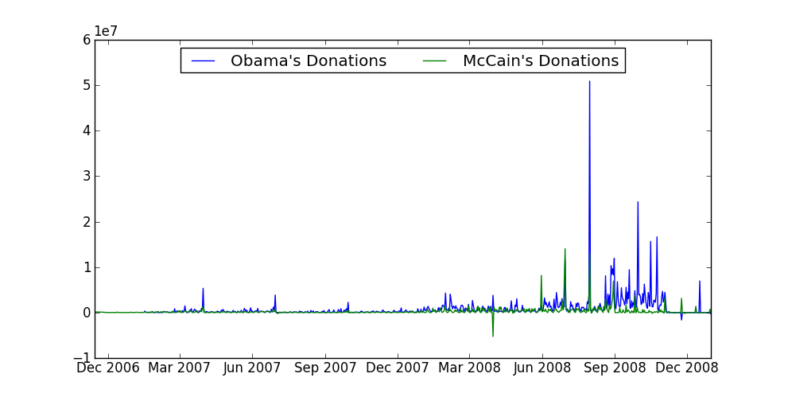
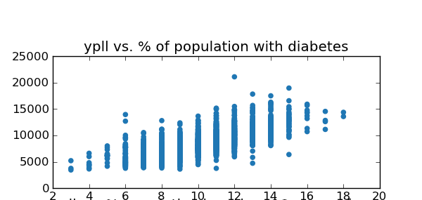
Raw Data
Cleaned, Structured Data
Exploratory Data Analysis
Verify Hunches (stats)
Data Product

Slide 8
Raw Data
T-test
Create a model
(linear regression)
Cleaned, Structured Data
Exploratory Data Analysis
Verify Hunches (stats)
Significance
Data Product

Slide 9
Raw Data
T-test
Create a model
(linear regression)
Cleaned, Structured Data
Exploratory Data Analysis
Verify Hunches (stats)
Significance
Data Product

Slide 10
Raw Data
Cleaned, Structured Data
Exploratory Data Analysis
Verify Hunches (stats)
Data Product

Slide 11
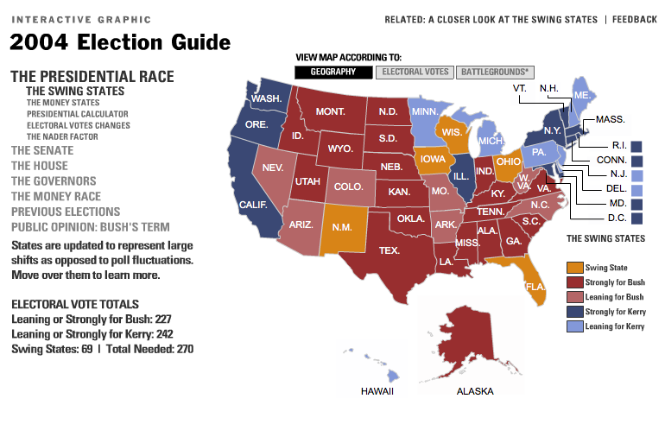
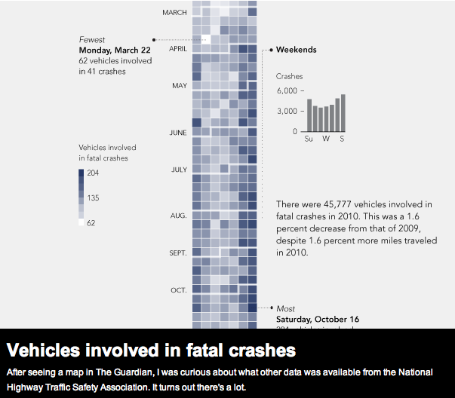
Raw Data
Cleaned, Structured Data
Exploratory Data Analysis
Verify Hunches (stats)
Data Product

Slide 12
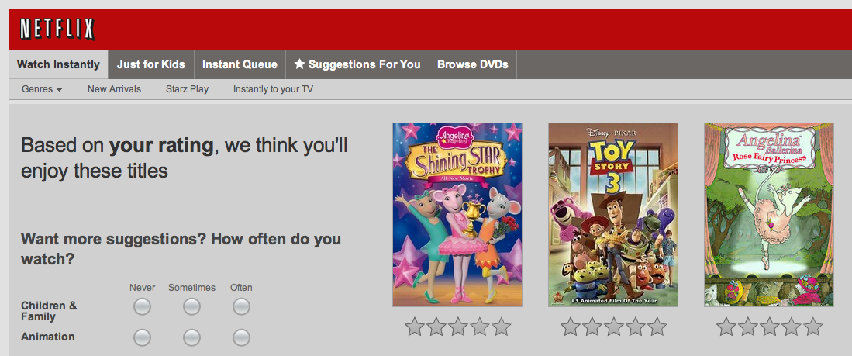
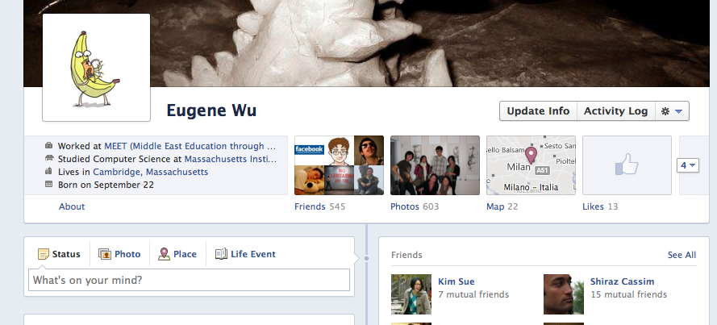

Raw Data
Cleaned, Structured Data
Exploratory Data Analysis
Verify Hunches (stats)
Data Product

Slide 13
Raw Data
Cleaned, Structured Data
Context
Exploratory Data Analysis
Verify Hunches (stats)
Data Product

Slide 14
Raw Data
Cleaned, Structured Data
Similar
Exploratory Data Analysis
Verify Hunches (stats)
Data Product

Slide 15

Raw Data
Cleaned, Structured Data
Exploratory Data Analysis
Verify Hunches (stats)
Data Product

Slide 16

Raw Data
Cleaned, Structured Data
Exploratory Data Analysis
Verify Hunches (stats)
Data Product

Slide 17

Raw Data
Cleaned, Structured Data
Exploratory Data Analysis
Verify Hunches (stats)
Data Product
Notes:
Hadapt doesn’t actively perform data analysis etc. Instead, they create platforms that help other companies (visiblemeasures etc) perform their data analysis faster.

Slide 18

Raw Data
Cleaned, Structured Data
Exploratory Data Analysis
Verify Hunches (stats)
Data Product
Notes:
Hadapt doesn’t actively perform data analysis etc. Instead, they create platforms that help other companies (visiblemeasures etc) perform their data analysis faster.

Slide 19
Visible Measures
Locu
Gave us context about what companies that are centered around data analytics are doing
A lot of them are very similar to what we did, at a huge scale.

Slide 20
Raw Data
Clean Data
Getting data
Visualization
Statistics
Machine Learning
Graph Analysis
Text Analysis
Databases
“Big Data”
Explore
Verify
Data Product
Notes:
Hadapt doesn’t actively perform data analysis etc. Instead, they create platforms that help other companies (visiblemeasures etc) perform their data analysis faster.

Slide 21
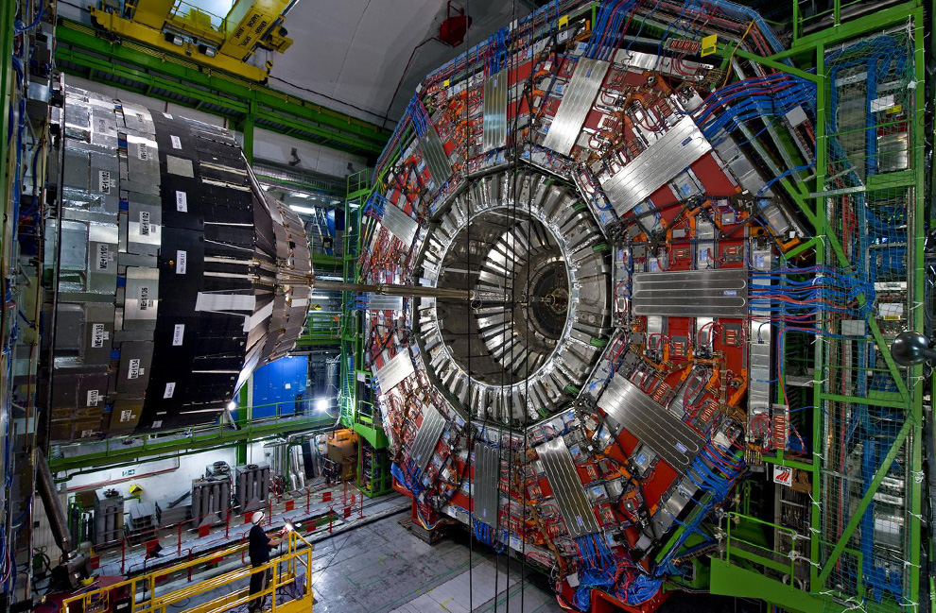
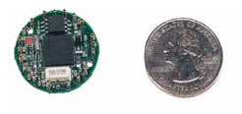
Getting Data
Raw Data
Clean Data
Surveys
Web Crawling/Scraping
https://scraperwiki.com
http://nutch.apache.org
Sensors
Explore
Verify
Data Product
Notes:
Gallop Polls

Slide 22
Visualizations
Raw Data
Clean Data
Interactive Visualizations
HTML5/CSS/JavaScript
Tools
processingjs, d3, prefuse
Blogs
http://flowingdata.com
http://infosthetics.com
Harvard http://cs171.org
MIT 6.831
Explore
Verify
Data Product

Slide 23
Statistics
Raw Data
Clean Data
Are they different?
T-Tests, ANOVA
Bayesian Statistics
Correlation
Regressions
Linear
Non-Linear
16.470j
http://statistics.mit.edu
Explore
Verify
Data Product
Notes:
Honestly where we are weak at as well, and some of the people in this class know waaay more than we do
Regressions make a model of the data

Slide 24
Machine Learning
Raw Data
Clean Data
Classification
Clustering
http://www.ml-class.org
MIT 6.867
Python scikit-learn (sklearn)
Explore
Verify
Data Product
Notes:
ML uses regressions to fit some model to your data, and use a threshold for classification

Slide 25
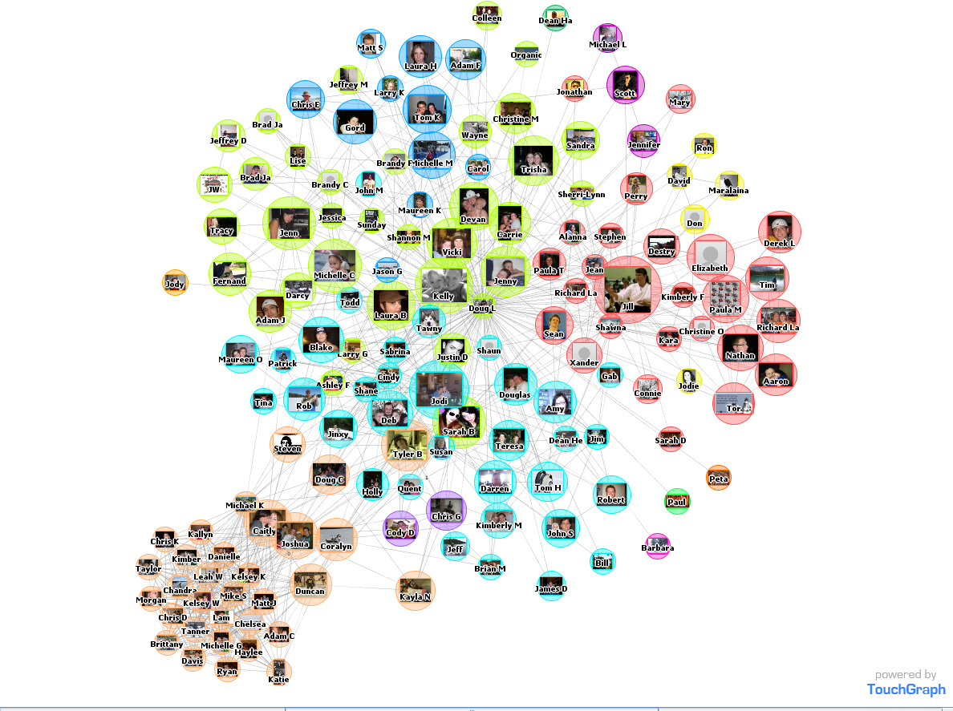
Graph Analysis
Raw Data
Clean Data
Explore
Verify
Data Product
Notes:
ML uses regressions to fit some model to your data, and use a threshold for classification

Slide 26
Graph Analysis
Raw Data
Clean Data
Examples:
web pages, friend graph, twitter
Metrics
Centrality
Cohesion
“Importance” (page rank)
Social Network Analysis
Web data mining MIT Course
Sep Kamvar Fall 2012
http://www.stats.ox.ac.uk/~snijders/sna_course.htm
Explore
Verify
Data Product
Notes:
ML uses regressions to fit some model to your data, and use a threshold for classification

Slide 27
Text Analysis
Raw Data
Clean Data
Natural Language Processing
Parsing sentences
Extracting the grammar/structure
Similarity measures
Cosine Similarity
Jaccard
Identifying Entities
Opencalais
MIT 6.864/6.863J
Explore
Verify
Data Product
Notes:
ML uses regressions to fit some model to your data, and use a threshold for classification

Slide 28
Databases
Raw Data
Clean Data
SQL Implements a lot of what we did
Filtering
Joining
Grouping
Summarizing
Specialized system to do this
SQL databases, Hive, Pig
MIT 6.830
http://db-class.org
Explore
Verify
Data Product
Notes:
Databases is what we do
What started us on teaching the course

Slide 29
“Big Data”
Raw Data
Clean Data
How to process on 1000+ machines?
Problems
Managing
Machines fail all the time
Network problems
Data out-of-sync (consistency)
Distributed Systems
MIT 6.824 (6.830 a bit)
Explore
Verify
Data Product
Notes:
Databases is what we do
What started us on teaching the course

Slide 30
Berkeley Also Has a Class!
http://datascienc.es

Slide 31
Hackathons
Boston python user group
Tonight web scraping thing
Hackathons
Transportation hackathon
http://transportclub.mit.edu/hackathon

Slide 32
Thank You!
git pull

Slide 33
Thank You!
http://tinyurl.com/dataiapsurvey

Slide 34
Databases
A lot of what we implemented, databases do
Filtering, joining datasets together, and grouping/summarizing data
Specialized system to do this
SQL
Pig/Hive to run on MapReduce
6.830
http://db-class.org

Slide 35
Visualization
Interactive Visualizations (most Web-based)
HTML/CSS/JavaScript
Tools
processing (processing.js)
d3
flash
They showed us a demo of their interface
As we can see it’s similar to what we did in the vis and stats day, so that people can see correlations and make hypotheses
http://cs171.org/

Slide 36
Graph Analysis
Examples: web pages, friend graph, twitter, directed/undirected graphs
Who the important people are (centrality measures)
Page rank
Web data mining Sep Kamvar Fall 2012

Slide 37
Text Analysis
NLP
Similarity measures other than cosine. String similarity and stuff
Mike Cafarella
Regina class and berwick class

Slide 38
Databases
A lot of what we implemented, databases do
Filtering, joining datasets together, and grouping/summarizing data
Specialized system to do this
SQL
Pig/Hive to run on MapReduce
6.830
http://db-class.org

Slide 39
MapReduce
Visible Measures put things in context
It’s really hard to count things!
A majority of work simple do what we did in this class at a very big scale!
Take google analytics and companies that analyze stuff. They are for the most part, counting.
Distributed Systems
6.824

Slide 40
Data Products
Mint
Netflix
NYT Viz

Slide 41
Hackathons
Boston python user group
Tonight web scraping thing
Hackathons
Transportation hackathons

