Slide 1

Statements – Card Sort
Students need to sort the set of cards in different configurations.
There are no definite answers, students could justify
debits or credits in many different ways.
The cards are in 3 sizes.

Slide 2
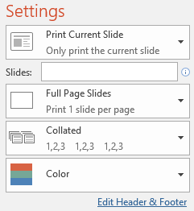
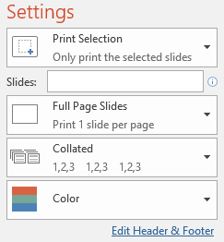
Printing
To print handouts from slides -
Select the slide from the left. Then click:
File > Print > ‘Print Current Slide’
To print multiple slides -
Click on a section title to highlight all those slides,
or press ‘Ctrl’ at the same time as selecting slides to
highlight more than one. Then click:
File > Print > ‘Print Selection’
To print double-sided handouts -
Highlight both slides before using ‘Print Selection’.
Choose ‘Print on Both Sides’ and ‘Flip on Short Edge’.

Slide 3
All these cards are items on a monthly bank statement. Sort them into CREDITS & DEBITS.
If someone had a £500 starting balance at the beginning of the month,
what is the maximum or minimum they could have at the end of the month?
A
B
C
ATM: Woodham Green
£50
Salary Income
£625.50
Electric Bill
£72.30
D
E
F
Birthday Gift Transfer
£30
Interest on Balance
£5.66
Internet
£32.99
G
H
I
‘Kool Klothes’
£82.45
Transfer: ‘Kelly’s Catering’
£165.80
Books.com Refund
£45.20
J
K
L
Transfer: ‘Auntie Jen’
£65
Online Auction
£144
Car Insurance
£133

Slide 4
All these cards are items on a monthly bank statement. Sort them into CREDITS & DEBITS.
If someone had a £500 starting balance at the beginning of the month,
what is the maximum or minimum they could have at the end of the month?
A
B
C
ATM: Woodham Green
£50
Salary Income
£625.50
Electric Bill
£72.30
D
E
F
Birthday Gift Transfer
£30
Interest on Balance
£5.66
Internet
£32.99

Slide 5
All these cards are items on a monthly bank statement. Sort them into CREDITS & DEBITS.
If someone had a £500 starting balance at the beginning of the month,
what is the maximum or minimum they could have at the end of the month?
Most items could be credits or debits:
What if you ran your own business?
A
B
C
ATM: Woodham Green
£50
Salary Income
£625.50
Electric Bill
£72.30
D
E
F
Birthday Gift Transfer
£30
Interest on Balance
£5.66
Internet
£32.99
G
H
I
‘Kool Klothes’
£82.45
Transfer: ‘Kelly’s Catering’
£165.80
Books.com Refund
£45.20
J
K
L
Transfer: ‘Auntie Jen’
£65
Online Auction
£144
Car Insurance
£133

Slide 6
All these cards are items on a monthly bank statement. Sort them into CREDITS & DEBITS.
If someone had a £500 starting balance at the beginning of the month,
what is the maximum or minimum they could have at the end of the month?
A
B
C
ATM: Woodham Green
£50
Salary Income
£625.50
Electric Bill
£72.30
D
E
F
Birthday Gift Transfer
£30
Interest on Balance
£5.66
Internet
£32.99
G
H
I
‘Kool Klothes’
£82.45
Transfer: ‘Kelly’s Catering’
£165.80
Books.com Refund
£45.20
J
K
L
Transfer: ‘Auntie Jen’
£65
Online Auction
£144
Car Insurance
£133

Slide 7
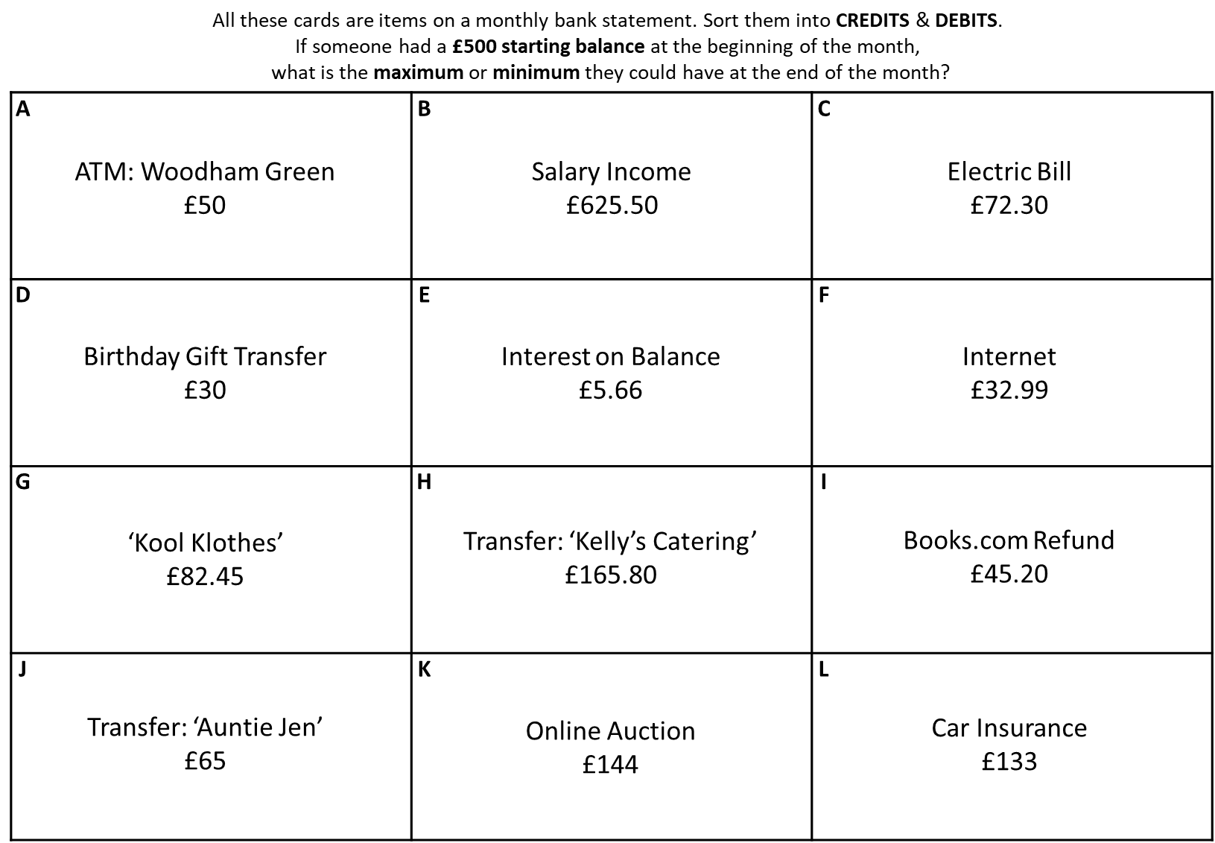

Slide 9
Questions?
Comments?
Suggestions?
…or have you found a mistake!?
Any feedback would be appreciated ☺.
Please feel free to email:
tom@goteachmaths.co.uk

