Slide 1
MathKGZ --
Амалдарды аткаруу тартиби – Салыштыруу оюну
Бул ресурс математикалык ыкманын жандуу демонстрацияларын камсыз кылат.
Анимацияларды текшерип, сабагыңызга КЕРЕГИ ЖОК слайддарды ӨЧҮРҮП САЛЫҢЫЗ.

Slide 2
Торт амал – баалулуктар жарышы
Бул сынактык иш-чарада окуучулар карталардагы атрибуттардын баалуулуктарын салыштырышат.
Жеңүүчү деп эң жогорку баалуулукка ээ болгон студент/топ/ тарап эсептелет.
1-10, 11-20, 21-30 жана 31-40 барган сайын татаалдашат.
Карталарды татаалдыгына жараша чогуу же өзүнчө бөлүп колдонсо болот.
Бул иш бүтүндөй класс (ар бири бир карта), топтордун ичинде (2+)
аткарылышы мүмкүн.
Же мугалим бүт класска каршы ойнойт (ар бири бирден карта менен).
Же класс экиге бөлүнүп, эки тарап болуп ойносо болот
(мини-тактай жана/же калькулятор менен).

Slide 3
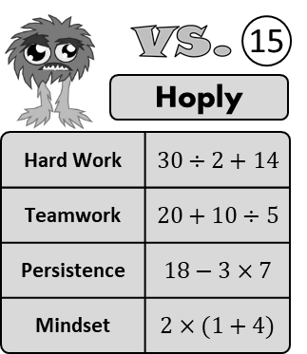



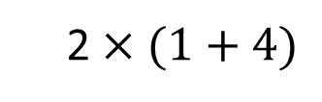
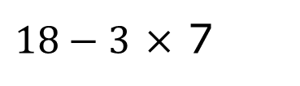
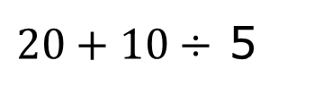
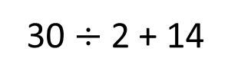
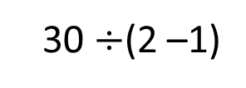


Салыштыр
менен.
Үч Көз
Узун Көз
1
6
Эмгекчил
$$2+1×2$$
30 $÷$2 + 14
Эмгекчил
Шерик
$$4×2 ÷2$$
Шерик
$20+10÷$ 5
Эстуу
$$10÷2+8$$
Эстуу
$18−3$ $×$ 7
Өжөр
2 $×(1+4)$
Өжөр
30 $÷$(2 –1)

Slide 4
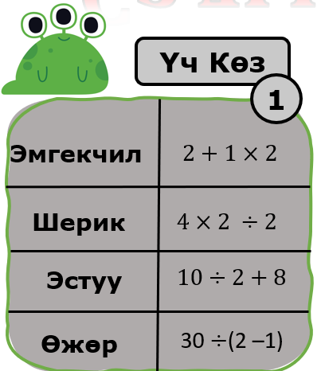
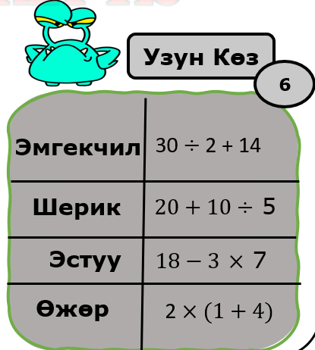
vs.
If you lost last,
you can’t use that same attribute
with your new card!
Find someone to challenge!
The person who lost last (or lowest number) chooses the attribute to compare.
Find out who wins! (If it’s a draw the other person chooses an attribute.)
Swap cards and find someone to challenge!
Record the amount of wins you get!

Slide 5
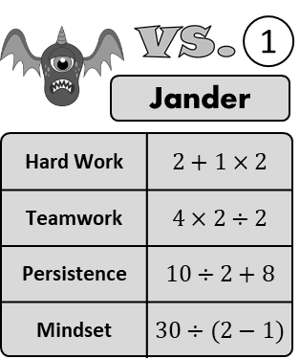
vs.
Split the cards in your groups. Only look at your top card.
Youngest player chooses the attribute to compare first.
Find out who wins! (If it’s a draw the person to the left chooses an attribute.)
Whoever has the highest value gets the other cards.
Continue until one player has all the cards!

Slide 6


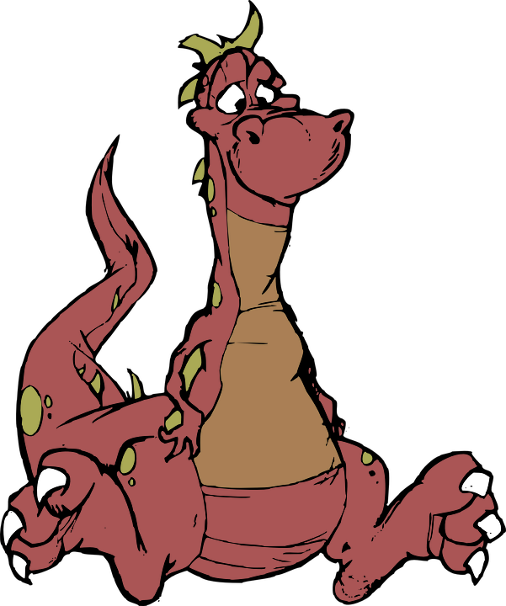










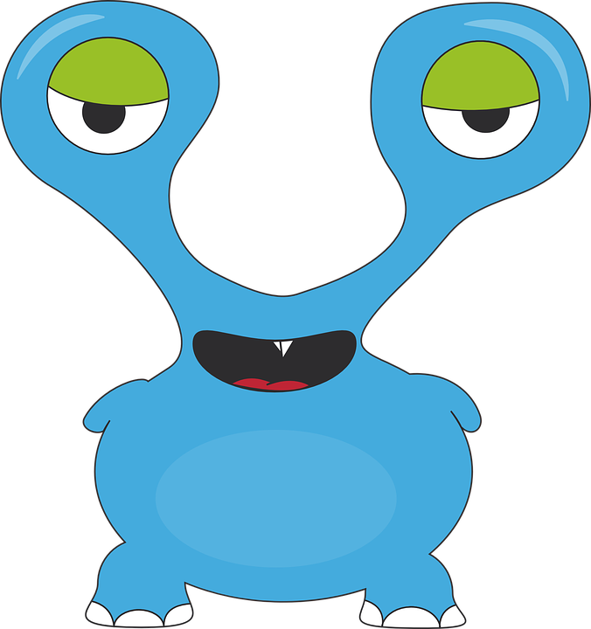


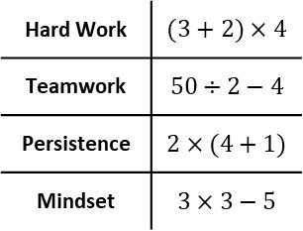
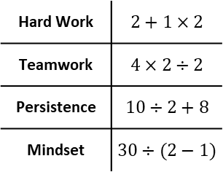
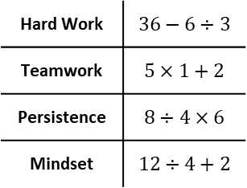
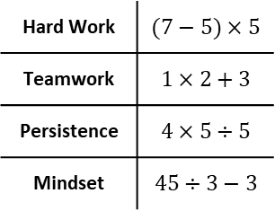
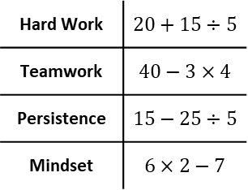
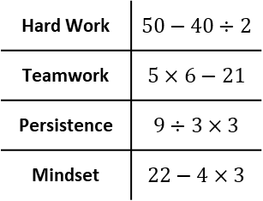
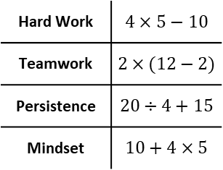
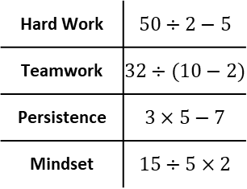
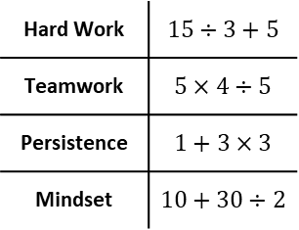
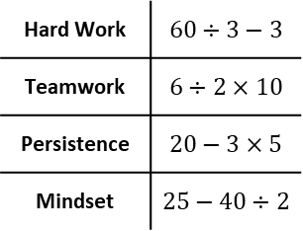
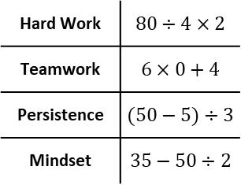
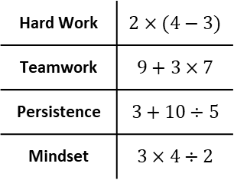
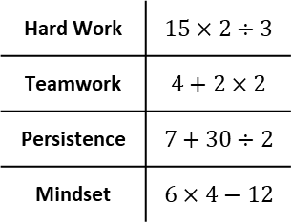
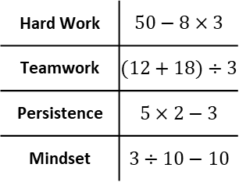
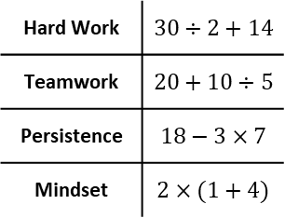
1
2
3
4
5
Jander
Sclarf
Qwert
Svivel
Omng
Hard Work | $$2+1×2$$
Teamwork | $$4×2÷2$$
Persistence | $$10÷2+8$$
Mindset | $$30÷(2−1)$$
Hard Work | $$2×(4−3)$$
Teamwork | $$9+3×7$$
Persistence | $$3+10÷5$$
Mindset | $$3×4÷2$$
Hard Work | $$15÷3+5$$
Teamwork | $$5×4÷5$$
Persistence | $$1+3×3$$
Mindset | $$10+30÷2$$
Hard Work | $$4×5−10$$
Teamwork | $$2×(12−2)$$
Persistence | $$20÷4+15$$
Mindset | $$10+4×5$$
Hard Work | $$(7−5)×5$$
Teamwork | $$1×2+3$$
Persistence | $$4×5÷5$$
Mindset | $$45÷3−3$$
6
7
8
9
10
Klix
Sklurb
Blosh
Wurble
Roglow
Hard Work | $$(3+2)×4$$
Teamwork | $$50÷2−4$$
Persistence | $$2×(4+1)$$
Mindset | $$3×3−5$$
Hard Work | $$15×2÷3$$
Teamwork | $$4+2×2$$
Persistence | $$7+30÷2$$
Mindset | $$6×4−12$$
Hard Work | $$60÷3−3$$
Teamwork | $$6÷2×10$$
Persistence | $$20−3×5$$
Mindset | $$25−40÷2$$
Hard Work | $$50−40÷2$$
Teamwork | $$5×6−21$$
Persistence | $$9÷3×3$$
Mindset | $$22−4×3$$
Hard Work | $$50−8×3$$
Teamwork | $$(12+18)÷3$$
Persistence | $$5×2−3$$
Mindset | $$3÷10−10$$
11
12
13
14
15
Twergle
Glurp
Xenus
Fliggle
Hoply
Hard Work | $$80÷4×2$$
Teamwork | $$6×0+4$$
Persistence | $$(50−5)÷3$$
Mindset | $$35−50÷2$$
Hard Work | $$50÷2−5$$
Teamwork | $$32÷(10−2)$$
Persistence | $$3×5−7$$
Mindset | $$15÷5×2$$
Hard Work | $$20+15÷5$$
Teamwork | $$40−3×4$$
Persistence | $$15−25÷5$$
Mindset | $$6×2−7$$
Hard Work | $$36−6÷3$$
Teamwork | $$5×1+2$$
Persistence | $$8÷4×6$$
Mindset | $$12÷4+2$$
Hard Work | $$30÷2+14$$
Teamwork | $$20+10÷5$$
Persistence | $$18−3×7$$
Mindset | $$2×(1+4)$$

Slide 7
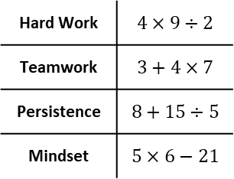
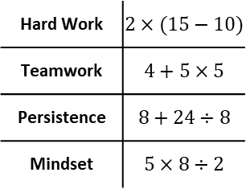
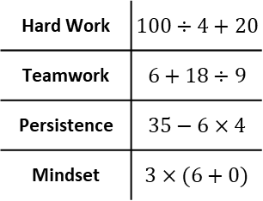
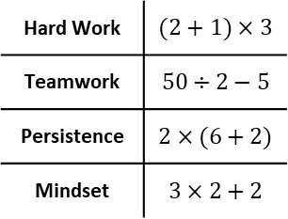
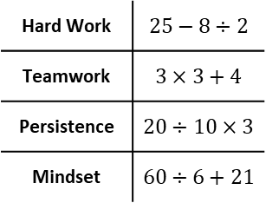
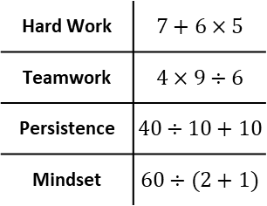
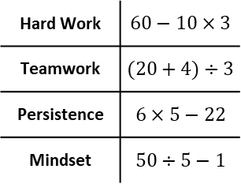
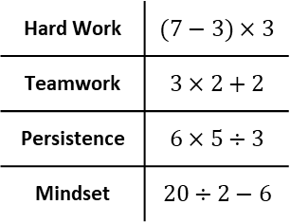
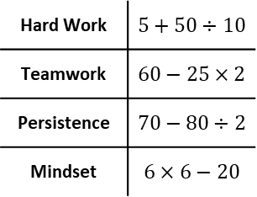
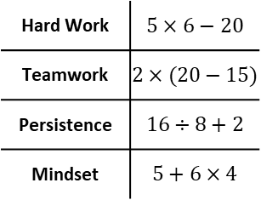
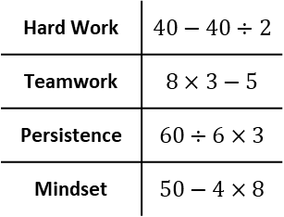
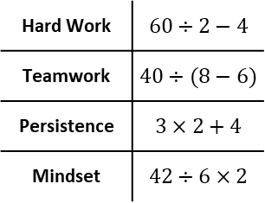
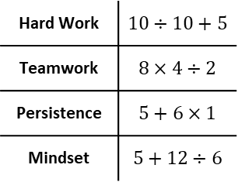
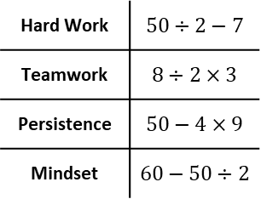
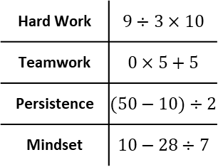
16
17
18
19
20
Zooms
Trex
Asderf
Swixel
Umngh
Hard Work | $$7+6×5$$
Teamwork | $$4×9÷6$$
Persistence | $$40÷10+10$$
Mindset | $$60÷(2+1)$$
Hard Work | $$2×(15−10)$$
Teamwork | $$4+5×5$$
Persistence | $$8+24÷8$$
Mindset | $$5×8÷2$$
Hard Work | $$10÷10+5$$
Teamwork | $$8×4÷2$$
Persistence | $$5+6×1$$
Mindset | $$5+12÷6$$
Hard Work | $$5×6−20$$
Teamwork | $$2×(20−15)$$
Persistence | $$16÷8+2$$
Mindset | $$5+6×4$$
Hard Work | $$(7−3)×3$$
Teamwork | $$3×2+2$$
Persistence | $$6×5÷3$$
Mindset | $$20÷2−6$$
21
22
23
24
25
Klif
Skloob
Blash
Wibly
Roklow
Hard Work | $$(2+1)×3$$
Teamwork | $$50÷2−5$$
Persistence | $$2×(6+2)$$
Mindset | $$3×2+2$$
Hard Work | $$4×9÷2$$
Teamwork | $$3+4×7$$
Persistence | $$8+15÷5$$
Mindset | $$5×6−21$$
Hard Work | $$50÷2−7$$
Teamwork | $$8÷2×3$$
Persistence | $$50−4×9$$
Mindset | $$60−50÷2$$
Hard Work | $$40−40÷2$$
Teamwork | $$8×3−5$$
Persistence | $$60÷6×3$$
Mindset | $$50−4×8$$
Hard Work | $$60−10×3$$
Teamwork | $$(20+4)÷3$$
Persistence | $$6×5−22$$
Mindset | $$50÷5−1$$
26
27
28
29
30
Triggle
Glorp
Xenon
Fluggle
Hiply
Hard Work | $$9÷3×10$$
Teamwork | $$0×5+5$$
Persistence | $$(50−10)÷2$$
Mindset | $$10−28÷7$$
Hard Work | $$60÷2−4$$
Teamwork | $$40÷(8−6)$$
Persistence | $$3×2+4$$
Mindset | $$42÷6×2$$
Hard Work | $$5+50÷10$$
Teamwork | $$60−25×2$$
Persistence | $$70−80÷2$$
Mindset | $$6×6−20$$
Hard Work | $$25−8÷2$$
Teamwork | $$3×3+4$$
Persistence | $$20÷10×3$$
Mindset | $$60÷6+21$$
Hard Work | $$100÷4+20$$
Teamwork | $$6+18÷9$$
Persistence | $$35−6×4$$
Mindset | $$3×(6+0)$$

Slide 8
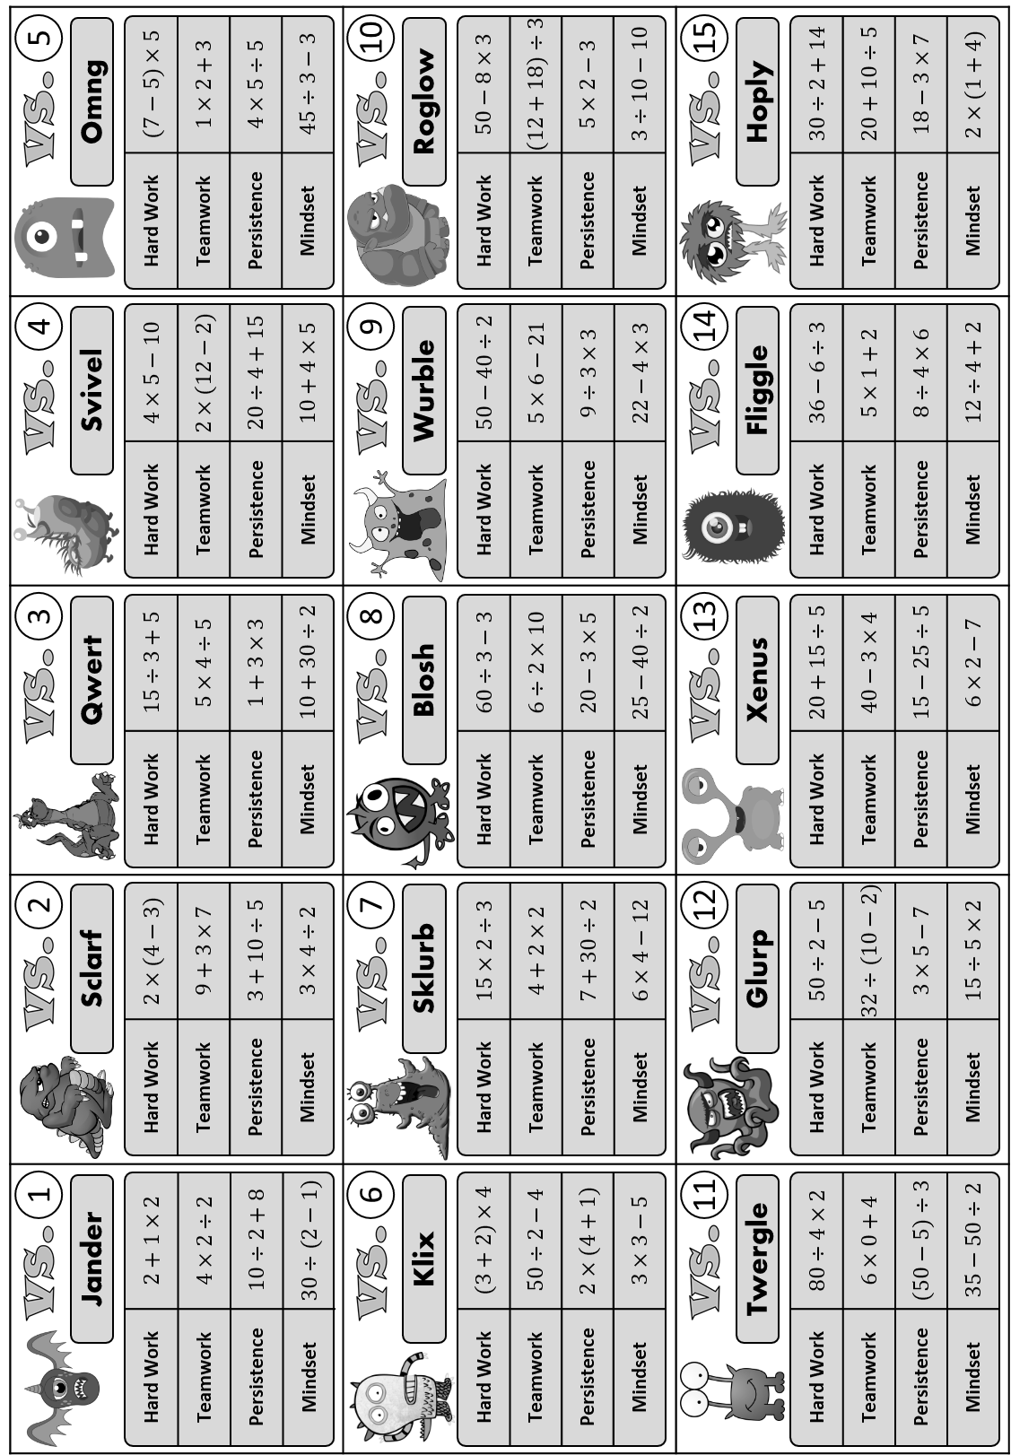
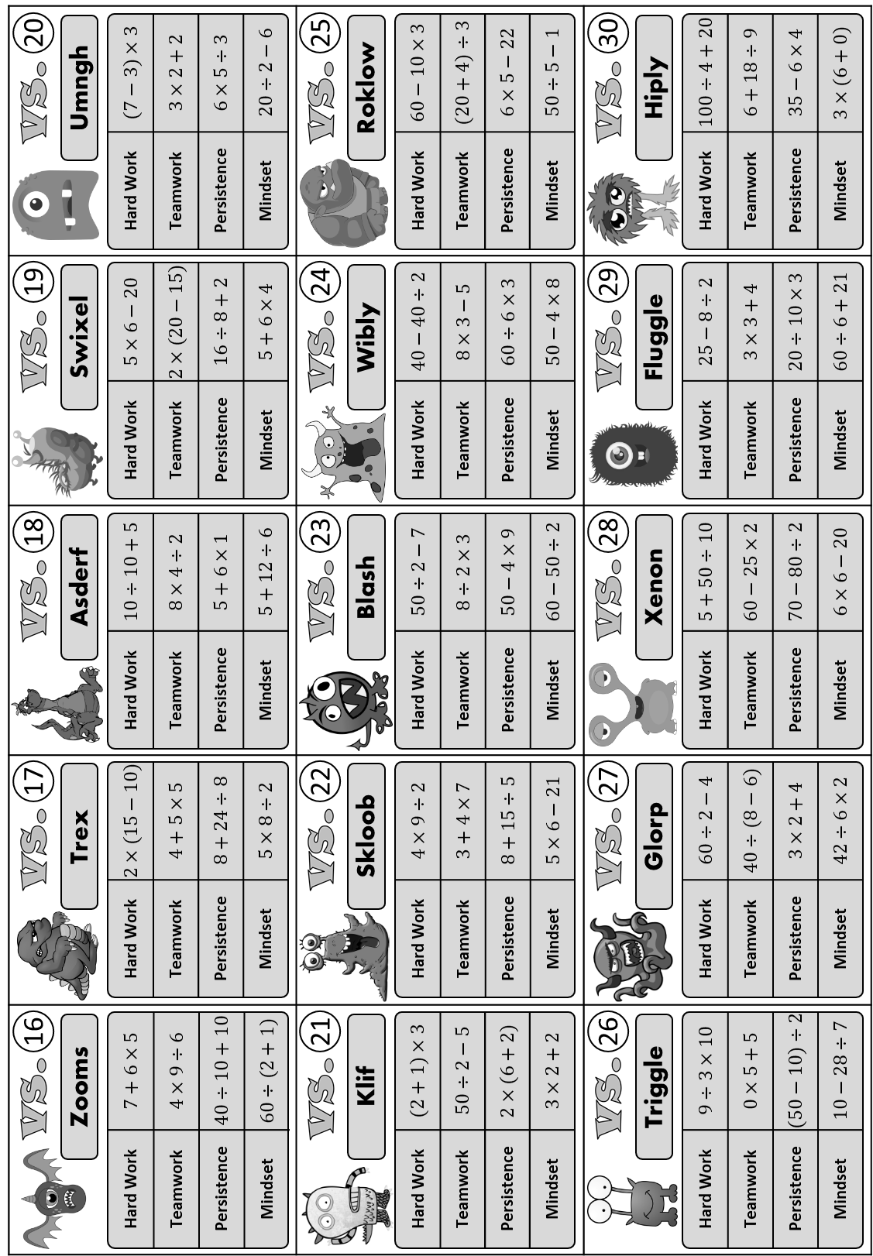

Slide 9

Questions?
Comments?
Suggestions?
…or have you found a mistake!?
Any feedback would be appreciated ☺.
Please feel free to email:
tom@goteachmaths.co.uk

